Slide 1
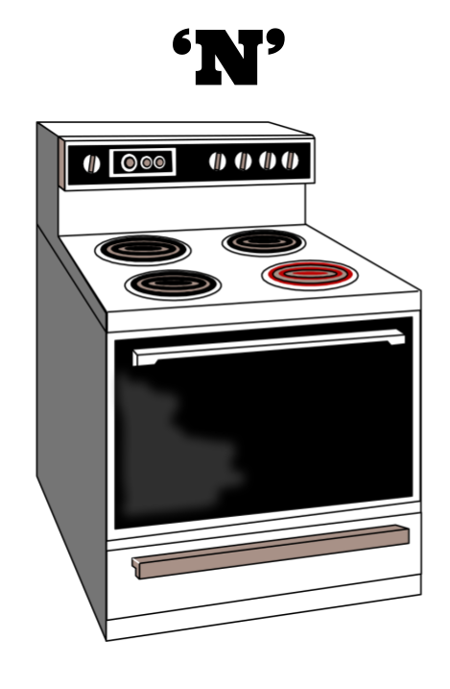
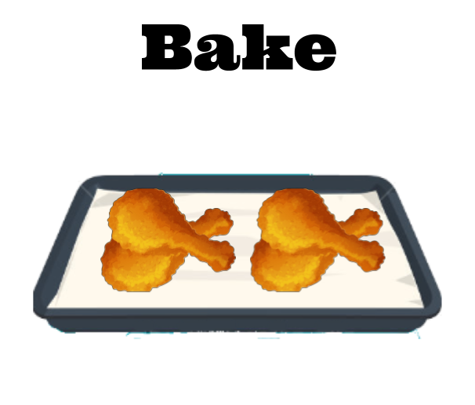
Welcome to the Industry!

Slide 2
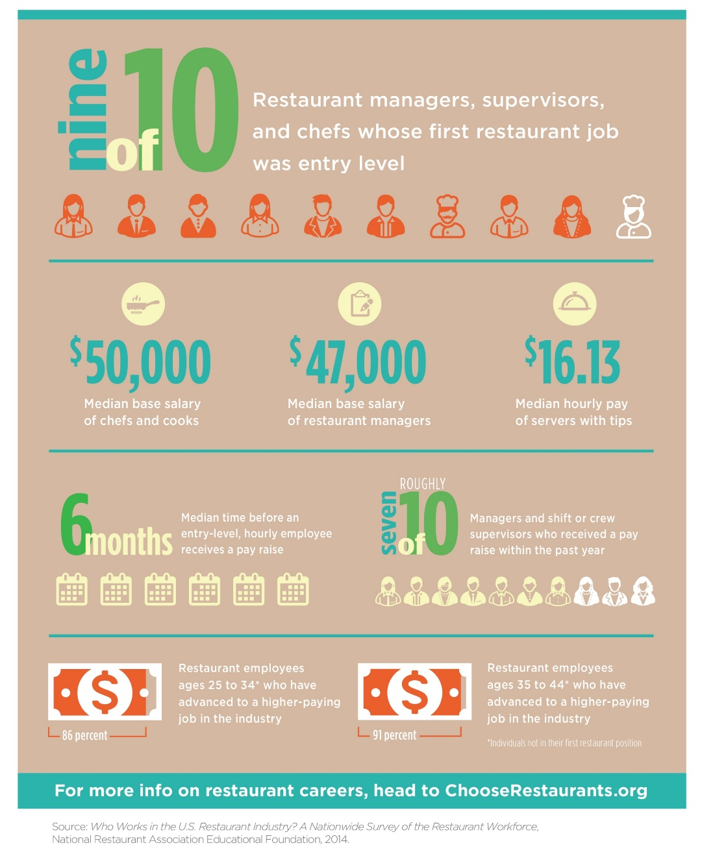
RESTAURANT INDUSTRY’S FINANCIAL HEALTH
Annual sales: $782 billion
Revenue: > 90% of world’s economies
Employment: > 14 million people
Job availability: estimated 1.7 million more jobs by 2025
Two major segments:
Commercial
80% of the industry
Noncommercial
20% of the industry
Notes:
Restaurants are also at the center of the nation’s financial health. With over $782 billion in annual sales, the restaurant and foodservice industry’s revenue
is larger than 90 percent of the world’s economies. Over 14 million people are employed in the industry. It is one of the largest private-sector employers in the
United States. And it will just continue to grow—with an estimated 1.7 million more jobs available by 2025.

Slide 3
COMMERCIAL RESTAURANTS AND FOODSERVICE SEGMENTS
Restaurants
Catering and banquets
Retail
Cruise ships and airlines

Slide 4
RESTAURANT CONCEPT
Unique combination of:
Menu offerings
Pricing
Service style
Ambiance
Décor
Notes:
Give examples like Mcdonalds vs Olive Garden

Slide 5
RESTAURANT SEGMENTS
Quick Service (Fast Food)
Guest orders at counter/window
Pay before eating
Take out, eat in, or delivery
Snack or beverage bars
Average check: $3–$6
Example: McDonald’s
Family Dining Full Service:
Service at table
Guest sits while ordering
Payment after meal
Menu emphasis = families (no alcohol served)
Average check: $10 or less
Example: Denny’s
Casual Dining Full Service:
Service at table
Guest sits while ordering
Payment after meal
Cooked to order
Average check: $10–$25
Example: Buffalo Wild Wings
Quick Casual Restaurant:
Guest orders at counter/window
Pay before eating
Freshly prepared with high-quality ingredients
Receive food quickly
Average check: $7–$9
Example: Panera
Fine Dining Full Service:
Service at table
Guest sits while ordering
Payment after meal
Intricate dishes
Tableware is high quality
Average check: $25 or more
Example: Ruth’s Chris Steak House

Slide 6
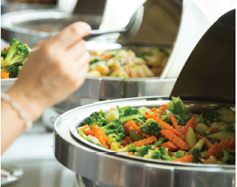
COMMERCIAL SEGMENTS
Catering:
Event host chooses menu
Caterers located in:
Own facility
Another business
Food delivered
Restaurants have catering
and banquet operations
Retail:
Offer prepared meals
Eat in store or at home
Located in:
Supermarkets
Convenience stores
Specialty retail operations
Sell limited items
Vending machines
Cruise:
Food always available
Dining styles vary
Food selections vary
Airlines:
Short flights—beverage service & small snacks
Long flights—seven-course meal
Airports offer many options
Notes:
Catering: The menu is chosen for a group of diners.
The food is delivered to the event location.
Many restaurants also have catering and banquet operations.
Retail: Limited items include: coffee, specialty drinks, and quick bites.
Cruise ships/airlines: Options range from casual dining and buffets to elegant dining and room service.
Food selection also varies, from steak to vegetarian to children’s meals and pizza.
Cruise ships sometimes serve thousands of meals in one seating.
Beverage service and small snacks for purchase are common on short flights in economy class.
But on long flights, you might eat a seven-course gourmet meal using real dishes and glassware.
Recently, many airlines have stopped offering food to passengers. Airports instead have stepped in to provide food to travelers, with many food options
now found among the gates.

Slide 7
NONCOMMERCIAL FOODSERVICE SEGMENT
Schools & universities:
On-campus food
Students and staff
Health-care facilities:
Guests and patients
Hospitals, nursing homes
Business & industry:
Employees
Cafeterias, vending,
executive dining
Clubs:
Member-based organizations
Gyms, golf clubs
Government:
Military bases and ships, government buildings, correctional facilities
Military members, government workers, prisoners
Contract feeding & Self Operators:
Operate in manufacturing or service industry
Manage and operate employee dining facilities
Self Operators:
Hire own staff
Notes:
This segment prepares and serves food in support of some other establishment’s main function or purpose. For example, the cafeteria at a local
university supports the school’s goal of educating students by serving them meals so that they have the energy to participate in class and activities.
Health-care facilities: Hospitals, nursing homes, and assisted-living centers all typically provide foodservice for guests and patients.
Business and industry: Many buildings provide cafeterias, vending machines, and executive dining to the employees of companies that work there.
• Clubs: Most of these member-based organizations have foodservice options. Exam
Within the noncommercial segment, foodservice is typically handled in one of two ways.
In contract feeding, contractors are businesses.
Self-operators hire their own staff to operate foodservices.

Slide 8
TIMELINE OF THE RISE OF THE HOSPITALITY INDUSTRY
ANCIENT GREECE
Lesche—private clubs
Phatnai—catered to travelers, traders, visitors
Meals nourished the soul
People ate on couches
Performances enhanced experience
THE FRENCH REVOLUTION
Epicurean—appreciation for fine wine and food
Haute cuisine—elaborate and refined food preparation
International trade improved life
First coffeehouse/café opened
Cafés welcomed women
Acceptable to eat in public
Boulanger
Served hot soups (restaurers)
Origin of restaurant
Unemployment caused the opening of restaurants
Paris has > 500 restaurants
THE RENAISSANCE
Cooks used exotic spices
Venice controlled spice trade
Sold at high prices
Guilds
Associations of people
Similar interests or professions
Cooking guilds—established professional standards and traditions
Notes:
The evolution of the restaurant and foodservice industry has been driven by a combination of social, scientific, and physical advancements for many centuries.
The people of ancient Greece rarely dined out, although they enjoyed the social aspect of dining and often got together for banquets.
Other establishments, called phatnai (FAAT-nay), catered to travelers, traders, and visiting diplomats.
It is most likely that travelers brought standard fare like grapes, olives, bread, dried fish, cheese, and wine with them to clubs.
People ate while reclining on couches, with performances of music, poetry, and dance to enhance their experience.
Partly to show off their wealth, European noblemen instructed their cooks to use large amounts of exotic spices in their dishes.
Because of their location on the Adriatic Sea, it was not long before merchants in Venice controlled the spice trade.
They could easily get spices from India and sell them at very high prices to distributors headed north.
The expansion of world travel changed the mind-set of the artists and philosophers of that time.
They adopted epicurean (ep-i-KYOO-ree-uhn) lifestyles—showing great appreciation for fine wine and food.
International trade also greatly improved the European way of life. For example, Europeans were introduced to coffee from Africa.
The first coffeehouse, or café, opened in 1650 in Oxford, England.
The new coffeehouses were open, airy, and inviting. Bakers soon started selling pastries as well.
Unlike taverns and ale houses, cafés welcomed women, and the coffee shop soon made it acceptable to eat in public.
Guilds were associations of people with similar interests or professions. They were organized during the reign of Louis XIV in France in an attempt to increase
the state’s control over the economy.
Each guild controlled the production of its specialties and could prevent others from making and selling the same items.
Two of these guilds were the Chaine de Rotissieres (roasters) and the Chaine de Traiteurs (caterers). Cooking guilds like these established many of the
professional standards and traditions that exist today.
In 1765, Boulanger began serving hot soups called restaurers (meaning restoratives) for their health-restoring properties.
He called his café a restorante, the origin of our modern word restaurant. His restorante became very popular.
People enjoyed having a place to go for a hot meal and good conversation with friends.

Slide 9
TIMELINE OF THE RISE OF THE HOSPITALITY INDUSTRY
THE RISE OF MODERN RESTAURANTS—THE TWENTIETH CENTURY
Employment was high
People ate out more—lunch
Economy grew—car ownership
Quick-service segment grew
COLONIAL AMERICA
Boston and New York—trade centers
1634: Boston inn—food and lodging
Colonial Americans rarely traveled or dined out
Travelers stayed in inns where they were fed
FROM CAFETERIAS TO ELEGANCE—THE LATE 1800s
Delmonico's and Astor House
Elegant surroundings
18-course meals
Gold rush
Population growth
Cafeteria developed
THE GLOBAL INDUSTRY—TODAY AND BEYOND
1970s: rapid growth of national chains
“Eating out” vs. eating at home
Busier households
American restaurant brands on many continents
Notes:
The first Europeans to settle in North America were city dwellers poorly equipped for farming. As more people immigrated to the New World to find
their fortunes or to escape religious persecution, cities along the East Coast grew. Boston and New York became major centers of trade.
As early as 1634, an inn in Boston called Cole’s offered food and lodging to travelers.
However, very few early colonial Americans ever traveled or dined out. Once they settled down, they rarely traveled more than 25 miles from their homes.
When people did travel, they stayed at inns, often sleeping together in the same large room and even sharing a single bed. Not much care was given to the
preparation of meals. If travelers arrived after dinner had been served, they would not eat.
When American high society dined out, they did so in style. Entrepreneurs in New York during the Gilded Age (1870s to 1900) opened fancy restaurants,
such as Delmonico’s and the Astor House, so that people could dine and be seen in elegant surroundings. Dinners of up to 18 courses were popular.
On the other side of the continent, California was in the middle of the gold rush. People poured into the area to claim their fortunes. With such a sudden
growth in population, meeting the demand to feed so many at once was nearly impossible.
Clever restaurateurs developed the cafeteria, an assembly-line process of serving food quickly and cheaply without the need for servers.
By the turn of the century, employment in the United States was at an all-time high. More and more people went to work in new factories, stores, and office
buildings. People were therefore eating out more, especially for lunch.
After World War II, in the 1940s and 1950s, the quick-service segment of the restaurant industry grew quickly.
The rapid growth of national chains since the 1970s has changed the face of the restaurant and foodservice industry. It has caused a major shift in how
people look at food and the social context of food. “Eating out” has become almost as commonplace as eating at home—not just for special occasions or as
a convenience. In the last few decades, lifestyles have moved steadily toward busier households that no longer have a dedicated daily food preparer.

Slide 10
FAMOUS CHEFS THROUGHOUT HISTORY
Georges August Escoffier
Known as “King of the Kitchen”
Transitioned haute cuisine to more contemporary cuisine
Established rules of conduct and dress for chefs
Developed kitchen brigade system
Introduced role of Expediter (aboyeur)
Marie-Antoine Carême
Believed cuisine was a branch of architecture
Created elaborate Pièces montées—decorative art
Responsible for many fine French sauces
Defined the art of Haute cuisine
Trained many other famous chefs
Notes:
Throughout history, chefs have been as critical to the growth of the industry as entrepreneurs. Today, the term chef is a mark of respect and distinction that
describes a professional who has reached the position through hard work and dedication to quality. Two important figures that led the way to such a level of
respect and admiration for chefs today are Carême and Escoffier.
Marie-Antoine Carême (1784–1833) believed that cuisine was simply a branch of architecture, as demonstrated by his elaborate pièces montées, which were masterpieces of decorative art.
He also perfected the recipes for many fine French sauces, placing them into four categories. Put simply, he defined the art of haute cuisine, which includes artful presentation, complex dishes,
and refined cooking techniques. Many would agree that Carême’s greatest claim to fame was training many other chefs who went on to become famous.
They were his followers and continued his traditions in many fine hotels and restaurants.
Georges August Escoffier (1846–1935) helped transition Carême’s haute cuisine into more contemporary cuisine. He also established exact rules of conduct and
dress for his chefs. Escoffier’s staff always dressed neatly and worked quietly. He also organized and defined the role of workers in the professional kitchen,
developing the kitchen brigade system. This system assigns certain responsibilities to kitchen staff.
For example, Escoffier introduced the aboyeur, or expediter, who takes orders from servers and calls out the orders to the various production areas in the kitchen.

Slide 11
MODERN CHEFS
Fernand Point
Father of modern French cuisine
Julia Child
Television series and cookbooks; Popularized French cuisine in America
Alice Waters
Forefront of sustainable agriculture
Nora Pouillion
First certified organic restaurant
Grant Achatz
Molecular gastronomy
Marcus Samuelsson
Owns restaurants worldwide; Judge on Chopped
Nancy Silverton
Respected baker (La Brea Bakery)
James Beard winner
Notes:
The industry has continued to produce iconic chefs who have added to the culinary arts and the business of serving guests. Here are a few of the most
influential chefs of the twentieth century.
Fernand Point: Known as the father of modern French cuisine, Point created lighter sauces using regional ingredients.
Julia Child: As great a personality as she was a chef, Child popularized French cuisine and technique with the American public through her
cooking television series and cookbooks.
Alice Waters: Waters’s goal was to provide dishes that used only seasonal, local products at the height of freshness and quality. She is still
at the forefront of sustainable agriculture in foodservice. Her restaurant, Chez Panisse, is a well-known operation in Northern California.
The roles of chef and entrepreneur have also frequently become blended, with many chefs investing in restaurants. Some have even created chains. Here
are a few examples of contemporary chefs and their contributions to today’s culinary scene.
Nora Pouillion: Owns the first certified organic restaurant in the United States—Restaurant Nora in Washington, DC. More than 95 percent
of the restaurant’s ingredients are organic. She is also active in many conservation groups.
Grant Achatz: Named Best Chef in the United States in 2008 by the James Beard Foundation, Achatz is a leader in molecular gastronomy—
a modern style of cooking that leverages science in its unusual preparation techniques. His restaurant, Alinea, has been ranked among the best
restaurants in the world.
Marcus Samuelsson: Often seen today on television, Samuelsson began his career in New York City. He began opening restaurants in his twenties
and has also authored cookbooks. He now has restaurants in many hotels and cities throughout the world.
Nancy Silverton: One of the most respected bakers in the industry, Silverton has also won James Beard awards, both as chef and pastry chef.
She started La Brea Bakery, which quickly became one of the largest bakeries in the industry and an example of a brand that moved into supermarkets.

Slide 12
Welcome to the Industry: Communication

Slide 13
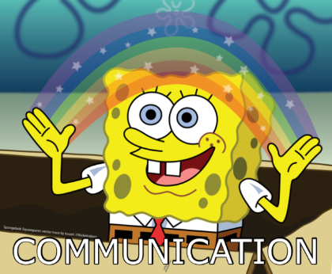
COMMUNICATION
Communication: act or process of using:
Words, sounds, signs, behaviors
Express or exchange information
Verbal—speaking and writing
Nonverbal—body language and gestures
Builds relationships
Notes:
Communication is the act or process of using words, sounds, signs, or behaviors to express or exchange information or to express your ideas, thoughts, feelings, etc., to someone else. Communication is a learned skill. Most people are born with the ability to express themselves but need to
learn how to do it effectively. Communication includes both verbal (speaking and writing) and nonverbal communication (body language and gestures).
Understanding how the communication process works is important for building strong relationships with employees and customers. It is not only what people say that is important—how they say it has a major impact on a message’s effectiveness.

Slide 14
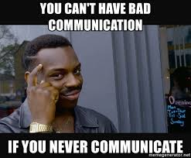
THE PROCESS OF COMMUNICATION
Five parts:
Sender
Message content
Message channel
Context
Receiver
Notes:
The communication process has five parts: sender, message content, message channel, context, and receiver.
The following is an example of the communication process at work in a restaurant:
Sender: Chef
Message content: Fire three shrimp on table 10.
Message channel: Verbal (speaking)
Context: The line cook is behind, and the chef really needs that food out quickly.
Receiver: Line cook

Slide 15
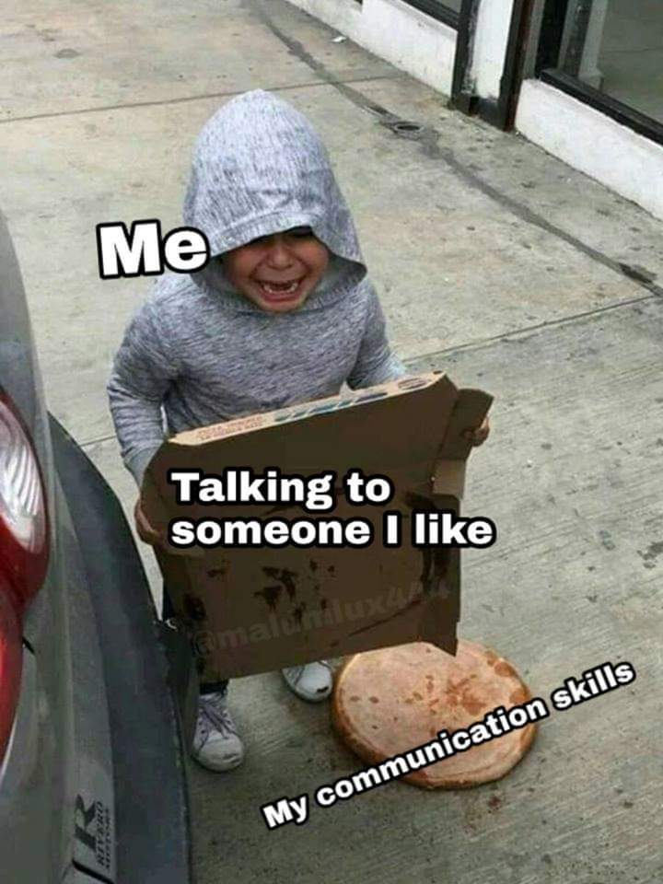
THE PROCESS OF COMMUNICATION
Sender:
Begins communication process
Wants something done
Thinks about:
Who will receive it?
What is the message?
How should it be sent?
Other factors to consider?
Notes:
Often, the sender wants something done as a result of the communication.

Slide 16
THE PROCESS OF COMMUNICATION
Message content:
Main connection between sender and receiver
Historical information—already happened
Action-required information—immediate or future
Message Context:
What is happening that may affect the message?
Are there any barriers in the way?
Notes:
The main connection between the people sending and receiving a message is the message content. This content might include:
1. Historical information: Examples include company history and orientation information, status updates, and management decisions.
Receivers do not usually need to do anything with these messages. They simply provide knowledge for future situations.
2. Action-required information: This is information that requires some type of action response from the receiver, either immediately or in the future.
One example is an order from a supervisor. It can be as simple as, “Clean that table.”

Slide 17
THE PROCESS OF COMMUNICATION
Message channel:
Clear method for audience
Words: verbal or written
Sounds: bell ringing or siren
Graphic illustrations: pictures, diagrams, job aids
Signs and symbols: gestures and nonverbal forms
Notes:
The sender must decide the best way for the message to be delivered. Which method or medium will help the message be as clear as possible for its intended
audience?

Slide 18
THE PROCESS OF COMMUNICATION
Receiver:
Usually needs to respond
Communicates understanding of message
Interprets message
Acts on the message
Makes decisions
Notes:
Make decisions along the way to complete the actions.

Slide 19
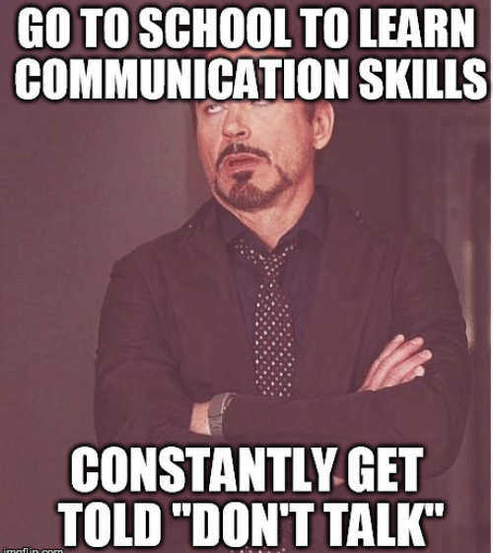
EFFECTIVE SPEAKING
Expressing thoughts and feelings in spoken language
Communicate key points
Brief and clear
Answer five “W” questions and “how” question
Notes:
When we think of communicating, we usually think of speaking. Speaking is the act of expressing one’s thoughts and feelings in spoken language. Just like any
other skill, you can learn to be an effective speaker.
When delivering a message, communicate the key points in a brief and clear manner. To ensure that you have provided all the vital information, answer the
five “W” questions and “how” question, as follows:
• Who?
• When?
• What?
• Why?
• Where?
• How?
Think about how your audience will respond to the message. Consider ways to personalize or customize the content, so that your audience recognizes
the importance of the information.

Slide 20
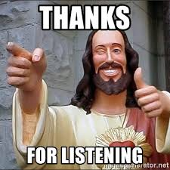
QUALITIES OF AN EFFECTIVE SPEAKER
Vary your speech patterns
Vary tone and pitch
Pronounce words clearly
Use complete, professional sentences
Minimize dialect
Eliminate mumbling
Speak at a steady pace
Speak with confidence
Close the conversation
Verify understanding
Repeat the message
Thank listeners
Present opportunities for follow-up
Interact with the audience
Comfortable interpersonal environment
Comfortable physical environment
Maintain eye contact
Use suitable language
Minimize jargon and buzzwords
Avoid slang and sarcasm
Define technical terms
Use appropriate nonverbal communication
Use appropriate gestures
Use appropriate facial expressions
Show an appropriate demeanor
Notes:
Comfortable interpersonal environment
Comfortable physical environment
Maintain eye contact
Minimize jargon and buzzwords
Avoid slang and sarcasm
Define technical terms
se appropriate gestures
Use appropriate facial expressions
Show an appropriate demeanor
Vary tone and pitch
Pronounce words clearly
Use complete, professional sentences
Minimize dialect
Eliminate mumbling
Speak at a steady pace
Speak with confidence
Verify understanding
Repeat the message
Thank listeners
Present opportunities for follow-up
Create a comfortable interpersonal and physical environment through tone and surroundings.

Slide 21
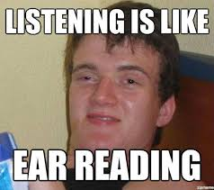
EFFECTIVE LISTENING
Effective listening
More information
Increase trust
Reduce conflict
Better communication with others
Notes:
Listening is the ability to focus closely on what another person is saying to summarize the true meaning of a message. Almost everyone believes that he or
she listens effectively. In fact, listening effectively is something that many of us cannot do. It is not because listening effectively is so difficult. It is just that many
of us have never developed the habits that would make us effective listeners.
By listening effectively, you can get more information from other people, increase others’ trust in you, reduce conflict, and better understand how to
work with others. An effective listener actively participates in the communication process.

Slide 22
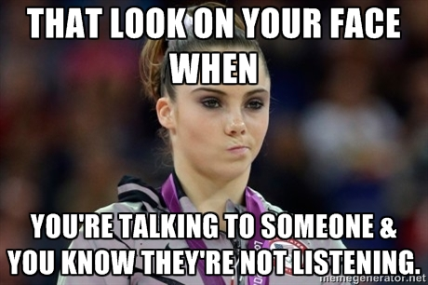
QUALITIES OF AN EFFECTIVE LISTENER
Participates in the communication process
Prepare to listen—stop talking
Use body language
Maintain eye contact
Nod
Lean in
Facial expressions
Do not interrupt
Ask questions to clarify
Occasionally rephrase and repeat
Listen between the lines
Do not overreact
Record key ideas and phrases
Notes:
Prepare to listen. Stop talking and focus on the other person.
Use body language to show that you are paying attention. You can:
• Maintain eye contact.
• Nod to show your approval.
• Lean toward the person speaking to show you are interested.
• Use appropriate facial expressions to show empathy or understanding.
Do not interrupt and do not finish the other person’s sentences in your mind or aloud.
Ask questions to clarify.
Occasionally rephrase and repeat what you have heard. Check listening skills by saying, “Here’s what I think I hear you saying….”
Listen between the lines. Often, it is not what someone says but how the person says it.
Do not overreact if you disagree.
Record key ideas and phrases. While most people probably do not need to take notes when talking to friends, note-taking is a valuable way to improve listening skills in the classroom or workplace.
Practice listening as often as you can. Listening is a learned skill, just like learning a knife skill or a cooking technique.

Slide 23
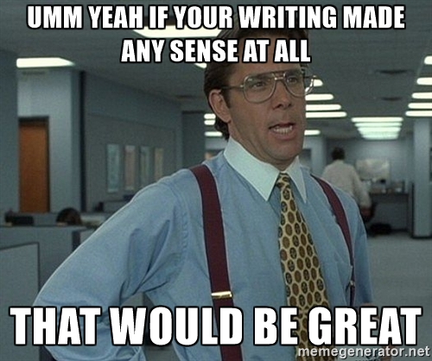
EFFECTIVE WRITING
Text messages, memos, faxes, emails, letters, reports
Common parts of written messages:
Introduction
Audience attention
Reason for message
Identifies topics
Establishes point of view
Body of message
Presents content
Topics of message
Conclusion
Summarizes key points
Calls for action
Identifies benefits and value
Notes:
In the restaurant business, much of the communication with staff, guests, and supervisors is done verbally, either in person or on the phone. However, written
business communications are also important when sharing information. These types of messages can include text messages, memos, faxes, emails, letters,
and reports.
Other than text messages, written messages tend to have a more formal structure than spoken messages.
This gets the audience’s attention, gives the reason for the message, identifies the topics of the message, and establishes the writer’s
point of view.
The writer summarizes key points, calls for action, and identifies the benefits and value of the message.
To write a successful message, you need to plan what to say. You need to build a structure. Writing can be challenging.

Slide 24
STEPS FOR EFFECTIVE WRITING
Be concise!
Be clear and complete!
Write with an upbeat attitude
Take a time out
Think about the audience
Think about the purpose
Think about the situation and details
Identify the benefits to the message
Identify topics
Write main body
Read draft
Write final draft
Notes:
For instance, the monthly financial update to the vice president of sales has a different audience than a training manual written for new servers.
What needs to be accomplished, and what action is desired as a result of the written message?
Ask questions to answer the five Ws and how, and write the answers (Who? Where? Why? What? When? How?).
How will it help the company, the reader, the customers, and the communicator?
Identify the topics in a logical order, and group the details underneath.
It might be easiest to write the main body first, then the introduction, and then the conclusion.
Edit and revise the draft for content, grammar, spelling, flow, and readability. If necessary, ask someone else, such as a peer, to read the draft and make suggestions for improvement.
Finish the final draft and distribute the communication.

Slide 25
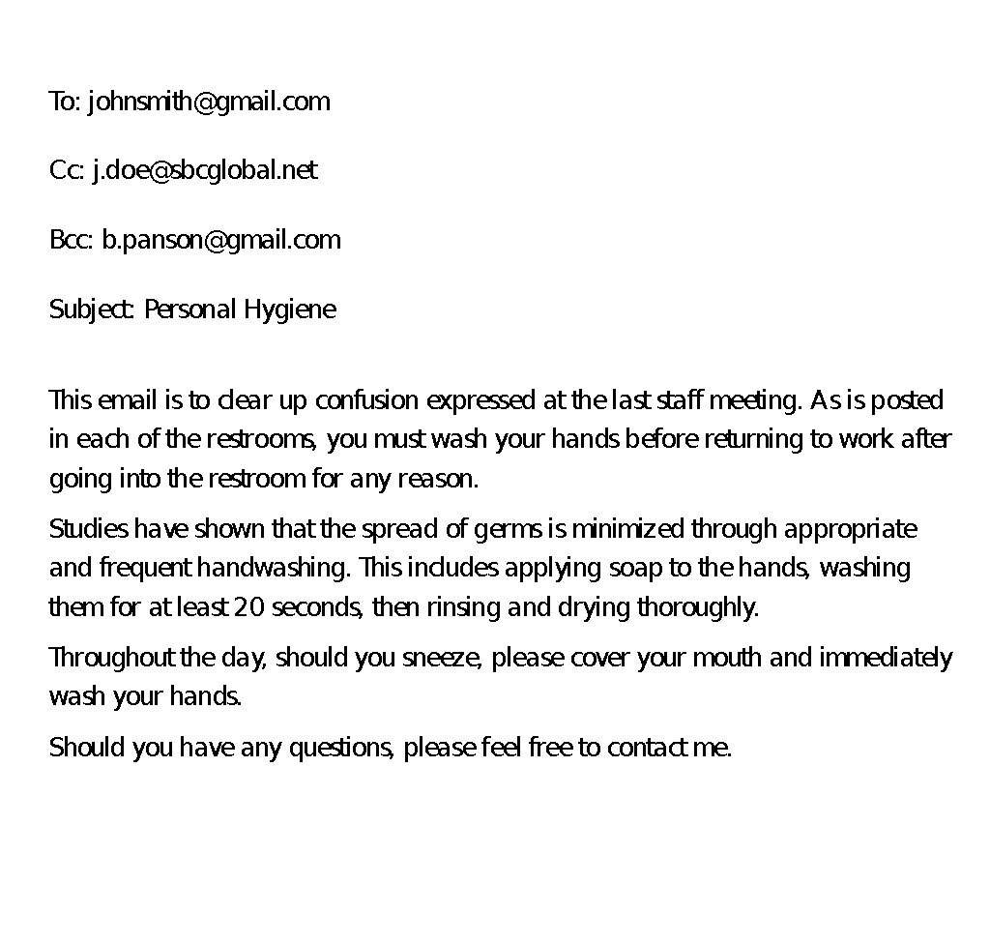
WELL-WRITTEN EMAIL
Notes:
Two sample workplace emails, both trying to convey the same material. One is well-written, answers the W and how questions, and
is properly organized, and the other is not. Do you see the difference?

Slide 26
POORLY-WRITTEN EMAIL
Notes:
Two sample workplace emails, both trying to convey the same material. One is well-written, answers the W and how questions, and
is properly organized, and the other is not. Do you see the difference?

Slide 27
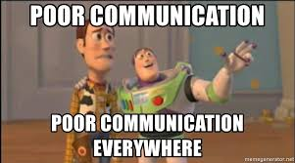
BARRIERS TO COMMUNICATION
Language differences
Semantics
Jargon
Tone of Message
Clarity
Assumptions
Cultural Differences
Prejudices & Biases
Noise
Nonverbal Boundaries
Gestures
Other Distractions
Notes:
Anything that interferes with or affects communication—from language barriers to lack of time to fear of confrontation—can set up a barrier.
Be aware of the potential obstacles to good communication before presenting any message. Remember that every communication,
large or small, sends a message about your values and priorities. Take the time to consider what you want to communicate. Make sure that you are consistent.
The message may differ, but the underlying values and priorities should remain the same.
LANGUAGE:
We all speak with accents and dialects that reflect where we live now and where we have lived in the past. A dialect is the variation of a
language spoken by a particular group of people, such as Easterners, Southerners, or Bostonians. Even if everyone is speaking the same
language, members of different groups must often work hard to understand what is being said.
For many people, including those working in the restaurant and foodservice industry, English is a second language. It takes a lot of
concentration and energy to master something new when someone is not completely familiar with the language. Be patient with people who are
still learning. Do not let the way a person speaks affect you negatively.
Examples:
Soda versus pop, or hoagie versus hero versus submarine versus grinder.
It may also be something as easy as understanding the dialect. For example, in the North Midland area of the United States
from Pennsylvania into the Central Midwest, doughnuts are often called dunkers or fatcakes.
Semantics:
Not everyone understands words in the same way. Can the audience understand the message as you intended? Does the audience
understand the actual words of the message as well as the speaker does? Do words or phrases mean one thing to the communicator and
another thing to the audience? Consider replacing “common” phrases (or adages) or words that have multiple meanings with simpler
terms. Make sure the intended meaning is clear.
Examples:
The word “ill” means “to be sick,” but sick can also mean “cool.”
The word “mouse” means “rodent” or “computer device.”
Cup of soup, cup of coffee, and cup of flour all mean something different—one is a bowl,
one is drinkware, and one is a measurement.
Jargon:
Buzzwords, technical language, and slang usually should not be used unless the communicator is absolutely sure that the audience
understands these words. It is better to avoid jargon altogether.
Examples:
Use of “loop in” to mean “keep informed,” or “heads-up” to mean “be aware” or “watch out.”
Tone of Message:
Speakers can say something in a tone that differs from the meaning of what they are saying. People often judge the sincerity of a speaker
by his or her tone.
Is the tone one of open sharing and inclusion? Or does the speaker sound negative, snobby, or disapproving? Avoiding negativity and
sarcasm is critical to sounding sincere.
Examples:
“Turn in your time card by the end of the day,” versus, “Time cards should be turned in at the end of the day, please.”
Clarity:
Bad writing can cause confusion and/or leave room for interpretation. Check the structure of the message to make sure that the message is as clear as possible. Follow good business writing guidelines.
Examples:
Remember, “Let’s eat, Grandma,” versus, “Let’s eat Grandma.” The first sentence invites grandma to eat. The second sentence invites others to eat grandma.
Assumptions:
Do you assume someone knows how to solve a problem when it happens? Have you provided enough instruction to get the problem
fixed? Or are you providing too much basic information? Make sure you understand what your audience knows before you deliver
a message.
Examples:
Stating, “We have too many people waiting to be seated,” identifies the problem, but it does not offer a fix. It assumes the recipient will fix it and/or knows how to fix it.
Cultural Differences:
Cultural differences can dictate how people communicate. Some use more direct, explicit language. Others leave much of the
message to be understood through context, nonverbal cues, and between-the-lines interpretation.
Examples:
Americans tend to expect messages to be specific, while some Asian cultures look for meaning in what is not said— body language, silences and pauses, and in knowing the person with whom they are communicating.
Prejudices & Biases:
A prejudice or bias is a preconceived idea about something that could affect a message, usually negatively. They come from many factors,
including experiences, upbringing, and cultural beliefs. People can be biased against a group, a particular person, or even a situation.
Do you carry certain biases based on experiences you have had? Do you think certain groups of people have a tendency to do something
or not do something? Do you have attitudes that influence the way you send your message? Are you afraid to talk to certain people?
Answer these questions honestly for yourself. Then reexamine your communications to make sure your messages do not include any bias.
Examples:
Some examples include thinking that all teenagers are lazy or that all older people do not know how to use technology.
Noise:
Noise is any sound that interferes with clear reception. Will machinery, loud-talking people, or blaring radios interfere with the
clear reception of the message? Is the noise associated with a specific time or location? Try to find a place to either get rid of or
reduce this noise.
Examples:
Trying to speak to an employee in the loud, busy entryway of a restaurant is not conducive to good communication. It would be better to move the conversation to somewhere quieter to ensure the recipient hears everything being communicated.
Nonverbal Boundaries:
Face-to-face meetings can be difficult for people who need a lot of personal space. The amount needed can vary based on people’s
upbringing and experiences. Give the other person space before beginning communication.
Examples:
North Americans usually feel comfortable with greater personal space, whereas Europeans prefer to be closer to their companions. While this may seem unimportant, opinions associated with the acceptable amount of personal space can become a problem. Moving too close to a North American could appear insolent or even threatening. Moving too far from a European could appear disdainful or aloof.
Gestures:
Does your body movement interfere with listening? Do your gestures help send the right message?
You should avoid using gestures that might appear to be in conflict with the message.
Examples:
An example might be smiling and nodding your head while rolling your eyes.
Other Distractions:
Many other things can affect how successful communication is. For example, personal life and mood might have an impact. Sometimes, what is acting as a barrier to communication is not obvious until the communicator tries to deliver a message.
Examples:
Be more careful with how you communicate with other people if you wake up restless and in a foul mood.

