Slide 2
CROSS-CONTAMINATION
Pathogens spread from one surface to another
Know how to prevent
Separate raw food and ready-to-eat food
Clean and sanitize
Prep food at different times
Store chemicals separately
Notes:
Throughout the flow of food, it is important to limit the amount of time food is kept at unsafe temperatures and minimize contamination risks. Understanding
where contamination can happen in these steps and knowing how to prevent it are critical tasks for all restaurant and foodservice professionals.
Think about the foodservice kitchens you have seen at school or in restaurants. A lot of people are handling a lot of food. In this environment, pathogens
can spread from one surface or food to another—otherwise known as cross-contamination.
If food handlers understand how and when cross-contamination can happen, then they can prevent it. The most basic way to prevent cross-contamination is to
separate raw food and ready-to-eat food.
To do this, employees must:
Make sure workstations, cutting boards, and utensils are clean and sanitized.
Not allow ready-to-eat food to touch surfaces that have come in contact with raw meat, seafood, or poultry.
Clean and sanitize work surfaces and utensils between each product preparation. If using the same table to prepare many kinds of food, prepare raw meat, seafood, and poultry at a different time than ready-to-eat food. Make sure chemicals are stored and used away from food and food-contact surfaces.

Slide 3
TIME-TEMPERATURE ABUSE
Food in temperature danger zone too long
41°F to 135°F (5°C to 57°C)
Pathogens grow well
70°F to 125°F (21°C to 52°C)
Pathogens grow faster
Reduce time
Longer than 4 hours—throw out
Notes:
Many foodborne illnesses happen because TCS food has suffered from time-temperature abuse. This means food has remained too long in the
temperature danger zone, 41°F to 135°F (5°C to 57°C). Pathogens grow well in this range, and they grow especially quickly in the middle of the range, between
70°F and 125°F (21°C and 52°C). The longer food stays in the temperature danger zone, the more time pathogens have to grow. To keep food safe, reduce
the time it spends in this temperature range. If food is held in this range for four or more hours, throw it out.

Slide 4
TIME-TEMPERATURE ABUSE
Cooked to wrong temperature
Held at wrong temperature
Cooled or reheated incorrectly
Notes:
In addition, food is time-temperature abused any time it is cooked to the wrong internal temperature, held at the wrong temperature, or cooled or reheated
incorrectly.

Slide 5
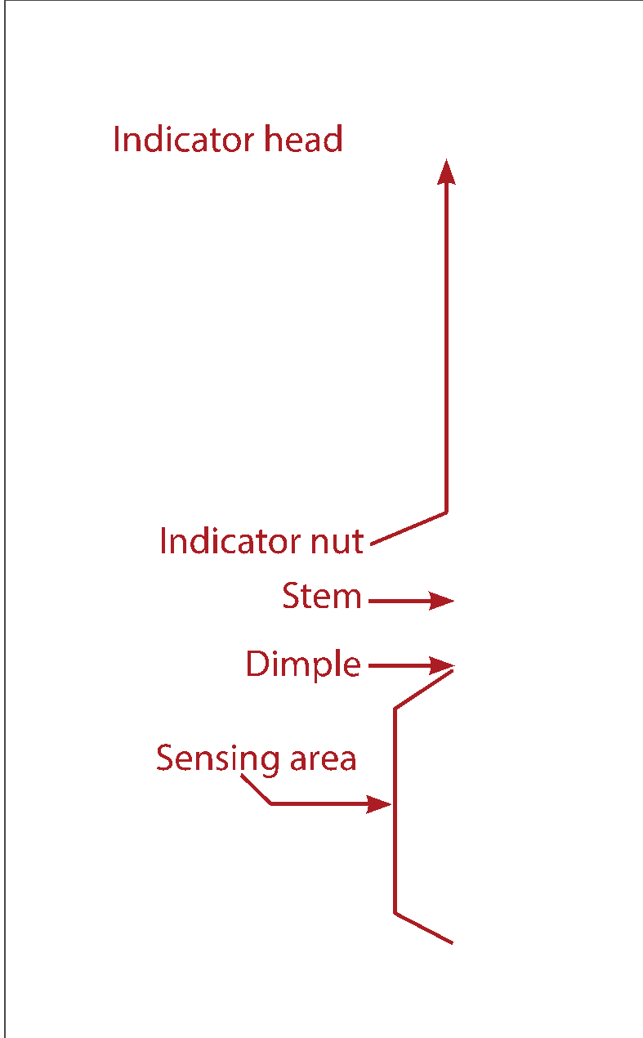
THERMOMETERS
Monitor temperature
Bimetallic stemmed thermometer
0°F to 220°F (-18°C to 104°C)
Hot and cold food
Notes:
The most important tool used to monitor temperature is the thermometer. A common thermometer seen in restaurant and foodservice operations is
a bimetallic stemmed thermometer, as shown in Figure 8.4. This type of thermometer can check temperatures from 0°F to 220°F (-18°C to 104°C)
through its metal stem. This makes it useful for checking both hot and cold types of food.

Slide 6
THERMOMETERS
Insert stem to dimple
Sensing area—tip to dimple
Large or thick food
Thickest part of food
Usually center
Two readings
Temperatures may vary
Notes:
When checking temperature, insert the stem into the food up to the dimple. The sensing area of the thermometer goes from the tip of the stem to the dimple.
This trait makes the thermometer particularly useful for checking the temperature of large or thick food. When checking food temperatures, insert the probe into
the thickest part of the food, as shown in Figure 8.5. This is usually the center. (Note: This is usually not practical for thin food such as hamburger patties.)
Also, you should take another reading in a different spot. The temperature may vary in different areas.

Slide 7
THERMOMETERS
Wait for thermometer to steady
Allow 15 seconds
Calibrated—adjusted regularly for accuracy
Notes:
Before recording a temperature, wait for the thermometer reading to steady. Bimetallic stemmed thermometers will take a little more time to steady than
digital thermometers. Allow at least 15 seconds after you insert the thermometer stem into the food.
Thermometers will only be effective if food handlers follow specific guidelines for using them. They also have to be adjusted regularly, or calibrated, to keep
them accurate.

Slide 8
HOW TO CALIBRATE THERMOMETERS
Lose accuracy
Bumped or dropped
Severe temperature changes
Calibrate or adjust
Follow manufacturer’s directions
Notes:
Thermometers can lose their accuracy when they are bumped or dropped, or when they go through severe temperature changes. When this happens, the
thermometer must be calibrated, or adjusted, to give a correct reading. Most thermometers can be calibrated, but some cannot and must be replaced or sent
back to the manufacturer. You should follow the manufacturer’s directions.

Slide 9
HOW TO CALIBRATE THERMOMETERS
Two ways to calibrate:
Ice-point method
Water freezes
More common
Boiling-point method
Water boils
Notes:
There are two ways to calibrate a thermometer. One is to adjust it based on the temperature at which water freezes. This is called the ice-point method.
The other way is to adjust it based on the temperature at which water boils. This is called the boiling-point method. Boiling is the point where water is hot
enough that bubbles form and rise to the top as vapor (steam). While either way works, the ice-point method of calibration is more common.

Slide 10
ICE-POINT METHOD
Fill container with ice
Add tap water until full
Stir mixture well
Notes:
Fill a large container with ice. Add tap water until the container is full.
Stir the mixture well.

Slide 11
ICE-POINT METHOD
Put thermometer stem in ice water
Sensing area underwater
Wait 30 seconds
Don’t let stem touch container
Notes:
Put the thermometer stem into the ice water. Make sure the sensing area is underwater.
• Wait 30 seconds, or until the indicator stops moving.
• Do not let the probe touch the container.

Slide 12
ICE-POINT METHOD
Adjust thermometer to 32°F (0°C)
Use wrench or other tool
Rotate nut until 32°F (0°C)
Notes:
Adjust the thermometer so it reads 32°F (0°C).
Hold the calibration nut with a wrench or other tool. Rotate the calibration nut until it reads 32°F (0°C).

Slide 13
CLEANING THERMOMETERS
Clean and sanitize
Keep storage cases clean
Notes:
It is also important to keep thermometers cleaned and sanitized to prevent cross-contamination. They are considered a food-contact surface and must be washed, rinsed,
sanitized, and air-dried. Be sure the sanitizing solution you use is for food-contact surfaces. Keep storage cases clean as well.

Slide 14
PURCHASING
Approved, reputable suppliers
Approved food source—inspected
Suppliers—good food safety practices
Supply chains—growers, distributors
Notes:
You have learned how cross-contamination happens and the importance of correct cleaning and sanitizing procedures, as well as how employees can
contaminate food with poor personal hygiene. But those are not the only ways food can become contaminated. As a manager, you need to monitor cleaning
and sanitizing and personal hygiene. You also need to start with purchasing safe food, and then make sure you keep it safe after receiving it.
All the food used in a restaurant or foodservice operation should come from approved, reputable suppliers. An approved food source is one that has been
inspected by appropriate agencies (e.g., government agencies) and meets all applicable local, state, and federal laws. Restaurant and foodservice purchasers
must make sure that their suppliers use good food safety practices. This applies to all suppliers along the supply chain, whether a local farmer or a large-sized
corporation. An operation’s supply chain can include growers, shippers, packers, manufacturers, distributors (trucking fleets and warehouses), and local markets.

Slide 15
RECEIVING
Train staff to
Receive
Inspect
Store
Inspect carefully and immediately
Put away quickly
Store in correct order
Accept or reject guidelines
Temperature, packaging, and quality guidelines
Notes:
To keep food safe during receiving, an operation needs to have enough trained staff available to receive, inspect, and store the food. Deliveries should
be carefully and immediately inspected. Then they should be put away quickly and stored in the correct order. Use the guidelines that follow regarding
temperature, packaging, and quality when deciding if an item should be accepted or rejected.

Slide 16
TEMPERATURE
Insert thermometer into product
In thickest part
Notes:
Use thermometers to check food temperatures during receiving.
Insert the thermometer stem or probe directly into the thickest part of the food. The center is usually the thickest part.

Slide 17
TEMPERATURE
Insert between two packages
Fold around thermometer
Do not puncture package
Notes:
Use thermometers to check food temperatures during receiving.
Insert the thermometer stem or probe between two packages. If the package allows, fold it around the thermometer stem or probe. Be careful
not to puncture the package.

Slide 18
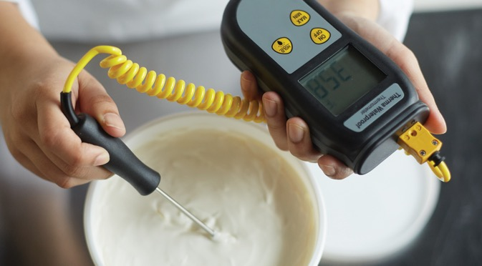
TEMPERATURE
Open package
Insert stem into food
Sensing area immersed
Do not touch package with stem
Notes:
Open the package and insert the thermometer stem or probe into the food. The sensing area must be fully immersed in the food. The stem or probe
must not touch the package.

Slide 19
TEMPERATURE
Receiving temperatures:
Cold TCS Food—41°F (5°C) or lower
Hot TCS Food—135°F (57°C) or higher
Frozen food—frozen solid
Notes:
Cold TCS food should be received at 41°F (5°C) or lower, unless otherwise specified by the manufacturer. Hot TCS food should be received at 135°F (57°C)
or higher. Frozen food should be frozen solid.

Slide 20
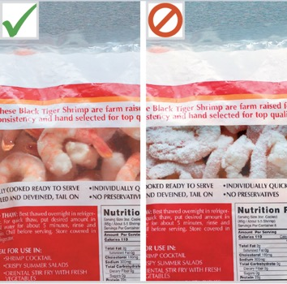
TEMPERATURE
Reject food with ice crystals
On the product
On the packaging
Reject thawed and refrozen
Reject food with fluids or frozen liquids
On bottom of case
Notes:
Reject any frozen food that has ice crystals on the product or packaging. Ice crystals can indicate the product
may have thawed and refrozen. You should also reject the food if any fluids or frozen liquids appear in the bottom of its case.

Slide 21
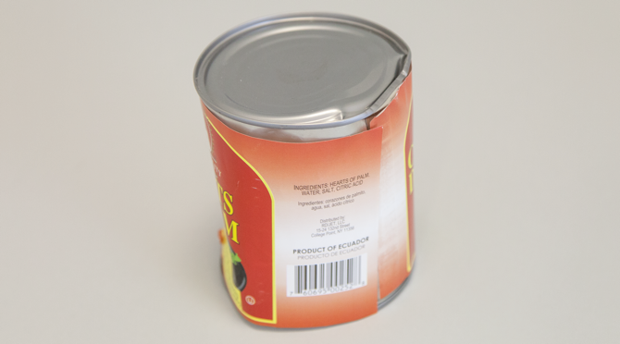
PACKAGING
Intact and clean
Reject
Dented, rusty, or bulging cans
Packaging with tears, holes, punctures, leaks, dampness, water stains
Pest damage
Expired use-by dates
Notes:
The packaging of food and nonfood items should be intact and clean. Reject any items with packaging problems, such as dented, rusty, or bulging cans or food
packaging with tears, holes, punctures, leaks, dampness, or water stains. You should also reject any items with signs of pest damage or expired use-by dates.

Slide 22
PACKAGING
Inspection stamps
Meat, poultry, eggs
Meet safety standards
U.S. Department of Agriculture (USDA)
State department of agriculture
Notes:
Meat, poultry, and eggs should also have an inspection stamp on their packaging. The stamps prove that the items meet the safety standards of the
U.S. Department of Agriculture (USDA) or a state department of agriculture.

Slide 23
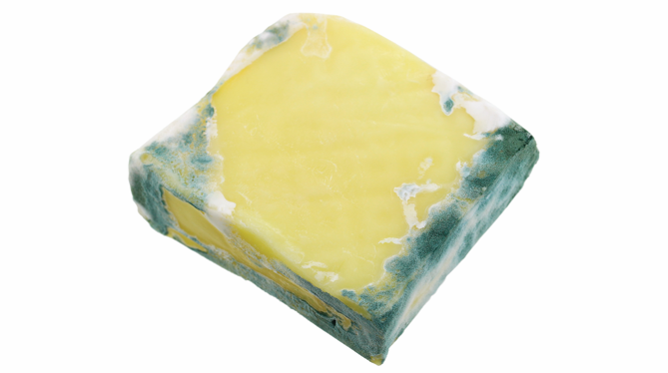
PRODUCT QUALITY
Reject food if:
Moldy or abnormal color
Slimy, sticky, or dry texture
Soft flesh
Abnormal or unpleasant odor
Notes:
Poor food quality is sometimes a sign of time-temperature abuse. Reject food if it has any of these problems:
• Moldy or has an abnormal color (for example, fresh fish should not have dark spots or discoloration)
• Slimy, sticky, or dry texture
• Soft flesh that leaves an imprint when you touch it
• Abnormal or unpleasant odor

Slide 24
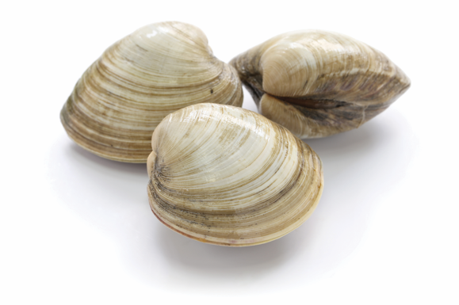
RECEIVING GUIDELINES FOR SPECIFIC FOODS
Shellfish—oysters, mussels, clams, scallops:
Air temperature 45°F (7°C)
Internal temperature < 50°F (10°C)
Cool to 41°F (5°C) or lower in four hours
Notes:
Live shellfish such as oysters, mussels, clams, and scallops should be received at an air temperature of 45°F (7°C) and an internal
temperature no greater than 50°F (10°C). Once received, the shellfish must be cooled to 41°F (5°C) or lower in four hours.

Slide 25
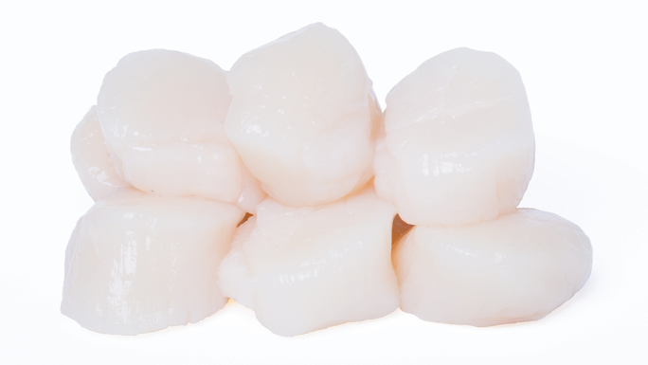
RECEIVING GUIDELINES FOR SPECIFIC FOODS
Shucked shellfish—oysters, mussels, clams, scallops:
Removed from shell
45°F (7°C) or lower
Cool to 41°F (5°C) or lower in four hours
Notes:
Shucked shellfish (shellfish that has been removed from its shell) should be received at 45°F (7°C) or lower. Cool the shellfish to
41°F (5°C) or lower in four hours.

Slide 26
RECEIVING GUIDELINES FOR SPECIFIC FOODS
Shellfish identification tags:
Live shellfish
Attached to delivery container
Write date last shellfish sold or served
Keep tags—90 days
Notes:
Live shellfish must be received with shellstock identification tags. These tags must remain attached to the delivery container until
all of the shellfish have been used. Employees must write on the tags the date that the last shellfish was sold or served from the
container. Operators must keep these tags on file for 90 days from the date written on them.

Slide 27
RECEIVING GUIDELINES FOR SPECIFIC FOODS
Reject shellfish if:
Very muddy
Broken shells
Dead

Slide 28
RECEIVING GUIDELINES FOR SPECIFIC FOODS
Eggs:
Clean and unbroken
45°F (7°C) or lower
USDA grade standards
Liquid, frozen, and dehydrated egg products:
Pasteurized
USDA inspection mark
Notes:
Eggs must be clean and unbroken when you receive them. Reject eggs if they do not meet the following guidelines:
• Shell eggs must be received at an air temperature of 45°F (7°C) or lower.
• Liquid, frozen, and dehydrated egg products must be pasteurized and have a USDA inspection mark.
• Eggs also must meet USDA grade standards.

Slide 29
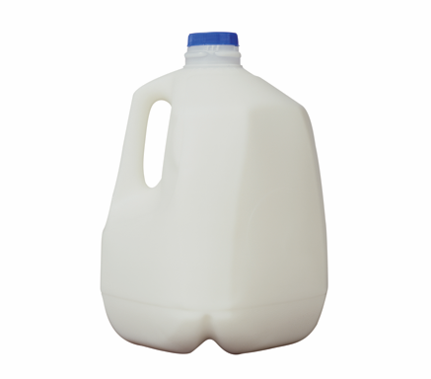
RECEIVING GUIDELINES FOR SPECIFIC FOODS
Milk and dairy products:
45°F (7°C) or lower
41°F (5°C) or lower in four hours
Pasteurized
FDA Grade A standards
Notes:
Milk and dairy products must be received at 45°F (7°C) or lower. Cool the milk to 41°F (5°C) or lower in four hours. These
products also must be pasteurized and meet Food and Drug Administration (FDA) Grade A standards.

Slide 30
STORAGE
TCS food:
41°F (5°C) or lower
135°F (57°C) or higher
Monitor temperatures
Notes:
Once food is purchased and received, it must be stored correctly to ensure safety. Store all TCS food at 41°F (5°C) or lower, or at 135°F (57°C) or higher.
Make sure to monitor food temperatures regularly.

Slide 31
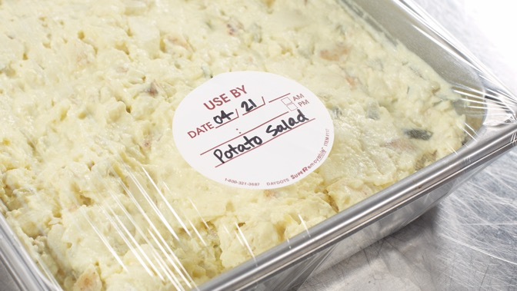
STORAGE
Label TCS food
Prepped in-house
Held > 24 hours
Label includes
Name of food
Date to be sold, eaten, or thrown out
Store for 7 days or less at 41°F (5°C) or lower
After 7 days, throw out
Notes:
Label all ready-to-eat TCS food that is prepped in-house if it will be held for longer than 24 hours. The label must include the name of the food and the
date by which it should be sold, eaten, or thrown out. This food can be stored for a maximum of seven days at 41°F (5°C) or lower.
Day one is the day that the food was prepared. After seven days, you must throw the food out.

Slide 32
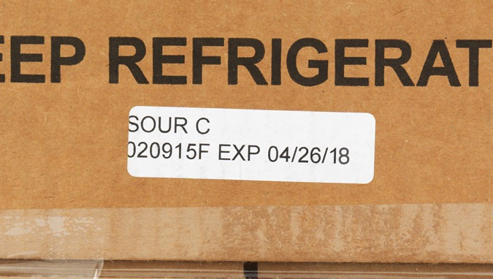
STORAGE
Rotate inventory—oldest first
First-in, first-out (FIFO) method
Identify use-by or expiration date
Store earlier items first
Use items stored in front first
Notes:
Rotate food in storage to use the oldest inventory first. Many operations use the first-in, first-out (FIFO ) method to rotate refrigerated, frozen, and dry food
during storage. Here is one way to use the FIFO method:
1. Identify the food item’s use-by or expiration date, which is usually somewhere on the packaging.
2. Store items with the earliest use-by or expiration dates in front of items with later dates.
3. Once shelved, use those items stored in front first.

Slide 33
PREVENTING CROSS-CONTAMINATION DURING STORAGE
Wrap or cover tightly
Separate raw from ready-to-eat food
Ready-to-eat food above raw
Prevent juices dripping onto ready-to-eat food
Notes:
You can store food to prevent cross-contamination by wrapping or covering it tightly. Store refrigerated raw meat, poultry, and seafood separately from
ready-to-eat food. If raw and ready-to-eat food cannot be stored separately, store ready-to-eat food above raw meat, poultry, and seafood. This will prevent
any raw food juices from dripping onto ready-to-eat food.

Slide 34
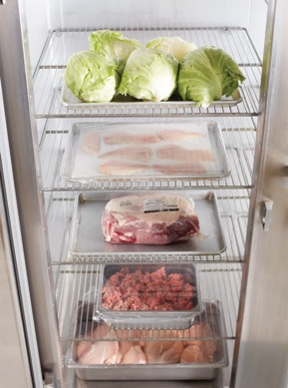
PREVENTING CROSS-CONTAMINATION DURING STORAGE
Top-to-bottom order:
Ready-to-eat food
Seafood
Whole cuts of beef and pork
Ground meat and ground fish
Whole and ground poultry
Based on minimum internal cooking temperatures
Notes:
You can store food to prevent cross-contamination by wrapping or covering it tightly. Store refrigerated raw meat, poultry, and seafood separately from
ready-to-eat food. If raw and ready-to-eat food cannot be stored separately, store ready-to-eat food above raw meat, poultry, and seafood. This will prevent
any raw food juices from dripping onto ready-to-eat food.
This order is based on the minimum internal cooking temperature of each food. For instance, meat cooked to higher temperatures is always stored beneath
meat cooked to lower temperatures.

Slide 35
PREVENTING CROSS-CONTAMINATION DURING STORAGE
Do not overload coolers or freezers
Prevents good airflow
Harder to stay cold
Do not line cooler or freezer shelves
Blocks circulation
Notes:
Do not overload coolers or freezers. Storing too many food items prevents good airflow and makes the units work harder to stay cold. Similarly, do not
line cooler or freezer shelves with aluminum foil or cardboard. This blocks the circulation of cold air.

Slide 36
PREPARATION
Time-temperature abuse
Remove only as much as needed
Prepare in small batches
Ingredients not in temperature danger zone
Notes:
Cross-contamination and time-temperature abuse can happen easily when you are preparing and cooking food. But you can prevent pathogens from
spreading and growing by making good food-prep choices and cooking food to safe internal temperatures.
Time-temperature abuse can easily happen during preparation. Remove from the refrigerator only as much food as can be prepared in a short period of
time. Prepare food in small batches. That way, ingredients will not sit out for too long in the temperature danger zone.

Slide 37
PREPARATION
Thawing:
Freezing does not kill pathogens
Never thaw at room temperature
Notes:
When thawing food before preparation, it is important to remember that freezing does not kill pathogens. When frozen food is thawed and exposed to
the temperature danger zone, any pathogens in the food will begin to grow. To reduce this growth, never thaw food at room temperature.

Slide 38
PREPARATION
Thaw TCS food:
In a cooler
41°F (5°C) or lower
Submerged under running water
70°F (21°C) or lower
Potable water
Never leave food above 41°F (5°C) for > 4 hours
Microwave oven
Part of cooking process
Notes:
Thaw TCS food in one of these ways:
In a cooler, at 41°F (5°C) or lower
Submerged under running water at 70°F (21°C) or lower (Make sure the water is potable—safe to drink. Never let the temperature of the food go above 41°F (5°C) for longer than four hours.)
In a microwave oven, if the food will be cooked immediately
As part of the cooking process

Slide 39
COOKING
Critical for safe food
Different temperatures
Specific amount of time
High-risk populations
No raw seed sprouts, raw or undercooked eggs, meat, or seafood
Notes:
Cooking food to the correct temperature is critical for keeping it safe. Each type of food has a minimum internal temperature that it must reach.
Once food reaches its minimum internal temperature, make sure that it stays at that temperature for a specific amount of time.
Operations that mainly serve a high-risk population, such as nursing homes or day-care centers, cannot serve certain items. For example, they cannot serve
raw seed sprouts or raw or undercooked eggs, meat, or seafood.

Slide 40
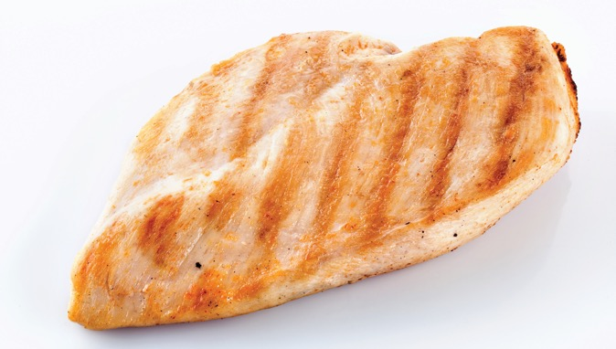
COOKING REQUIREMENTS FOR SPECIFIC FOOD
165°F (74°C) for 15 seconds
Poultry—including whole or ground chicken, turkey, or duck
Stuffing made with TCS ingredients
Stuffed meat, seafood, poultry, or pasta
Dishes that include previously cooked TCS ingredients
Notes:
Dishes that include previously cooked TCS ingredients (raw ingredients should be cooked to their minimum internal temperatures)

Slide 41
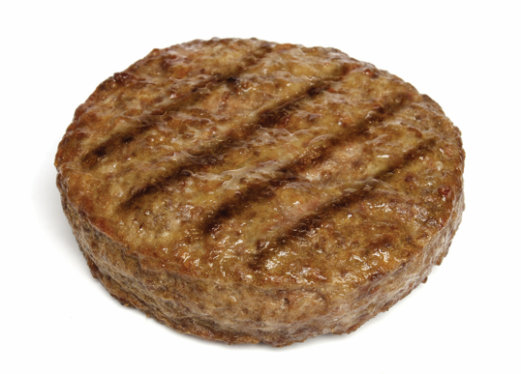
COOKING REQUIREMENTS FOR SPECIFIC FOOD
155°F (68°C) for 15 seconds
Ground meat—including beef, pork, and other meat
Injected meat—including brined ham and flavor-injected roasts
Mechanically tenderized meat
Ground seafood—including chopped or minced seafood
Shell eggs that will be hot held for service

Slide 42
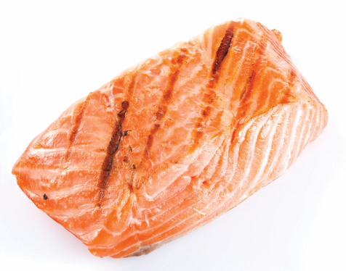
COOKING REQUIREMENTS FOR SPECIFIC FOOD
145°F (68°C) for 15 seconds
Seafood—including fish, shellfish, and crustaceans
Steaks/chops of pork, beef, veal, and lamb
Shell eggs that will be served immediately

Slide 43
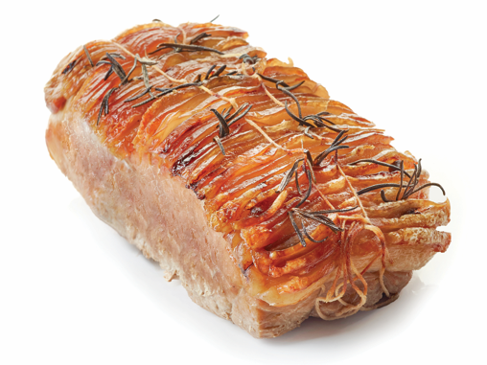
COOKING REQUIREMENTS FOR SPECIFIC FOOD
145°F (68°C) for 4 minutes
Roasts of pork, beef, veal, and lamb

Slide 44
COOKING REQUIREMENTS FOR SPECIFIC FOOD
135°F (57°C)
Commercially processed, ready-to-eat food that will be hot held for service
Notes:
Commercially processed, ready-to-eat food that will be hot held for service (e.g., cheese
sticks, deep-fried vegetables)

Slide 45
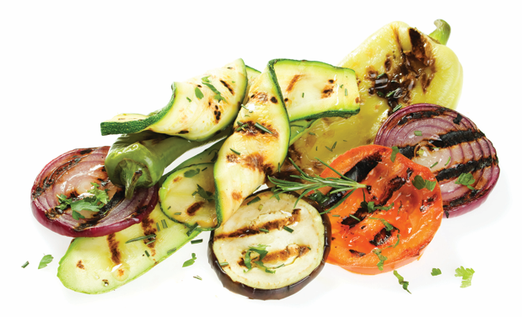
COOKING REQUIREMENTS FOR SPECIFIC FOOD
135°F (57°C)
Fruit, vegetables, grains, and legumes that will be hot held for service
Notes:
Fruit, vegetables, grains (e.g., rice, pasta), and legumes (e.g., beans, refried beans) that
will be hot held for service

Slide 46
HOLDING
Hot food at 135°F (57°C) or higher
Cold food at 41°F (5°C) or lower
Check temperatures every four hours
Do not reheat in hot-holding equipment
Notes:
To hold TCS food safely, follow these guidelines:
• Hold hot food at 135°F (57°C) or higher.
• Hold cold food at 41°F (5°C) or lower.
• Check temperatures at least every four hours. Throw out any food that is in the temperature danger zone.
• Do not reheat food in hot-holding equipment not designed to do so.

Slide 47
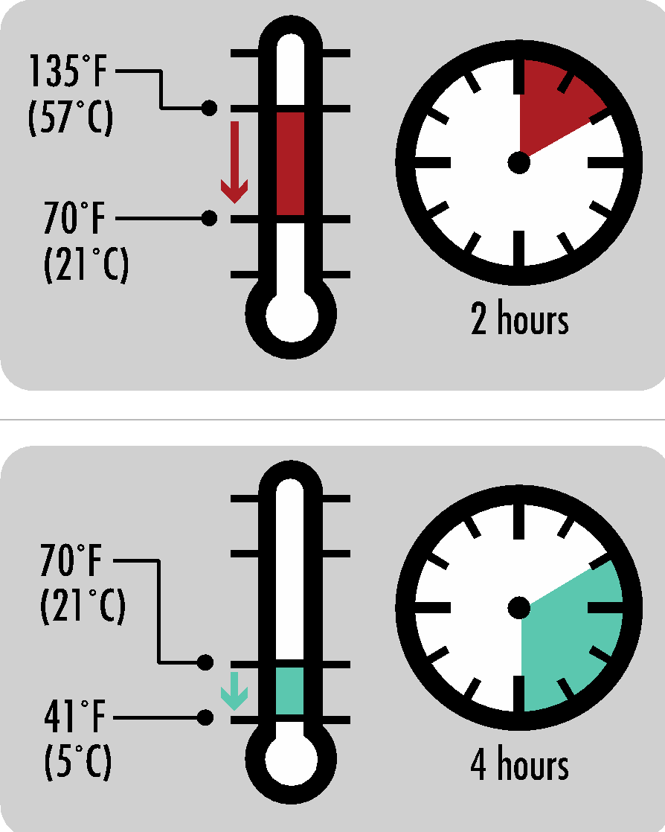
COOLING
135°F (57°C) to 70°F (21°C) within 2 hours
41°F (5°C) or lower in the next 4 hours
70°F (21°C) within 2 hours
Throw out
Reheated and cooled again
Notes:
Remember, pathogens grow well in the temperature danger zone. And they grow much faster at temperatures between 70°F and 125°F (21°C and 52°C).
First, cool food from 135°F (57°C) to 70°F (21°C) within two hours.
Then, cool it to 41°F (5°C) or lower in the next four hours.
If food has not reached 70°F (21°C) within two hours, it must be either thrown out or reheated and then cooled again.

Slide 48
COOLING
Reduce size
Cut large items into smaller pieces
Use small or shallow containers
Notes:
There are many ways to cool food quickly and safely. First, reduce the size of the food. Cut large food items into smaller pieces or divide large containers
of food into smaller or shallow containers. The greater the surface area of the food, the more quickly it can release heat to cool.

Slide 49
COOLING
Ice-water bath
Ice paddles
Add ice as ingredient
Blast chiller
Notes:
Then cool it using one of these methods:
Place small containers into a clean and sanitized prep sink or a large pot filled with ice water. This is called an ice-water bath. Stir the food frequently to cool it faster and more evenly.
Use clean and sanitized ice paddles to stir food. Ice paddles are plastic paddles that can be filled with ice or with water and then frozen. Food stirred with these paddles cools quickly.
Add ice as an ingredient to foods such as soups or stews.
Place food into a blast chiller. (This is not a common piece of equipment.)

Slide 50
REHEATING
Immediate service:
Reheat to any temperature
Cooked and cooled correctly
Hot holding:
Heat TCS food to 165°F (74°C) for 15 seconds
Within 2 hours
Notes:
How you reheat food depends on how you intend to use the food. Follow these guidelines when reheating food:
Food for immediate service: You can reheat food that will be served immediately, such as beef for a beef sandwich, to any temperature.
However, you must make sure the food was cooked and cooled correctly.
Food for hot holding: You must heat TCS food for hot holding to an internal temperature of 165°F (74°C) for 15 seconds. Make sure the food
reaches this temperature within two hours from start to finish.

Slide 51
SERVING
Ready-to-eat food
Use tongs, deli sheets, or gloves
Separate utensils for each item
Clean and sanitize
Extend handle above rim
Place on clean and sanitized surface
Notes:
So, you have purchased, stored, prepared, and cooked the food. Now you are ready to serve it. Again, to prevent contamination, kitchen and service
employees must know how to serve food in ways that keep it safe, including:
• Handle ready-to-eat food with tongs, deli sheets, or gloves.
• Use separate utensils for each food item. Clean and sanitize them after each serving task.
• Store serving utensils in the food with the handle extended above the rim of the container. This prevents anyone from accidentally
touching the food while they try to grab the utensil. Alternatively, place utensils on a clean and sanitized food-contact surface.

Slide 52
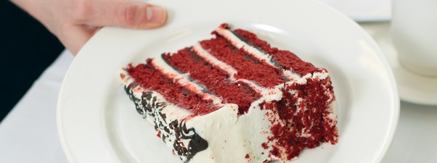
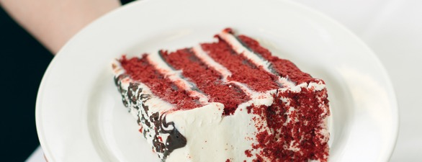
GUIDELINES FOR SERVICE STAFF WHEN SERVING FOOD
Do not touch food-contact areas of dishes or glassware.
Hold dishes by bottom or edge.
Notes:
The service staff needs to be just as careful as the kitchen staff. They can contaminate food by handling the food-contact areas of glasses, utensils, and
Dishes.

Slide 53
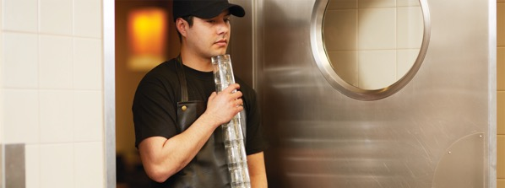
GUIDELINES FOR SERVICE STAFF WHEN SERVING FOOD
Do not stack glasses when carrying them.
Carry glasses in a rack or tray.

Slide 54
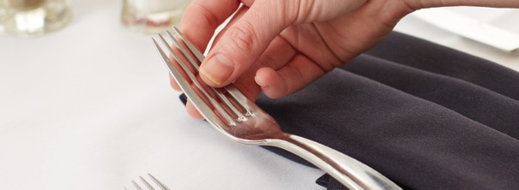
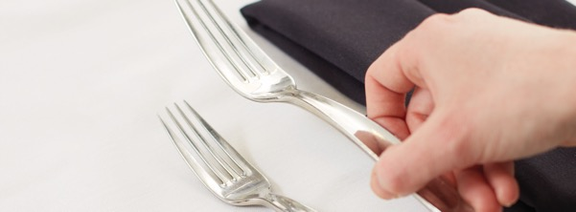
GUIDELINES FOR SERVICE STAFF WHEN SERVING FOOD
Do not hold flatware by food-contact surfaces.
Hold flatware by the handle.
Store so servers grab handles.

Slide 55
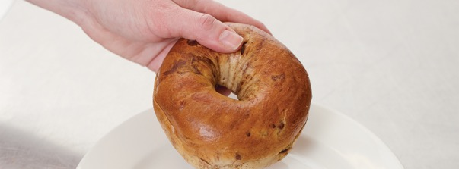
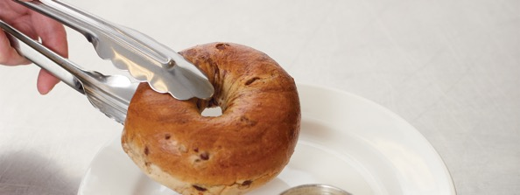
GUIDELINES FOR SERVICE STAFF WHEN SERVING FOOD
Avoid bare-hand contact with ready-to-eat food.
Handle ready-to-eat food with tongs, deli sheets, or gloves.

Slide 56
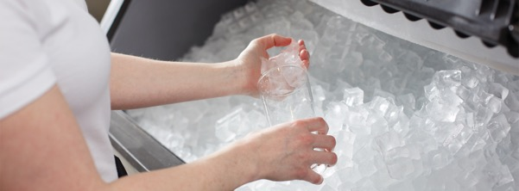
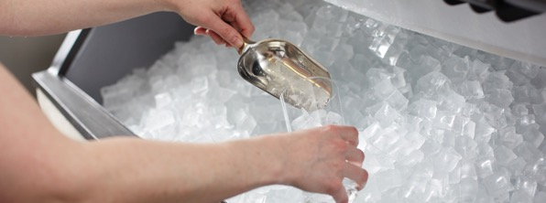
GUIDELINES FOR SERVICE STAFF WHEN SERVING FOOD
Never scoop ice with bare hands or glasses.
Glasses may chip or break.
Use ice scoops or tongs.

Slide 57
OFF-SITE FOODSERVICE
Delivery
Mobile/temporary kitchens
Vending machines
Notes:
Any delay between preparation and service increases the threat to food safety. Food that will be served off-site has a greater risk of time-temperature
abuse and contamination. Off-site service includes delivery, mobile/temporary kitchens, and vending machines. An insulated container
keeps food at the correct temperature for holding, transporting, and catering.

Slide 58
OFF-SITE FOODSERVICE
Use insulated containers
Check food temperatures
Clean delivery vehicles
Label food
Use-by date and time
Reheating and service instructions
Correct utilities
Store food separately
Notes:
There are specific procedures to keep food for off-site service safe:
• Use insulated food containers that keep food out of the temperature danger zone. Use only food-grade containers that will not mix, leak, or
spill food.
• Check internal food temperatures regularly.
• Clean the inside of delivery vehicles regularly.
• Label food with a use-by date and time, as well as reheating and service instructions for staff at off-site locations.
• Make sure the service site has the correct utilities (such as safe water and garbage containers).
• Store raw meat, poultry, and seafood separately from ready-to-eat items.

Slide 59
FOOD SAFETY MANAGEMENT SYSTEM
Group of procedures and practices
Work together to prevent foodborne illness
Controls risks and hazards
Notes:
One of the best ways for restaurant and foodservice managers to prevent foodborne illness is to develop and follow a food safety management system.
A food safety management system is a group of procedures and practices that work together to prevent foodborne illness. Combined, these procedures and
practices control risks and hazards throughout the flow of food in an operation.

Slide 60
FOOD SAFETY MANAGEMENT SYSTEM
Active managerial control
Control risks
Proactive
Anticipate risks
Achieve active managerial control
Training programs
Manager supervision
Standard operating procedures (SOPs)
HACCP
Notes:
It is the manager’s responsibility to actively control risk factors for foodborne illness. This is called active managerial control. It is important to note that active
managerial control is proactive rather than reactive; you must anticipate the risks and plan for them.
There are ways to achieve active managerial control in the operation. According to the FDA, you can use simple tools such as training programs,
manager supervision, and the incorporation of standard operating procedures (SOPs). Active managerial control can also be achieved through more complex
solutions, such as a HACCP program.

Slide 61
FOOD SAFETY MANAGEMENT SYSTEM
Hazard Analysis Critical Control Point (HACCP)
Identifies major hazards
Prevent, eliminate, or reduce
Notes:
A Hazard Analysis Critical Control Point, or HACCP, system is an example of a food safety management system. HACCP identifies major hazards
at specific points within a food’s flow through the operation. The idea is that if managers can figure out where a biological, chemical, or physical hazard might
happen, then they can prevent, eliminate, or reduce it.

Slide 62
FOOD SAFETY MANAGEMENT SYSTEM
Hazard Analysis Critical Control Point (HACCP)
Written plan based on operation’s
Menu
Guests
Equipment
Processes
Operations
Each plan is unique
Notes:
An effective HACCP system is based upon a written plan that considers an operation’s menu, guests, equipment, processes, and operations. Because there
are so many variables, each HACCP plan is unique. A plan that works for one operation might not work for another.

Slide 63
FOOD SAFETY MANAGEMENT SYSTEM
Monitoring
Corrective action
Verify
Notes:
Monitoring is critical to the success of active managerial control. Food will be safe if managers monitor critical activities in the operation. Managers
must take the necessary corrective action when required. They must also verify that the actions taken to control the risk factors for foodborne illness are
actually working.

