Slide 1
Jeopardy
Types of
Knives
Safety
Parts of
A Knife
Knife Cuts
Knife
Station
$100
$100
$100
$100
$100
$200
$200
$200
$200
$200
$300
$300
$300
$300
$300
$400
$400
$400
$400
$400
$500
$500
$500
$500
$500
Final Jeopardy

Slide 2
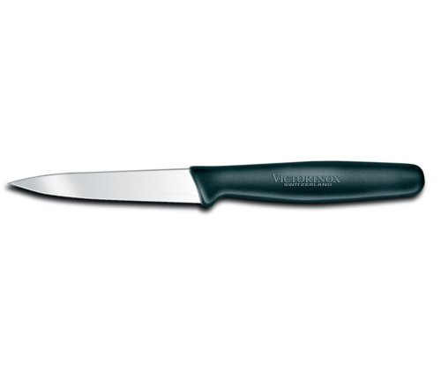
Types of Knives - $100
What is this knife?
Paring knife

Slide 3
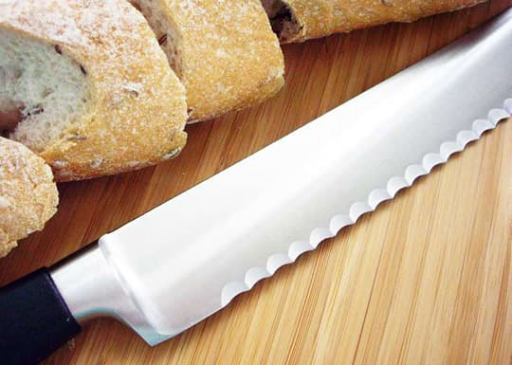
Types of Knives - $200
What type of knife is pictured here?
Serrated knife

Slide 4
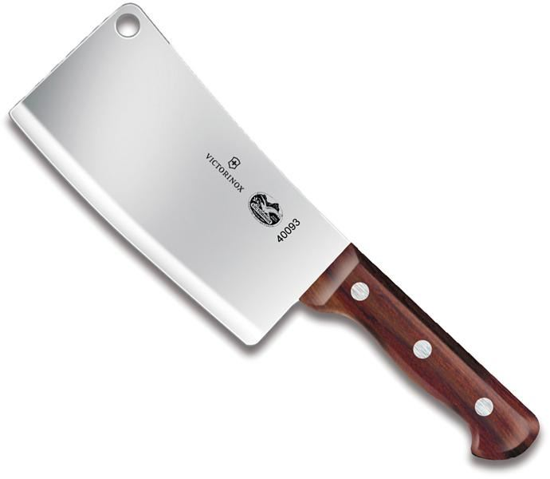
Types of Knives - $300
What type of knife is this?
Cleaver

Slide 5
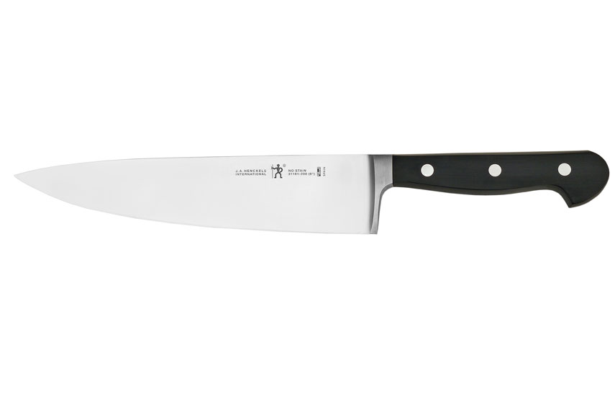
Types of Knives - $400
What type of knife is this?
Chef’s knife

Slide 6
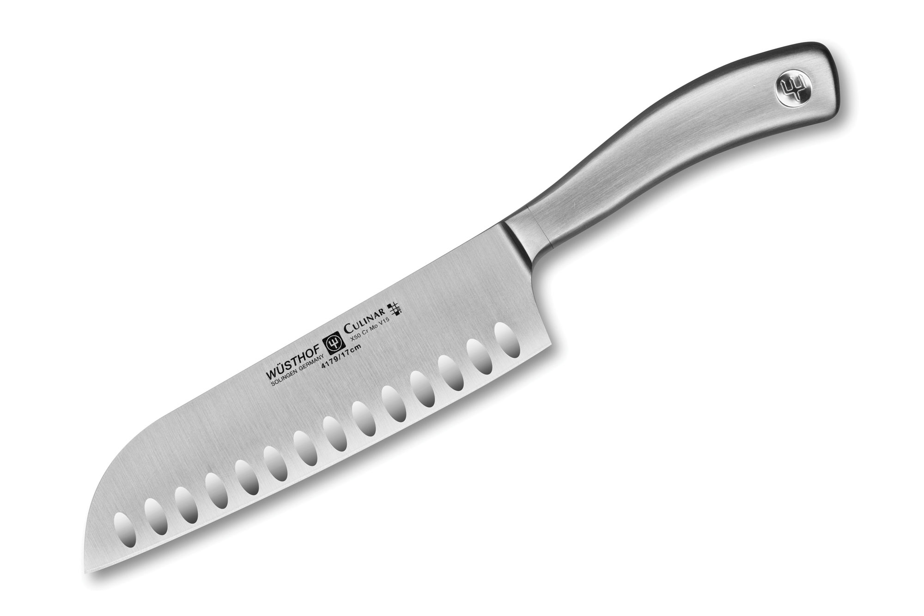
Types of Knives - $500
What type of knife is this?
Santoku knife

Slide 7
Safety - $100
How should you carry a knife?
Carry is point down, by your side

Slide 8
Safety - $200
Why should you never mess around with knives?
Someone could easily get hurt.

Slide 9
Safety - $300
What is the safest type of knife to use?
Sharp

Slide 10
Safety - $400
A knife has fallen off the counter what do you do?
Let it fall, make sure your feet are out of the way.

Slide 11
Safety - $500
Why should a knife not be placed in a sink filled with water?
Risk of getting hurt

Slide 12
Parts of a Knife - $100
What part of a knife is this?
Tip

Slide 13
Parts of a Knife - $200
What part of the knife is this?
Blade

Slide 14
Parts of a Knife - $300
What part of the knife is this?
Rivets/Tang

Slide 15
Parts of a Knife - $400
What part of the knife is this?
Tang

Slide 16
Parts of a Knife - $500
What part of the knife is this?
Bolster or shank

Slide 17
Knife Cuts - $100
Which cut makes the final product about the size and shape of matchsticks?
Julienne

Slide 18
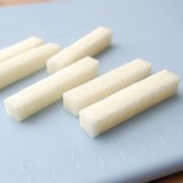
Knife Cuts - $200
Why is it important to cut all pieces going into a recipe (such as stew) a similar size
So that they cook evenly and equally

Slide 19
Knife Cuts - $300
Name something that you would mince?
Garlic
Fresh Herbs

Slide 20
Knife Cuts - $400
Why should you cut a little bit off the bottom of a vegetable when you are cutting it? This is sometimes called “squaring off”
To keep the vegetable from rolling around on the cutting board.

Slide 21
Knife cuts - $500
What are the three types of Dice?
Small Medium and Large

Slide 22
Knife Station - $100
When you set up a knife station you should ________ the counters.
Sanitize

Slide 23
Knife Station - $200
How do you stand at a knife station?
Your body is at a 45 degree angle to the counter and the item is parallel to the counter.
Or you are standing parallel to the counter and the item is at a 45 degree angle.

Slide 24
Knife Station - $300
The hand that is holding the item that is being cut is like a_______?
Claw

Slide 25
Knife Station - $400
When working at your knife station you might have three bowls, what should go in each of the bowls?
Scrap
Useable waste
Product

Slide 26
Knife Station - $500
What knives would you use at your knife station? Name two that you might use most frequently.
Chef’s knife
Paring Knife

Slide 27
Final Jeopardy
What is the most used knife in a kitchen?
Chef’s knife

