Slide 2
Hand Tools and Small Equipment
Bench scraper
Bowl scraper
Rigid, small sheet of stainless steel
Metal blade
Scrape material off of work surface
Cut or portion soft items
Flexible piece of rubber or plastic
Combine ingredients in bowl
Scrape out ingredients
Cut and separate dough
Scrape dough and flour from wooden worktables
Notes:
Every operation has smallware—small hand tools and small equipment easy to use for food pre-preparation.
These tools are designed to aid in cutting, shaping, moving, or combining food. Similar to knives, many
hand tools are designed for specific tasks.
Bench scraper
A rigid, small sheet of stainless steel with a metal blade. Used to scrape material off of a work surface
or “bench” or to cut or portion soft, semi-firm items (like bread dough or cookie dough).
Bowl scraper
A flexible piece of rubber or plastic. Used to combine ingredients in a bowl and then scrape them out
again, to cut and separate dough, and to scrape extra dough and flour from wooden worktables.

Slide 3
Hand Tools and Small Equipment
Channel knife
Peeler
Cuts lengthwise groves
Cuts a thick layer from vegetables
or fruits
More efficient than paring knife
Notes:
Channel knife
A knife used to cut grooves lengthwise in a vegetable such as a carrot.
Peeler
Cuts a thick layer from vegetables and fruits more efficiently than a paring knife.

Slide 4
Hand Tools and Small Equipment
Grater
Zester
Shredder
Grates food into fine pieces
Shreds small pieces of outer peel
Citrus fruits
Notes:
Grater
Also known as a shredder; grates food into fine pieces. Examples include graters for hard cheeses,
vegetables, and potatoes.
Zester
Shreds small pieces of the outer peel, often used for citrus fruits.

Slide 5
Hand Tools and Small Equipment
Bakers rolling pin
Classic rolling pin
French rolling pin
Rolls over pastry
Flattens or shapes dough
Straight cylinder
Rolls over pastry
Flattens or shapes dough
Two handles attached to a
center dowel
Rolls over pastry
Flattens or shapes dough
Ends are tapered
Notes:
Rolling pin (Bakers)
A cylinder used to roll over pastry to flatten or shape it; this rolling pin is simply a straight cylinder.
Rolling pin (Classic)
A cylinder used to roll over pastry to flatten or shape it; this rolling pin has two handles attached to a center
dowel that turns.
Rolling pin (French)
A cylinder used to roll over pastry to flatten or shape it; this rolling pin is a single piece that tapers slightly
on the ends.

Slide 6
Hand Tools and Small Equipment
Pizza cutter
Fish scaler
Pastry wheel
Cuts pizza and rolled-out dough
Removes scales from fish
Notes:
Pizza cutter
Also known as a pastry wheel. Used to cut pizza and rolled-out dough.
Fish scaler
Removes scales from a fish.

Slide 7
Hand Tools and Small Equipment
Corer
Parisienne scoop
Remove core of apples or pears
Melon baller
Cuts round shapes
Soft fruits and vegetables
Notes:
Corer
Used to remove the core of an apple or pear in one long, round piece.
Parisienne (pah-REE-see-en) scoop
Also called a melon baller. Cuts ball shapes out of soft fruits and vegetables.

Slide 8
Hand Tools and Small Equipment
Can opener
Kitchen shears
Mounted onto utility table
Opens large cans
Cut string and butcher’s twine
Cut grapes into small clusters
Notes:
Can opener
A large can opener is mounted onto a metal utility table in order to be used to open large cans. A small,
handheld can opener, like those for home use, may be used in a restaurant or foodservice kitchen to open
small cans of food.
Kitchen shears
Strong scissors used to cut string and butcher’s twine and to cut grapes into small clusters.

Slide 9
Hand Tools and Small Equipment
Pastry bag
Pastry brush
Piping tools
Canvas, plastic, or nylon
Pipe out frosting, creams, and puréed foods
Brush egg wash, melted butter, glazes, other liquids onto baked goods, raw pasta, or meat
Decorative tips
Presses
Piping bags
Notes:
Pastry bag
A bag made of canvas, plastic, or nylon, used to pipe out frostings, creams, and puréed foods. Different
pastry tips create a variety of decorations.
Pastry brush
Used to brush egg wash, melted butter, glazes, and other liquids onto items such as baked goods, raw
pasta, or meat.
Piping tools
Include piping bags (canvas, plastic, disposable), decorative tips (metal or plastic, of varying shapes),
and presses (cylinders with a handle on one end that force dough through a metal cutout).

Slide 10
Hand Tools and Small Equipment
China cap
Colander
Strainer
Pierced, metal, cone-shaped strainer
Strains soups, stocks, other liquids
Allows liquid to drain while retaining solids
Stands on metal feet
Mesh-like material or metal with holes
Hand-held
Shaped like a bowl
Strains pasta, vegetables, other large food items
Notes:
China cap
A pierced, metal, cone-shaped strainer. Used to strain soups, stocks, and other liquids to remove all solid
ingredients. A very fine China cap made of metal mesh and called a chinois (chin-WAH) strains out very
small solid ingredients.
Colander
Allows liquid to drain while retaining solids such as cooked pasta and vegetables. Colanders stand on
metal feet, while strainers are usually handheld.
Strainer
Made of mesh-like material or metal with holes in it. Strainers come in different sizes and are often shaped
like a bowl. Strainers strain pasta, vegetables, and other larger food items cooked in liquid.

Slide 11
Hand Tools and Small Equipment
Sandwich spreader
Offset spatula
Straight spatula
Short, stubby spatula
Used to spread sandwich filling and condiments
Long, narrow tool
Flat metal blade
Frost cakes
Even out layer of batter
Flexible, round-tipped tool
Ice cakes
Spread fillings and glazes
Level dry ingredients
Turn small pancakes
Notes:
Sandwich spreader
A short, stubby spatula used to spread sandwich fillings and condiments.
Offset spatula (SPACH-e-la)
Long, narrow tool that has a flat metal blade at one end, often used to frost cakes or even out a layer
of batter.
Straight spatula
A flexible, round-tipped tool used for icing cakes, spreading fillings and glazes, leveling dry ingredients
when measuring, and even turning small pancakes and other food items.

Slide 12
Hand Tools and Small Equipment
Food mill
Ricer
Tamis/drum sieve
Used to purée food
Coarse, medium, and fine grating screens
Rice-like pieces of cooked food
Press through sheet of small
holes—pierced hopper
Screen that stretches across metal or wood base
Shaped like a drum
Food forced through
Purée very soft food
Remove solids from purées
Notes:
Food mill
A machine that comes with several detachable parts, such as coarse, medium, and fine grating screens.
Used to purée food to different consistencies.
Ricer
Used to create rice-like pieces of cooked food by pressing the food through a sheet of small holes—
known as a pierced hopper—that are typically about the diameter of a piece of rice.
Tamis (TA-mee)/drum sieve
A screen that stretches across a metal or wood base that is shaped like a drum. Food is forced through it.
It is used to purée very soft food and to remove solids from purées.

Slide 13
Hand Tools and Small Equipment
Cheesecloth
Funnel
Sieve
Light, fine-mesh gauze
Straining liquids
Bundling herbs
Thickening yogurt
Pour liquids from larger containers to a smaller one
Sifter
Mesh screen to sift flour or other dry ingredients
Remove large impurities
Combine and aerate food product
Notes:
Cheesecloth
A light, fine-mesh gauze for straining liquids such as stocks or custards, for bundling herbs, or for
thickening yogurt.
Funnel
Used to pour liquid from a larger to a smaller container.
Sieve (SIV)
Also known as a sifter. Has a mesh screen to sift flour and other dry baking ingredients and to remove any
large impurities, as well as to combine and aerate the food product.

Slide 14
Hand Tools and Small Equipment
Wire whip
Rubber spatula
Skimmer
Whisk
Mix, beat, and stir food
Scraper
Fold ingredients together
Scrape sides of bowls
Flat head with holes
Remove foam from stock or soup
Remove solid ingredients from liquids
Notes:
Wire whip (whisk)
Wire whips of different sizes and heaviness are used to mix, beat, and stir food.
Rubber spatula
Often called a scraper. A spatula with a long handle used to fold ingredients together and scrape the
sides of bowls.
Skimmer
Has a larger round, flat head with holes. Used to remove foam from stock or soup and to remove
solid ingredients from liquids. Mesh skimmers are also available.

Slide 15
Hand Tools and Small Equipment
Cook’s fork
Tongs
Kitchen fork
Lift items onto plate
Steady an item being cut
Do not use to turn dry-cooked meats
Scissor-like utensil
Pick up and handle solid food
Notes:
Cook’s fork (kitchen fork)
A fork with two long, pointed tines to lift items to the plate and steady an item being cut. Do not use a cook’s
fork to turn meat that is being dry-cooked because the tines may pierce the meat and release the juices.
Tongs
Scissor-like utensil that food handlers use to pick up and handle all kinds of solid food. To keep food
safe, food handlers should never use their hands to pick up food.

Slide 16
Hand Tools and Small Equipment
Spoons
Pie server
Solid, perforated, or slotted
Stainless steel
Holds three ounces
Solid spoons—liquids or solid ingredients
Perforated or slotted spoons—allow liquids to drain
Lift out and serve pie pieces
Wedge spatula
Notes:
Spoons
Cooking spoons for quantity cooking are solid, perforated, or slotted. They are made of stainless
steel and hold about three ounces. Solid spoons are serving spoons without holes in them. Use them to
spoon out both liquid and solid ingredients. Perforated and slotted spoons have holes that allow liquid to
drain while holding the solid items on the spoon.
Pie server
A specially shaped spatula made for lifting out and serving pieces of pie. It is also known as a
wedge spatula.

Slide 17
Measuring Utensils
Balance scale/baker’s scale
Digital (electric) scale
Portion scale
Weigh dry ingredients
Precise scale
Measure weight
U.S. and metric systems
Measure recipe ingredients
¼ ounce to 1 pound to 2 pounds
Notes:
Measuring utensils, available in many sizes, are most commonly thought of in terms of measuring an amount of an ingredient, either liquid or dry,
when cooking. They can be made of plastic, metal, wood, or other materials. However, other measuring tools are used in restaurant and foodservice
operations as well. They may measure weight or temperature.
Balance scale/baker’s scale
Weighs dry ingredients in the bakeshop.
Digital (electric) scale
A precise scale used to measure weight. It provides a digital readout in both U.S. and metric systems.
Portion scale
Used to measure recipe ingredients, from ¼ ounce to 1 pound to 2 pounds.

Slide 18
Hand Tools and Small Equipment
Bimetallic stemmed thermometer
Thermocouple
Check temperature of large or thick food
Insert up to dimple
Hold for at least 15 seconds
Check temperature of thick or thin food
Instant read
Notes:
Bimetallic stemmed thermometer
Used to check the temperature of large or thick food. These thermometers are inserted into the food
up to a dimple on the probe and held for at least 15 seconds to check temperature.
Thermocouple
Thermometer that measures temperature in thick or thin food almost instantly as the temperature is read
at the tip of the probe. Do not leave this kind of thermometer in food as it cooks.

Slide 19
Hand Tools and Small Equipment
Ladle
Portion scoop
Measure fluid ounces and milliliters
Portion out liquids
Short-handled measuring utensil
Scoop out soft foods
Notes:
Ladle
Available in various sizes and measured in fluid ounces and milliliters so they can be used to portion
out liquids.
Portion scoop
Short-handled measuring utensil used to scoop out soft foods, such as ice cream, butter, and sour cream.
Portion scoops come in various sizes.

Slide 20
Measuring Utensils
Measuring cup
Measuring spoon
Volume measures
Measures dry goods and liquids
Spouts used for measuring and pouring liquids
¼-cup, ⅓-cup, ½-cup, and 1-cup sizes
Measure small quantities of spices or liquids
¼ teaspoon, ½ teaspoon, 1 teaspoon, and 1 tablespoon
Similar to liquid measuring cups—bigger
1 pint, 1 quart, ½ gallon, and 1 gallon
Notes:
Measuring cup
Measures varying quantities of both dry goods and liquids. Measuring cups with spouts are useful for
measuring and pouring liquids. Measuring cups usually come in ¼-cup, ⅓-cup, ½-cup, and 1-cup sizes.
Measuring spoon
Used to measure small quantities of spices or liquids. The spoons measure in the amounts of ⅛ teaspoon
(not all sets include this smallest size), ¼ teaspoon, ½ teaspoon, 1 teaspoon, and 1 tablespoon.
Volume measures
Similar to liquid measuring cups but bigger, usually available in sizes of 1 pint, 1 quart, ½ gallon, and 1 gallon.

Slide 21
Pots and Pans
Cookware
Copper, cast iron, chrome, stainless steel, aluminum
Pots
  Larger vessels
  Straight sides
  Two loop handles
Pans
  Shallower
  One long handle
  Straight or sloped sides
Notes:
Pots and pans, essential tools in the professional kitchen, are often called cookware. They are available in many shapes and sizes and are made of
a variety of materials, such as copper, cast iron, chrome, stainless steel, and aluminum, with or without a nonstick coating. In general, pots are larger vessels
with straight sides and two loop handles. Pans, on the other hand, tend to be shallower, with one long handle and either straight or sloped sides.

Slide 22
Pots
Brazier:
Rondeau
Medium to large
More shallow than saucepots
Straight sides and two handles for lifting
Heavyweight material
Thick bottom—good heat distribution
Braise meat and vegetables
Notes:
Pots are available in a range of sizes based on volume. Use them on the stove top for making stocks or soups, or for boiling or simmering food.
Brazier
Also called a rondeau. This medium to large pot, more shallow than saucepots, has straight sides and two handles for lifting.
This is typically made of heavyweight material with a thick bottom for good heat distribution. Use it to braise meat and vegetables.

Slide 23
pots
Double boiler:
Lower pot
  Holds boiling or simmering water
Upper pot
  Food gently cooked
Melt chocolate
Heat milk, cream, or butter
Notes:
Has an upper pot and a lower pot. The lower pot holds boiling or simmering water that gently
cooks the food in the upper pot. Use it for melting chocolate or heating milk, cream, or butter.

Slide 24
pots
Saucepot:
Prepare sauces, soups, and other liquids
More shallow than stockpots
Straight sides
Two loop handles for lifting
Notes:
Used to prepare sauces, soups, and other liquids. Saucepots are more shallow than stockpots,
with straight sides and two loop handles for lifting.

Slide 25
pots
Stockpot:
Large pot for preparing stock
Some have spigots—pour liquids out easily
Notes:
A large pot for preparing stocks. Stockpots with spigots allow the liquid to be poured
out easily without losing any of the solid ingredients.

Slide 26
Pans
Cake pan
Springform pan
Muffin tin
Straight sides
Variety of sizes and shapes
Two-part, spring-loaded baking pan
Easy to remove cake from pan
Metal tray
Small, round cups or molds
Muffins, cupcakes, or other small baked goods
Notes:
Cake pan
Pan with straight sides and available in a variety of sizes and shapes, including round, rectangular,
square, and specialty (such as heart-shaped).
Springform pan
A two-part, spring-loaded baking pan. The bottom piece and ring secure with a spring to hold the bottom
in place. Once an item is baked, the chef can release the spring to make it easy to remove the cake from
the pan.
Muffin tin
Metal tray with small, round cups or molds used to make muffins, cupcakes, or other small baked goods.

Slide 27
Pans
Hotel pan
Roasting pan
Sheet pan
Holds prepared food
Steam table, hot-holding cabinet, or refrigerator
Baking, roasting, or poaching
Various sizes, lengths, and depths
Shallow, rectangular pan
Medium-high sides
Two handles
Roast and bake food
Very shallow pan
One inch deep
Various lengths
Notes:
Hotel pan
Used to hold prepared food in a steam table, hot-holding cabinet, or refrigerator. This can sometimes
be used for baking, roasting, or poaching, but because it is thin, it generally does not do well with proteins
and vegetables. Hotel pans come in various sizes, with different lengths and depths.
Roasting pan
A shallow, rectangular pan with medium-high sides and two handles, used to roast and bake foods, such
as meat and poultry.
Sheet pan
A very shallow pan, about one inch deep, used for just about anything, from baking cookies to
roasting vegetables. Sheet pans come in various lengths, such as half or quarter sheet pans.

Slide 28
Pans
Cast-iron skillet
Sauté pan
Heavy, thick pan
Pan grill or pan-fry
Meat or vegetables
Slope-sided
Thin metal for quick heating
Strictly used to sauté
Notes:
Cast-iron skillet
A heavy, thick pan made of cast iron, used to pan grill or pan-fry food like meat or vegetables.
Sauté pan
The original French sauté pan is slope-sided and made of thin metal for quick heating. It is used
strictly to sauté items.

Slide 29
Pans
Saucepan
Sautoir
Medium height
Straight sides
Single long handle
General cooking—liquid or liquid-based mixtures
Wide bottom
Straight sides
Pan-frying, stir-frying, shallow poaching
Notes:
Saucepan
A pan with medium height, straight sides, and a single long handle, used for general cooking, in
particular liquid or liquid-based mixtures, on ranges.
Sautoir (saw-TWAHR)
The classic sautoir shape has a wide bottom and straight sides. Some typical tasks include
pan-frying, stir-frying, and shallow poaching.

Slide 30
Pans
Fish poacher
Crêpe pan
Wok
Long, narrow, metal pan
Perforated rack—raise or lower fish
Cooking liquid
Shallow skillet
Very short, slightly sloping sides
Create crêpes
Metal pan
Rounded bottom
Curved sides
Easy to toss or stir food
Asian cooking
Notes:
Fish poacher
A long, narrow, metal pan with a perforated rack used to raise or lower the fish into a cooking liquid
so it does not break apart.
Crêpe pan
A shallow skillet with very short, slightly sloping sides, used to create crêpes, a thin pancake.
Wok
A metal pan with a rounded bottom and curved sides. The curved sides make it easy to toss or
stir food. Cooks use woks especially for frying and steaming in Asian cooking.

Slide 31
Care of Pots and Pans
Specific instructions for care and cleaning
Follow proper cleaning and sanitizing
Approved by local regulatory authority
Wait for pots and pans to cool
Notes:
Pots and pans are available in a variety of materials, each with specific instructions for care and cleaning. Always follow proper cleaning
and sanitizing rules—most often in a three-compartment sink. Make sure that whatever technique you use is approved for food safety by
your local regulatory authority. To avoid warping, always wait for pots and pans to cool before washing or rinsing.

Slide 32
Care of Pots and Pans
Aluminum:
Hand wash in soapy water
Nonabrasive cleaner to remove stains
Chrome:
Wash in warm water
Soap or detergent
Do not use abrasive cleaners
Copper:
Commercial cleaners
Removes discoloration before washing

Slide 33
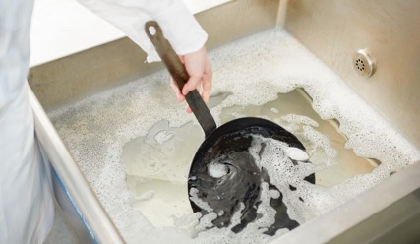
Care of Pots and Pans
Cast iron:
Wash in warm, sudsy water
Mild detergent
Reapply thin layer of fat or oil
Air-dry
Notes:
Wash in warm, sudsy water with a mild detergent. Reapply a thin layer of fat or oil and air-dry to prevent rust and pitting.
Some people feel that cleaning and sanitizing cast iron can remove or damage the seasoning on the pan. Therefore they
opt for cleaning techniques such as scrubbing with coarse salt and a paper towel or clean cloth.

Slide 34
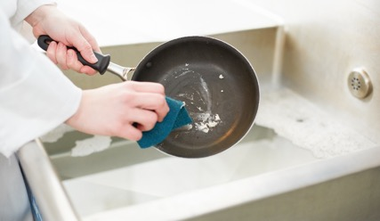
Care of Pots and Pans
Stainless steel:
Wash in hot, soapy water
Rinse thoroughly
Air-dry
Nonstick coating:
Use plastic mesh scrubber—avoid scratches
Remove all residue from bottom of pan—food may burn

Slide 35
knives
Most widely used kitchen equipment
Most cooking preparations
Designed for a specific purpose
Made of stainless steel
Notes:
Knives are the most widely used pieces of kitchen equipment. Food handlers use knives in most cooking preparations, from slicing to chopping to shredding.
Each knife is designed for a specific purpose, such as paring a vegetable or cutting meat from the bone. A good knife is made of stainless steel because it is
very durable and stays sharp for a long time.

Slide 36
The Parts of a Knife
Two main parts:
Blade
  Cutting surface
  Metal
  Forged or stamped
Handle
Notes:
A knife has two main parts, the blade and the handle. The blade is the cutting surface of the knife. The blade is made of metal and is either forged or stamped.

Slide 37
The Parts of a Knife
Forged blade:
Single piece of heated metal
Dropped on a mold
Struck with a hammer
Pounded into correct shape
Stamped blade:
Cutting blade—shaped pieces
From sheets of milled steel
Notes:
A forged blade is made from a single piece of heated metal that is dropped into a mold and then struck with a hammer and pounded into the correct shape.
A stamped blade is made by cutting blade-shaped pieces from sheets of milled steel.

Slide 38
The Parts of a Knife

Slide 39
The Parts of a Knife
Tip:
Detail work—paring, trimming, and peeling
Cutting edge:
Bottom of the blade, between tip and heel
Slicing, carving, precision cuts
Edges
  Flat ground and tapered
  Serrated
  Hollow ground
  Granton
  Single side
Notes:
Tip: Cooks use the tip for detailed work such as paring, trimming, and peeling.
Cutting edge: The cutting edge is located along the bottom of the blade between the tip and the heel.
Use it for slicing, carving, and making precision cuts. The cutting edge can be flat ground and tapered
(both sides of the blade taper smoothly to a narrow V shape), serrated (shaped into a row of teeth that
can be set very closely or widely apart), hollow ground (the sides of the blade near the edge are ground away
to form a hollow, making the blade extremely sharp), granton (ovals are ground into the sides of the blade,
which helps food to release easily), and single side (the edge is sharpened on just one side).

Slide 40
The Parts of a Knife
Spine:
Top of the blade
Noncutting edge
Heel:
Widest and thickest part of blade
Cut through large, tough, or hard foods
Notes:
Spine: The top of the blade is the spine and is the noncutting edge of the blade.
Heel: The heel is the widest and thickest part of the blade. Use the heel to cut through large, tough, or
hard foods.

Slide 41
The Parts of a Knife
Bolster:
Heel of blade
Blade meets handle
Tang:
Metal from blade through handle
Full tang—as long as knife handle
  Chef’s knives and cleavers
Partial tang—lighter work
  Paring or bread knives
Notes:
Bolster: The bolster is located at the heel of the blade. It is where the blade meets the handle.
Tang: The tang is the metal that continues from the blade through the handle. A full tang is as long as the
whole knife handle. Chef’s knives and cleavers have full tangs. Some knives have partial tangs and are
used for lighter work, such as paring or bread knives.

Slide 42
The Parts of a Knife
Scales:
Make up the handle
Rivets:
Hold handle to tang
Handle:
Rivets hold handle to tang
Butt:
End of the handle
Notes:
Scales: The scales are the part of the knife that make the handle.
Rivets: The rivets hold the handle to the tang.
Handle: The handle is made with various materials, including hardwoods or textured metal.
Butt: The butt is the end of the handle.

Slide 43
Types of Knives
Chef’s (French) knife
Cleaver
Santoku
All-purpose knife
Chopping, slicing, mincing
8 to 14 inches long
Blade tapers at tip
Heavy, rectangular knife
Chop all kinds of food
Cut through bone
General-purpose knife
Granton—indented notches
Release food easily
Comfortable, well-balanced grip
Notes:
Chef’s (French) knife
This is an all-purpose knife for chopping, slicing, and mincing all types of food. Its blade is normally 8 to 14 inches long and tapers to a point at the tip.
Cleaver
This heavy, rectangular knife is used to chop all kinds of food, from vegetables to meat. It is also able to cut through bones.
Santoku
A santoku is a general-purpose kitchen knife with a five- to seven-inch blade with granton (indented notches) on the side that help food to release easily.
The santoku knife is designed for a comfortable, well-balanced grip, while allowing for full blade use.

Slide 44
Types of Knives
Boning knife
Slicer
Serrated knife
Separate raw meat from bone
Thin, flexible blade
Thick, less flexible blade
Slice cooked meat
Blade could be 14 inches
Long, thin, serrated blade
Slice breads and cakes
Notes:
Boning knife
Food handlers and cooks in the butchering area use this six-inch knife to separate
raw meat from the bone. They come in two types: one has a thin, flexible blade
that is shorter than the blade of a chef’s knife; the other has a thicker, less flexible
blade used for cutting larger pieces of protein.
Slicer
This knife is used for slicing cooked meat. Its blade can be as long as 14 inches.
Serrated slicer
This knife has a long, thin, serrated blade and is used to slice breads and cakes.

Slide 45
Types of Knives
Paring knife
Tourné
Steak knife
Trim and pare fruits and vegetables
Small knife
Sharp blade
Curved blade
Cut curved surfaces of vegetables
Bird’s beak
Curved knife
Cut beef steaks from loins
Notes:
Paring knife
The paring knife is used to trim and pare vegetables and fruits. It is a small knife
with a sharp blade, only two to four inches long.
Tourné (tour-NAY)
Similar to a paring knife, this knife has a curved blade for cutting the curved
surfaces of vegetables. It is sometimes called a bird’s beak for its shape.
Steak knife
This curved knife is used for cutting beef steaks from the loin.

Slide 46
Types of Knives
Clam knife
Oyster knife
Short, blunt point
Shuck clams
Sharp edge
Short, stubby knife
Point tip
Shuck oysters
Notes:
Clam knife
This short, blunt-point knife is used to shuck, or open, clams. Unlike the oyster
knife, it has a very sharp edge.
Oyster knife
An oyster knife is a short, stubby knife with a pointed tip for shucking oysters.

Slide 47
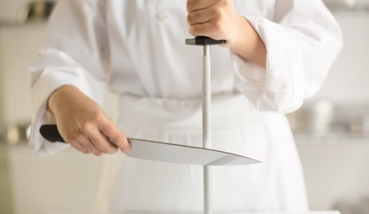
Knife Care
Honing:
Regular maintenance
Keeps knives sharp
Steel:
Long metal rod
Lightly grooved and magnetized
Remove microscopic burrs—dull knife
Knife returns to convex shape
Use daily
Notes:
Honing is the regular maintenance required to keep knives in the best shape. Chefs keep their knives sharp by using a steel and a sharpening stone. A steel
is a long metal rod that is lightly grooved and magnetized. It removes the microscopic burrs that are created as a knife is used. These burrs create drag,
dulling the slicing ability of the knife. The steel also helps to return the blade to the convex shape that exists on a sharp blade. This shape is flattened as the
knife is used. The steel should be used daily and before each cut to ensure the blade is at its best. Make sure to wipe your knife off after using the steel
to remove any microparticles of metal.

Slide 48
Types of Steel
Ceramic steel
Diamond steel
Honing steel
Slender ceramic rod
Ceramic and metal knives
Slender metal rod
Sometimes flattened
Diamond dust
Do not use ceramic knives
Short sword
Remove broken pieces
Realign remaining ground edges
Notes:
Ceramic steel
Slender ceramic rod embedded in a handle. It is used both on ceramic and metal knives to
hone sharpened knives.
Diamond steel
Slender metal rod, or sometimes flattened rod, that is impregnated with diamond dust. It should not be
used to hone ceramic knives. Because of the diamond material, it can produce an extremely sharp edge, as
does ceramic steel.
Honing steel
Shaped like a short sword with a round blade, it helps remove broken pieces and realign the remaining
ground edges.

Slide 49
Knife Care
Sharpening stone:
Grind and hone edges
Remove metal from blade
Use only when steel does not work
Knife held at 20-degree angle
Blade passes over oiled or watered stone
Equal number of times on each side
Notes:
A sharpening stone is used to grind and hone the edges of steel tools and implements. Sharpening removes metal from the blade, so it is only done when a knife is so dull
that it cannot be brought back to a sharp edge with the steel. The knife blade is held at a 20-degree angle to a sharpening stone. The blade is then passed across the oiled
or watered stone an equal number of times on each side until the desired sharpness is achieved. Often sharpening stone units hold three stones. These range from coarse to
very fine and allow the blade to be smoothed as the process is finished.

Slide 50
Knife care
Proper care and use guidelines:
Keep knives sharpened
Use only for intended purpose
Keep handle clean and dry
Do not soak knives in water
Never talk or point with a knife
Notes:
To properly care for and use knives, follow these guidelines:
• Keep knives sharpened. A sharp blade cuts more evenly and with less force than a dull blade, so it is safer.
• Use a knife only for its intended purpose.
• Keep the handle of the knife clean and dry.
• Never leave knives soaking in water. Clean the knife immediately and return it to its proper storage place.
• Never talk or point with a knife.

Slide 51
Knife care
Proper care and use guidelines:
Do not distract others using knives
Do not catch a falling knife
Store in knife kits, racks, or sheaths
Do not hand someone a knife
Notes:
• Never distract others who are using knives.
• If a knife is dropped, jump back and allow it to fall. Do not try to catch it.
• Store knives in knife kits, racks, or sheaths.
• Never hand someone a knife. Put the knife on the counter and let the other person pick it up.

Slide 52

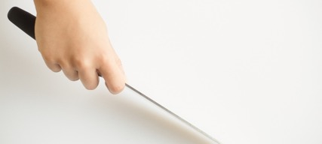
Knife basics
Use one hand to hold food
Other hand holds knife handle
Two basic knife grips
  Handle grip
  Blade grip
Notes:
When you start working with knives, you will likely find yourself cleaning and cutting raw foods. This is one of the first steps of mise en place. Fresh
vegetables, fruit, and meat often require trimming and cutting. To use most knives, hold the food on the cutting board with one hand and
hold the knife by its handle with the other. There are two basic knife grips—handle grip and blade grip.

Slide 53
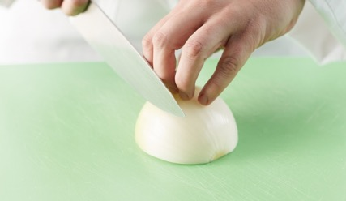
Knife basics
Guiding hand:
Hand not holding knife
Prevents slippage
Control the size of the cut
Claw grip:
Most acceptable
Bend fingers inward toward palm
Hold thumb well back
Notes:
In every grip, the hand that is not holding the knife, called the guiding hand, prevents slippage and helps to control the size of the cut. The claw grip is the
most acceptable. Bend the fingers of the guiding hand inward toward the palm, and hold the thumb well back. One finger should be the farthest forward with
the other fingers and thumb behind that finger. This allows a clear view while cutting. When using a knife, move the knife in a smooth downward and forward slicing motion.
With practice, a cook is able to cut food in many different ways, increase knife speed, and become more accurate with cuts.

Slide 54
Demonstrating Classical Knife Cuts
11 classical knife cuts
Take time
Use proper knife-skill techniques
Cutting board—flat and secure
Knife blade perpendicular to cutting board
Notes:
There are 11 classical knife cuts that all students should understand and be able to demonstrate. You will have to be patient because this
takes a lot of practice. You can practice these classical knife cuts using root vegetables such as turnips, rutabagas, carrots, or onions.
Make sure that you take your time and use proper knife-skill techniques. Your cutting board should be flat and secure on your table. A warped board
will cause the product to be uneven when cutting. Also, make sure that on each cut your knife blade is perpendicular to the cutting board (forming a 90-degree
angle). Tilting the blade either way, even by a few degrees, will cause your cut to be off and your product to be misshapen.

Slide 55
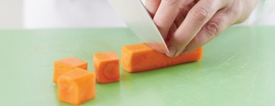
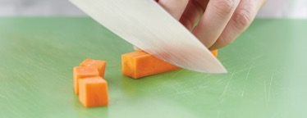
Classical Knife Cuts
Large dice
Medium dice
¾ inch x ¾ inch x ¾ inch
½ inch x ½ inch x ½ inch

Slide 56
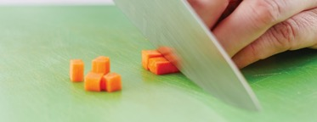
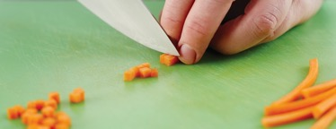
Classical Knife Cuts
Small dice
Brunoise
¼ inch x ¼ inch x ¼ inch
⅛ inch x ⅛ inch x ⅛ inch

Slide 57
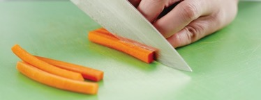
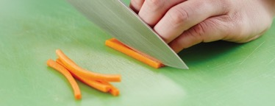
Classical Knife Cuts
Batonnet
Julienne
¼ inch x ¼ inch x 2 inches
⅛ inch x ⅛ inch x 2 inches

Slide 58
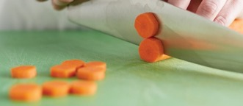
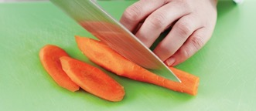
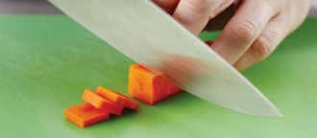
Classical Knife Cuts
Rondelle
Diagonal
Paysanne
¼-inch-thick slices
¼-inch-thick oval slices
½ inch x ½ inch x ⅛ inch

Slide 59
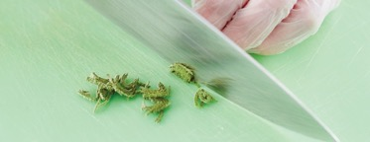
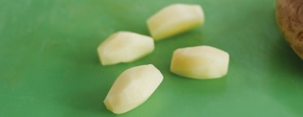
Classical Knife Cuts
Chiffonade
Tourné
Leafy vegetables stacked
Rolled tight
Cut into long strips
Approximately ⅛-inch wide
Football shaped
¾-inch diameter, 2 inches long, 7 equal sides, flat ended

