Slide 2
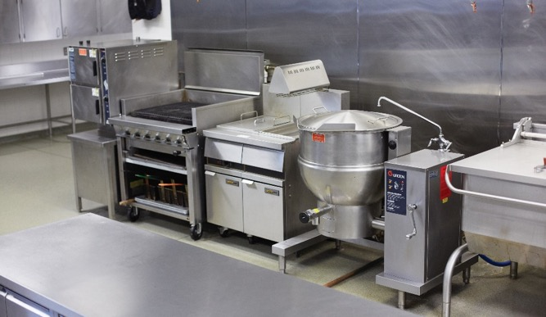
Workstations
Work area dedicated to particular task
Keep kitchen running smoothly
Number of workstations
  Budget
  Space
Work section
  Workstation grouped with similar equipment
Notes:
A foodservice kitchen has multiple workstations. A workstation is a work area in the kitchen dedicated to a particular task, such
as broiling or salad making. Workstations using the same or similar equipment for related tasks are grouped together into a work
section. Workstations help keep a kitchen running smoothly. Budget and space are the two major issues in determining the number
of workstations.

Slide 3
Workstations
Good kitchen design:
Maximize flow of goods and staff
Efficient work environment
Keep food safe
Reduce preparation and service time
Notes:
The guiding principle behind good kitchen design is to maximize the flow of goods and staff from one area to the next and within each area itself. Maximizing flow creates an efficient work environment, keeps food safe, and helps reduce preparation and service time.

Slide 4
Work sections and their Stations
Hot-food section:
Broiler station
Fry station
Griddle station
Sauté/sauce station
Holding

Slide 5
Work sections and their Stations
Garde-manger section:
Salad preparation
Cold-food preparation
Sandwich station
Showpiece preparation

Slide 6
Work sections and their Stations
Bakery section:
Mixing station
Dough holding and proofing
Dough rolling and forming
Baking and cooling
Finish cake decorating
Dessert preparation
Frozen-dessert preparation
Plating desserts

Slide 7
Work sections and their Stations
Banquet section:
Steam cooking
Dry-heat cooking (roasting, broiling)

Slide 8
Work sections and their Stations
Short-order section:
Holding and plating
Griddle station
Fry station
Broiler station

Slide 9
Work sections and their Stations
Beverage section:
Hot-beverage station
Cold-beverage station
Alcoholic-beverage station

Slide 10
Kitchen Brigade System
System of staffing a kitchen
Each worker is assigned specific tasks
  Related by cooking method, equipment, or type of food produced
Notes:
A brigade is a system of staffing a kitchen so that each worker is assigned a set of specific tasks. These tasks are often related by cooking method, equipment, or the types of food being produced. Over the years kitchens have changed and positions that used to be more common, such as a fish chef, are less common. As a result, there are fewer people available with those skills. Additionally, there has been an increase in new technology and equipment that has helped alleviate the need for some of those skilled workers. As a result, the modern kitchen brigade system has become smaller than it once was.

Slide 11
Modern Kitchen Brigade System
Chef:
All kitchen operations
Sous chef:
Second chef
Schedules personnel
Covers chef’s or station chef’s work
Accepts orders
Relays to stations
Reviews dishes
Notes:
The chef is responsible for all kitchen operations.
Also known as the second chef, the sous chef is responsible for scheduling personnel and covering
the chef’s or station chefs’ work as necessary, accepting orders from the dining room and relaying
them to various station chefs, and reviewing the dishes before service.

Slide 12
Modern Kitchen Brigade System
Station chef:
Produces menu items
Supervision of chef or sous chef
Assigned a specific task
Based on cooking method, equipment, or item category
Includes line cooks
Notes:
A station chef produces the menu items under the supervision of the chef or sous chef. Each station chef is assigned a specific task based on either the cooking method and equipment or the category of items to be produced—this also includes line cooks. Station chefs/cooks include the following:
• Sauté station chef
• Broiler station chef
• Cook I
• Cook II
• Cook III

Slide 13
Modern Kitchen Brigade System
Pastry chef:
Baked goods, desserts, pastries
Separate kitchen or section
Expediter:
Communicates orders
Checks that food cooked in correct order
Waitstaff serves food warm and ready
Notes:
A pastry chef produces all baked goods, desserts, and pastries. This chef might operate from a
separate section of the kitchen or a separate kitchen entirely.
The expediter communicates orders, makes sure the food is cooked in the right order and for all
parties at the table, and sees that servers run food to the table while it is warm and ready.

Slide 14
Dining-Room Brigade System
Dining-room manager:
Maître d’
Leads dining-room brigade
Trains all service personnel
Oversees wine selections
Develops menu with chef
Organizes seating chart
Seats guests
Notes:
Like the back-of-the-house staff, the front-of-the-house staff is also organized into a brigade. A traditional dining-room brigade is led by the dining-room manager (sometimes known as a maître d’), who generally trains all service personnel, oversees wine selections, sometimes works with the chef to develop the menu, organizes the seating chart, and seats the guests.

Slide 15
Dining-Room Brigade System
Wine steward:
Wine service
Purchases wines
Assists guests selecting wine
Serves wine
Headwaiter:
Service throughout dining room or section
Notes:
All posts noted in the dining-room brigade report to the dining room manager.
The wine steward is responsible for the wine service, including purchasing wines, assisting guests in selecting wines, and serving
the wines.
The headwaiter is responsible for service throughout the dining room or a section of it.

Slide 16
Dining-Room Brigade System
Captain:
Explains menu to guests
Takes orders
Table-side preparations
Front waiter:
Tables set properly for each course
Food orders delivered to correct tables
Needs of guests met
Back waiter:
Clears plates
Refills water glasses
Other general tasks
Notes:
The captain is responsible for explaining the menu to guests and taking their orders. The captain is also responsible for any
table-side preparations.
The front waiter is responsible for assuring that the tables are set properly for each course, food orders are delivered properly to the correct tables, and the needs of the guests are met.
The back waiter is responsible for clearing plates, refilling water glasses, and other general tasks appropriate for new
dining-room workers.
Depending on the nature and size of the restaurant or foodservice operation and the type of service provided, an operation may employ some or all of these positions.

Slide 17
Mise en Place
Getting ready to work
French for “to put in place”
Preparation and assembly of
  Ingredients
  Pans
  Utensils
  Equipment
  Serving pieces
Preparation of dish
Setup before
Cleaning while preparing
Notes:
Once you have your staff trained and your kitchen set up, you are ready to cook. In the restaurant and foodservice industry, getting ready to cook is called mise en place. Mise en place (MEEZ ehn plahs) is French for “to put in place.” It refers to the preparation and assembly of ingredients, pans, utensils, equipment, or serving pieces needed for a particular dish or service. It includes not only the production of a dish, but also the setup before and cleaning while preparing.

Slide 18
Mise en Place
Mise en place solves two problems:
Plan and prepare before service
  Everything runs smoothly
Food items made at proper time
  Ensures quality levels are maintained
Notes:
Mise en place solves the two basic problems facing the professional chef:
Problem #1: There is too much work to do in a kitchen to leave everything until the last minute. Some work must be done ahead of time. Therefore, you should plan and prepare as much as possible before service to ensure it runs smoothly.
Problem #2: Most food items are at their best quality immediately after preparation. They deteriorate as they are held, and they begin to lose their nutritional value. Food items need to be made at a proper time to ensure that quality levels are maintained.
There is only one way to solve these problems—plan ahead.

Slide 19
Planning Ahead
Identify each ingredient and equipment
Write a timeline
Assemble the workstation, tools, and ingredients
Perform advance preparation
Balance working quickly and high-quality food
Clean station
Improvements?
Notes:
Identify each ingredient and piece of equipment needed to prepare, finish, and hold each menu item for service. Do this the night before when possible.
Write a timeline showing what activities should be done in what order. See Figure 13.2. Make sure to note all steps, including washing vegetables or even prepping certain food items the night before.
Assemble the workstation (cutting board, containers, etc.), tools, and ingredients.
Perform advance preparation consistent with providing the best possible product to guests. As each item is finished, label it and store it appropriately to prevent time-temperature abuse, nutrient loss, and moisture loss.
Once service begins, balance the need to work quickly with the need to prepare safe, delicious, and high-quality food for guests.
After service, clean the station and store any leftover food as quickly as possible, observing food safety rules.
Consider what went well during preparation and service. What could have been done better? How could the work have
been streamlined?
Think about these issues when preparing for the next day’s work.

Slide 20
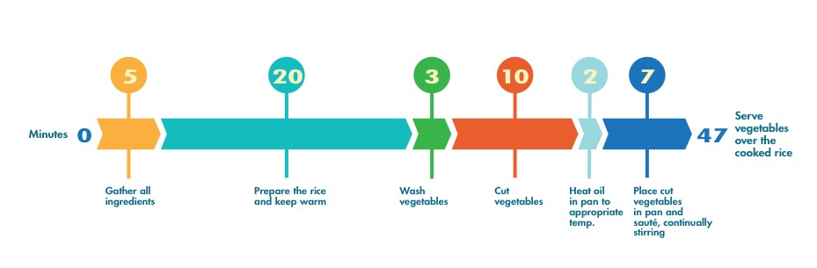
Timetable for vegetable stir-fry

Slide 21
Mise en Place
Steps of pre-preparation:
Assemble tools
Assemble ingredients
Wash, trim, cut, prepare, and measure ingredients
Prepare equipment
Notes:
The goal of pre-preparation is to do as much of the work as possible in advance without any loss in ingredient quality. The steps to pre-preparation include the following:
• Assemble the tools.
• Assemble the ingredients.
• Wash, trim, cut, prepare, and measure the ingredients.
• Prepare the equipment (preheat oven, line baking sheets, etc.).

Slide 22
Mise en Place
Elements of mise en place:
Knife cuts
Flavorings
Herbs and spices
Basic preparations
Building blocks of chef training
Essential throughout career
Notes:
The basic elements of mise en place—knife cuts, flavorings, herbs and spices, and basic preparations—are the building blocks of a professional chef’s training. These methods and techniques will be essential throughout a professional career in the industry.

Slide 23
Seasoning and Flavor
Seasoning:
Enhances flavor
Does not change flavor of dish
Prevent overuse
Add at the beginning
Create depth of flavor
Notes:
A seasoning is something that enhances the flavor of an item without changing the primary flavor of the dish. Seasonings must
be used with care to prevent overuse, but they generally should be added at the start of the dish to create a depth of flavor.

Slide 24
Basic Seasonings
Salts
  Kosher
  Iodized/table salt
Peppers
  Black pepper
  Red pepper flakes
Sugars
  Granulated sugar
  Powdered sugar
Acids
  Vinegar
  Wine
Notes:
There are four basic types of seasoning ingredients.
Salts: Kosher, iodized/table salt, pink Himalayan salt, sea salt, rock salt, coarse grinding salt, black salt
Peppers: Black pepper, white pepper, pink peppercorns, red pepper flakes, green peppercorns, Tellicherry pepper
Sugars: Granulated sugar, powdered sugar, brown sugar, sugar in the raw, sanding sugar, honey, molasses, dextrose, sucrose, lactose
Acids: Citric acid (lemon, orange, lime), wine, vinegar, lactic acid

Slide 25
Seasoning and Flavor
Flavor:
Way food tastes
Flavoring:
Enhance base ingredients
Bring another flavor to product
Notes:
Flavor refers to the way a food tastes. A flavoring should enhance the base ingredients of the dish or bring another flavor to the product. For example, the addition of a small amount of onion to a consommé (a clear soup made from richly-seasoned stock) enhances the flavor without changing it, but the addition of a large quantity of onion introduces an onion flavor to the dish.

Slide 26
Seasoning and Flavor
Flavorings that change the taste of original food:
Herbs
Spices
Extracts
Fruits and vegetables
Aromatic liquids
Cured food
Notes:
There are many types of flavorings that have the capability to change the taste of the original food product:
• Herbs
• Spices
• Extracts
• Fruits and vegetables
• Aromatic liquids (examples include stock, beer, and tea)
• Cured food (often salt, sugar, and nitrates or nitrites are used to cure food)
So what is the difference between seasoning and flavoring? If a cook adds a small amount of salt to the water used to cook pasta, the pasta will simply taste like cooked pasta. That means it has been properly seasoned. However, if the cook adds a lot of salt, the cooked pasta will take on the distinct and easy-to-identify flavor of salt. Salt has become a flavoring in the dish, not a seasoning.

Slide 27
Herbs and Spices
Enhance and add flavor
Herbs—leaves, stems, or flowers of aromatic plant
Spices—bark, roots, seeds, buds, or berries of aromatic plant
Can be used together
  New and exciting flavor combinations
Notes:
Herbs and spices are important ingredients used to enhance and add to the flavor of food. Herbs (URBS) are the leaves, stems, or flowers of an aromatic plant. Spices are the bark, roots, seeds, buds, or berries of an aromatic plant.
Each herb or spice used in a recipe contributes its own distinct flavor to a finished dish, and several of them can be used together to create new and exciting flavor combinations.
Strong, flavorful spices and herbs such as pepper, cumin, basil, and oregano, or spice blends like curry powder, fines herbes, and Chinese five-spice powder, can often be used to reduce the amount of salt in recipes.

Slide 28
Herbs and Spices
Herbs:
Fresh
  Add fresh herbs at the end of cooking
  Use 2 to 3 times more than dried
Dried
  Much stronger
  Lightly crumble or grind—releases flavor
Notes:
Herbs are available fresh or dried. Dried herbs are much stronger than fresh herbs because the herbs’ flavorful oils are concentrated during the drying process. When using dried herbs, lightly crumble or grind them before adding them to a dish. This releases their flavor. When using fresh herbs in place of dry, use two to three times the amount called for in the recipe. Always add fresh herbs toward the end of the cooking process to retain their delicate flavors. It is common to use both dried and fresh herbs in the same dish.

Slide 29
Herbs and Spices
Spices:
Dried form
Whole
  Add early during cooking
Cut or ground
  Toast to enhance flavor
  Add later during cooking
Notes:
Cooks use spices most often in their dried form. They can be purchased whole or ground. Whole spices should be added early during cooking to allow their flavors to carry throughout the food. Cut or ground spices can be toasted to enhance their natural flavors and then added later in the cooking process.

Slide 30
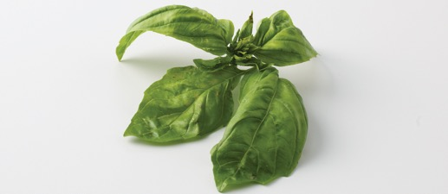
Common Herbs Used in Cuisine
Basil
Bay leaves
Chives
Italian, Mediterranean, American
Turkish, Mediterranean, North American, Indian
Central Asian, Central European

Slide 31

Common Herbs Used in Cuisine
Cilantro
Dill
Lavender
Latin American
Northern European, North American
French, North American

Slide 32
Common Herbs Used in Cuisine
Lemon grass
Marjoram
Mint leaves
Asian, Thai, Malaysian, Vietnamese
Mediterranean, North American,
Western Asian
Northern Mediterranean
(Morocco, North Africa, Turkey)

Slide 33
Common Herbs Used in Cuisine
Oregano
Parsley
Rosemary
Mediterranean, Italian, Mexican
All cuisines
Mediterranean

Slide 34
Common Herbs Used in Cuisine
Sage
Savory
European, Croatian, North American
European, North African, Mediterranean

Slide 35
Common Herbs Used in Cuisine
Tarragon
Thyme
European (French), Mexican
European, African, North American

Slide 36
Common Spices Used in Cuisine
Allspice
Anise
Capers
Jamaican, Caribbean, tropical South American
Turkish, Spanish, Egyptian,
Mediterranean, Central American
Mediterranean

Slide 37
Common Spices Used in Cuisine
Caraway
Cardamom
Cayenne
Dutch, Canadian, Russian
Indian, Asian, Guatemalan
Central American, South American, Mexican, Southwest American

Slide 38
Common Spices Used in Cuisine
Chili pepper
Cinnamon
Cloves
Central American, South American, Mexican, Southwest American, Caribbean, Indian
Indian, French, Indonesian, Asian, Caribbean, Mexican,
Central American
Asian, Sri Lankan, Indian, European, North American

Slide 39
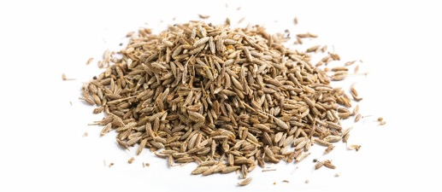
Common Spices Used in Cuisine
Coriander
Cumin
Fennel
European, Indian, Canadian, Egyptian, Vietnamese
Indian, Middle Eastern, African, Mexican
Southern European, Italian, Mediterranean

Slide 40
Common Spices Used in Cuisine
Ginger
Mace
Mustard seeds
Chinese, Indian, Jamaican
Indonesian, Caribbean, French
Asian, Indian, Northern European, French

Slide 41
Common Spices Used in Cuisine
Nutmeg
Paprika
Peppercorns
Indonesian, French
South American, Hungarian, Spanish
All cuisines

Slide 42
Common Spices Used in Cuisine
Poppy seeds
Saffron
Star anise
Indian, Turkish, Dutch, Eastern European, North American, Southeast Asian
Asian, Indian, Spanish, Mexican
Chinese, Vietnamese, Laotian

Slide 43
Common Spices Used in Cuisine
Sesame seeds
Turmeric
Vanilla bean
African, Mexican, Chinese, Indonesian
Eastern Asian, Indian, Caribbean
Mexican, Central American, African

Slide 44
Herbs and Spices
Store properly—fresh and flavorful
Heat, light, air—speed up loss of flavor
Storage
  Tight, glass jar
  Covered cabinet, drawer, or pantry
  Away from heat or light
  Do not store near stoves, dishwashers, sinks, or air ducts
Notes:
Storing spices and herbs properly helps to keep them fresh and flavorful. Heat, light, and air all speed the loss of flavor and color. A tight glass jar in a covered cabinet, drawer, or pantry away from any heat or light source is the best protection for dried herbs and spices. Avoid storing them close to stoves, dishwashers, sinks, or air ducts. If the spice rack is open, make sure to locate it away from direct sunlight.

Slide 45
Herbs and Spices
Dominant herbs and spices
Overpower flavor of dish
  Rosemary
  Cinnamon
  Cardamom
  Paprika
Build layers of flavor
Add at various stages of cooking
Check seasoning
  Adjust as final step
Notes:
There are herbs and spices that must be used carefully because their dominant flavors can overpower the flavor of the dish. Rosemary, cinnamon, cardamom, and paprika are examples of herbs and spices that must be used with caution.
The key to using herbs and spices is to build layers of flavor by adding items at various stages of cooking so that they are at their peak when the dish is served. Seasoning should always be checked and adjusted as the final step in completing the dish.

Slide 46
Pre-Preparation Techniques
Refine certain ingredients for preparation:
Clarifying butter
Setting up water bath
Separating eggs
Whipping egg whites
Parchment paper liners
Mise en place
Notes:
Certain ingredients need to be refined before they are ready for use at the time of preparation. Some of the cooking techniques used in pre-preparation include clarifying butter, setting up a water bath, separating eggs, whipping egg whites, and making parchment liners for pans. Pre-preparation techniques also include mise en place—examples of which include cleaning and cutting vegetables for dishes to be cooked that day.

Slide 47
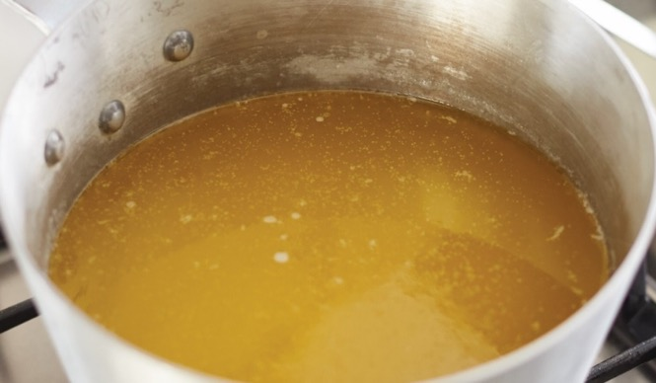
Clarified Butter
Removing milk proteins from fat
“Clarify” fat for use
Milk proteins brown when exposed to high heat
Used for sautéing
Does not require undo browning
Notes:
Clarified butter is used for sautéing when the desired end product does not require undo browning. Milk proteins tend to brown when exposed to high heat. Clarified butter is the result of separating and removing the milk proteins from the fat to “clarify” the fat for use.

Slide 48
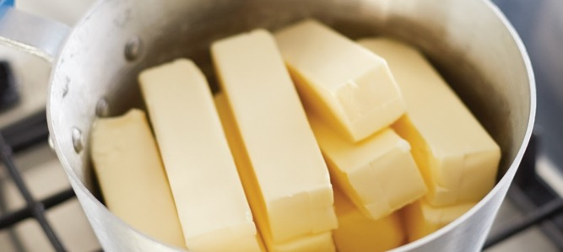
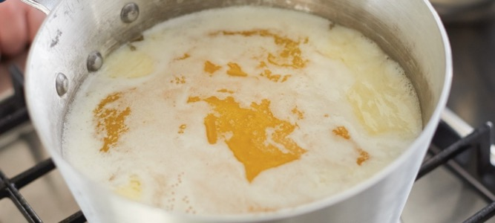
Clarified Butter
Prepare a pound of butter and a small stockpot
Melt butter over low flame
  Do not stir
Notes:
Prepare a pound of butter and a small stockpot.
Over a low flame, gently melt the butter without disturbing it (no stirring), so it melts completely.

Slide 49
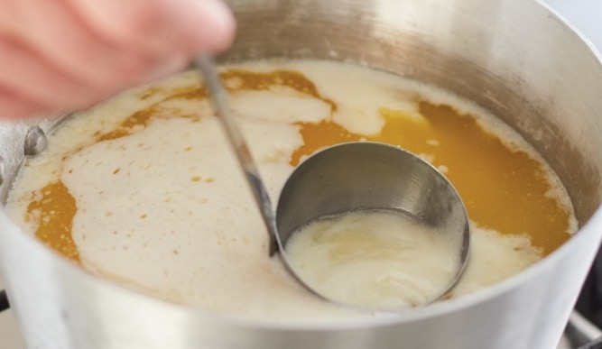
Clarified Butter
Ladle off white liquid foam
Discard milk proteins
Properly store and label
Notes:
Ladle off the white liquid foam. Then ladle off the desired butterfat from the watery bottom portion, which is the milk proteins.
Discard the milk proteins.
Properly store and label the clarified butter.

Slide 50
Setting Up a Water Bath
Water bath:
Gently cook baked goods
Oven heat absorbed by water
Gently transferred to product
Uniform heating process
Prevents hot spots
Notes:
A water bath is used to gently cook softer baked goods such as custards and cheesecakes. By placing a product in a water bath,
the oven heat is absorbed by the water and gently transferred to the product. This provides a more uniform heating process and
prevents hot spots.

Slide 51
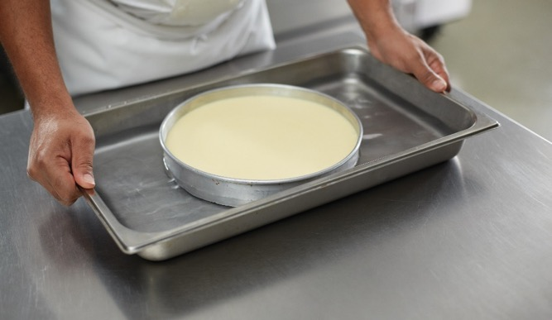
Setting Up a Water Bath
Prepare item for cooking
  Ensure pan is watertight (springfoam)
Place in appropriate-size hotel pan.
  Add enough water—⅔ side of item’s pan
  Two-inch space on each side
Place hotel pan in oven
Notes:
Prepare your item for cooking. If using a springform pan, ensure that it is watertight.
Place your item into an appropriate-size hotel pan. Add enough water to cover up to two-thirds of the sides of the item’s pan. Also ensure that there is two inches of space between the item and the sides of the hotel pan. Make sure the hotel pan is not too big; for example, a small terrine can be placed in a half hotel pan instead of a full one.
Place the hotel pan in the oven.

Slide 52
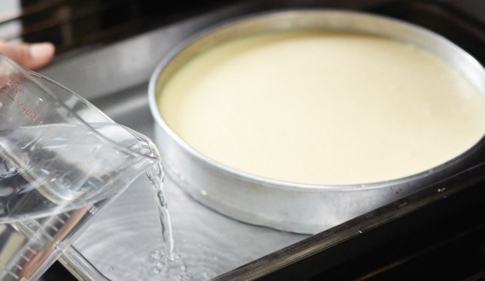
Setting Up a Water Bath
Pour warm water in hotel pan
  Do not overfill
Check water level
  Add more if needed
Be careful removing from oven.
Notes:
Pour warm water into the hotel pan while it is in the oven until the water comes up to the height of the sides of the item being cooked. Do not overfill.
During baking, make sure the water level is adequate and does not drop significantly. Add more if necessary.
When removing from the oven, take care to ensure the water does not spill on you.

Slide 53
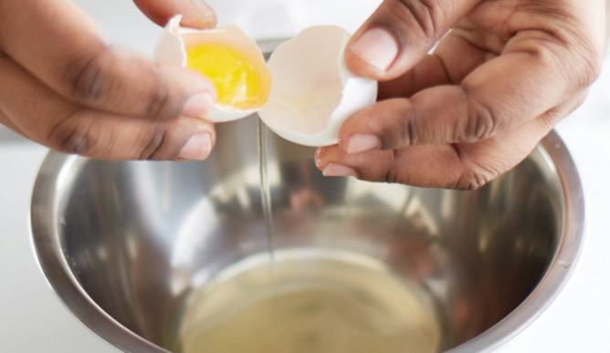
Separating Eggs
Two containers and one small bowl
Crack open egg over bowl
Transfer egg back and forth
  Let white drop into bowl
Place yolk in one container
Inspect egg white
  Transfer to egg white container
Notes:
Use two containers and a small bowl.
Crack open the egg over the bowl.
Transfer the egg back and forth between the halves of the shell, letting the white drop into the bowl.
Place the yolk in one of the containers.
Inspect the egg white. If there are any traces of yolk present, reserve it for use in other preparations. If the white is clean, transfer it to the container for egg whites.
Note: It is necessary to separate eggs when a recipe calls for only raw egg yolks or egg whites.

Slide 54
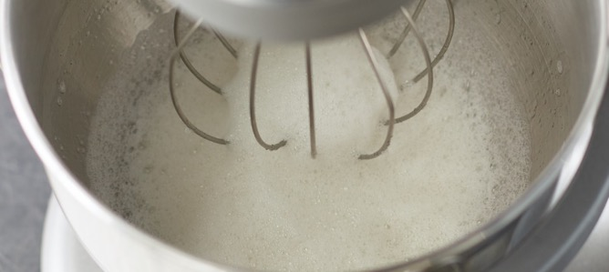
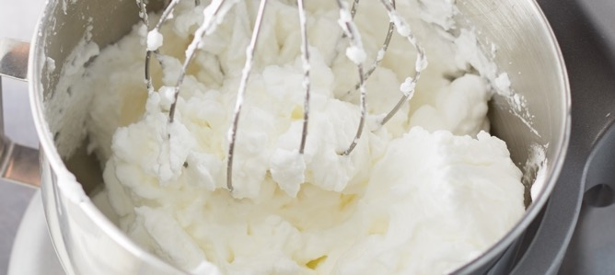
Whipping Egg Whites
Clean mixing bowl and whisk
  No oil residue
Whip at moderate speed
When foamy, increase speed
Whip to appropriate stage
  Do not overbeat eggs
  Overbeaten eggs—surface dry
Notes:
Thoroughly clean the mixing bowl and the whisk. Oil residue will reduce the volume of the whipped egg whites.
Begin whipping the egg whites by hand or machine at a moderate speed. Tilt the bowl to make whipping by hand easier, resting the bowl on a folded towel to prevent it from slipping. To add more volume and give the foam greater stability, add a small amount of lemon juice or cream of tartar.
When the whites are quite foamy, increase the speed of the mixer (or your hand whipping).
Whip to the appropriate stage. Never overbeat egg whites. Overbeaten egg whites may resemble those at the stiff-peak stage, but their surface looks dry.

Slide 55
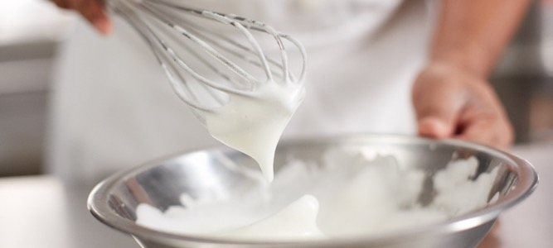
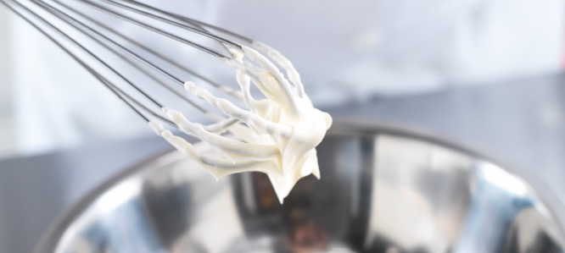
Whipping Egg Whites
Soft peak
  Droopy, rounded peak
Medium peak
  Moist surface
  Rounded, stable peak
Stiff peak
  Stiff, stable peak
  Moist and glossy
Notes:
• At soft peak, whipped egg whites have a droopy, rounded peak.
• A t medium peak, whipped egg whites have a moist surface and form a rounded, but fairly stable, peak.
• A t stiff peak, the whipped egg whites have stiff, stable peaks. Stop beating while the surface is still moist and glossy.
Note: The method for whipping cream is the same as that for whipping egg whites. The cream should be cold when whipped. Clean and chill both the bowl and beaters in advance to give the whipped cream more volume.

Slide 56
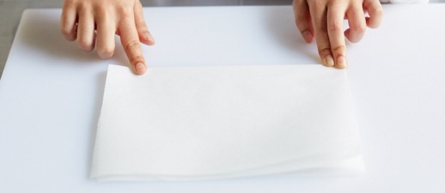
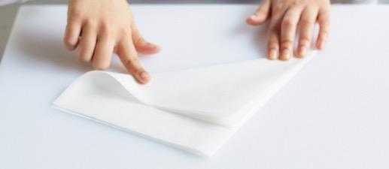
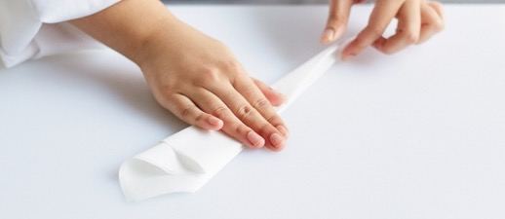
Making a Parchment Liner for a Round Pan
Cut bigger than pan’s diameter
Fold in half to form a triangle
Continue folding triangle in half
Notes:
Parchment paper is often used to line pans to prevent food from sticking to them. In addition, it is also used to make a cartouche,
which covers the surface of a stew, soup, stock, or sauce to reduce evaporation, to prevent a skin from forming, and/or to keep components submerged.
Cut a piece of parchment paper a little larger than the pan’s diameter.
Fold the rectangular piece of parchment paper in half to form a triangle. There may be extra paper at one edge of the triangle.
Continue folding the triangle in half in the same direction—kind of like making a paper airplane—until a long, thin triangle is formed.

Slide 57
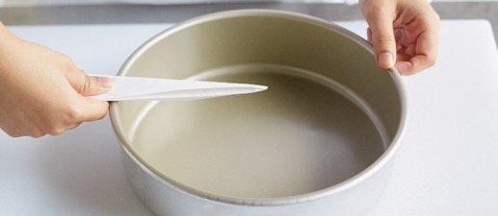
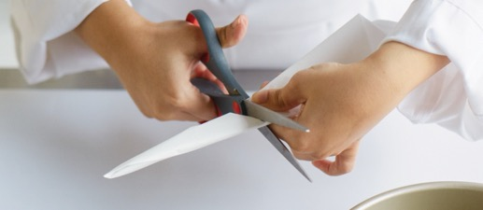
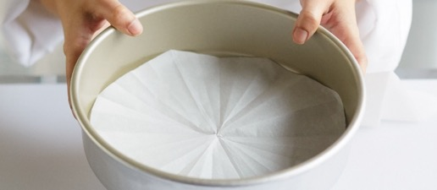
Making a Parchment Liner for a Round Pan
Position narrow end above pan’s center
Cut portion that extends beyond pan’s edge
Unfold and flatten in pan
Notes:
Position the triangle’s narrow end above the pan’s center.
Cut away the part that extends beyond the edge of the pan.
Unfold the triangle and flatten it into the pan.

Slide 58
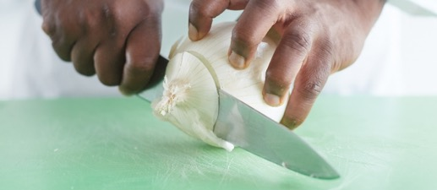
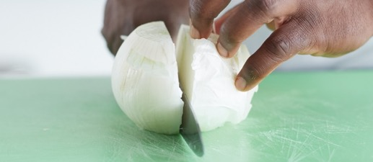
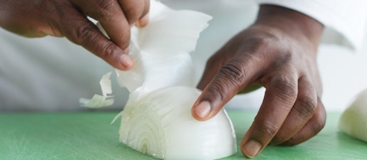
Peeling and Dicing an Onion
Hold onion on its side
  Slice off top and bottom
Stand onion upright
  Slice in half vertically
Peel each half
Notes:
One of the most common tasks in a kitchen is preparing onions. Peeling and dicing an onion can be a lot of work, but it is simplified by using the following steps:
Holding the onion on its side, slice off its top and bottom, taking care not to remove too much of the root end, otherwise the onion will fall apart.
Stand the onion upright (root end down) and slice it in half vertically.
Peel each half, discarding the peels.

Slide 59
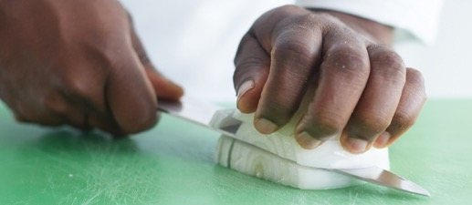
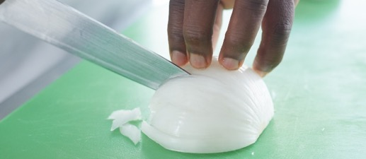
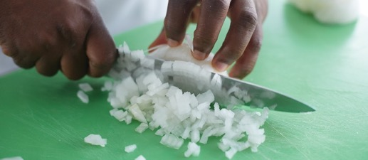
Peeling and Dicing an Onion
Place onion curved side up
  Make horizontal cuts
  Do not slice through root
Make vertical cuts
  Do not cut through root
Slice across onion to form a dice
Notes:
With the half onion sitting curved side up, carefully make a number of horizontal cuts in the onion, taking care not to slice completely through the onion’s root end; the number of cuts depends upon the size of the dice required.
Make a number of vertical cuts through the onion at right angles to the original cuts without cutting through the onion’s root end; the number of cuts again depends upon the size of the dice required.
Slice across the onion to form dice. Repeat steps 4–6 with the other onion half.

Slide 60
Nutrition Labels
Nutrition facts label:
Information on what dishes contain
Helps people:
Avoid food allergens
Plan special diets
Understand nutrient amounts
Notes:
As a cook, you will work with both fresh and prepared ingredients. Once you plan your own menus, you will be expected to provide information on what your dishes contain. The standard format for all of this is the nutrition facts label. Learning how to read and use nutrition information from a nutrition facts label can help people to do the following:
• Avoid food allergens
• Plan special diets
• Understand the amount of fat, cholesterol, sodium, carbohydrates, fiber, sugars, and proteins included in each item

Slide 61
Nutrition Labels
Percentage daily value (DV):
Nutrients reported as a percentage
Based on 2,000-calorie diet
Notes:
Each nutrient on the label is reported as a percentage of daily value (DV). The DVs are based on a 2,000-calorie daily diet. Providing percentages of DVs on the label helps people see how different types of food contribute to their overall daily diets. Figure 13.9 is an example of a nutrition facts label.

Slide 62
Nutrition Labels
Certain nutrient content required
Order represents priority of dietary recommendations
Notes:
The FDA requires a nutrition facts label to contain certain nutrient information because these nutrients address current health concerns. The order in which the nutrients must appear reflects the current priority of dietary recommendations.

Slide 63
Nutrition Labels
Serving size and servings per container:
Serving size
  Basis for reporting each food’s nutrient content
  Amount of food eaten at one time
Servings per container
  Servings within package
  Size influences calories and nutrient amounts
Notes:
Serving size and servings per container: The serving size is the basis for reporting each food’s nutrient content and is defined as the amount of food customarily eaten at one time for each food category. The servings per container reflect how many servings are contained within the package. The size of the serving on the food package influences the number of calories and all the nutrient amounts listed on the top part of the label.

Slide 64
Nutrition Labels
Total calories:
Caloric content of one serving
Total fat and saturated fat:
Total grams of fat in one serving
Total grams of saturated fat in one serving
Trans fat:
Total grams of trans-fatty acid (trans fat) in one serving
Negative effect on cholesterol and heart
Notes:
Serving size and servings per container: The serving size is the basis for reporting each food’s nutrient content and is defined as the amount of food customarily eaten at one time for each food category. The servings per container reflect how many servings are contained within the package. The size of the serving on the food package influences the number of calories and all the nutrient amounts listed on the top part of the label.
Total calories: The caloric content of one serving.
Total fat and saturated fat: The total grams of fat in one serving and the number of grams of saturated fat in one serving (included under grams of total fat per serving) are listed.

Slide 65
Nutrition Labels
Cholesterol:
Percentage of daily value—300 milligrams
Sodium:
Percentage of daily value—2,400 milligrams
Sodium and chloride
Notes:
Cholesterol: Cholesterol is listed in milligrams, and the percentage of daily value is based not on calories, but on a daily recommendation of 300 milligrams or less.
Sodium: Sodium is listed in milligrams with a percentage of daily value based on a daily recommendation of 2,400 milligrams or less.
Salt contains sodium and chloride.

Slide 66
Nutrition Labels
Notes:
Salt and its sodium equivalents.

Slide 67
Nutrition Labels
Total carbohydrate, dietary fiber, and sugars:
Fiber and sugar = food’s total carbohydrate content
Percent of fiber—daily recommendation of 25 grams
Decrease cholesterol
Aids in digestion
Protein:
Total grams in one serving
Vitamin D, calcium, iron, and potassium:
People usually do not get enough
Higher risk of chronic health problems
Notes:
Total carbohydrate, dietary fiber, and sugars: Dietary fiber and sugars are included in a food’s total carbohydrate content.
The percentage of dietary fiber is based on a daily recommendation of 25 grams. This has been associated with decreasing
cholesterol and aiding in food transport through the digestive tract.
Protein: The total grams of protein in one serving is listed.
Vitamin D, calcium, iron, and potassium: The FDA requires the label to list vitamin D and the minerals calcium, iron, and
potassium because they have identified that people generally do not get enough of these and are therefore at higher risk
of chronic health problems.

