Slide 2
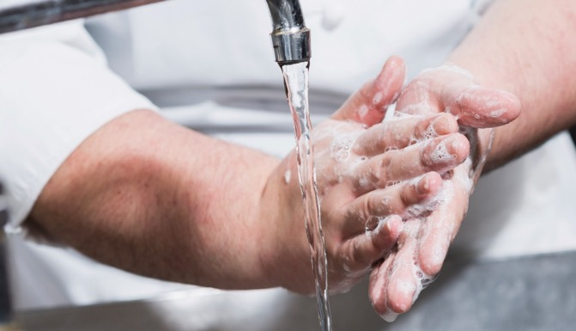
How to Prevent Food Handlers from Contaminating Food
Food handlers
  Cooks
  Servers
  Dish washer
Handle food directly
Touch food surfaces
Notes:
Food handlers are not just the people who prepare food. Servers and even dish washers are considered food handlers. They either handle food directly
or work with the surfaces that the food will touch.

Slide 3
How to Prevent Food Handlers from Contaminating Food
Situations that lead to contaminating food:
Foodborne illness
Exposed, infected wounds
Contact with sick person
Touching body, face, or hair
Notes:
Unfortunately, there are a variety of situations in which food handlers can contaminate food. They can contaminate food when they:
• Have a foodborne illness
• Have exposed wounds that are infected
• Have contact with a person who is sick
• Touch their hair, faces, or bodies and then do not wash their hands

Slide 4
How to Prevent Food Handlers from Contaminating Food
Situations that lead to contaminating food:
Contaminated hands
Diarrhea
Vomiting
Jaundice
Eating, drinking, smoking, chewing gum or tobacco
Blood
Notes:
• Touch anything that may contaminate their hands and then do not wash them
• Have symptoms such as diarrhea, vomiting, or jaundice (a yellowing of the eyes or skin)
• Eat, drink, smoke, or chew gum or tobacco while preparing or serving food
• Touch anything that has come into contact with human blood
To prevent food handlers from contaminating food, managers must create personal hygiene policies. These policies must address personal cleanliness,
clothing, hand care, and health.

Slide 5
Personal Cleanliness and Work Attire
Good first impression
Personal hygiene
Pathogens on hair and skin
Transferred to food and equipment
Bathe or shower before work
Keep hair clean
Notes:
Personal cleanliness is not just important for giving guests a good impression. It is an important part of personal hygiene as well. Pathogens can be found on
hair and skin that are not kept clean. These pathogens can be transferred to food and food equipment, contaminating that food and equipment. All food
handlers must bathe or shower before work and keep their hair clean.

Slide 6
Personal Cleanliness and Work Attire
Dirty clothing:
Makes bad impression
Carries pathogens
Causes foodborne illness
Notes:
Personal cleanliness is not just important for giving guests a good impression. It is an important part of personal hygiene as well. Pathogens can be found on
hair and skin that are not kept clean. These pathogens can be transferred to food and food equipment, contaminating that food and equipment. All food
handlers must bathe or shower before work and keep their hair clean.

Slide 7
Personal Cleanliness and Work Attire
Prevent spread of foodborne illness:
Wear hair covering
Wear clean clothing
Remove aprons
Remove jewelry
Notes:
The following are guidelines designed to prevent food handlers from spreading foodborne illnesses:
Food handlers should always cover their hair. Tie long hair back. Wear a clean hat or other hair covering. Figure 7.1 shows a food handler
wearing a hat.
Wear clean clothing every day. This includes chef coats and uniforms.
Remove aprons when leaving prep areas; for example, when taking out garbage or using the restroom. Change any apron that becomes dirty.
Remove jewelry from hands and arms before preparing food or when working around prep areas. Do not wear watches, bracelets (including
medical bracelets), or rings, except for a plain metal band.

Slide 8
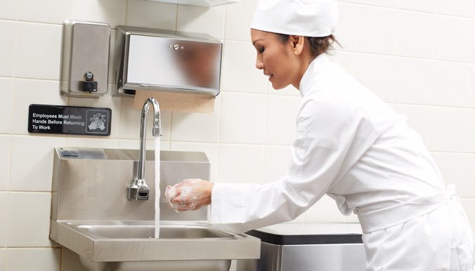
Handwashing
Wash hands before work
Wash hands after
  Using the restroom
  Handling raw meat, poultry, seafood
  Touching hair, face, body
  Sneezing, coughing, using a tissue
  Eating, drinking, smoking, or chewing gum or tobacco
Notes:
Handwashing is the most important part of personal hygiene. It may seem like an obvious thing to do, but many food handlers do not wash their hands
correctly or as often as they should.
Food handlers must wash their hands before they start work. They must also wash their hands after the activities listed.

Slide 9

Handwashing
Wash hands after:
Handling chemicals
Taking out garbage
Clearing tables or busing dirty dishes
Touching clothing or aprons
Handling money
Using a phone
Touching a contaminated surface
Notes:
Food handlers must wash their hands after handling chemicals that might affect food safety, as well as after touching
anything else that may contaminate hands, such as dirty equipment, work surfaces, or towels.

Slide 10
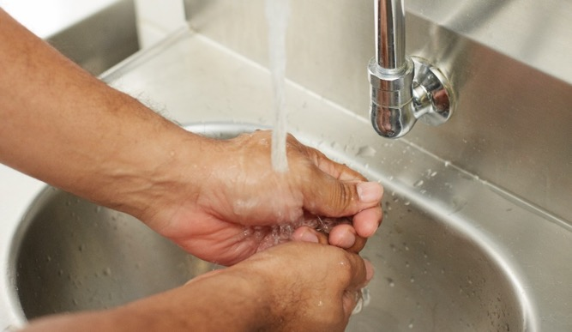
Steps for Correct Handwashing
Step 1:
Wet hands and arms
Use running water
As hot as you can comfortably stand
Notes:
Wet hands and arms with running water as hot as you can comfortably stand (at least 100°F [38°C]).

Slide 11
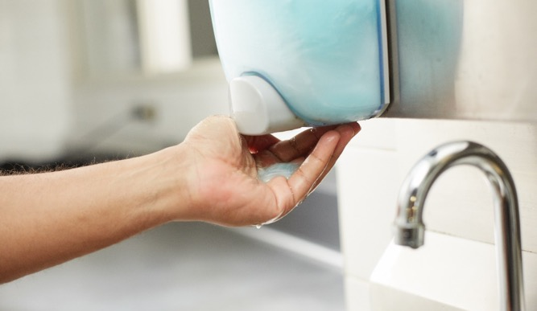
Steps for Correct Handwashing
Step 2:
Apply soap
Enough to build a lather
Notes:
Apply soap. Apply enough to build up a good lather.

Slide 12
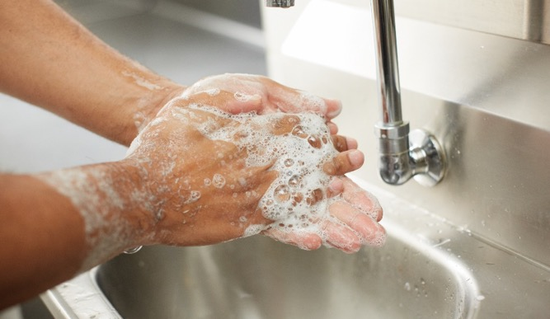
Steps for Correct Handwashing
Step 3:
Scrub hands and arms
Vigorously for 10–15 seconds
Clean under fingernails
Clean between fingers
Notes:
Scrub hands and arms vigorously for 10–15 seconds, cleaning under fingernails and between fingers.

Slide 13
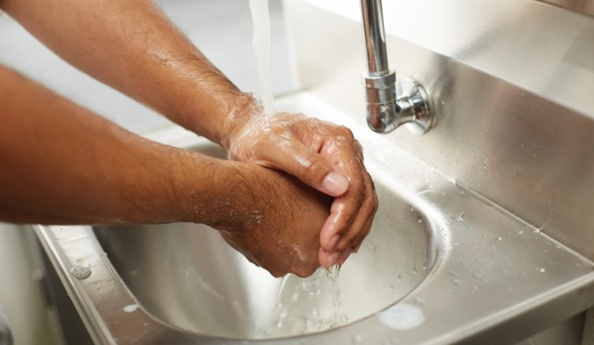
Steps for Correct Handwashing
Step 4:
Rinse hands and arms
Under running water
Notes:
Rinse hands and arms thoroughly under running water.

Slide 14
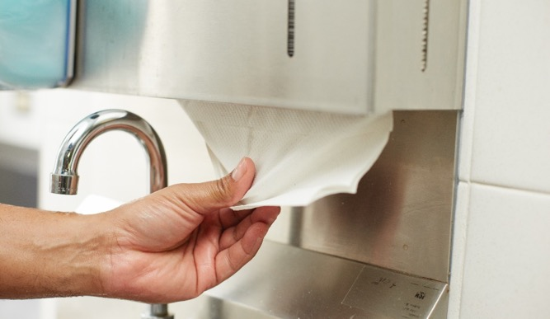
Steps for Correct Handwashing
Step 5:
Dry hands and arms
Single-use paper towel
Warm-air hand dryer
Notes:
Dry hands and arms with a single-use paper towel or warm-air hand dryer.

Slide 15
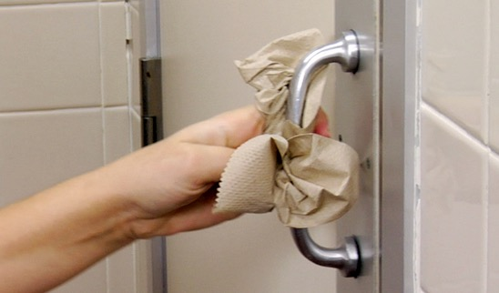
Handwashing
Whole process—20 seconds
Designated hand sink
Use a paper towel to
  Turn off faucet
  Open restroom door
Notes:
The whole process should take about 20 seconds. Food handlers should wash their hands only in a designated handwashing sink.
When you are done washing your hands, you can use a paper towel to turn off the faucet and to open the door when leaving the restroom.
This can prevent hands from becoming contaminated.

Slide 16
Hand Maintenance
Keep fingernails short and clean
Long fingernails difficult to clean
Notes:
Besides handwashing, hands need additional care to prevent the spread of pathogens.

Slide 17
Hand Maintenance
Do not wear false nails
  Break off into food
  Difficult to clean
Notes:
Do not wear false nails. They can break off into food and are difficult to keep clean.

Slide 18
Hand Maintenance
Do not wear nail polish
  Hides dirt
  Flakes off
Notes:
Do not wear nail polish. It can hide dirt under nails and flake off into food.

Slide 19
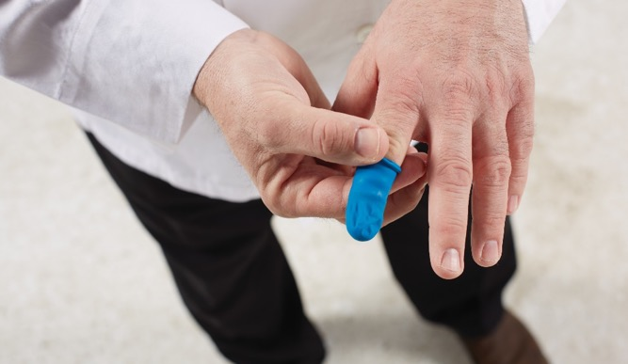
Hand Maintenance
Hand and arm wounds
  Bandage
  Keep wound from leaking
Hand or finger wounds
  Single-use glove
  Finger cot
  Protect bandage
Notes:
Wear a bandage over wounds on hands and arms. Make sure it keeps the wound from leaking. Also wear
a single-use glove or a finger cot (a finger cover) over bandages on hands or fingers. These will protect the
bandage and keep it from falling off into food.

Slide 20
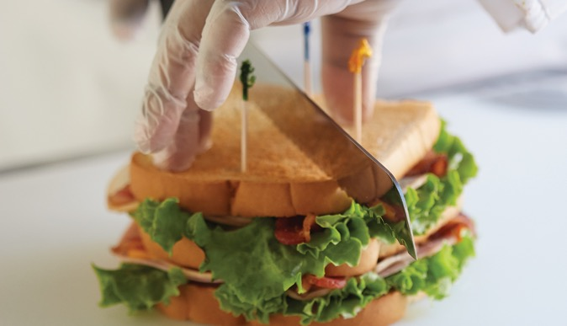
Bare-Hand Contact with Ready-to-Eat Food
Bare hands increase contamination risk
Use gloves, tongs, or deli tissues
Gloves not required for:
  Washing produce
  Handling RTE ingredients that will be cooked
Notes:
Food handlers need to use care when handling ready-to-eat (RTE) food. Remember, these are food items that can be eaten without further preparation,
washing, or cooking. Cooked food, washed fruit and vegetables (whole and cut), and deli meat are some examples of RTE food. Using bare hands to handle
ready-to-eat food can increase the risk of contaminating it. Gloves, tongs, and deli tissues can help keep food safe by creating a barrier between hands and
food. There are specific times when gloves are not required. These include while washing produce or when handling ready-to-eat ingredients for a
dish that will be cooked to the correct internal temperature.
The Essential Skills feature on page 126 describes how to use gloves.

Slide 21
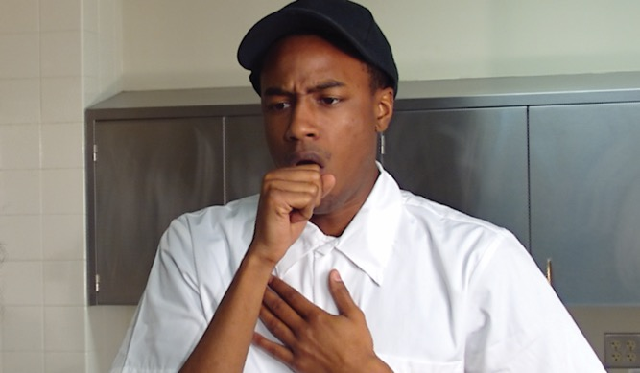
Work Requirements Related to Illness
Sick employees can spread pathogens
Might not be able to work with food
Notes:
Restaurant and foodservice managers and owners/operators have a responsibility to ensure that their employees do not spread foodborne illnesses.
Food handlers who are sick can spread pathogens to food. Depending on the illness, they might not be able to work with food until they recover.

Slide 22
Handling Staff Illnesses
Situation:
Sore throat with fever
Procedure:
Cannot work with or around food
High-risk populations—cannot work
Notes:
Situation
The food handler has a sore throat with a fever.
Procedure
The food handler cannot work with or around food. If the operation serves mostly high-risk guests (such as at a nursing home), then
the food handler should not be in the operation.

Slide 23
Handling Staff Illnesses
Situation:
One symptom from infectious condition
  Vomiting
  Diarrhea
  Jaundice
Procedure:
Cannot work
Notes:
Situation
The food handler has at least one of these symptoms from an infectious condition:
• Vomiting
• Diarrhea
• Jaundice
Procedure
The food handler should not be in the operation.

Slide 24
Handling Staff Illnesses
Situation:
Diagnosed with foodborne illness and has symptoms
Procedure:
Cannot work
Notes:
Situation
The food handler has been diagnosed with a foodborne illness and has symptoms.
Procedure
The food handler should not be in the operation.

Slide 25
Handling Staff Illnesses
Situation:
Diagnosed with Hepatitis A or Salmonella Typhi
Procedure:
Cannot work
Notes:
Situation
The food handler has been diagnosed with Hepatitis A or Salmonella Typhi.
Procedure
The food handler should not be in the operation.

Slide 26
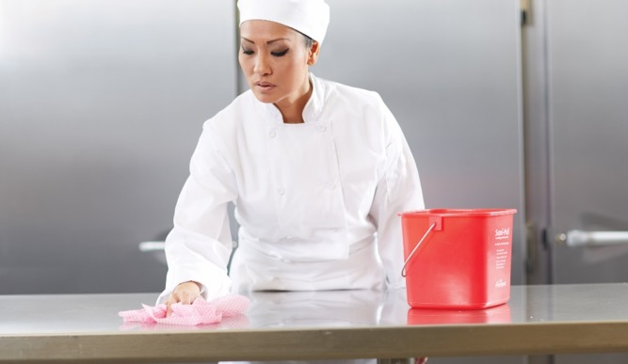
How to Clean Effectively
Cleaning—removes food and dirt
Sanitizing—reduces pathogens to safe levels
Clean only
  Walls, storage shelves, garbage containers
Clean and sanitize
  Surfaces that touch food
  Knives, cutting boards, prep tables
Notes:
We know that a food handler has to maintain good hygienic practices. But did you also know that it is important to make sure food-contact surfaces are kept
clean? And it does not stop there. Besides being cleaned, food-contact surfaces need to be sanitized.
Food can be contaminated easily if equipment and kitchen surfaces are not kept clean and sanitized. Cleaning removes food and other dirt from a surface.
Sanitizing reduces pathogens on a surface to safe levels.
Some surfaces only need to be cleaned, such as walls, storage shelves, and garbage containers. However, any equipment or surface that touches food, such
as knives, stockpots, preparation tables, and cutting boards, must be cleaned and sanitized.

Slide 27
How to Clean Effectively
Clean and sanitize food contact surfaces:
After used
Before working with different food
After interruptions
After four hours
Notes:
All food-contact surfaces need to be cleaned and sanitized at the following times:
• After they are used.
• Before food handlers start working with a different type of food; for example, if a food handler is prepping chicken and then switches to chopping lettuce.
• Any time food handlers are interrupted during a task and the items being used may have been contaminated.
• After four hours, if items are in constant use.

Slide 28
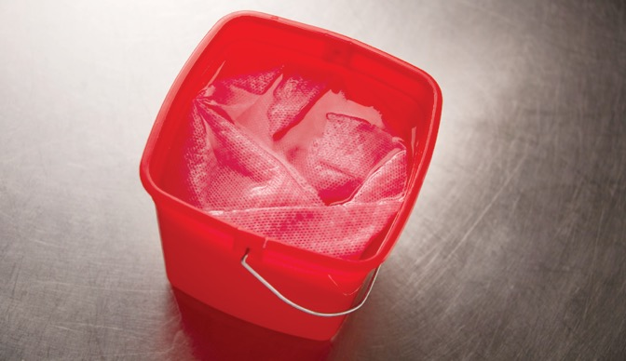
How to Clean Effectively
Cloths for food spills
  Not for food-contact surfaces
Store in sanitizer solution
Keep towels separate
Notes:
Never use cloths or towels meant for cleaning food spills to clean food-contact surfaces. Store cloths or towels for general cleaning in a sanitizer solution
between uses. Keep towels that come in contact with raw meat, seafood, or poultry separate from other cleaning towels..

Slide 29
Cleaners
Remove dirt, rust, stains, minerals, other deposits
Stable and safe
Manufacturer’s directions
Divided into four groups
  Detergents
  Degreasers
  Delimers
  Abrasive cleaners
Notes:
Cleaners are chemicals that remove food, dirt, rust, stains, minerals, and other deposits. They must be stable and safe to use. Always use cleaners as indicated
by the manufacturer’s directions. Cleaners can be divided into the following four groups:

Slide 30
Cleaners
Detergents:
General purpose or heavy duty
General purpose
  Remove fresh dirt
  Used on almost anything
Heavy duty
  Remove wax, dried-on dirt, baked-on grease
  Dishwasher detergent
Notes:
Detergents are either general purpose or heavy duty. General-purpose detergents remove fresh dirt and can be used on almost anything.
Heavy-duty detergents remove wax, dried-on dirt, and baked-on grease. Dishwasher detergents are an example of a heavy-duty detergent.

Slide 31
Cleaners
Degreasers:
Dissolve grease
Burnt-on grease
  Oven doors
  Range hoods
Notes:
Degreasers dissolve grease and work well where grease has burned on, such as on oven doors and range hoods.

Slide 32
Cleaners
Delimers:
Acid cleaners
Mineral deposits
Clean scaling, rust stains, tarnish
Apply carefully
Notes:
Delimers are acid cleaners used on mineral deposits and dirt that other cleaners cannot remove. For example, they are designed to clean scaling
(mineral deposits such as those left by hard water), rust stains, and tarnish. Delimers must be applied carefully.

Slide 33
Cleaners
Abrasive cleaners:
Scouring agent
Hard-to-remove dirt
Remove baked-on food
Apply carefully
Avoid damaging smooth surfaces
Notes:
Abrasive cleaners have a scouring agent that helps scrub hard-to-remove dirt. Dish washers often use abrasive cleaners to remove baked-on foods
in pots and pans. They must be applied carefully to avoid damaging smooth surfaces.

Slide 34
Sanitizing
Food-contact surfaces
Chemical or heat
Specific requirements
Notes:
Food-contact surfaces must be sanitized after they have been cleaned and rinsed. Sanitizing can be done either by using chemicals or heat. Both methods
have specific requirements that must be followed for the sanitizing to be effective.

Slide 35
Sanitizing
Heat sanitizing:
Tableware, utensils
Hot water
At least 171°F (77°C)
30 seconds
Check water temperature
Notes:
One way to sanitize items such as tableware, utensils, or equipment is to soak them in hot water. This is known as heat sanitizing. For this method to work, the
water must be at least 171°F (77°C). The items must also be soaked for at least 30 seconds. Be sure to check the water temperature with a thermometer.

Slide 36
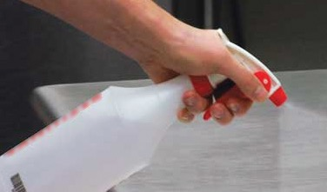
Sanitizing
Chemical sanitizing:
Tableware, utensils
Soak in sanitizer
Rinse, swab, or spray
Different requirements
Read manufacturer’s directions
Notes:
Another way to sanitize is chemical sanitizing. Tableware, utensils, and equipment can be sanitized by soaking them in a sanitizing solution. Staff can
also rinse, swab, or spray items with the solution. Different types of sanitizer have different requirements for how long an item must be in contact with the
solution. Be sure to read the manufacturer’s directions.

Slide 37
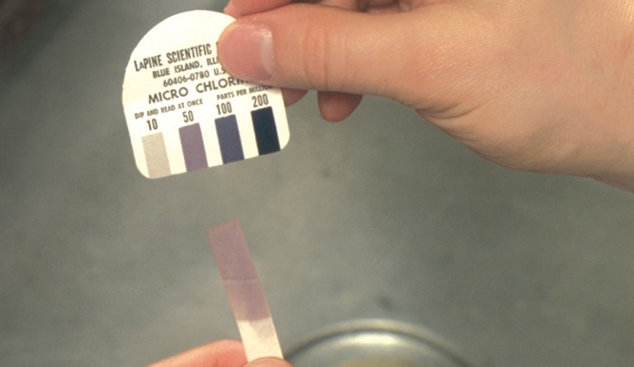
Sanitizing
Three common sanitizers
  Chlorine
  Iodine
  Quaternary ammonium (quats)
Mix with water
Manufacturer's directions
Correct concentration
Use test kit
Notes:
Three common types of chemical sanitizers are chlorine, iodine, and quaternary ammonium compounds (or quats). Each type has to be mixed with water to
create a sanitizer solution. Make sure to follow the manufacturer’s directions when creating the solution. The concentration must be correct or the sanitizer
will not work, and it can cause harm in high concentrations. To make sure the concentration is correct, use a test kit. These are usually available from the
sanitizer manufacturer or supplier.
The Essential Skills feature on page 129 describes the cleaning and sanitizing process.

Slide 38
Factors That Influence the Effectiveness of Sanitizers
Contact time
  Specific period of time
  Depends on sanitizer
Temperature
Concentration
  Proper amount of water
  Too high—unsafe
  Too low—will not kill pathogens
Notes:
Several factors influence the effectiveness of chemical sanitizers:
Contact time: Items being sanitized must be immersed in the solution for a specific period of time. This is called contact time. The contact time
depends on the type of sanitizer being used.
Temperature: The water in sanitizing solutions must be the correct temperature.
Concentration: Mixing sanitizer with the proper amount of water is important. The concentration of this mix (the amount of sanitizer to water) is critical.
Concentrations that are too high can be unsafe and leave an odor or bad taste on objects. Concentrations that are too low may not be effective in
killing pathogens.

Slide 39
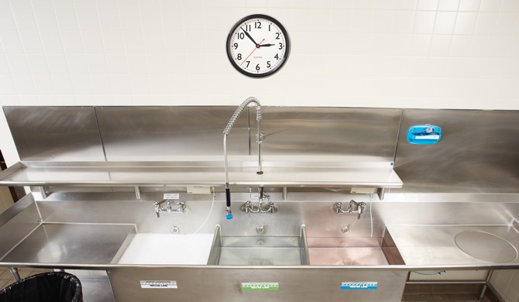
Procedures for Cleaning and Sanitizing
Dishwashing machine
  Tableware
  Utensils
Three-compartment sink
  Larger items—pots and pans
  Clean and sanitize sinks first
Notes:
Dish washing staff clean and sanitize tableware and utensils in a dishwashing machine. Larger items, such as pots and pans, are cleaned by hand in a three-compartment
sink. However, dish washers must be sure to clean and sanitize each sink and drain board before washing any items.
The Essential Skills feature on page 132 shows the steps for cleaning and sanitizing items in a three-compartment sink.

Slide 40
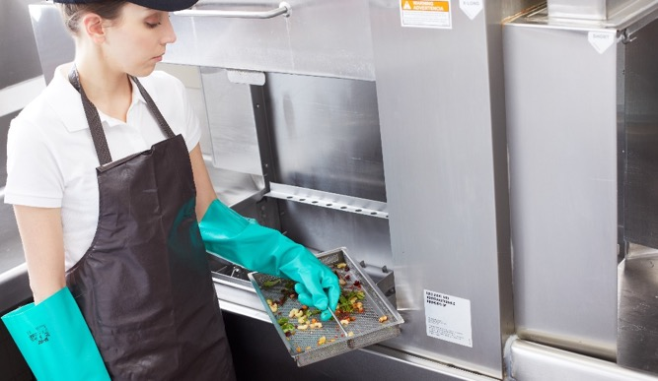
Cleaning and Maintaining a Dishwasher
Clear spray nozzles and food traps
Fill tanks with clean water
Detergent and sanitizer filled
Remove mineral deposits
Notes:
It is important to clean and maintain dishwashing machines frequently throughout the day:
• Clear spray nozzles and food traps of food and other objects.
• Fill tanks with clean water as needed.
• Make sure detergent and sanitizer dispensers are filled.
• Use a delimer to remove mineral deposits when needed.

Slide 41
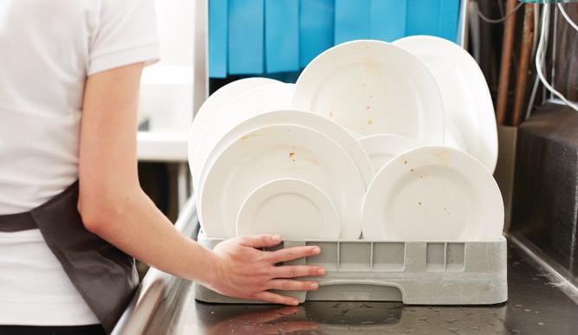
Cleaning and Maintaining a Dishwasher
Dishwasher guidelines:
Scrape, rinse, or soak
Presoak
Never overload
Use correct rack
Notes:
Always use dishwashers according to the manufacturer’s directions. In addition, follow these guidelines:
• Scrape, rinse, or soak items before washing.
• Presoak items with dried-on food.
• Never overload the dish racks.
• Use the correct rack for the items you are washing.

Slide 42
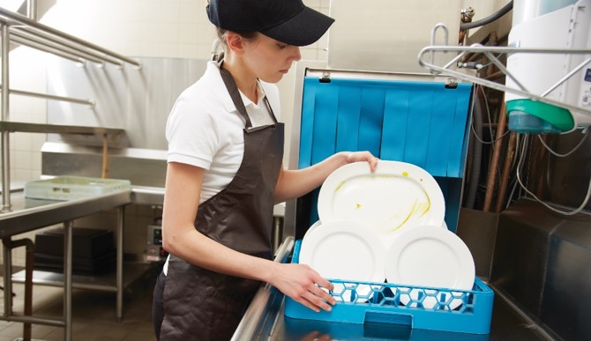
Cleaning and Maintaining a Dishwasher
Dishwasher guidelines:
Load racks properly
Check for dirty items
Rewash dirty items
Air-dry all items
Check water temperature and pressure
Notes:
• Load racks so the water spray will reach all surfaces.
• As each rack comes out of the machine, check for dirty items.
• Rewash dirty items.
• Air-dry all items; never use a towel to dry items.
• Frequently check water temperature and pressure; change the water when necessary.

Slide 43
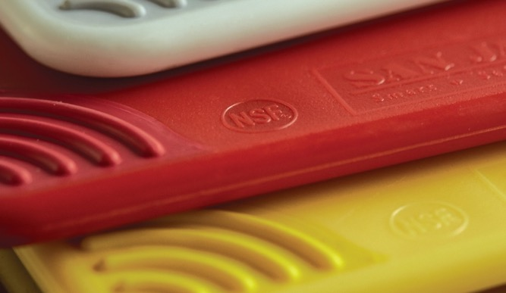
Equipment Standards
NSF International—creates standards
Accredited by American National Standards Institute (ANSI)
Nonabsorbent, smooth, corrosion-resistant
Clean, durable, resistant to damage
Notes:
Equipment that comes in direct contact with food must meet certain standards. NSF International is an organization that creates these standards. The NSF is
accredited by the American National Standards Institute (ANSI). NSF/ANSI standards for foodservice equipment require that it be nonabsorbent, smooth,
and corrosion-resistant. Foodservice equipment must also be easy to clean, durable, and resistant to damage.

Slide 44
Developing a Cleaning Program
Cleaning program
  Organizes cleaning and sanitizing tasks
  Critical to food safety management system
Focus on three items:
  Create master cleaning schedule
  Train staff
  Monitor
Notes:
A cleaning program is a system that organizes all of the cleaning and sanitizing tasks in the kitchen. A clean and sanitary operation is critical to a successful
food safety management system. Restaurant and foodservice managers with the most effective cleaning programs focus on three things:
1. Creating a master cleaning schedule
2. Training staff to follow the cleaning schedule
3. Monitoring the program to make sure it works

Slide 45
Developing a Cleaning Program
To create a schedule, look at:
How is cleaning being done?
How should cleaning be done?
Improvements?
Notes:
To create a master cleaning schedule, first look at how cleaning is currently done. Figure out how things need to be cleaned and ways to make improvements.

Slide 46
Developing a Cleaning Program
To create a schedule, include:
Items to be cleaned
What should be cleaned?
When should items be cleaned?
What type of cleaner?
Who should clean?
Notes:
Next, make a master cleaning schedule, including the following information:
• The item that needs to be cleaned
• What should be cleaned on that item
• When the item should be cleaned
• What should be used to clean the item
• Who should clean the item

Slide 47
Master cleaning schedule
Notes:
Example of a master cleaning schedule

Slide 48
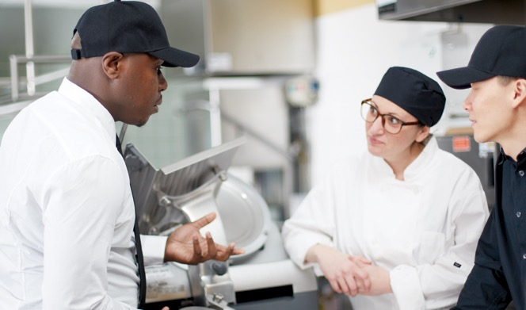
Developing a Cleaning Program
Train employees
Make sure schedule is working
Review and update
Notes:
Once the master cleaning schedule is created, employees must be trained to follow it. Then managers must make sure the schedule is working by checking
that the cleaning is being done. Review and update the schedule as needed; for example, when the menu changes or when new equipment is purchased.

Slide 49
Developing a Cleaning Program
Effective cleaning helps keep the operation free of:
  Smells
  Noise
  Pests
  Messiness
Prevents transfer of pathogens
Keeps guests comfortable and safe
Notes:
The importance of making sure the schedule is followed cannot be overstated. Effective cleaning helps to keep an operation free of smells, noise, pests, and
messiness. It also helps prevent the transfer of pathogens from dirty surfaces to food or to clean surfaces. In addition, it helps guests to feel comfortable and
safe in your operation.

Slide 50
Controlling Pests
Integrated pest management (IPM)
System that prevents, controls, or eliminates infestations
Prevention measures
Control measures
Notes:
How do restaurants and foodservice operations prevent pests, such as rodents and insects, from getting in? Good cleaning and sanitizing
will help, but they probably will not go far enough. So foodservice operations need an integrated pest management (IPM ) program. An IPM program is a
system that will prevent, control, or eliminate pest infestations in an operation.
An IPM program has two parts. First, it uses prevention measures to keep pests from entering the operation. Second, it uses control measures to eliminate any
pests that get inside.

Slide 51
Controlling Pests
Three basic rules:
Deny access
Deny food, water, and hiding/nesting place
Licensed pest control operator (PCO)
Notes:
There are three basic rules for an IPM program:
Deny pests access to the operation.
Deny pests food, water, and a hiding or nesting place.
Work with a licensed pest control operator (PCO) to get rid of pests that do enter the operation.

Slide 52
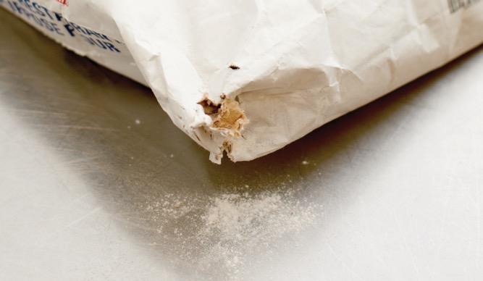
Controlling Pests
Pests can enter:
With deliveries
Through openings
Notes:
Pests can enter an operation in one of two ways. Sometimes they are brought inside with deliveries. They can also enter through openings in the building.

Slide 53
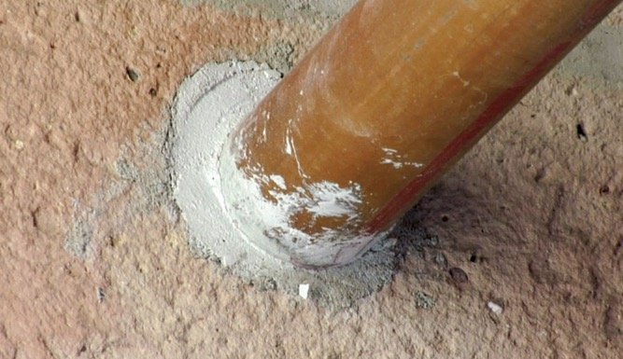
Controlling Pests
Prevent pests from entering by:
Checking deliveries
Screening windows and vents
Keeping exterior openings closed
Covering floor drains
Sealing cracks
Filling holes
Notes:
Prevent pests from entering by paying attention to the following areas:
• Check all deliveries before they enter the operation. Refuse shipments that have pests or signs of pests, such as body parts (wings, legs, etc.) or egg cases.
• Screen all windows and vents, and check the screens regularly for holes and dirt.
• Keep all exterior openings closed tightly. For example, drive-through windows should be closed when not in use.
• Cover floor drains with hinged grates.
• Seal all cracks in floors and walls with a permanent sealant.
• Use concrete to fill holes or sheet metal to cover openings around pipes.

Slide 54
Controlling Pests
Work with PCO:
Access to safe and current methods
Trained on best methods
Local regulations
Experts at applying, storing, and throwing out pesticides
Notes:
Even after an operation has made every effort, some pests may still get in. If this happens, work with a pest control operator to get rid of them. PCOs have
access to the safest and most current methods for getting rid of pests. They are trained to determine the best methods for eliminating specific pests. PCOs
are also knowledgeable about local regulations and are experts at applying, storing, and throwing out pesticides.

