Slide 2
Heat Transfer
Heat—type of energy
Conduction
Convection
Radiation
Notes:
The three general types of cooking methods are dry-heat cooking, moist-heat cooking, and combination cooking. Each method can be used to bring out the
flavor and tenderness of specific dishes. In addition, these methods can reflect cultural and regional preferences.
Heat is a type of energy. When two items of different temperatures have contact, energy, in the form of heat, transfers from the warmer item to the cooler until they both reach the same temperature. Heat travels in items in three ways: conduction, convection, and radiation.

Slide 3
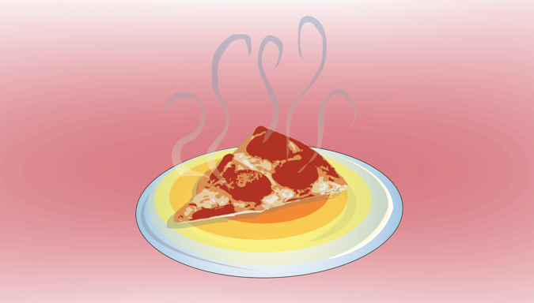
Heat Transfer
Conduction:
Transfer of heat
Items come into direct contact
Heat transferred to air
Heat transferred surface to surface
Notes:
Conduction is the transfer of heat from one item to another when the items come into direct contact with each other. Sometimes the heat is transferred to
the air or from surface to surface. An example is when a cold plate begins to warm when covered with hot food. The heat of the food is conducted into the
surface of the plate.

Slide 4
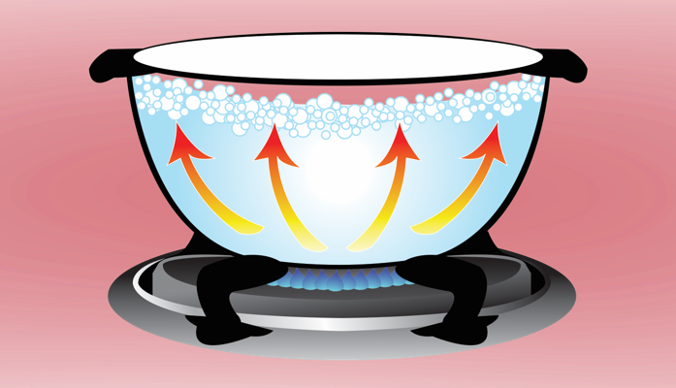
Heat Transfer
Convection:
Movement of molecules
Warmer area to cooler
Heating water or convection oven
Notes:
Convection is the transfer of heat caused by the movement of molecules (in the air, water, or fat) from a warmer area to a cooler one. When heating water,
natural convection occurs. As water heats at the bottom of the pot, it travels upward. In the process, it transfers energy to the cooler water higher in the pot.
This is a continuous process, with the hot water constantly rising and replacing the cooling water. It also occurs as mechanical convection in a convection oven
when hot air is forced into the chamber.
Note: Chefs often think of convection cooking simply as moving air, which is in line with the common use of convection ovens. Remember, cooking methods might use two or more methods of heat transfer. So, for example, both conduction and convection heat are used in sautéing, pan-frying, braising, and stewing.

Slide 5
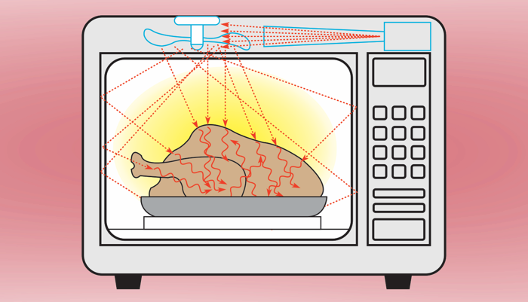
Heat Transfer
Radiation:
No physical contact
Infrared heat
Heat absorbed, radiated to food
Broiler
Affects exterior of food—food browns
Microwaves
Agitate water molecules in food
No browning
Tough, rubbery, or dried out
Notes:
Radiation does not require physical contact between the heat source and the food being cooked. Instead, heat moves by way of microwave and infrared
waves. Infrared heat is created when the heat from a source is absorbed by one material and then radiated out to the food. The flame in a broiler heats the
tiles in the broiler, which radiate the heat to the food. Microwaves agitate the water molecules in the food, creating a form of friction that heats the water and
thereby the food.
It is important to remember that infrared waves affect the exterior of the food. Heat on the outside of the food then spreads inward through conduction. The
result is that the outside of the food browns. Microwaves penetrate the item and cook it from the inside out, so browning does not take place. Microwaving is
good for some recipes, but many food items can quickly become tough and rubbery or dried out if microwaved too long.

Slide 6
Dry-Heat Cooking Methods
Dry-heat cooking method (without fat):
Broiling
Grilling
Roasting
Baking
Dry-heat cooking method (with fat):
Sautéing
Pan-frying
Stir-frying
Deep-frying
Notes:
In dry-heat cooking, food is cooked either by direct heat, like on a grill, or by indirect heat in a closed environment, like in an oven.
Dry-heat cooking methods without fat include the following:
Broiling
Grilling
Roasting
Baking
Another way to prepare food is to use dry-heat cooking methods with fat and oil. These methods include the following:
Sautéing
Pan-frying
Stir-frying
Deep-frying

Slide 7
Broiling
Rapid cooking method
High heat
Heat source above food
Food browned on top
Tender cuts of meat, young poultry, fish, some fruits/vegetables
Notes:
Broiling is a rapid cooking method that uses high heat from a source located above the food. Broiled food becomes browned on the top. Food items that can be broiled include tender cuts of meat, young poultry, fish, and some fruits and vegetables.

Slide 8
Broiling Food
Preheat broiler
Oil broiler or item
Place item on grid—broiler cavity
Adjust item distance from heat
Turn over halfway through cooking process.
Notes:
Preheat the broiler.
Oil the broiler grid lightly or oil item lightly, if necessary.
Place the item on the broiler grid and move it into the broiler cavity. See Figure 18.2a.
Adjust the distance between the item and the heat as needed to control the rate of cooking. Place the food farther away and cook it a little longer to reach a higher internal temperature in the finished product, and move it closer for less time for a lower internal temperature in the finished product. To cook red meat to a rare level, use shorter cooking times with more heat; for well-done use longer cooking times with less heat. Both should have a well-browned, flavorful crust on the outside and a juicy interior when finished. See Figure 18.2b.
Turn the item over halfway through the cooking process to achieve even cooking on both sides of the product.

Slide 9
Grilling
Simple dry-heat method
Smaller pieces of food
Cooked on grill rack—above heat source
No liquid
Small amounts of fat or oil
Add flavor
Highly flavored outside, moist inside
Smoky, slighted charred flavor
Crosshatching
Special woods—mesquite, hickory, apple
Add flavor
Marinade
Unique flavor
Moist
Notes:
Grilling is a very simple dry-heat method that is excellent for cooking smaller pieces of food. The food is cooked on a grill rack above the heat source. No liquid is added to the food during cooking. A cook might add small amounts of fat or oil during the cooking process simply to add flavor to the finished dish.
The result of grilling is food with a highly flavored outside and a moist inside. Grilled food has a smoky, slightly charred flavor because the fat melts and drips down into the heat source, along with some of the meat’s juices. As the fat and juices burn, the smoke helps provide the charred flavor. The crosshatching look common to grilled food comes from the hot metal grill rack that the food sits on. Special woods, such as mesquite, hickory, or apple, can be used in the heat source to flavor the grilled food. Using a marinade can give the food a unique flavor, as well as making it moister.

Slide 10
Grilling Food
Clean and preheat grill
Season main item
Marinate or brush with oil
Place on grill
Turn 60 degrees
Flip item over
Cook to desired doneness
Notes:
Thoroughly clean and preheat the grill.
Season the main item. Marinate or brush it with oil, if necessary, to prevent it from sticking to the grill.
Place the item on the grill.
Turn the item about 60 degrees to produce crosshatch marks.
Flip the item over to complete cooking to the desired doneness.
The finished product should be cooked to the desired doneness and should be golden brown with no burning or charring. Achieving this requires control of the heat source.

Slide 11
Roasting
Hot, dry air
Outer layers heat, juices turn to steam
Juices create natural sauce
Fish, tender meats and poultry, some fruits/vegetables
Covered or uncovered
Longer cooking times
Food raised off of cooking pan
Basting—adds flavor, moisture, color
Golden-brown exterior
Moist, tender interior
Notes:
Roasting and baking are techniques that cook food by surrounding the items with hot, dry air in the oven. As the outer layers of the food become heated, the food’s natural juices turn to steam and are absorbed into the food. These juices create a natural sauce. Food items that can be baked or roasted include fish, tender meats and poultry, and some fruits and vegetables.
You can bake food covered or uncovered, depending on the recipe. Food items that are baked uncovered, such as cookies and casseroles, develop a golden-brown color on top.
Roasting generally requires longer cooking times and often for the food to be raised off the pan by a rack or a bed of mirepoix. Roasting is most often used with large cuts of meat, whole birds (poultry), or fish. Adding liquid to the pan and/or basting during the roasting process will add flavor, moisture, and color to the food. Roasted food should have a golden-brown exterior and moist, tender interior.

Slide 12
Roasting Meat
Season, stuff, or marinate
Place on rack in roasting pan
Uncovered or covered
Carryover cooking
Rest before carving
Prepare pan gravy
Carve
Notes:
Season, stuff, or marinate the main item. For meat other than a bird, sear, or quickly brown, its surface over direct heat.
Place the food on a rack in a roasting pan so that hot air can touch it on all sides.
Roast the item uncovered or covered, as the recipe calls for, until the desired temperature is reached. Allow for carryover cooking. Carryover cooking describes what happens to food after it has been removed from the oven. The roasted item holds a certain amount of heat that continues to cook the food.
Allow the roasted item to sit or rest before carving. Doing this allows the juices, which are being drawn out to the edges of the meat during roasting, to return to the center of the item and make it juicier.
Prepare pan gravy in the roasting pan.
Carve the roasted item, and serve it with the appropriate gravy or sauce.

Slide 13
Griddling
Hot, flat surface
Dry, heavy-bottomed fry pan or cast-iron skillet
Even, golden-brown finish
Slightly crisp exterior
Steaks, chops, chicken breasts
Griddle cakes
Notes:
Griddling is cooking a food item on a hot, flat surface (known as a griddle) or in a relatively dry, heavy-bottomed fry pan or cast-iron skillet. The goal is to give the product an even, golden-brown finish and a slightly crisp exterior texture. When cooking meats on a high-heat griddle or in a cast-iron pan, the result is a high level of browning that gives the finished product a unique taste and texture not achieved with other cooking methods. In particular, steaks, chops, and chicken breasts are often cooked on a griddle or in a hot cast-iron skillet.
The griddle is also used to prepare one of the most popular breakfast menu items—griddle cakes (pancakes). To produce a quality product, clean the griddle well and make sure the temperature of the griddle surface is appropriate for the item being cooked.

Slide 14
Sautéing
“Jump”
Cooks food rapidly
Water and vitamin loss low
High amount of color and flavor
Small amount of fat—adds flavor
High heat
Select cuts of meat, chicken, and fish/seafood
Notes:
The sautéing (saw-TAY-ing) method cooks food rapidly in a small amount of fat over relatively high heat. The fat adds to the flavor. Select cuts of meat, chicken, and fish or seafood are often prepared this way. The thinner and more delicate the piece of meat, the faster it will cook.
The literal translation of the French term sauté is “jump.” To sauté is to cook the food quickly to keep water and vitamin loss at a minimum, while gaining a high degree of color and flavor. When sautéing, the pan is heated first, and just enough fat is added to coat the bottom of the pan.

Slide 15
Sautéing
Mise en place
Cut food into appropriate-sized pieces
Select correct pan
High to medium heat
Minimal fat
Preheat pan
Place thin layer of food
Brown food
Notes:
Perform thorough mise en place.
Cut food into appropriately sized pieces to allow maximum surface contact with the pan.
Select the correct pan, which should have the following characteristics:
Large enough to allow food to spread well in pan (overloading the pan does not allow rapid cooking)
Sides that slant outward to allow moisture vapors to easily escape
Made of a metal that provides good heat conductivity
Use high to medium heat that can be easily controlled.
Use minimal fat or clarified butter; just enough to prevent sticking and help conduct heat and flavor.
Preheat the pan and fat to a high temperature (but not burning).
Place a thin layer of food in the hot pan (overloading the pan drops the temperature of the pan too rapidly and items will not brown).
Allow food to remain in contact with the surface long enough to brown, but move it often enough to prevent burning.

Slide 16
Stir-Frying
Related to sautéing
Quick-cooking
High heat
Little fat
Stir quickly
Sauce created in pan
Meats and vegetables—bite-sized pieces
Wok—bowl-shaped pan
Notes:
Stir-frying is a cooking method closely related to sautéing. Like sautéing, it is a quick-cooking, dry-heat method. Food is cooked over a very high heat, generally in a wok with little fat, and stirred quickly. In this Asian style of cooking, sauce is usually created in the same pan after the product has been sautéed. The items to be stir-fried, usually meats and fresh vegetables, are cut into bite-sized pieces. The wok, a bowl-shaped pan, makes stir-frying easy. A wok is usually made of rolled steel and is used for nearly all Chinese cooking methods.

Slide 17
Pan-Frying
Cook in oil
Less-intense heat
Coat food with batter, seasoned flour, or breading
Flavorful exterior
Crisp, brown curst
Juices and flavor retained
Beef tenderloin, fish fillets
Notes:
Stir-frying is a cooking method closely related to sautéing. Like sautéing, it is a quick-cooking, dry-heat method. Food is cooked over a very high heat, generally in a wok with little fat, and stirred quickly. In this Asian style of cooking, sauce is usually created in the same pan after the product has been sautéed. The items to be stir-fried, usually meats and fresh vegetables, are cut into bite-sized pieces. The wok, a bowl-shaped pan, makes stir-frying easy. A wok is usually made of rolled steel and is used for nearly all Chinese cooking methods.

Slide 18
Stir-Frying
Mise en place
Heat small amount of oil
Wok
Large sauté pan
Add main item
Stir-fry—constant motion
Add additional ingredients
Add liquid ingredients
Thickener
Serve immediately
Notes:
Perform thorough mise en place.
Heat a small amount of oil in a wok or large sauté pan.
Add the main item.
Stir-fry, keeping the food in constant motion with a wooden paddle or spoon.
Add additional ingredients, including seasonings, in the proper sequence (longest-cooking ingredient in first, shortest-cooking ingredient in last).
Add the liquid ingredients to the pan to create the sauce. Then add the thickener, as necessary.
Serve the food immediately.

Slide 19
Pan-Frying
Mise en place
Fill fry pan ⅔ full—oil or fat
Heat to 350°F (177°C)
Add food item
Pan-fry first side
Turn item over
Cook to desired doneness
Drain on absorbent paper
Season and serve with sauce and garnish
Notes:
Perform thorough mise en place.
Fill a fry pan half to two-thirds full with appropriate oil or fat.
Heat the cooking oil to about 350°F (177°C). (Oil that is too cool will result in excess oil absorption by the item, and oil that is too hot will burn the outside coating before the item is cooked.)
Add the food item (usually breaded, coated with seasoned flour, or batter-coated) to the pan in a single layer.
Pan-fry the food on the first side until it is well browned.
Turn the item and cook it to the desired doneness. (If the item is extremely thick, it can be finished in the oven to prevent burning the crust.)
Drain the item on absorbent paper.
Season and serve it with the appropriate sauce and garnish.

Slide 20
Deep-Frying
Bread or batter coat food
Immerse in hot fat
Crispy coating
Interior—moist and tender
Batter
Combines wet and dry ingredients
Primary dry ingredient—flour, cornmeal
Liquid—beer, milk, water
Binder—egg
Breading
Same components as batter
Not blended together
Notes:
To deep-fry food, bread or batter coat it, immerse (completely cover) it in hot fat, and fry it until it is done. The outside of the food item develops a crispy coating, while the inside stays moist and tender. The coating on the food item can be a standard breading or a batter. A batter combines dry and wet ingredients. It is a mixture of the primary dry ingredient (wheat flour, all-purpose flour, cornmeal, or rice flour), the liquid (beer, milk, wine, or water), and a binder (generally egg), which helps the mixture adhere to the product. Examples include the beer batter often used on fish, cornmeal batter used on corn dogs, and tempura batter (light batter) used on tempura vegetables and fish.
A breading has the same components as batter, but they are not blended together. A standard breading would be seasoned all-purpose flour and an egg and milk dip.

Slide 21
Deep-Frying
Food—naturally tender
Size and shape—cook quickly
35% flavor from oil
Use good-quality oil
Float
Items rise to surface
Golden brown
Check internal temperature
Crust—crisp and delicate
Notes:
Food that can be deep-fried must be naturally tender and of a shape and size that allows it to cook quickly without becoming tough or dry. As much as 35 percent of the flavor of a deep-fried food comes from the oil in which it is fried. Always use a good-quality oil.
The float of the item—the point when the item rises to the surface of the oil and appears golden brown—indicates doneness. To ensure doneness, check a piece of the item being cooked for the proper internal temperature. The crust should be crisp and delicate, surrounding a moist, tender piece of meat, fish, poultry, or vegetable.

Slide 22
Deep-Frying
Swimming method:
Item drops to bottom
Swims to the surface
Turn over
Notes:
There are three methods for deep-frying food:
In the swimming method, gently drop a breaded or batter-coated food in hot oil, where it falls to the bottom of the fryer and then swims to the surface. Once the food items reach the surface, turn them over, if necessary, so they brown on both sides.

Slide 23
Deep-Frying
Basket method:
Place in basket
Lower into oil
Lift when done
Notes:
In the basket method, bread the food, place it in a basket, lower the basket and food into the hot oil, and then lift it all out with the basket when the food is done.

Slide 24
Deep-Frying
Double-basket method:
Longer period of time
Place basket on top of other basket
Food does not float to surface
Notes:
Use the double-basket method for certain foods that need to be fully submerged in hot oil for a longer period of time in order to develop a crisp crust. In this method, place the food item in a basket, and then fit another basket on top of the first. The top basket keeps the food from floating to the surface of the oil.

Slide 25
Deep-Frying
Recovery time:
Time oil takes to reheat
More items, longer recovery time
Smoking point:
Fats and oils smoke
Fat breaks down
Oil:
Neutral flavor and color
High smoking point—425°F (218°C)
Notes:
Recovery time is the amount of time it takes oil to reheat to the correct cooking temperature once food is added. The more food items dropped into the oil at one time, the longer the recovery time. The smoking point is the temperature at which fats and oils begin to smoke, which means that the fat has begun to break down. Use oil for deep-frying that has a neutral flavor and color and a high smoking point, around 425°F (218°C).

Slide 26
Standard Breading Procedure
Prepare assembly line
One hand for wet food; one for dry food
Flour, egg wash, crumbs
Coat entire product
Arrange items on lined pan
Store in refrigerator or freezer
Discard unused flour, egg wash, and crumbs
Notes:
Cooks often give fried food items a crisp coating through the standard breading procedure, which involves dredging the seasoned items in flour, egg wash, and finally a crunchy ingredient (such as breadcrumbs or grated cheese).
Prepare an assembly line. Working from left to right (if you are right-handed), organize your seasoned, uncoated items, a pan of flour, a pan of egg wash, a pan of breadcrumbs or other crunchy substance, and a parchment-lined pan for the coated product.
Keeping one hand for wet food and one hand for dry food, submerge each item first in flour, then in egg wash, and then in crumbs, removing any excess as you go. Make sure to coat the entire product.
Carefully arrange the coated items on the lined pan, separating layers with additional parchment paper as needed.
Store the finished product in the refrigerator or freezer until needed.
Discard all unused flour, egg wash, and crumbs to prevent cross-contamination.

Slide 27
Deep-Frying
Heat oil or fat—325°F to 375°F (163°C to 191°C)
Add food item
Turn item, if necessary
Finish in oven, if necessary
Place on rack to drain or absorbent paper towel
Season and serve with sauce and garnish
Notes:
Heat the fat or oil to the proper temperature, usually 325°F to 375°F (163°C to 191°C).
Add the food item (usually breaded, floured, or batter-coated) to the hot oil, using the appropriate method (swimming, basket, or double-basket).
Turn the item during frying, if necessary.
If the item is too thick to cook fully in the oil, then crisp the item on the outside and finish it in the oven.
Place fried food on a rack to drain or on absorbent, single-use paper towels.
Season and serve with the appropriate sauce and garnish.

Slide 28
Moist-Heat Cooking Methods
Delicately flavored, moist food
Simmering
Poaching
Shallow poaching
Blanching
Steaming
Notes:
Moist-heat cooking techniques produce food that is delicately flavored and moist, sometimes with a rich broth that can be served as a separate course or used as a sauce base. In fact, an entire dinner, complete with meat, fish, or poultry and vegetables, can be cooked in one pot. One example of this is the classic New England boiled dinner, consisting of corned beef, cabbage, carrots, and potatoes. Moist-heat cooking methods provide the opportunity to create nutritious, appealing dishes with a range of flavors and textures.
Moist-heat cooking methods include the following:
• Simmering
• Poaching and shallow poaching
• Blanching
• Steaming

Slide 29
Simmering
Completely submerge food in liquid
Constant, moderate temperature—185°F to 205°F (85°C to 96°C)
Well-flavored liquid
Less-tender cuts of meat
Bubbles gently rise and break surface
Do not boil—stringy and rubbery meat
Notes:
When simmering, you completely submerge food in a liquid that is at a constant, moderate temperature. Use well-flavored liquid and cuts of meat that are less tender than those recommended for dry-heat cooking methods. Simmering less-tender items cooks them at a slightly higher temperature than other moist-heat methods, 185°F to 205°F (85°C to 96°C). Simmering differs from boiling in that bubbles in a simmering liquid rise gently and just begin to break the surface. Do not allow the water to come to a full boil, because the boiling motion will cause meat to become stringy and rubbery.

Slide 30
Poaching
Temperature—between 160°F and 180°F (71°C and 82°C)
Liquid—surface motion, no air bubbles breaking
Well-flavored liquid
Tender food—chicken or seafood
Notes:
When poaching, cook food between 160°F and 180°F (71°C and 82°C). The surface of the poaching liquid should show some motion, but no air bubbles should break the surface. Use well-flavored liquid, and make sure the food is naturally tender. Cooks commonly poach chicken and seafood.
Cooks also often serve poached and simmered items with a flavorful sauce prepared from the poaching/simmering liquid to add zest to the dish’s mild flavor. Be careful not to overcook poached and simmered food.

Slide 31
Poaching
Shallow poaching:
Steam and liquid bath
Portion-sized or small pieces
Partially covered by liquid
Acid—wine or lemon juice
Steam cooks food
Tender and moist
Fragile texture
Paupiettes
Long, thin slices of fish or meat
Stuffed with filling
Cuisson—liquid as sauce base
Notes:
Shallow poaching cooks food using a combination of steam and a liquid bath. Shallow poaching is a last-minute cooking method most suitable for food that is cut into portion-sized or smaller pieces. The food is partially covered by a liquid containing an acid (usually wine or lemon juice), herbs, and spices in a covered pan. The steam cooks the items that are not directly covered by the poaching liquid. Food that has been shallow poached should be very tender and moist, with a fragile texture. Cooks commonly shallow poach paupiettes of sole and other white fishes. Paupiettes are long, thin slices of fish or meat that are rolled and stuffed with a filling. Shallow poaching transfers much of the flavor of the food from the food item to the liquid. To keep this lost flavor, use the liquid as a
sauce base. This liquid is called a cuisson.

Slide 32
Shallow Poaching
Heat butter in saucepan
Add seasonings
Add poaching liquid
Bring liquid to proper temperature
Cover saucepan
Notes:
Heat butter in a saucepan.
Add the seasonings to the pan, and level them out evenly.
Add the poaching liquid and the food item. The liquid should come partway up the food item.
Bring the liquid to a proper cooking temperature, usually 160°F–180°F (71°C–82°C).
Cover the saucepan with buttered parchment paper or a lid.

Slide 33
Shallow Poaching
Finish food in saucepan
Direct heat or oven
Remove from poaching pan
Reduce poaching liquid
Prepare sauce
Plate and garnish
Notes:
Finish the food in the saucepan, either over direct heat or in an oven.
Remove the food item from the poaching pan, and keep it warm and moist.
Reduce the poaching liquid, and prepare a sauce as desired.
Plate the food item and serve it with the sauce and appropriate garnish.

Slide 34
Blanching
Variation of boiling
Parcooking—partially cook food, finish later
Pre-prepare vegetables
Two-step process
Shocking
Plunge into ice bath
Halts cooking process
Bright color
Notes:
Blanching is a variation of boiling. When blanching, partially cook food (also called parcooking), and then finish cooking it later. Cooks frequently use blanching to pre-prepare vegetables.
Blanching is a two-step process. Take green beans as an example. Once you know that the green beans are cooked, quickly remove them from the boiling water and plunge them into the ice bath to halt the cooking process. This technique is called shocking. Then give them a quick toss with seasoned butter in a hot pan at service. The result is a green bean cooked to perfection, with bright color, but prepared fresh and quickly at service. Many times, cooks blanch food that would otherwise take too long to cook thoroughly, before they deep-fry it.

Slide 35
Blanching
Bring water to a boil
Place item in boiling water
Boil for short time
Remove item
Place in ice bath
Drain
Notes:
Bring water to a boil, and then place items in the boiling water.
Boil the food for a short time, not cooking it all the way.
Remove the item from the pot, and then shock it by placing it in ice water. This immediately stops the cooking.
Drain and dry the item, and then hold it until it is time for finishing.

Slide 36
Steaming
Surround food by steam
Steamer basket, steam cabinet, combi-oven
Remove items with care
Notes:
Steaming is cooking food by surrounding it in steam in a confined space such as a steamer basket, steam cabinet, or combi-oven. Direct contact with the steam cooks the food. Care should be taken when removing items from a steamer, to avoid burns.

Slide 37
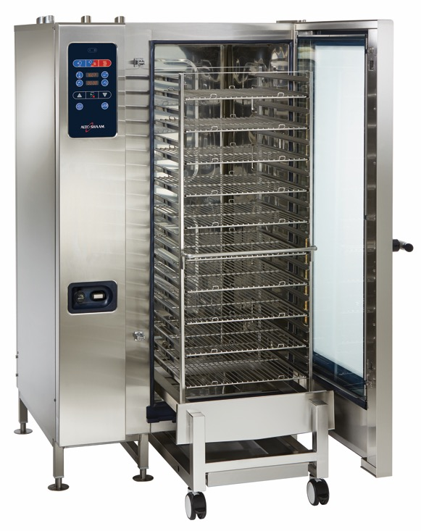
Steaming
Without pressure:
Steamer basket—boiling water
Exposes food to steam—212°F (100°C)
With pressure:
Commercial steam cabinet
Combi-oven
Direct contact with steam
Temperature is higher
Cooks faster
Notes:
Steaming can take place with or without pressure. Placing food in a steamer basket on top of a pot of boiling water directly exposes the food to steam, which is 212°F (100°C). Placing food in a commercial steam cabinet or combi-oven also cooks food through direct contact with the steam, but the temperature is generally higher because the steam is under pressure. It cannot escape the cabinet or oven. Both methods cook in the same way, but steaming with pressure cooks faster than steaming without pressure. Take this into consideration when preparing a dish.

Slide 38
Steaming
Enhances flavor
Use broth instead of water
Tender food
Small pieces
Rack above liquid
Do not remove lid—slows cooking process
Notes:
Enhance the flavor of food steamed over, but not directly in, boiling liquid by using broth instead of water as the liquid. Use naturally tender food, cut it into small pieces, and place it on a rack above the boiling liquid within a closed cooking pot. As the liquid comes to a boil, the steam created surrounds the food, heating it evenly and keeping it moist. Once all the ingredients are in the steamer and the cover is in place, do not remove the lid because the steam will escape, slowing down the cooking process.

Slide 39
Steaming
Food keeps nutritional value
No added calories—fat or oil
Mild, delicate flavor
Fresher taste, color, appearance
Cooking time is longer
Notes:
When you cook with steam, food keeps more of its nutritional value and there are no added calories from fat or oil. Items cooked with steam have mild, delicate flavors and often have a fresher taste, color, and appearance. Cooking time is longer with steaming than with boiling or simmering. But you have to be careful that food is not overcooked. Steamed food should be moist and plump, not rubbery or chewy.

Slide 40
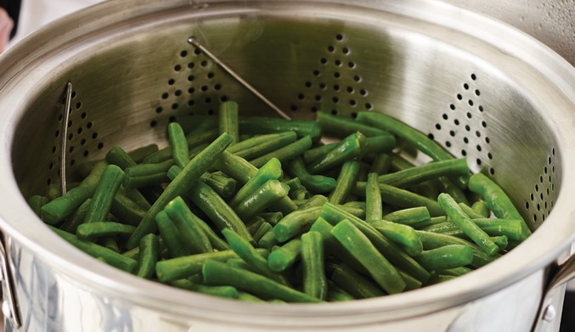
Steaming Food on Top of the Range
Bring to a boil
Add food item
Single layer on rack
Cover pot
Steam to correct doneness
Serve immediately
Appropriate sauce and garnish
Notes:
Bring the liquid to a boil.
Add the food item to the pot in a single layer on a rack raised above the boiling liquid.
Cover the pot.
Steam the food to the correct doneness.
Serve the food immediately with the appropriate sauce and garnish.

Slide 41
Combination-Cooking Methods
Dry and moist-heat cooking
Less tender food
Braising—large cuts of meat
Stewing—small pieces of food
Notes:
Sometimes the best method for preparing a certain food is a combination of both dry-heat and moist-heat cooking methods. Such cooking is called combination cooking. For example, braising and stewing use both dry and moist heat to cook food that is less tender. Combination-cooking techniques are useful because they can transform the less tender and less expensive main ingredients into delicious and tender finished products.
Combination-cooking methods include the following:
• Braising: Primarily used for larger cuts of meat
• Stewing: Used for smaller pieces of food

Slide 42
Braising
Sear in hot oil
Partially cover with liquid
Cover tightly
Finish slowly—oven or stove top
Seasonings—adds moisture and flavor
Vegetables—end of cooking process
Long, slow cooking
Notes:
In braising, first sear the food item in hot oil, and then partially cover it in enough liquid to come halfway up the food item. Then cover the pot or pan tightly, and finish the food slowly in the oven or on the stove top until it is tender. A bed of seasonings adds moisture and flavor to the food. If the recipe calls for them, add vegetables to braised meat or poultry near the end of the cooking time. As the meat cooks, its flavor is released into the cooking liquid, which becomes the accompanying sauce. The key to quality braising is long, slow cooking. In an item such as coq au vin (chicken cooked in red wine), the meat should slide from the bone in the final product, and the meat itself should fall apart with a gentle touch.

Slide 43
Braising
Tough connective tissue—fork tender
Few nutrients are lost
Pot roasting—American term for braising
Notes:
Slow, gentle braising causes the tougher connective tissue of lean meat to become fork tender and well done. More tender food requires less cooking fluid and can be heated at lower temperatures for a shorter time. Few nutrients are lost with braising. Braised food that is finished in the oven is less likely to be scorched than food that is finished on the stove top. Braised food should be extremely tender, but should not fall into shreds.
An example of a braising technique is pot roasting, which is a common American term for braising, and the name of a traditional dish (pot roast).

Slide 44
Braising
Preheat pan and oil
Sear meat
Add mirepoix and tomato
Pincé mixture
Deglaze pan
Notes:
Preheat both the pan and the oil.
Sear meat on all sides.
Add mirepoix and tomato. Be sure to pincé (peen-say) the mixture. (Pincé is a French culinary term for caramelizing sugars in tomato paste to a rusty brown color to add flavor.)
Stir a small amount of liquid into the mirepoix to deglaze the pan.

Slide 45
Braising
Add appropriate amount of liquid
Cover and finish
Check for proper doneness
Place over direct heat
Reduce sauce
Notes:
Add the appropriate amount of liquid.
Cover the pot and finish the braise.
Check to see if the braised food items are done.
Place the pot over the direct heat, and continue to reduce the sauce to develop its flavor, body, and consistency.

Slide 46
Stewing
Similar to braising
Pre-preparation different
Cut into bite-sized pieces
Sear or blanch
Cook in oil
Cover completely with liquid
Cover pot
Notes:
Stewing techniques are similar to braising, but the pre-preparation is a little different. First, you cut the main food item into bite-sized pieces and either blanch or sear them. As with braising, you cook the food in oil first, and then add liquid. Stewing requires more liquid than braising. Cover the food completely while it is simmering.

Slide 47
Stewing
Cut into uniform-sized pieces
Heat fat in rondo
Brown all sides
Sauté other ingredients
Add roux or thickening agent
Add liquid
Stir to prevent lumps
Cover items completely
Notes:
Cut the food to be stewed into uniform-sized pieces. Dredge pieces in flour (optional).
Heat fat in a small rondo. Brown pieces on all sides, until golden brown.
Add other ingredients and sauté.
Add roux or thickening agent.
Gradually add liquid, stirring to prevent lumps. Liquid should cover food items completely.

Slide 48
Stewing
Bring to temperature
Cover container
Remove items and hold properly
Return sauce to simmer and thicken
Heat items and serve
Notes:
Bring the stew to temperature. Place lid on container and stew on stove top until pieces are tender and cooked through.
Remove food items and hold them in a warming drawer or on a warm stove top.
Return sauce to a simmer and thicken as desired.
Return held items to the stew, then heat through and serve.

Slide 49
Sous Vide Cooking
Cooked for a long time
“Under vacuum”
Airtight plastic bags
Hot water
Controlled heating—exact range
Locks flavor molecules in with food
Notes:
Two other cooking methods are sous vide and microwave cooking. Sous vide involves sealing the food in sturdy plastic bags to keep in the juices and aroma that otherwise would be lost in the process. Microwave cooking involves heating food by passing microwave radiation through it.
Sous vide is a method in which food is cooked for a long time, sometimes well over 24 hours. Sous vide is French for “under vacuum.” Rather than placing food in a slow cooker, the sous vide method places food in airtight plastic bags in water that is hot but well below boiling point. This cooks the food using precisely controlled heating, at the temperature at which it should be served.
The water might feel about as hot as a hot bath in a bathtub, but feeling is not enough. For safety and quality reasons, sous vide water-bath temperatures are measured in tenths of a degree. The exact range is narrow and precise.
The aroma of food cooking actually means that precious molecules of flavor are escaping from the food. Sous vide locks all of those flavor molecules in with the vacuum seal. Sous vide food items do not lose flavor. In fact, in some cases, the flavors actually intensify and improve.

Slide 50
Microwave Cooking
Alters protein—tough
No browning
Glass and ceramic cookware, plastics
Never use brown grocery bags, newspaper, metal, or foil
Notes:
Many food items can be baked or roasted in a microwave oven. However, microwave ovens do not give the same results as convection or conventional ovens because they cook food with waves of energy or radiation, rather than with heat.
Microwave cooking alters protein, causing it to toughen. This can be a problem in breads, eggs, and meats. Cooks can use special techniques with specific microwave recipes to maintain the quality of the finished recipe. Because there is no external heat source, there is no browning. Food cooks because microwave radiation increases molecular activity inside the food. It begins at the center, so the surface does not turn a crispy golden brown while the inside slowly cooks, as in a conventional oven.
Glass and ceramic cookware and plastics that are labeled microwave safe can be used in the microwave oven. Never use brown grocery bags, newspaper, metal, or foil in the microwave oven.

Slide 51
Determining Doneness
Desired texture
Minimum internal temperature
Check temperature
Large and small quantities
Individual portions
Never assume—standardized cooking time
Carryover cooking—continued cooking after removed from heat source
Notes:
There are two important qualities that are used to determine a product’s doneness:
• Has it achieved the desired texture?
• Has it reached the minimum internal temperature it needs to be safe?
For products that are made in large quantities, many restaurant and foodservice operations will test the products to determine the standardized cooking temperature and the length of cooking time that will produce the same doneness every time. This type of control depends on cooking the same size or quantity of product every time.
It is important to check the temperature of the item both in the tests that lead to standardized cooking times and temperatures and in the determination of doneness in smaller quantities and individual items, such as a steak or chicken breast. Never assume that an item is at the right temperature because it has finished its standardized cooking time. Table 18.1 shows minimum cooking temperatures for most food items. In addition, carryover cooking needs to be taken into consideration when gauging cooking times. Carryover cooking refers to the process of continued cooking after a food item has been removed from its heat source.

Slide 52
Cooking Requirements for Specific Food
165°F (74°C) for 15 seconds:
Poultry—including whole or ground chicken, turkey, or duck
Stuffing made with TCS ingredients
Stuffed meat, seafood, poultry, or pasta
Dishes that include previously cooked TCS ingredients
Notes:
These are the cooking requirements for dishes that include previously cooked TCS ingredients (raw ingredients should be cooked to their minimum internal temperatures).

Slide 53
Cooking Requirements for Specific Food
155°F (68°C) for 15 seconds
Ground meat—including beef, pork, and other meat
Injected meat—including brined ham and flavor-injected roasts
Mechanically tenderized meat
Ground seafood—including chopped or minced seafood
Shell eggs that will be hot held for service

Slide 54
Cooking Requirements for Specific Food
145°F (68°C) for 15 seconds
Seafood—including fish, shellfish, and crustaceans
Steaks/chops of pork, beef, veal, and lamb
Shell eggs that will be served immediately

Slide 55
Cooking Requirements for Specific Food
145°F (68°C) for 4 minutes
Roasts of pork, beef, veal, and lamb

Slide 56
Cooking Requirements for Specific Food
135°F (57°C)
Commercially processed, ready-to-eat food that will be hot held for service
Notes:
These are the cooking requirements for commercially processed, ready-to-eat food that will be hot held for service (e.g., cheese sticks, deep-fried vegetables).

Slide 57
Cooking Requirements for Specific Food
135°F (57°C)
Fruit, vegetables, grains, and legumes that will be hot held for service
Notes:
This is the required cooking temperature for fruit, vegetables, grains (e.g., rice, pasta), and legumes (e.g., beans, refried beans) that
will be hot held for service.

