Slide 1
The Science of Cooking the perfect Thanksgiving Meal!
Ms. Swanson with the help of the Smithsonian!

Slide 2
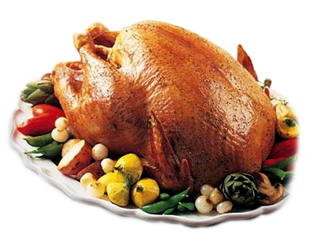
The Turkey!

Slide 3
Brine that Turkey!
A brine is a simple solution of salt and water
When you place a turkey in a brine, both the salt and the water move from an area of greater concentration (the brine) to an area of lesser concentration (the meat) in processes called diffusion and osmosis
The added water in the turkey’s muscle cells makes the meat juicier.
Meanwhile, the proteins in the turkey rearrange to incorporate the sodium and chloride ions from the salt
This reshaping helps the proteins to hold on to the added water, even after the meat is cooked.
The reconfiguring of the proteins also makes the meat more tender.

Slide 4
Simple Brine Recipe:
A 12- to 17-pound turkey should soak in 2 gallons of cold water and 1 cup of table salt for 6 to 12 hours.
An 18- to 24-pounder should sit in 3 gallons of cold water and 1 1/2 cups of table salt, also for 6 to 12 hours
If you are making a bone-in turkey breast, it requires 1 gallon of cold water and 1/2 cup of table salt for a brining time of 3 to 6 hours.

Slide 5
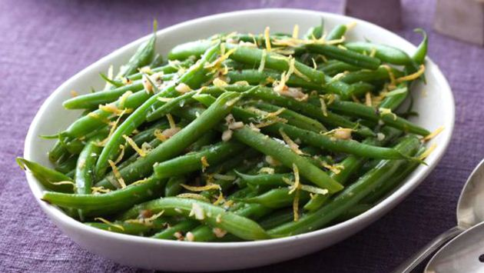
GREEN BEANS

Slide 6
Mushy? Heck no!
The secret to firm, yet tender, brightly colored green beans?
all about a high-heat blanch followed by an ice-cold shock
As soon as the green beans hit boiling water, their color brightens
Some of the air contained between their cells expands and bubbles off, bringing the cell walls closer together and causing the plant tissue to become more transparent, producing a brighter green color
The heat causes the beans to tenderize, but how?
The polymer, pectin, which gives the vegetable’s cell walls their structure, breaks down and water leaks from the cells.
The optimal boiling time for green beans, according to the pros, is three to five minutes.
If you boil any longer, your beans will be pretty limp
After some time, the color of the beans will also dull—a result of the chlorophyll molecules losing their magnesium ions in the heat.
Tossing the beans into a bowl of ice water stops these processes.

Slide 7
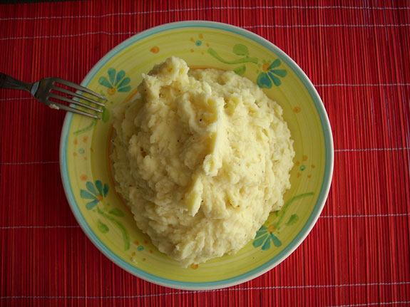
Fluffiest Mashed Potatoes!

Slide 8
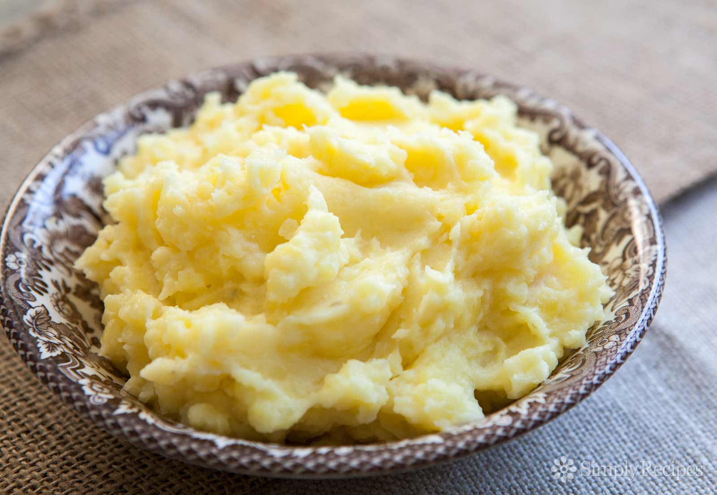
Russets all the way:
Potatoes are anywhere from 16-22% starch content and Russets are at the high end of that (review from our last chapter!)
When potatoes are cooked the granules absorb water from within the potato and swell like balloons, causing the cells that contain them to expand, separate and eventually burst
This, in turn, translates to a potato that falls apart when cooked.
A crumbly potato is an easily mashable potato
Russets also have more amylose starch molecules, as opposed to amylopectin; amylose is a sponge for liquid
This is just what you want when adding dairy to a potato!

Slide 9
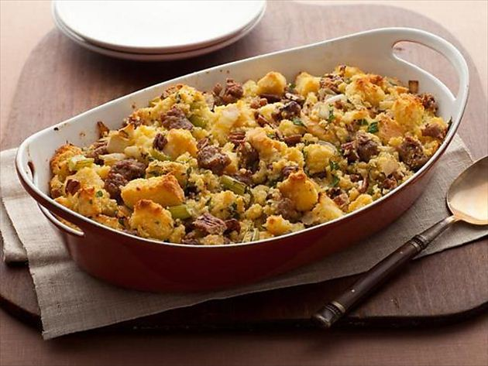
Savory Stuffing!

Slide 10
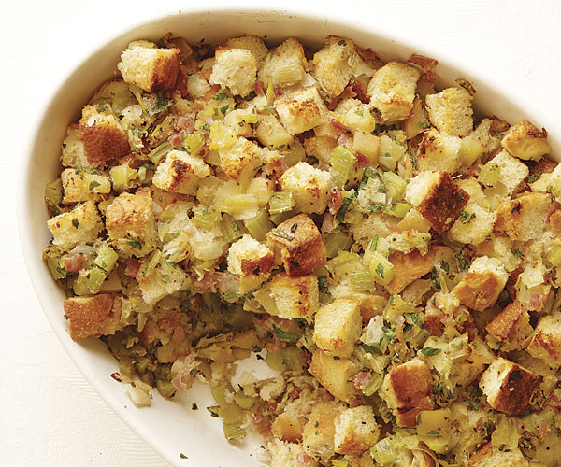
Stuff for yo’ Stuffin’ !
Sage Stuffing is traditional, but why sage?
Sage is a hearty herb, meaning its flavor compounds can withstand cooking.
sage, rosemary, oregano, thyme and marjoram are all hearty herbs
Basil, parsley, cilantro, dill, mint, chives and tarragon are delicate herb
The sage releases its flavors during the hours that a stuffed turkey cooks
Test cooks compared fresh herbs to dried herbs in 24 different recipes (other than stuffing), and in all but one case, tasters preferred fresh.
Be warned, though, ounce for ounce, dried herbs are more potent than fresh
So, if your stuffing recipe calls for dried sage, the test cooks recommend you quadruple the measurement for fresh sage leaves.

Slide 11
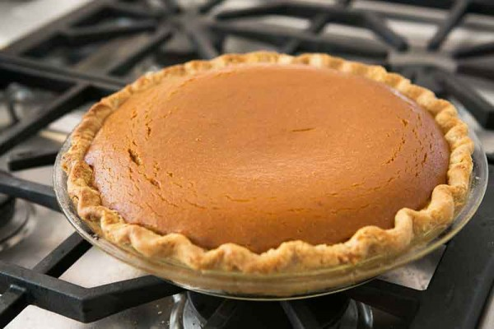
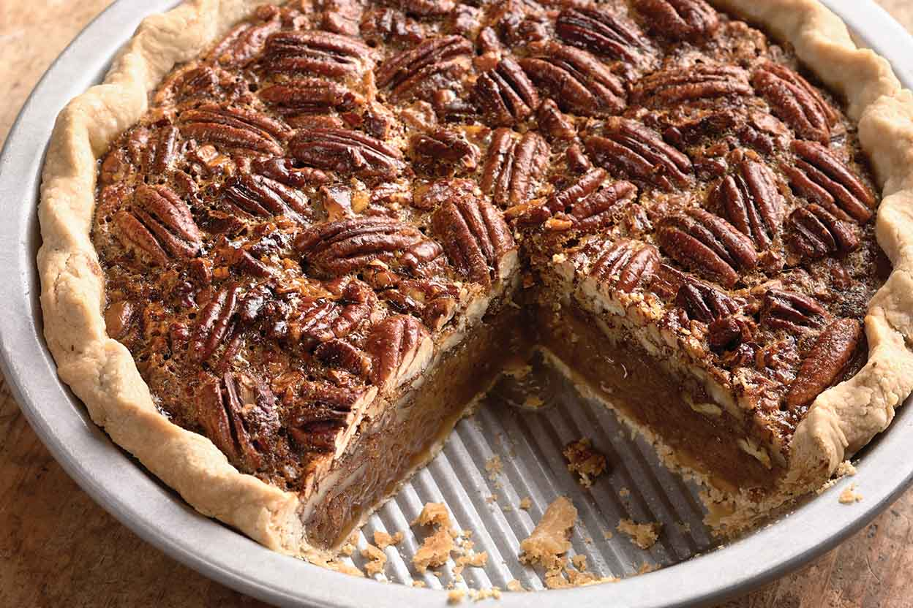
Pie!
VS.

Slide 12
Secret to best pie? The dough!
Perfect pie dough has just the right balance of tenderness and structure
The former comes from fat, the latter from long protein chains called gluten that form when flour mixes with water
Too little gluten and the dough won’t stick together—but too much and the crust turns tough
The test cooks at America’s Test Kitchen suggest using a combination of water and vodka, in place of the water that a crust recipe calls for.
When vodka is added to flour, its molecules, unlike water, do not cause the proteins to reconfigure into gluten
Using a mixture of vodka and water allows us to add more liquid to the dough to get it to be as malleable and easy to work with as possible without causing excessive toughness

