Slide 1
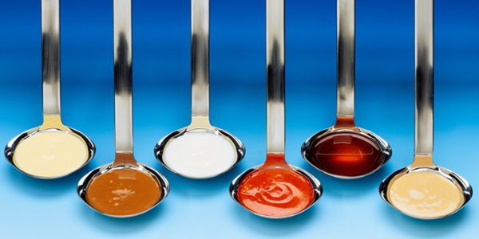
THE MOTHER SAUCES
Identify and describe culinary techniques used to thicken sauces
Identify and describe the 5 mother sauces and their ingredients, as well as sauces derived from the sauce
Identify and describe non-mother sauces

Slide 2
History of the Mother Sauces
All sauces in cooking are derived from
five basic sauces…
The Mother Sauces.
Traditionally prepared in huge quantities & then separated into smaller portions.
These smaller portions combined with additional ingredients created over 100’s of variations.

Slide 3
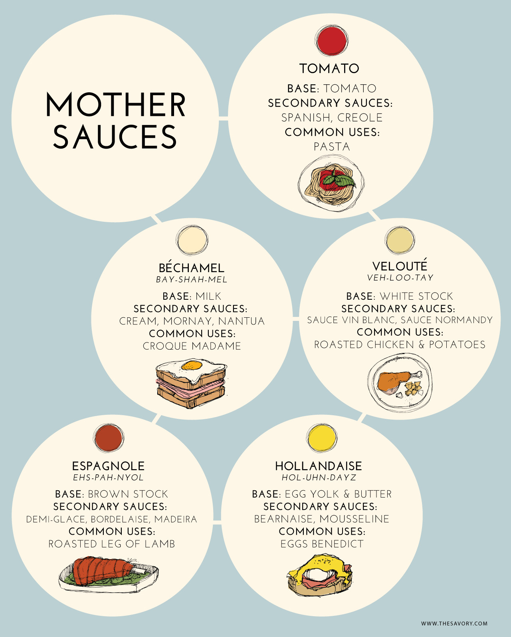

Slide 4
Thickeners in Sauces
A key ingredient in almost all sauces is the thickener, adding richness and body.
Roux
Beurre manié
Slurry
Liaison

Slide 5
Roux
1:1 ratio
4 T butter :: ¼ cup flour
Melt fat in the pan and then add flour
Stir until the flour is incorporated and then cooked.
The longer you cook it, the darker it will become.
The darker the roux, the less thickening power it has.
The end result is a thickening and flavoring agent.

Slide 6
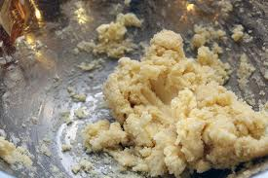
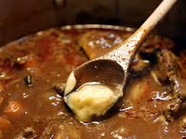
Beurre Manié
“Burr- Manyay”
1: 1 Ratio of Flour:Fat
Fat is NOT heated before adding to hot liquid

Slide 7
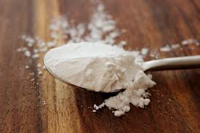
Slurry
Cornstarch mixed with a cold liquid
Used in place of a roux
Add slowly and stir continuously

Slide 8
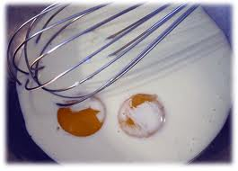
Liaison
“Lee-ay-zohn”
Mixture of egg yolks and heavy cream
Often used to finish some sauces.

Slide 9
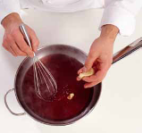
Review: Thickeners in Sauces
Which thickener is made of equal parts cooked flour and a fat, such as clarified butter, oil, or shortening?
Which thickener is a mixture of egg yolks and heavy cream, often used to finish some sauces?
Which thickener made of equal parts flour and soft, whole butter and added without cooking the butter?
Which thickener is made from cornstarch mixed with a cold liquid and can be used instead of roux?

Slide 10
Thickeners add richness and body to the…
Mother Sauces
Béchamel
Veloute
Tomato
Espagnole
Hollandaise

Slide 11
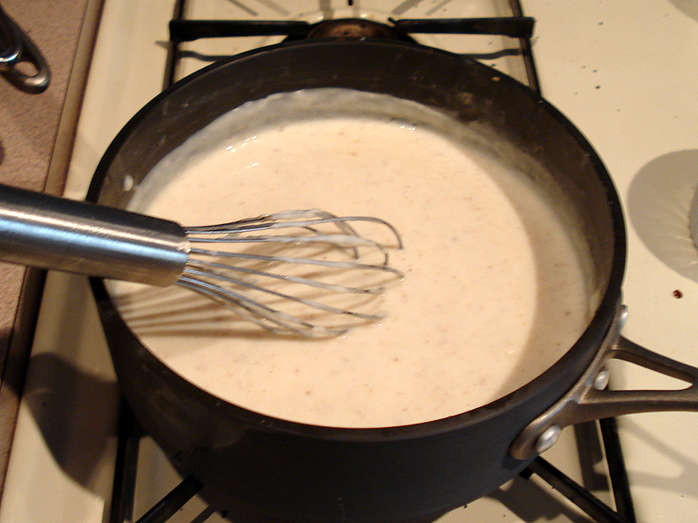
Bechamel - White Sauce
Preparation
Whisk scalded milk gradually into a flour butter roux.

Slide 12
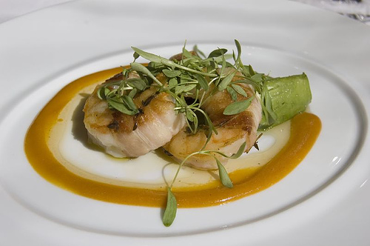
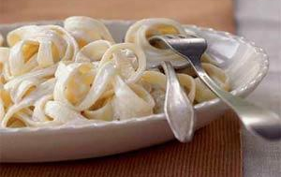
These Sauces are made FROM a Bechamel
Mustard Sauce: Whisk the Bechamel Sauce with ¼ cup of prepared mustard at the end.
Dill Cream Sauce: Add dry or fresh Dill 1 tsp at a time. Taste after each addition to check for readiness.
Once you have the basic sauce made, you can work with it to fit the taste profile you’re looking for.
Alfredo Sauce: Whisk grated parmesan cheese into the finished sauce (off heat) until it melts.
-Use about ¾ cup of cheese per two cups of sauce.
-Pour your cheese sauce over angel hair noodles that are cooked al dente.

Slide 13
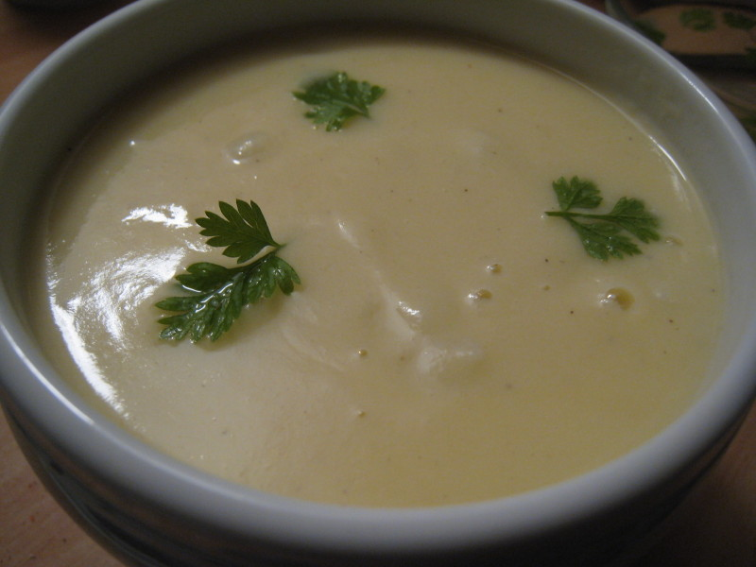
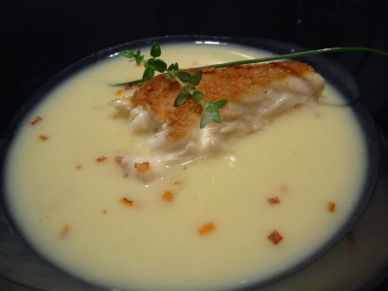
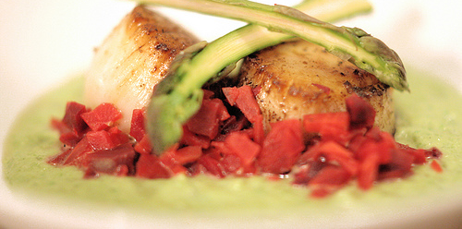
Veloute - Blonde Sauce
Uses a slightly darker roux (the roux is toasted longer to a slight brown color), and a white stock such as chicken or fish.
Use the 1:1 ratio = 1 cup liquid (stock) per 1 ounce of roux

Slide 14
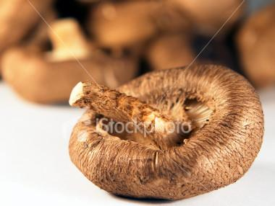
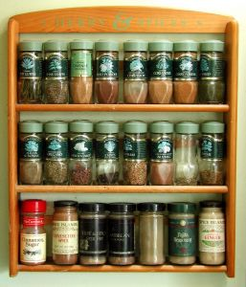
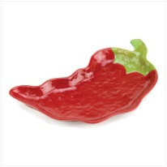
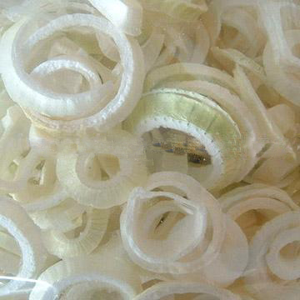
Veloute-Based Sauces
Mushroom Sauce: by sautéing mushrooms and stirring them into the finished sauce.
Herb sauce by finishing the Veloute sauce with minced fresh herbs to taste. Be careful, the herbs are potent.
Pepper Sauce: f you want a spicier sauce, add some hot pepper in with the roux and toast it a bit before adding your liquid.
Onion sauce: If you want some onion flavor, chop up part of an onion and sauté it, same as you’d do for a mushroom sauce.

Slide 15
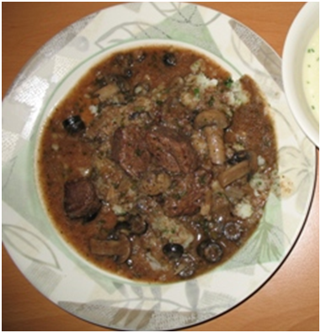
Espagnole - Brown Sauce
Prepared from vegetables and herb that are cooked in a brown roux, a dark stock such as beef, and then a tomato purée.
The sauce is left to simmer for around two hours until it reduces to a thick brown sauce.
The final stage is to pass the sauce through a sieve, which will retain all of the vegetables, lumps and unwanted ingredients.

Slide 16
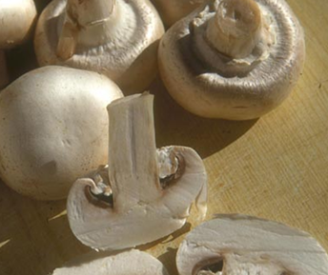
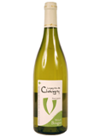
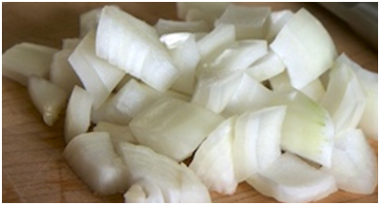
Espagnole-Based Sauces
Mushroom Sauce: Espagnole sauce and mushrooms.
Bordelaise Sauce: Espagnole sauce with red wine, shallots and herbs.
Lyonnaise Sauce: Espagnole sauce with chopped onions, parsley and white wine.

Slide 17
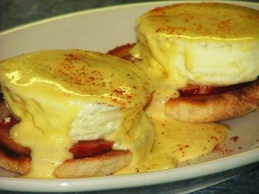
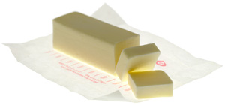
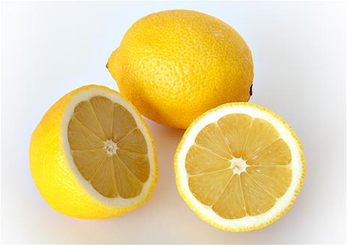
Hollandaise - Butter Sauce
Hollandaise sauce is an emulsion of butter and lemon juice.
Egg yolks are used as the emulsifying agent.
Usually seasoned with salt and cayenne pepper.
It must be made and served
warm, not hot
Properly made, the sauce
is smooth and creamy.
The flavor should be rich and buttery, with a mild tang added by the lemon juice and seasonings.

Slide 18
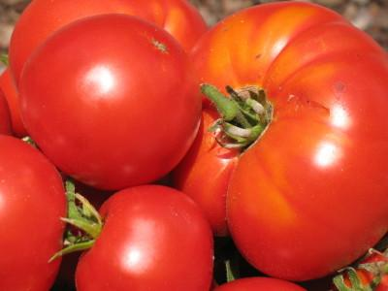
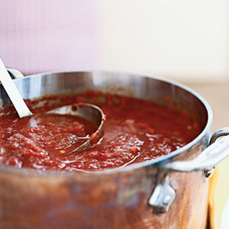
Tomato Sauce - Red Sauce
Made with tomatoes, vegetables, seasonings, and vegetable stock.
Final product is thick and rich, with a slightly sweet flavor.
Marinara sauce is a common Italian variation of this mother sauce, made by adding onions, garlic and oregano.

Slide 19
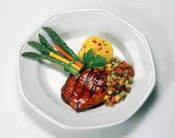
Other Sauces (Non-Mother)
Compound butter
Coulis
Salsa
Jus-lié
6.2

Slide 20
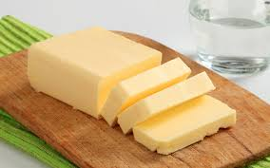
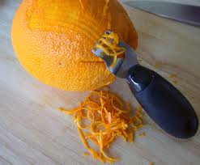
Other Sauces (Non-Mother)
Compound butter
A mixture of raw butter and various flavoring ingredients, such as herbs, nuts, citrus zest, shallots, ginger, and vegetables.
6.2

Slide 21
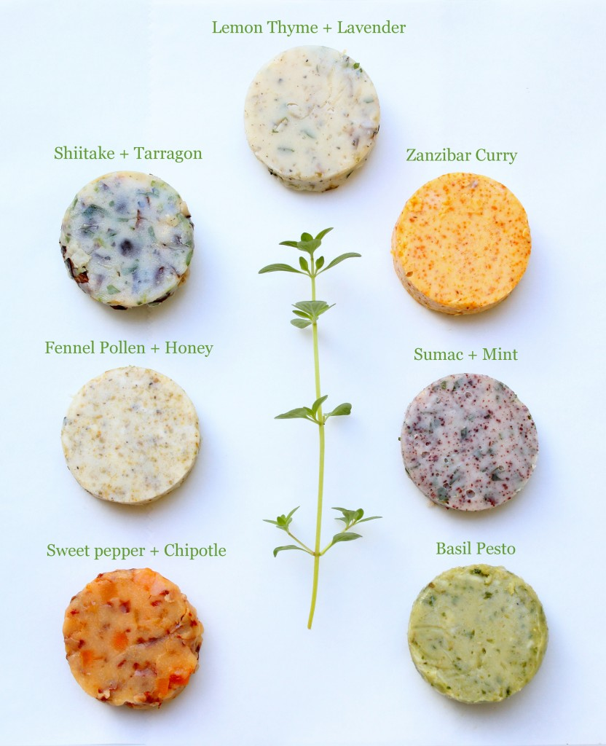

Slide 22
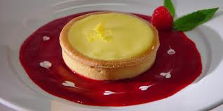
Other Sauces (Non-Mother)
Coulis
Thick puréed sauce
Typically made from fruit
6.2

Slide 23
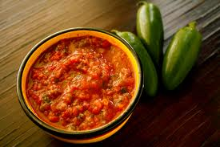
Other Sauces (Non-Mother)
Salsa
Cold mixture of fresh herbs, spices, fruits, and/ or vegetables.
It can be used as a sauce for meat, poultry, fish, or shellfish.
6.2

Slide 24
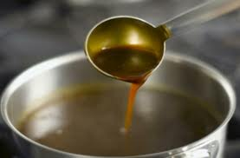
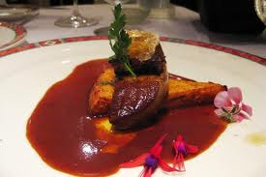
Other Sauces (Non-Mother)
Jus-lié
Sauce made from the juices from cooked meat and brown stock.
6.2

Slide 25
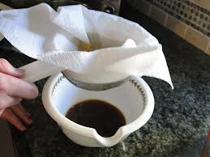
Straining a sauce…
The easiest way to strain sauce is the wringing method.
Place a clean cheesecloth over a bowl, and pour the sauce through the cheesecloth into the bowl.

Slide 26
Mother Sauce Web-Site
You work for a local restaurant and have been asked to create an informational web-site describing the following of one of the mother sauces:
History of the sauce
Sauces derived from the mother sauce
Recipes using the sauce
Images and videos showing how to make the sauce and how home cooks could make their own
Béchamel
Veloute
Tomato
Espagnole
Hollandaise

