Slide 2
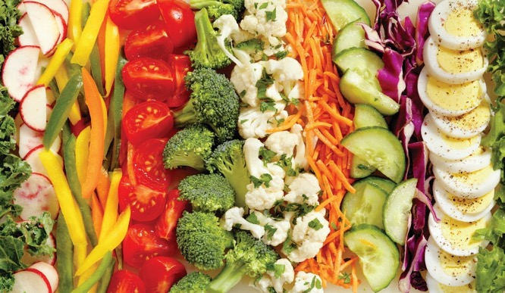
SALADS AND THE MENU
Salad:
Single food
Mix of different foods
Held together
Accompanied by dressing
Notes:
A salad is defined as a single food or a mix of different foods accompanied by or held together with a dressing. Today the salad section on most menus
goes way beyond the simple dinner salad. Salads can actually be used in five different ways.

Slide 3
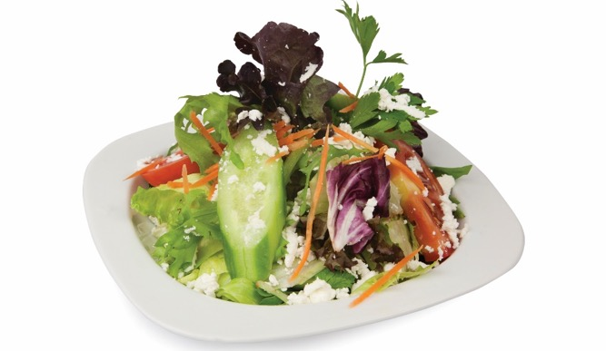
SALADS AND THE MENU
Starter salad:
Appetizer to main meal
Smaller portion
Light, fresh, crisp ingredients
Tangy, flavorful dressings
Small portions of proteins
Set tone for rest of meal
Notes:
A starter salad, served as an appetizer to the main meal, is smaller in portion and consists of light, fresh, crisp ingredients to stimulate the appetite. Generally, salad greens and other vegetables lightly coated with a tangy, flavorful dressing work well as starter salads. A starter salad can also include small portions of protein such as seared tuna. A satisfying, attractive salad can set the tone for the rest of the meal.

Slide 4
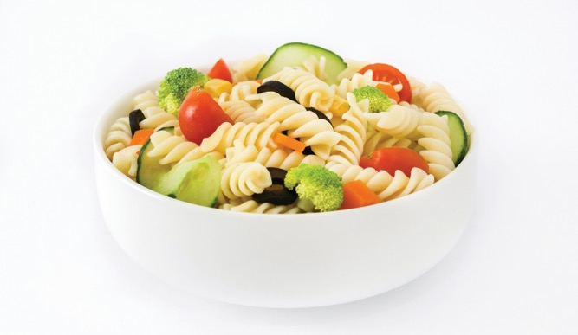
SALADS AND THE MENU
Accompaniment salad:
Side salad
Served with main course
Light and flavorful
Not too rich
Balance
Complement main course
Notes:
An accompaniment salad, also known as a side salad, is served with the main course of the meal. It should be light and flavorful, but not too rich.
The side salad should balance and complement the main course. For example, never serve a starchy salad, such as potato salad, when the main entrée also
contains a starch (potatoes, rice, or pasta). Sweet fruit salads can accompany ham and pork. Lighter vegetable salads are good choices for hearty meals.
Heavier salads, such as potato or pasta salad, go with a light main entrée, such as a sandwich.

Slide 5
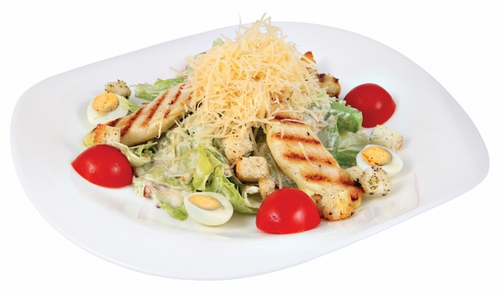
SALADS AND THE MENU
Main-course salad:
Full meal
Protein ingredients
Well-balanced meal—visually and nutritionally
Variety of vegetables, greens, and/or fruits
Notes:
Main-course salads, as shown in Figure 15.3, are large enough to serve as a full meal and also contain protein ingredients, such as meat, poultry, seafood,
egg, beans, or cheese. They provide a well-balanced meal, both visually and nutritionally. In addition to protein ingredients, the main-course salad can contain a variety of vegetables, greens, and/or fruits. It is a menu staple for many restaurants. Such salads range from the very traditional chef’s salad, containing mixed greens, raw vegetables, strips of meat, and cheese, to very popular Caesar salads with grilled chicken or shrimp.

Slide 6
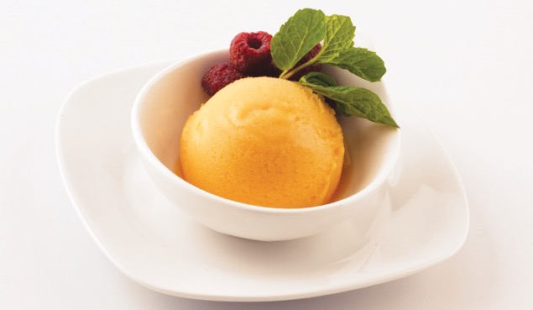
SALADS AND THE MENU
Intermezzo salad:
Palate cleanser
After rich dinner; before dessert
French meals
Refreshes or stimulates appetite
Very light
Slightly acidic dressings
Notes:
The intermezzo salad is intended to be a palate cleanser after a rich dinner and before dessert. Often served in classic French meals, it refreshes or
stimulates a person’s appetite for the dessert or next course. This salad must be very light, such as Bibb lettuce or Belgian endive lightly dressed with vinaigrette, or a small fruit salad. Slightly acidic dressings, such as lemon or vinaigrette with flavored vinegar, help to clear the palate of previous flavors. Sorbet is also sometimes served as an intermezzo salad.

Slide 7
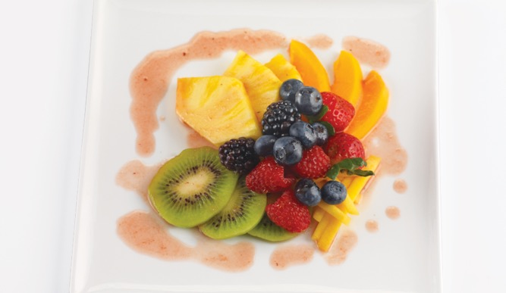
SALADS AND THE MENU
Dessert salad:
Sweet and contain fruits, sweetened gelatin, nuts, cream, and whipped cream
Buffet service
Family-style service
Attractive visual presentation
Notes:
Dessert salads are usually sweet and often contain fruits, sweetened gelatin, nuts, cream, and whipped cream. These salads are often too sweet to be served
at any other point in the meal. They are popular for buffet service and meals served family style because the colors make an attractive visual presentation.

Slide 8
SALAD INGREDIENTS
Quality salad:
Freshest ingredients—emphasis on seasonality
Ingredients in balance
Appealing to the eye
Consider:
Freshness
Flavor
Eye appeal
Notes:
Most salads consist of a lettuce base, but a wide variety of ingredients can go into a salad.
The three keys to ensuring a quality salad, regardless of the ingredients used, are as follows:
• Using the freshest ingredients with an emphasis on seasonality
• Having all the ingredients in balance
• Making sure the salad is appealing to the eye
Always consider freshness, flavor, and eye appeal when making any type of salad.

Slide 9
SALAD INGREDIENTS
Traditional salad vegetables:
Celery
Cucumber
Fruit
Mushrooms
Peppers
Tomatoes
Root vegetables
Notes:
There are many traditional salad vegetables, including:
• Celery
• Cucumber: many species, including European and Japanese varieties
• Fruit: berries and citrus fruits
• Mushrooms: common mushroom, enoki, portabella, crimini, cepe, morel, shiitake, chanterelle
• Peppers: hot or sweet, bell, pimiento, banana
• Tomatoes: various colors and sizes
• Root vegetables (roots, tubers, and bulbs): carrots, beets, radishes, turnips, onions, scallions

Slide 10
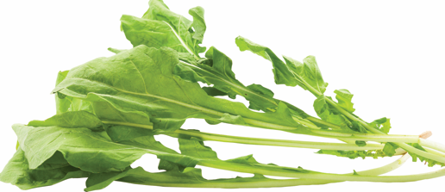
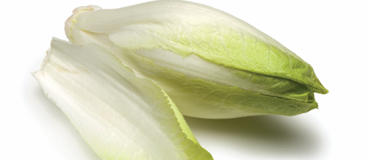
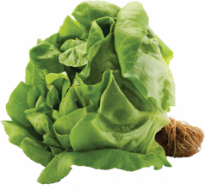
TYPES OF SALAD GREENS
Arugula
Belgian endive
Butterhead lettuce
Pungent, distinctive, peppery flavor
Witloof, witlof, French endive
Related to endive
Bitter, but pleasant flavor
Used alone or mixed with other greens
Steamed, simmered, or grilled
Tender, loose, bright-green leaves
Mild flavor
Does not keep well
Bib lettuce and Boston lettuce
Notes:
Belgian endive
Also known as witloof, witlof, or French endive, Belgian endive is related to endive, has a slightly
bitter but pleasant flavor, is used solo for salads or mixed with other greens, and can be steamed,
simmered, or grilled.
Butterhead lettuce
Butterhead lettuce has tender, loose, bright-green leaves with a mild flavor, which allows for
countless culinary pairings. It does not keep well. Bib (limestone) lettuce and Boston lettuce are
two varieties.

Slide 11
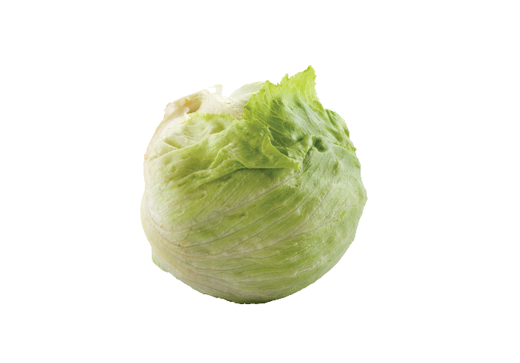
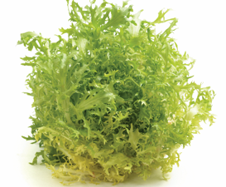
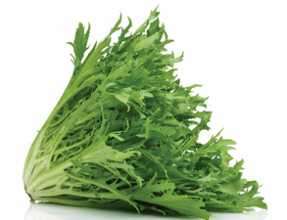
TYPES OF SALAD GREENS
Crisphead lettuce
Curly endive
Escarole
Head lettuce
Most popular
Served alone or mixed with
other greens
Frisée or chicoree frisée
Bitter flavor
Used with other greens
Strength and bitterness diminishes as color lightens
Notes:
Crisphead lettuce
Also known as iceberg (head) lettuce, crisphead lettuce is the most popular American salad green.
It can be served alone or mixed with other greens, such as romaine.
Curly endive
Also known as frisée or chicoree frisée, curly endive has a slightly bitter flavor and is generally used with
other greens.
Escarole
The strength and bitterness of flavor of escarole diminishes as its color lightens.

Slide 12
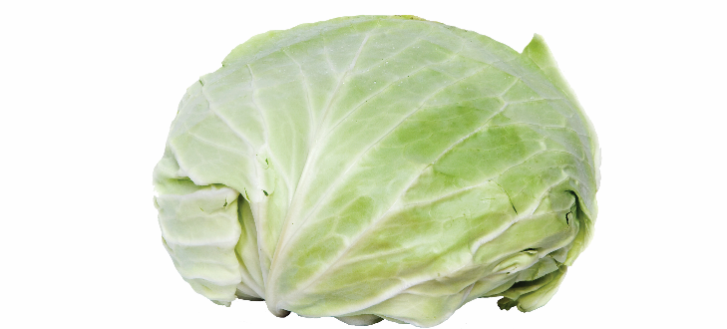
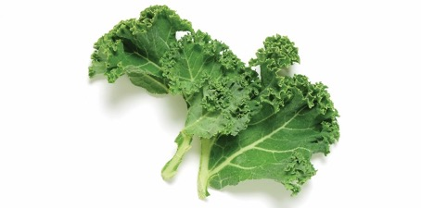
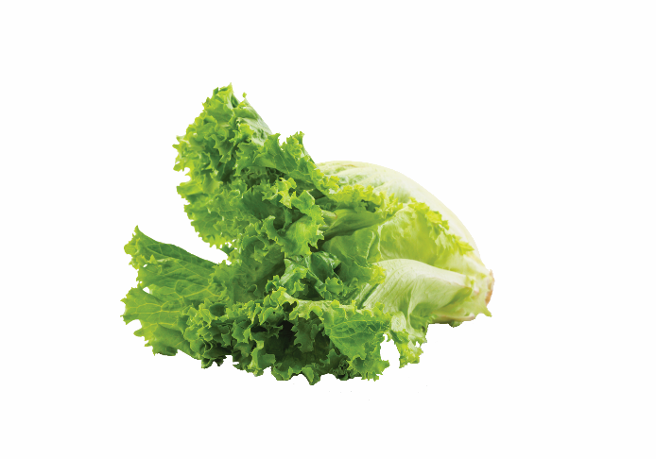
TYPES OF SALAD GREENS
Green cabbage
Kale
Leaf lettuce
Slightly tough leaf
Slightly strong flavor
Cabbage produces large, wrinkled leaves
Curly-leaved kale
Light to dark green or red
Great nutritional value
Red or green leaves
Grow in bunches
Wilts easily
Mild flavor
Variety and color to salads
Oak leaf—slightly bitter flavor
Notes:
Green cabbage
Green cabbage has a slightly tough leaf and slightly strong flavor.
Kale
Kale is a cabbage that produces large, wrinkled leaves. There is also a curly-leaved kale. Kale can
range in color from light to dark green, with red varieties as well. Raw kale has great nutritional
value and is popular in salads.
Leaf lettuce
Leaf lettuce has red or green leaves; grows in bunches; wilts easily; and gives mild flavor, variety,
and color to salads. Oak leaf lettuce has a slightly bitter flavor.

Slide 13
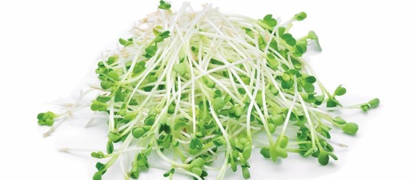
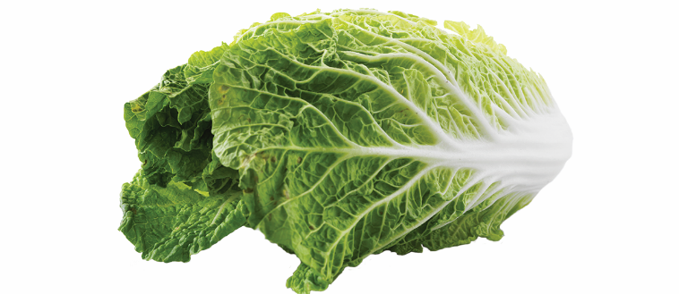
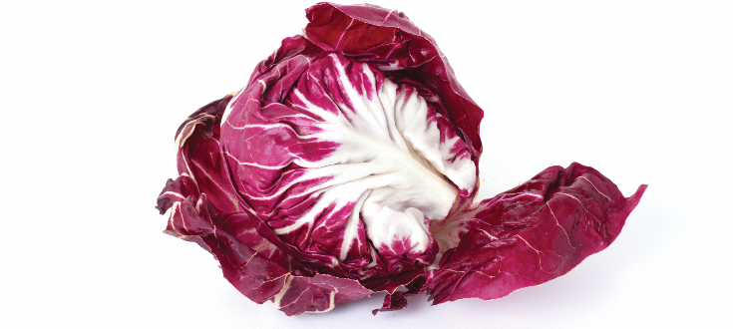
TYPES OF SALAD GREENS
Microgreens
Napa cabbage
Radicchio
Plant’s first true leaves
Formed between sprouting seed stage and baby stage
Mild, delicate flavor
Add color and flavor
Milder flavor than Savoy cabbage
Leaf chicory
Italian chicory
Crunchy texture
Slightly bitter flavor
Mixed with other greens
Adds color
Notes:
Microgreens
Microgreens are a plant’s first true leaves formed between the sprouting seed stage and baby stage.
They have a mild, delicate flavor and add color and flavor. There are many types, including arugula,
broccoli, green and red cabbage, kohlrabi, Swiss chard, radish, beetroot, and red kale.
Radicchio
Radicchio is a leaf chicory sometimes known as Italian chicory. It has a crunchy texture and slightly
bitter flavor, is generally used in a mixture with other greens for flavor and color, and can be
cooked like collard greens or other greens.

Slide 14
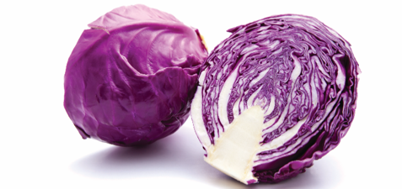
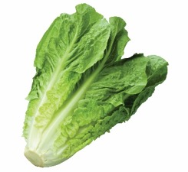
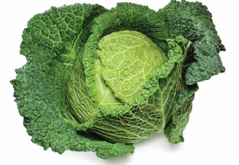
TYPES OF SALAD GREENS
Red cabbage
Romaine
Savoy cabbage
Slightly tough leaf
Mild flavor
Crisp texture
Full, sweet, mild flavor
Keeps well and easy to handle
Caesar salad
Milder flavor than green cabbage
Notes:
Romaine
Romaine lettuce has a crisp texture and full, sweet, mild flavor; it keeps well and is easy to handle; and
it is an essential ingredient in Caesar salad.

Slide 15
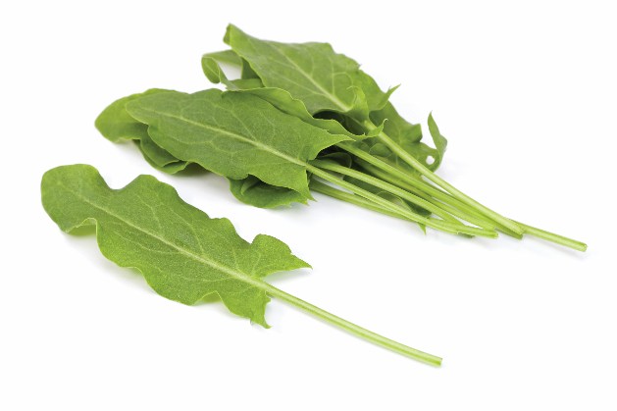
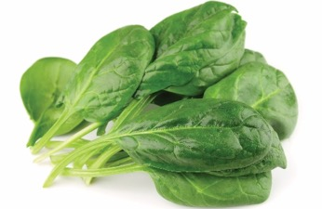
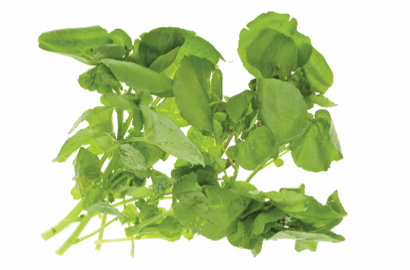
TYPES OF SALAD GREENS
Sorrel
Spinach
Watercress
Slightly acidic and bitter flavor
Small leaves—mild flavor
Wash thoroughly
Remove coarse stems
Baby spinach—mild, fresh flavor
Pungent, peppery flavor
Garnish and salads
Notes:
Sorrel
Sorrel contains oxalic acid, yielding a slightly acidic and bitter flavor; smaller leaves are preferred for
their milder flavor.
Spinach
Good alone or mixed with other greens, spinach must be washed very thoroughly, removing coarse
stems before service. Baby spinach is highly regarded for its mild, fresh flavor.
Watercress
Watercress has a pungent, peppery flavor and is used as a garnish and in salads.

Slide 16
THE FOUR BASIC PARTS OF A SALAD
Base:
Layer of salad greens
Line plate or bowl
Small leafy greens
Notes:
Although salads are made up of many ingredients and vary greatly in appearance, there are four basic parts to most any salad.
The base of a salad is usually a layer of salad greens that line the plate or bowl in which the salad will be served. Use smaller leafy greens,
cup-shaped Boston lettuce, or iceberg lettuce leaves to give height to salads and form edible containers. Finely cut iceberg lettuce may also
serve as a base to support garnishes served with tacos, like sour cream, guacamole, and salsa. Also use romaine, Belgian endive, and leaf lettuce
as a salad base.

Slide 17
THE FOUR BASIC PARTS OF A SALAD
Body:
Main ingredients
Mixture of vegetables
Meats
Cheeses and various fruits
Mayonnaise-based salad
Ingredients vary by season or occasion
Notes:
The body of a salad consists of the main ingredients. The body can be a mixture of vegetables, such as lettuce, tomatoes, carrots, etc.; meats,
such as turkey breast or ham; or cheeses and various fruits, such as mandarin oranges or apples. Use mayonnaise-based salads, such as tuna
salad or crabmeat salad, as a salad body placed on a base of lettuce. Salad ingredients can vary by season or occasion, but freshness is
always important.

Slide 18
THE FOUR BASIC PARTS OF A SALAD
Dressing:
Liquid or semiliquid used to flavor salads
Holds salad together
Mayonnaise to vinaigrette
Cold sauces—flavor, moisten, enrich
Green and vegetables salads—tart or sour dressings
Fruit salads—slightly sweetened dressings
Mix ahead, plate, or service
Notes:
A salad dressing is a liquid or semiliquid used to flavor salads. The dressing acts as a sauce that holds the salad together. Dressings
can range from mayonnaise for potato- or macaroni-based salads to vinaigrettes for lettuce-based salads. Sometimes dressings are called
cold sauces because their purpose is to flavor, moisten, and enrich food. Use tart or sour dressings for green salads and vegetable salads.
Use slightly sweetened dressings for fruit salads. Mix some dressings with the ingredients ahead of time, such as for a bound salad. Add some
dressings at plating and service to bring an additional flavor aspect to the final product.

Slide 19
THE FOUR BASIC PARTS OF A SALAD
Garnish:
Enhances appearance
Complements overall taste
Eaten with body of salad—flavor component
Simple
Mix with ingredients or add at end
Consider components and overall taste
Notes:
A garnish enhances the appearance of the salad while also complementing the overall taste. A garnish should be something that will
be eaten with the body of the salad, functioning as a flavor component. Simple garnishes are the best. Mix them with the other salad ingredients
or add them at the very end. For example, mix shredded carrot or a fine julienne of red bell pepper with salad greens, or lightly toss them with
seasoning and then place them on top of the greens. This garnish is decorative as well as tasty. Always consider the components and overall
taste of the salad when choosing a garnish.

Slide 20
TYPES OF SALAD
Green (tossed or composed)
Bound
Vegetable
Fruit
Combination

Slide 21
TYPES OF SALAD
Green salad:
Tossed (mixed) and composed
Prepare ingredients individually
Tossed—mix ingredients prior to plating
Composed—do not toss together ingredients
Arrange ingredients on base separately
Create desired taste experience
High level of visual appeal
Notes:
The two types of green salad are tossed (or mixed) and composed salad. Prepare all ingredients individually for either salad. Mix (or toss) together
the ingredients of a tossed green salad prior to plating. Then, place a tossed salad on a base or serve without further garnish. You do not toss together
the ingredients for a composed salad. Arrange the ingredients on the base separately to create the desired taste experience and achieve a high level of
visual appeal.

Slide 22
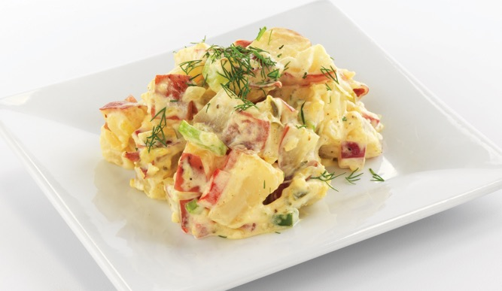
TYPES OF SALAD
Bound salad:
Prepared from cooked ingredients
Bound together with heavy dressing
Notes:
The bound salad is prepared from cooked primary ingredients such as meat, poultry, fish, egg, or starch such as potato, pasta, or rice.
The ingredients are bound together with some type of heavy dressing such as mayonnaise.

Slide 23
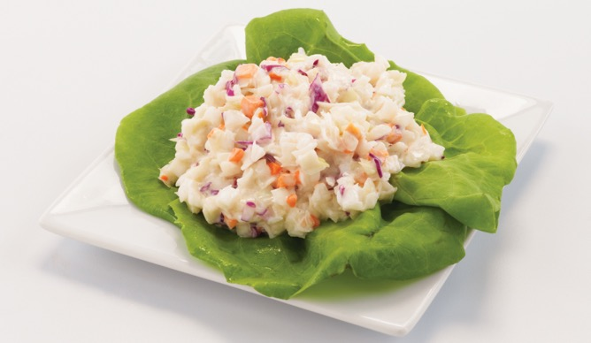
TYPES OF SALAD
Vegetable salad:
Prepared from cooked and/or raw vegetables
Heavy or light dressing
Allow ingredients to rest
  Increase flavor
  Change texture
Notes:
A vegetable salad is prepared from cooked and/or raw vegetables. Use a heavy dressing to bind this type of salad or toss with a lighter dressing.
For example, bind the cabbage for coleslaw with a heavier mayonnaise-based dressing or a lighter vinegar-and-oil dressing. As part of the preparation, allow the ingredients in a vegetable salad to rest for a period of time to increase flavor and change texture in the mixture of ingredients.

Slide 24
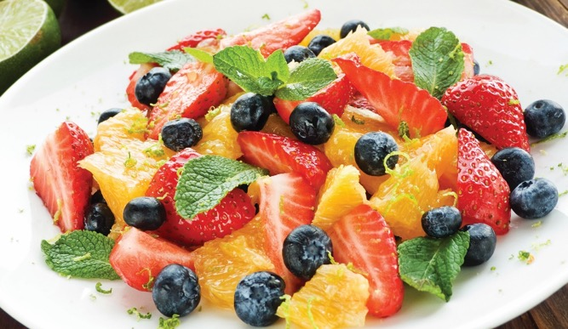
TYPES OF SALAD
Fruit salad:
Slightly sweet or sweet/sour dressing
Handle fruit carefully
Prepare salad close to service
  Prevents softening, browning, and moisture loss
Notes:
You prepare a fruit salad from fruit using a slightly sweet or sweet/sour dressing to enhance the flavor. Handle the
fruit carefully, and prepare the salad close to service to prevent the cut fruit from softening, browning, or losing moisture.

Slide 25
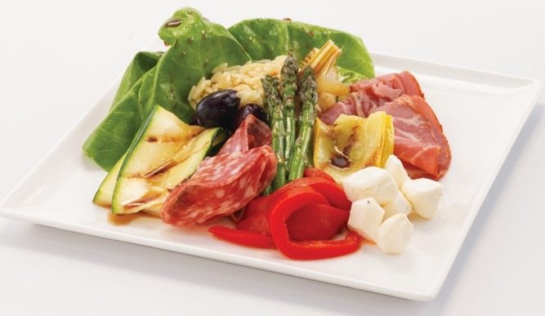
TYPES OF SALAD
Combination salad:
Incorporates combination of other salad types
Prepare according to individual guidelines
Notes:
A combination salad incorporates a combination of any of the four salad types discussed previously. When making a combination salad, prepare the different components according to their individual guidelines. Be sure to follow the guidelines for attractive salad arrangement.

Slide 26
TYPES OF SALAD
Salads—ready-to-eat food
Wash hands before prep
Wear single-use gloves
Change gloves when required
Notes:
Because salads are not cooked and are a ready-to-eat food, it is important to wash your hands before preparing them. Wear single-use gloves when
handling these ingredients and remember to change gloves when required.

Slide 27
DESIGNING AN ATTRACTIVE SALAD
Plate or bowl—picture frame
  Select right dish for portion
  Keep salad off rim
Maintain color balance
Add height
Cut ingredients neatly and uniformly
Notes:
Look at the plate or bowl as a picture frame. Select the right dish for the portion size. Keep the salad off the rim of the dish.
Maintain a good balance of colors. Dress up plain iceberg lettuce with shredded carrots, red cabbage, another colored vegetable, or darker greens. Remember, three colors is usually enough. Too many colors is unappetizing.
Height makes a salad more attractive. Ingredients that are mounded on a plate are more interesting and appealing than if they are spread flat over it. Place tomato or fruit wedges so that they overlap or lean on each other.
Always cut the ingredients neatly and uniformly.

Slide 28
DESIGNING AN ATTRACTIVE SALAD
Ingredients easily identified
Finely chop seasoning ingredients
Keep ingredient arrangement simple
Notes:
Make sure every ingredient can be easily identified. Cut every ingredient into large enough pieces so that the guest can recognize them immediately. Use bite-sized pieces unless the food item can be cut with a fork.
Finely chop items used as seasoning, such as onions.
Keep the arrangement of ingredients simple. Using too many ingredients in an effort to make a salad more visually attractive may end up muddling the taste of the salad.

Slide 29
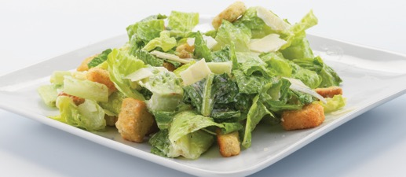
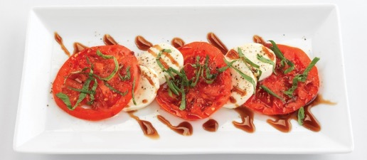
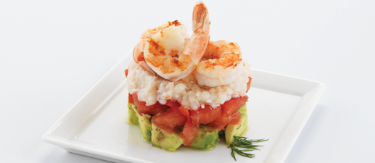
DESIGNING AN ATTRACTIVE SALAD
Caesar salad
Caprese salad
Crab and shrimp tower salad
Notes:
A variety of presentation styles.

Slide 30
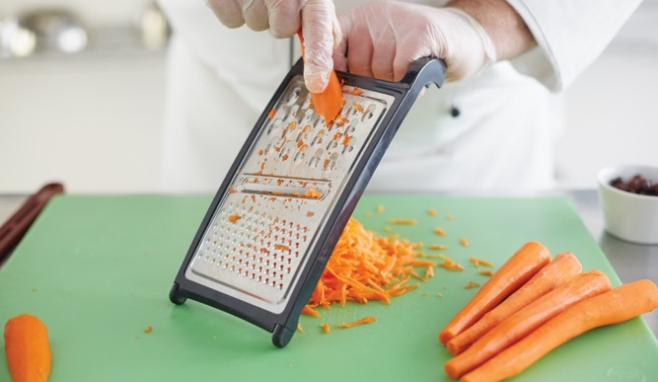
PREPARING VEGETABLE SALADS
Gather all ingredients
Cut ingredients neatly
  Uniform size
  Cut fresh vegetables close to service
Cook vegetables according to recipe
  Firm, crisp texture
  Good color
Notes:
Gather all ingredients, including dressing.
Cut all ingredients neatly. The shapes of the vegetables are important to the appearance of the salad:
Cut vegetables in a uniform size.
Cut the fresh vegetables as close to service time as possible.
Cook vegetables in accordance with the recipe, if the vegetables need to be cooked, but always protect
the color and texture. Cooked vegetables should be firm, with a crisp texture and good color.

Slide 31
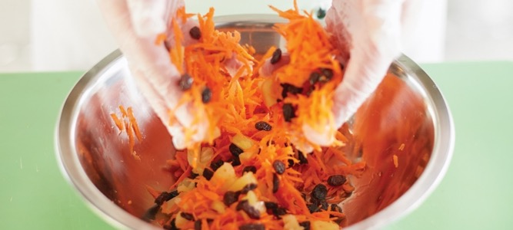
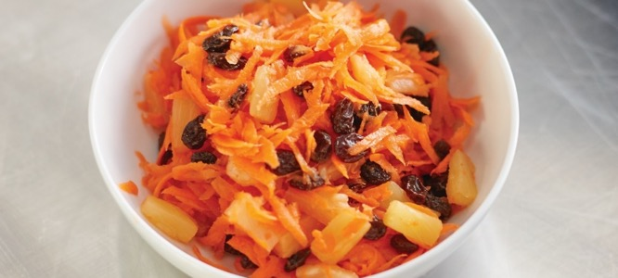
PREPARING VEGETABLE SALADS
Drain and chill cooked vegetables before mixing
Toss ingredients in a stainless-steel bowl
Use chilled plate or bowl
Notes:
Thoroughly drain and chill cooked vegetables before mixing them with the other ingredients.
Toss all ingredients in a stainless-steel bowl and chill thoroughly.
Serve on a chilled plate or in a chilled bowl, with base and garnish if called for, in accordance with the recipe:
Do not plate vegetable salads with acidic dressings too far ahead of time.
If a base is called for, use sturdy, crisp greens—iceberg, romaine, or endive—because these greens will not wilt easily.

Slide 32
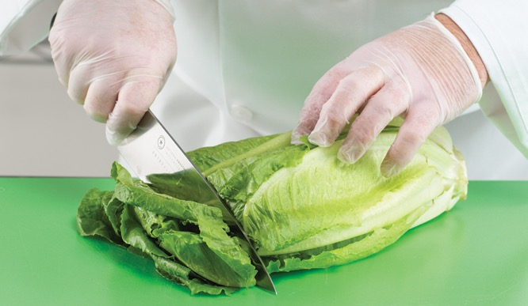
PREPARING A GREEN SALAD
Choose ingredients
  Various types of greens
Wash and clean ingredients
  Discard withered, wilted, moldy, discolored, or rotten pieces
Notes:
Choose the ingredients. Try using one or more types of greens with flavors that will enhance the combination:
some sweet and some bitter; some crisp and some soft; and some light in color and some dark in color.
Wash and clean the ingredients. Discard all withered, wilted, moldy, discolored, or rotten pieces.

Slide 33
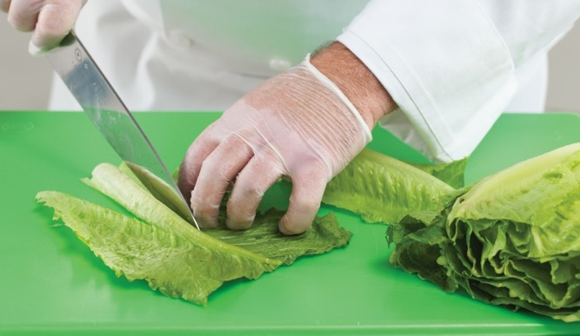
PREPARING A GREEN SALAD
Remove bitter and/or woody stems and cores
Use salad spinner to dry ingredients
Notes:
Remove all bitter and/or woody stems and cores.
Use a salad spinner to spin the ingredients completely dry.

Slide 34
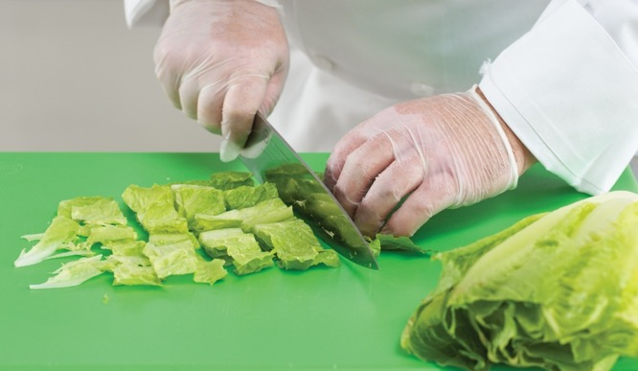
PREPARING A GREEN SALAD
Uniform cuts
Store ingredients immediately
Tear or cut greens into bite-size pieces
  Serving size of lettuce—half of dollar bill
Notes:
Cut as required, making sure the cuts are uniform.
Store any ingredients that you are not using immediately.
Tear or cut the greens into bite-size pieces. Guests should not have to cut the greens.
The preferred serving size for a piece of lettuce is about the size of half of a dollar bill.
If time does not allow for tearing greens, be sure to use sharp, stainless-steel knives to
cut them.

Slide 35
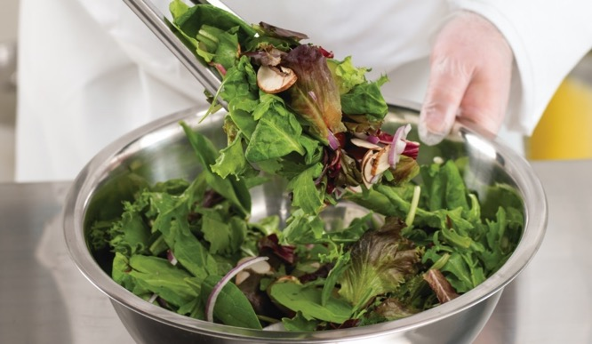
PREPARING A GREEN SALAD
Tossed green salad:
Combine ingredients in stainless-steel bowl
  Toss greens gently
  Mix uniformly
  Add nonjuicy raw vegetable garnish
Garnish with vegetables
  Before service
  Avocado
  Croutons
Notes:
When ready for assembly:
Tossed Green Salad
Combine all ingredients in a stainless-steel bowl and toss gently (being careful not to break apart delicate items).
Toss the greens gently until they are uniformly mixed. It is acceptable to add a nonjuicy raw vegetable garnish,
such as julienne of green pepper or carrot shreds. Cut the garnish into broad, thin slices or shreds.
Garnish with tomato wedges, cherry tomatoes, cucumber slices, radishes, and pepper rings, as desired.
Garnishes that will become soggy or discolored, such as croutons or avocados, should be added just before service.

Slide 36
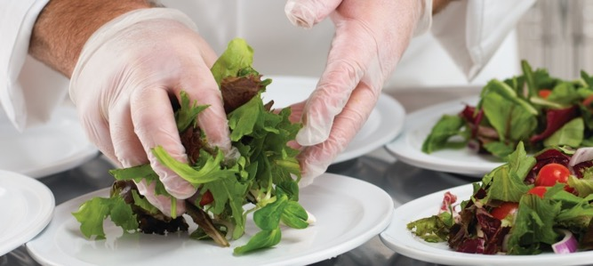
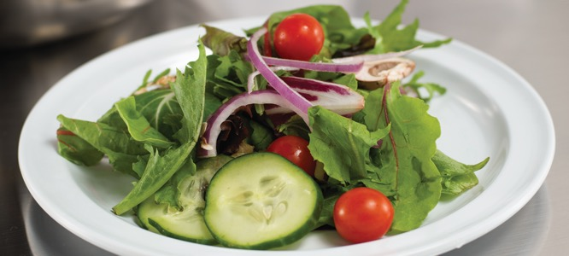
PREPARING A GREEN SALAD
Tossed green salad:
Dress greens appropriately
  Lightly coat greens
  One-third ounce dressing to ounce of greens
4. Place on cold plates
  Use a base
  Do not plate > 2 hours before service
5. Serve chilled with chilled fork and dressing
Notes:
When ready for assembly:
Tossed Green Salad
Dress the greens appropriately with only enough dressing to lightly coat the greens as close to service time as possible.
The normal ratio is one-third ounce of dressing per ounce of greens.
Place the salad on cold plates, using a base if necessary. Avoid putting salad ingredients on plates more than an hour
or two before service, because they will wilt or dry out.
Serve chilled with a chilled fork and dressing as required.

Slide 37
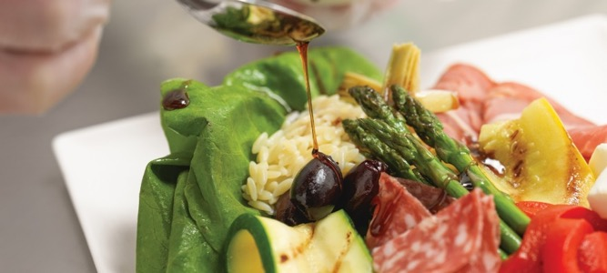
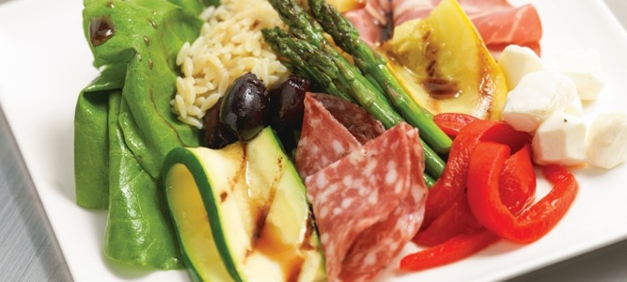
PREPARING A GREEN SALAD
Composed green salad:
Place base on chilled plate or bowl
Toss ingredients with dressing
Place ingredients
Garnish and dress
Served chilled with chilled fork
Notes:
When ready for assembly:
Composed Green Salad
Place desired base on a chilled plate or bowl.
If serving immediately, pretoss each ingredient with a small amount of dressing or olive oil and lightly
season. If not serving immediately, skip this step to avoid wilting and loss of color. The flavor of the
finished dish will not be as complete, but the texture and color of the ingredients will be fresher.
Place ingredients as planned.
Garnish and dress in accordance with the recipe or service need.
Serve chilled with a chilled fork.

Slide 38
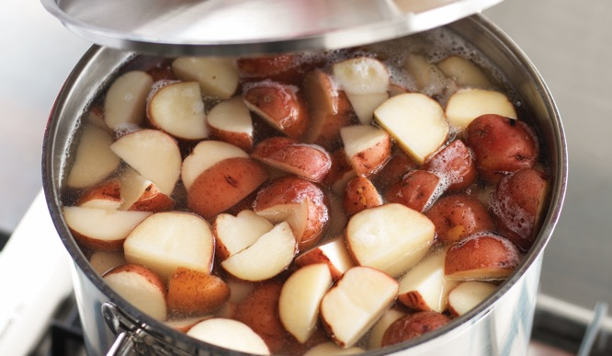
PREPARING BOUND SALADS
Cook main ingredients correctly
  Pasta—al dente
  Potatoes—soft in center
  Proteins—moist and tender
Uniform-sized ingredients
Attractive shapes
Well-balanced and seasoned dressing
Chill ingredients during preparation
Notes:
Cook main ingredients correctly:
Ensure pasta is cooked al dente.
Ensure potatoes are cooked until soft in the center, but not falling apart. See Figure 15.16a.
Ensure proteins are fully cooked, but still moist and tender.
Cut cooked and raw ingredients to a uniform size.
Cut ingredients in attractive shapes to enhance the appearance of the finished dish.
Ensure all dressing is well-blended and seasoned.
Keep all ingredients chilled during preparation:
Make sure that cooked ingredients are well chilled before mixing with mayonnaise or mayonnaise-based dressing.
Keep the completed salad out of the temperature danger zone at all times to avoid any danger of foodborne illness.

Slide 39
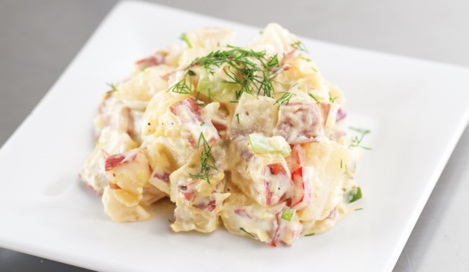
PREPARING BOUND SALADS
Add crisp food—flavor and interest
Marinate potatoes and seafood
Fold in thick dressings
Use scoops to portion
  Adds height and shape
Serve on chilled plates
  Appropriate base and garnish
Notes:
Add crisp food for flavor and interest, such as celery, carrots, green peppers, chopped pickles, onions, water chestnuts, or apples.
Be sure that the flavors complement each other.
Marinate potatoes and seafood in a light vinaigrette before mixing with other salad ingredients. Be sure to drain excess liquid first.
Fold in thick dressings gently to avoid crushing or mashing the main ingredient, as with potato or egg salad.
Portion cooked salads with a utensil such as a scoop to provide portion control and give height and shape to the salad.
Serve on chilled plates with an appropriate base and garnish in accordance with the recipe and service needs.

Slide 40
PREPARING GELATIN SALADS
Use right amount of gelatin
  Molded gelatin—2 ounces dry, unsweetened per gallon liquid
  Medium-texture (sliceable)—8 ounces of dry, unsweetened gelatin per gallon liquid
  Sweetened, flavored gelatin—24 ounces of gelatin per gallon liquid
Notes:
Use the right amount of gelatin for the volume of liquid in the recipe. Basic proportions for unflavored gelatin are:
For a soft gel (molded gelatin), use 2 ounces of dry, unsweetened gelatin per gallon of liquid (19 grams per liter).
For a medium-texture, sliceable gelatin, use 8 ounces of dry, unsweetened gelatin per gallon of liquid.
The basic proportions for sweetened, flavored gelatin are 24 ounces of gelatin per gallon of liquid (180 grams per liter).

Slide 41
PREPARING GELATIN SALADS
Recipe altered—changes gelatin setting
  Test recipe first
Gelatin dissolves at 100°F (38°C)
Add solid ingredients when partially set
  Mix evenly
  Prevents from sinking
  Raw pineapple or papaya dissolve gelatin
Drain canned fruit
Notes:
Altering the standard recipe in any way (using fruit, whipping, etc.) changes the way gelatin sets. Test each recipe before using it on the menu.
Gelatin dissolves at about 100°F (38°C), but it will dissolve faster at higher temperatures. To dissolve unflavored gelatin, stir it into cold liquid to
avoid lumping. Let it stand for five minutes to absorb water. Heat it until dissolved, or add hot liquid and stir until dissolved. To dissolve
sweetened, flavored gelatin, stir it into boiling water. Use half cold water or crushed ice for a quick set.
Add solid ingredients when the gelatin is partially set to keep them evenly mixed and prevent them from settling to the bottom.
Raw pineapple or papaya contains enzymes that dissolve the gelatin; the gelatin will not set. Cooked or canned pineapple or papaya
may be used.
Always drain canned fruit well. Measure the drained liquid and include it in the added liquid.

Slide 42
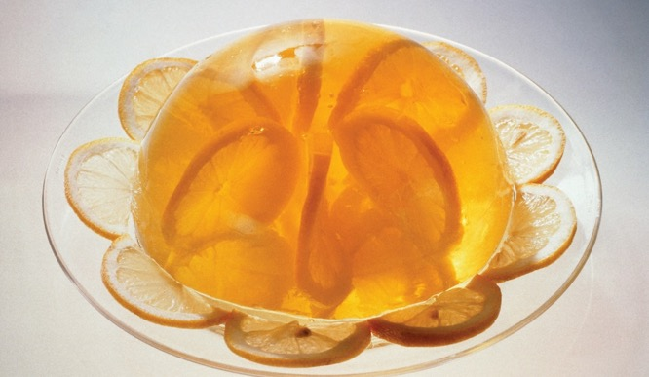
PREPARING GELATIN SALADS
Pour gelatin into molds or pans
Unmold gelatin
  Knife around edge of mold
  Dip into hot water
Refrigerate until just before service
Notes:
Pour the gelatin into pans or individual molds and allow it to set. Then cut it into equal portions and garnish.
To unmold gelatin:
Run a thin knife blade around the top edges of the mold to loosen the salad.
Dip the mold three-quarters of the way into hot water of 120°F to 140°F (49°C to 60°C) for one or two seconds only.
Quickly wipe the bottom of the mold so that water does not drip onto the gelatin. Invert the salad plate over the mold
and carefully flip the plate and mold over together.
Always refrigerate gelatin salads until just before serving to keep them firm.
Add unflavored gelatin to fruit salads or vegetables, such as shredded cabbage and carrots, to achieve a desired texture and appearance. Although flavored, sweetened gelatins can be used with fruits, unflavored gelatin does not compete with the natural flavors of the
vegetables or fruits. Gelatin is also essential in certain savory creations.

Slide 43
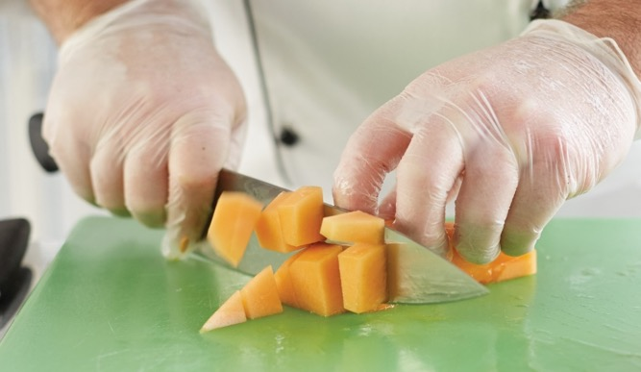
PREPARING FRUIT SALADS
Tossed or composed
Dip fruit in lemon juice and water
  Bananas
  Apples
Prepare close to service
Drain canned fruit—use for dressings
Notes:
Fruit salads may be either tossed or composed.
Some fruit discolors after it is peeled and cut, such as bananas and apples. Dip these fruits in a combination of lemon juice
and water to keep their fresh appearance. Do not soak the fruit in the mixture, or it will ruin the flavor of the fruit.
Fruit does not hold well after it has been cut and peeled. Prepare fruit salads as close to service time as possible.
Drain canned fruit well before mixing it into a salad. Some of the liquid can be saved and used in fruit-salad dressings or in
other preparations.

Slide 44
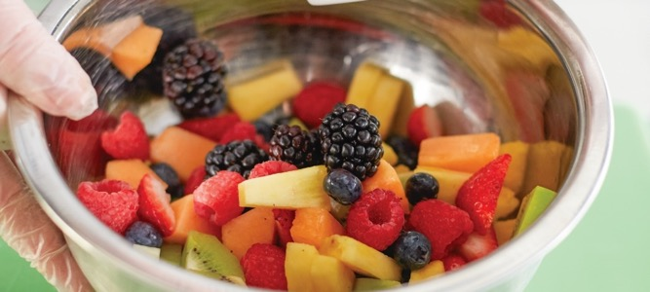
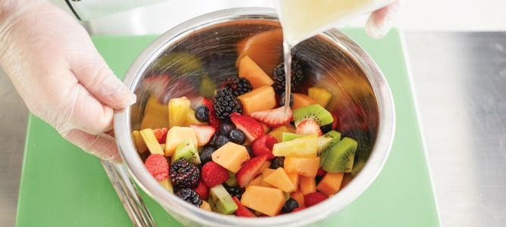
PREPARING FRUIT SALADS
Attractive and delicate pieces on top
  Broken/less attractive on the bottom
Sweet or tart dressing
Notes:
Save the most attractive and delicate pieces of fruit for the top. Place broken or less attractive pieces of fruit on the bottom of the salad.
Dressings for fruit salads are usually sweet, but a little tartness gives additional flavor. Use fruit juices in the dressings.

Slide 45
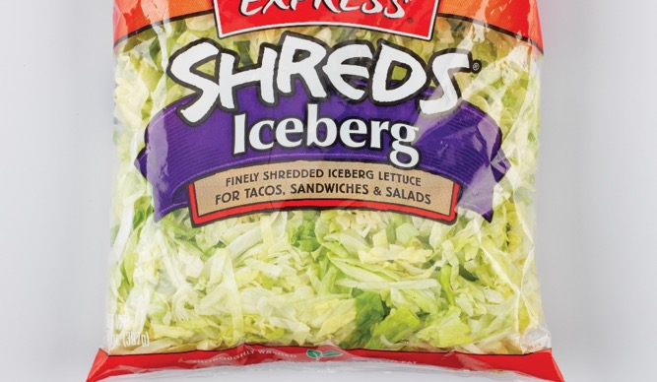
CLEANING AND STORING GREENS
Thoroughly wash greens
Do not handle ingredients too much
Do not open containers until ready to use
Check quality
Prepackaged greens
  Convenient
  Decrease labor costs
  Decrease risk of contamination
Notes:
To prepare a good-tasting, interesting, attractive salad, start with clean, fresh ingredients. Always thoroughly wash greens,
because dirt can lodge between leaves. Also, be careful not to handle ingredients too much.
After the greens are clean, proper storage is essential to keep them fresh. Proper storage ensures the quality of the product
served to the guest. Remember, the quality of the salad is determined just as much by its wholesomeness (if it is safe to eat)
and freshness as by the quality of its ingredients and preparation. Do not open the containers of produce until you are ready
to use them. And, always remember to check the quality of the product before serving it to guests. Prepackaged greens are
commonly used in a commercial kitchen. Prepackaged greens are convenient and decrease labor costs and the risk of contamination.

Slide 46
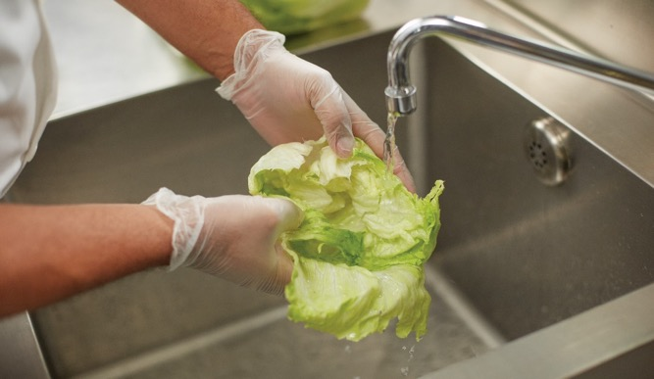
CLEANING GREENS
Refrigerate greens until ready to prepare and serve
  Store between 36°F and 41°F (2°C and 5°C)
Clean greens thoroughly
Remove outer leaves
Separate leaves
Rinse thoroughly
  Water warmer than greens
  Avoid soaking
Notes:
Keep greens refrigerated until they are ready to be prepared and served. Salad greens are best stored at between 36°F and 41°F (2°C and 5°C).
When ready to use, greens need to be cleaned thoroughly.
Remove the outer leaves and discard.
Pull greens completely apart into separate leaves.
Rinse each leaf thoroughly until all traces of dirt, grit, and insects are completely removed. The water should be a little warmer than the greens being washed. If possible, avoid soaking greens, because they tend to absorb water.

Slide 47

CLEANING GREENS
Dry greens
  Salad spinner
  Colander
  Dressing will not adhere
Remove tough stems or wilted spots
  Tear delicate greens—do not bruise leaves
Refrigerate
Notes:
Dry the greens as thoroughly as possible after rinsing. Spinning the greens in a salad spinner is highly recommended. Using a colander is another option. Remember to handle greens gently to avoid crushing or bruising the leaves. Water on the greens will not allow dressing to adhere to the leaf and will dilute the consistency and flavor of the dressing, so it is important that leaves are completely dry.
Remove any tough stems or wilted spots. Tearing is preferred for delicate greens, but be careful not to bruise the leaves.
When the greens have been rinsed and dried, you can refrigerate them for a few hours. Sturdy greens, such as iceberg lettuce or romaine lettuce, can be held for as long as 24 hours.

Slide 48
OILS AND VINEGARS
Salad dressing—enhances salad ingredients
Dressing type—depends on texture of ingredients
Light dressings—delicate ingredients
Heavy dressings—robust, heartier ingredients
Notes:
The flavor of a salad dressing complements or enhances the salad ingredients. For example, when working with a slightly bitter green such as arugula or
radicchio, give the dressing a hint of sweetness (as well as a slight acidity) to work with the bitterness of the green. The type of dressing also depends on
the texture of the salad ingredients. Use lighter dressings on more delicate ingredients; use heavier dressings on more robust, heartier ingredients.

Slide 49
TYPES OF DRESSING
Primary dressings:
Vinaigrette
Emulsified vinaigrette
Mayonnaise-based
Mayonnaise
Notes:
Dressings can be made from a number of different ingredients, but the primary dressings are:
• Vinaigrette
• Emulsified vinaigrette
• Mayonnaise-based
• Mayonnaise

Slide 50

TYPES OF DRESSING
Vinaigrette dressing:
Oil and vinegar
Lighter, thinner dressing
Used on delicate ingredients
Standard ratio—three parts oil to one part vinegar
Substitute vinegar—acidic juices
Notes:
Vinaigrette dressing in its simplest form is made of oil and vinegar. Vinaigrettes are lighter, thinner dressings often used on more delicate ingredients, such as greens and vegetables. The standard ratio for a basic vinaigrette is three parts oil to one part vinegar. Substitute acidic juices like lemon, lime, or orange juice for part or all of the vinegar.

Slide 51
TYPES OF DRESSING
Suspension:
Temporary mixture of ingredients
Eventually separates back
Vinaigrette—separates after nonuse
Remix before every service
Notes:
When shaken together, these ingredients form a suspension. A suspension is a temporary mixture of ingredients that eventually separates back into its unique parts. The ingredients in vinaigrette will separate after nonuse; remix them before every service.

Slide 52
TYPES OF DRESSING
Sharp-flavored vinegars—use sparingly
Strong-flavored oil—can overpower other flavors
  Use in moderation
Notes:
Use certain vinegars with sharp flavors, such as tarragon or balsamic vinegar, sparingly. Strongly flavored oils, such as extra virgin or virgin olive oils (which
are made from the first pressing of the olives) and nut oils, contribute a flavor of their own and can overpower the other flavors in the dressing and the salad if not used in moderation. Generally, add other flavoring ingredients to the vinegar-and-oil mixture.

Slide 53
TYPES OF OIL
Canola:
Light color
Mild flavor
Low in saturated fat
High in monounsaturated fat
Good omega-3 fatty acid profile
Corn:
Light golden color
Nearly tasteless

Slide 54
TYPES OF OIL
Cottonseed/soybean/safflower:
Bland
Nearly tasteless
Olive:
Distinctive flavor
Fruity flavor
Greenish color
Not all-purpose

Slide 55
TYPES OF OIL
Peanut:
Mild but distinctive
Somewhat expensive
Disclose use—allergies
Walnut:
Distinctive flavor
Expensive
Elegant restaurants with specialty salads
Disclose use—allergies

Slide 56
TYPES OF VINEGAR
Balsamic:
Special wine vinegar
Aged in wooden barrels (4–50 years)
Dark brown
Sweet taste
Sticky consistency—high sugar content
Cider:
Made from apples
Brown color
Slightly sweet taste

Slide 57
TYPES OF VINEGAR
Flavored:
Other products added—tarragon, garlic, or raspberries
Sherry:
Made from sherry wine
Sherry flavor

Slide 58
TYPES OF VINEGAR
Specialty:
Malt, rice vinegar, and vinegars flavored with fruits (raspberry)
Lemon juice or other citrus
White or distilled:
Distilled and purified—neutral flavor
Wine or champagne:
White or red color
Made from wine or champagne
Notes:
Specialty
Malt, rice vinegar, and vinegars flavored with fruits, such as raspberry; sometimes lemon juice or other citrus juices are used in
place of or in addition to vinegar in some salad dressings.

Slide 59
TYPES OF DRESSING
Emulsified vinaigrettes:
Emulsion process
Salads with sturdy, robust ingredients
Emulsion:
Mixture of ingredients
Permanently stay together
Need an emulsifier
Emulsifier:
Permanently bind dissimilar ingredients
Egg yolks—lecithin
Notes:
Unlike the suspension mixture of regular vinaigrettes, emulsified vinaigrettes have gone through the emulsion process. An emulsion is a mixture
of ingredients that permanently stays together, unlike a suspension, which eventually separates. In order to create an emulsion, you need an emulsifier.
An emulsifier is an ingredient that can permanently bind dissimilar ingredients, such as oil and vinegar, together on a molecular level. Egg yolks contain
lecithin, an effective emulsifier. Egg yolks bind oil and vinegar together permanently, so these three ingredients make up the base of many emulsified
vinaigrettes. Emulsified vinaigrettes are thicker than suspension vinaigrettes and coat ingredients more heavily. They are good dressings for salads containing sturdier, more robust ingredients, such as pastas, meats, or fish.

Slide 60
PREPARING VINAIGRETTES AND EMULSIONS
Mayonnaise:
Thickest and most stable emulsified dressing
Higher ratio of oil to vinegar
Greater quantity of egg yolks
Notes:
There are simple, basic steps to follow when preparing vinaigrettes and emulsions.
Mayonnaise is the thickest and most stable emulsified dressing. It contains a higher ratio of oil to vinegar and a greater quantity of egg yolks than is
required for emulsified vinaigrette.

Slide 61
PREPARING VINAIGRETTES AND EMULSIONS
Mayonnaise-based dressings:
Creamy dressings
Thicker than emulsified vinaigrettes
Apply close to service
Versatile
Create flavor profiles—mustard, herbs, garlic
Notes:
Mayonnaise-based dressings are typically creamy dressings, such as Russian, Thousand Island, and blue cheese dressings.
They are often thicker than emulsified vinaigrettes (but not always). You can apply them like vinaigrettes, as close to service as possible.
Mayonnaise-based dressings are versatile, in that food handlers can use them to dress lighter greens or heartier ingredients, such as potatoes, tuna,
or chicken. You can add other ingredients to the mayonnaise to create different flavor profiles. Mustard is a common addition to mayonnaise dressings,
as are fresh herbs and garlic.
You can also use other ingredients, such as sour cream, yogurt, and fruit juices, as the main dressing ingredients. Since most salad dressings are served
fresh, without cooking, the dressing quality depends directly on the quality of ingredients used to prepare it. Higher-quality ingredients typically improve the overall quality of the dressing, and lower-quality ingredients detract from the overall quality.

Slide 62
MATCHING DRESSINGS WITH SALAD GREENS
Dressings | Greens
Vinaigrette dressing made with vegetable or olive oil and vinegar or lemon juice | Any greens
Vinaigrette dressing made with nut oil and balsamic vinegar | Delicate greens
Emulsified vinaigrette dressing | Any greens
Mayonnaise-based dressing | Hardy greens
Notes:
Vinaigrette dressing made with nut oil and balsamic vinegar
Delicate greens: butterhead lettuce, Bibb lettuce, Belgian endive,
radicchio, baby lettuces, arugula, watercress
Mayonnaise-based dressing
Hardy greens: iceberg, romaine, leaf lettuce, escarole, curly endive,
sorrel, dandelion greens

Slide 63

HOW TO MAKE EMULSIFIED VINAIGRETTE DRESSING
Beat egg yolks—frothy consistency
  Add water if too thick
Add small amount of vinegar or lemon juice
Mix ⅔ oil, whisking constantly
Add remainder of vinegar or lemon juice
  Blend well
Notes:
Beat the egg yolks until they are frothy. Add a little water if the yolks are very thick.
Add a small amount of the vinegar or lemon juice.
Gradually mix in two-thirds of the oil, whisking the mixture constantly.
Add remainder of vinegar or lemon juice and blend well.

Slide 64

HOW TO MAKE EMULSIFIED VINAIGRETTE DRESSING
Mix remainder of oil, seasonings, or flavorings
Check for nappe consistency
  Sauce or dressing coats spoon
Serve immediately or refrigerate
Notes:
Gradually mix in the remainder of the oil and any additional seasonings or flavoring ingredients.
Use a spoon to check for nappe consistency. Nappe consistency describes the point where a
sauce or dressing is thick enough to coat a spoon, and therefore evenly coat the food.
Serve the dressing at once or store it in refrigeration.

Slide 65


HOW TO MAKE MAYONNAISE
Place egg yolks in stainless-steel bowl
Add dry ingredients
  Whisk until frothy and blended
Drizzle oil slowly into mixture
  Whisk rapidly
Alternate adding vinegar or lemon juice
Notes:
Place egg yolks in an appropriately sized stainless-steel bowl.
Add dry ingredients (such as cayenne, salt, dry mustard, etc.) and whisk until frothy and well blended.
Drizzle oil slowly into mixture, whisking rapidly.
As mixture thickens, slowly alternate adding small amounts of vinegar or lemon juice and oil until all are used.

Slide 66

HOW TO MAKE MAYONNAISE
Check taste
Serve immediately or refrigerate
House-made mayonnaise—use pasteurized egg yolks
Notes:
Check the seasoning by tasting the product, but be sure not to contaminate the mixture.
Serve the dressing at once or refrigerate it.
Although house-made mayonnaise is fresh-tasting, it is usually best to use commercially prepared mayonnaise in a restaurant or
foodservice operation because the acidity in commercially prepared versions has been raised to make them less susceptible to
pathogen growth. If using house-made mayonnaise, use pasteurized egg yolks.

Slide 67
DIPS
Flavorful mixture
Accompanies certain food items
Served hot or cold
Cold dip bases
  Mayonnaise
  Sour cream
  Cream cheese
Notes:
A dip is a flavorful mixture that accompanies certain food items. Like salad dressings, dips complement or enhance a food’s flavor. Depending on their
ingredients and purpose, dips can be served hot or cold. Cold dips often use mayonnaise, sour cream, or cream cheese as a base. Make cold dips the
same way as mayonnaise-based salad dressings, although dips are normally thicker. You can thin many cold dips for use as salad dressings.

Slide 68
DIPS
Proper consistency and temperature
Scoop with cracker, chip, or vegetable
Thickens in refrigeration
Heated in oven or microwave
Notes:
It is important for a dip to have the proper consistency. Any dip should be soft enough to scoop up with a cracker, chip, or vegetable, but thick enough to stay on it. Serve each dip at the proper consistency and serving temperature. Most dips become thicker as they are held in the refrigerator. Some dips are heated in the oven or microwave before serving.

Slide 69



DIPS
Guacamole
Salsa
Hummus
Avocado dip
Aztec origin
Made from peppers, onions, and tomatoes
Mexico
Made with chickpeas, garlic, and tahini
Middle East
Notes:
Ethnic variations of special salads and accompaniments are very popular as dips.
• Guacamole: This is an avocado dip (of Aztec origin).
• Salsa: This is made from peppers, such as jalapeño or serrano, onions, and tomatoes (from Mexico).
• Hummus: This is made with chickpeas, garlic, and tahini (from the Middle East).

Slide 70



DIPS
Queso
Plum sauce
Spinach and artichoke
Queso Oaxaca, peppers, and spices
Mexico
Made with plums, soy, garlic, ginger, and vinegar
China
Made with spinach, mayonnaise, cream cheese, artichokes, and spices
American favorite
Unknown origin
Notes:
The texture and flavors of each of these dips are bold and unique, and the dips are also nutritious.

Slide 71

MAKING A COLD DIP
Select base
Add flavoring ingredients
Blend ingredients well
Adjust consistency
Serve immediately or refrigerate
Notes:
Select your base, such as mayonnaise, sour cream, or cream cheese. If cream cheese is the base, first soften it by mixing it in an electric mixer.
Add the selection of flavoring ingredients (chopped cooked vegetables; chopped cold vegetables; chopped cold, cooked fish; seafood; herbs;
spices; etc.).
Blend all ingredients well.
Adjust the consistency by adding milk, buttermilk, cream, sour cream, or another liquid that is suitable for the dip.
Serve immediately or refrigerate until service.

