Slide 2
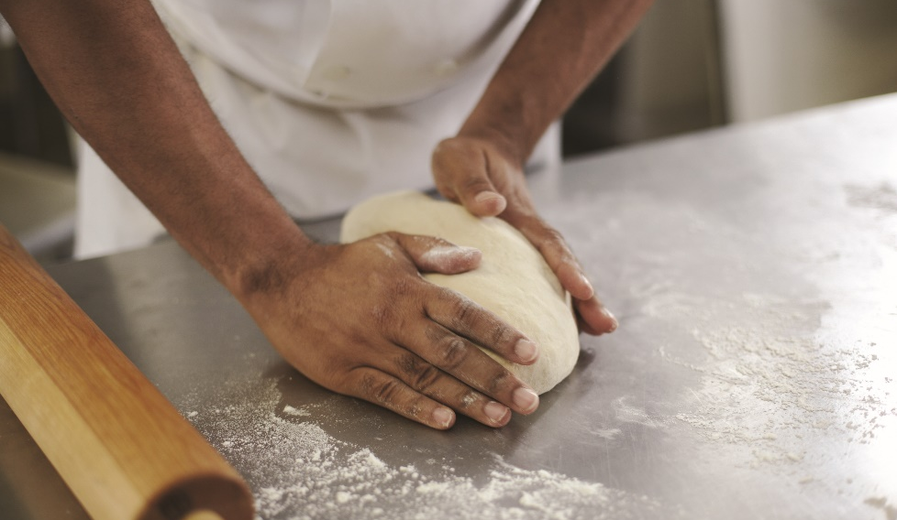
BAKER’S INGREDIENTS
Fats/shortenings—butter and oils
Sweeteners—sugars and syrups
Chemical, organic, and physical leaveners—baking powder, baking soda, yeast, steam
Thickeners—cornstarch, flour, eggs
Flavorings—extracts and spices
Liquids—water, milk, cream, eggs, honey, molasses, butter
Additives—food coloring
Notes:
Nearly all bakery products are prepared using a common list of ingredients that fall into eight categories:
Strengtheners, such as flour and eggs
Fats/shortenings, such as butter and oils
Sweeteners, such as sugars and syrups
Chemical, organic, and physical leaveners, such as baking powder, baking soda, yeast, and steam
Thickeners, such as cornstarch, flour, and eggs
Flavorings, such as extracts and spices
Liquids, such as water, milk, cream, eggs, honey, molasses, and butter
Additives, such as food coloring

Slide 3
BAKER’S INGREDIENTS
Strengtheners:
Stability
Main strengthener used
Check gluten content—nutrition label
Higher protein = higher gluten
Gluten—protein in flour
Too much mixing, working, kneading = elastic and stretchy
Notes:
In baking, strengtheners provide stability and ensure that the baked item does not collapse once it is removed from the oven. Flour is a main
strengthener used in baking. There are six popular types of wheat flour, as described in Table 19.1. To check the gluten content of a particular
flour, look at the nutrition label: the higher the protein content, the higher the gluten content. Gluten (gloo-ten) is a protein found in flour.
The more bakers mix, work, and knead yeast doughs, the more the gluten becomes elastic and stretchy. When baked, it helps provide the firm
structure and light, even texture needed in bread production.

Slide 4
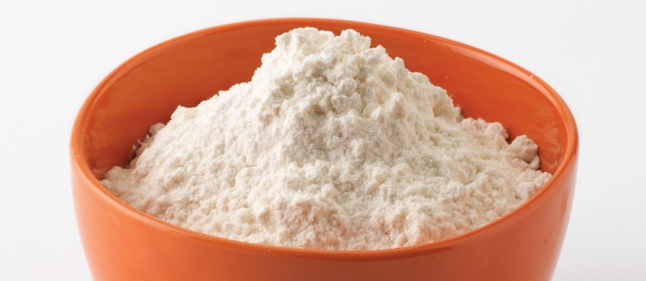
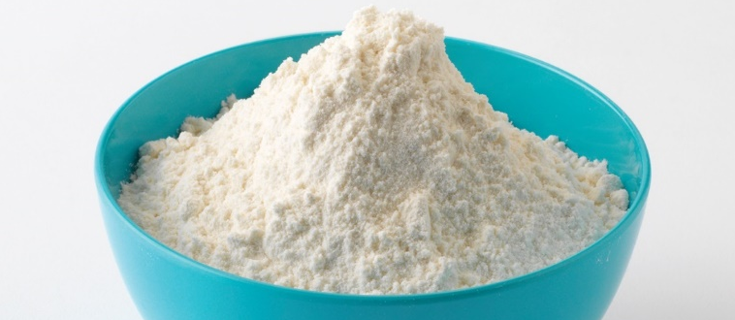
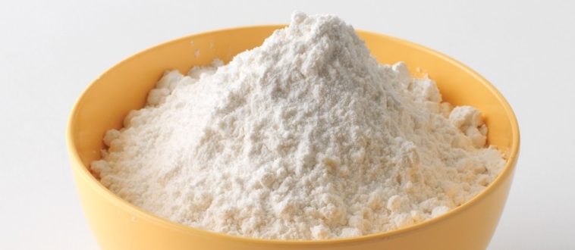
TYPES OF WHEAT FLOUR
All-purpose flour
Bread flour
Cake flour
Between pastry and bread flour
Cookies, biscuits, general production work
Gluten content 10%–12%
Strong flour
Bread, hard rolls
Gluten content 12.5%–13.5%
Soft, smooth texture
Pure white color
Cake and delicate baked goods
Gluten content 7%–9%
Notes:
All-purpose flour: This flour falls between pastry and bread flour. It is good to use in cookies, biscuits, and general production work.
Gluten content is 10%–12%.
Bread flour: As its name suggests, this is a strong flour that is used for making breads, hard rolls, and any product that needs high gluten for a strong
texture. Gluten content is 12.5%–13.5%.
Cake flour: This flour has a low gluten content, a very soft, smooth texture, and a pure white color. Use cake flour for cakes and other delicate baked
goods. Gluten content is 7%–9%.

Slide 5
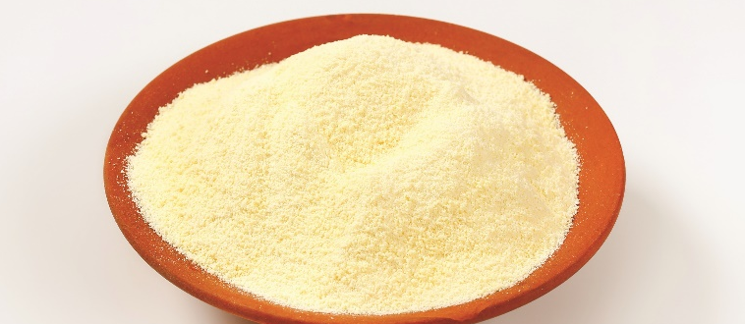
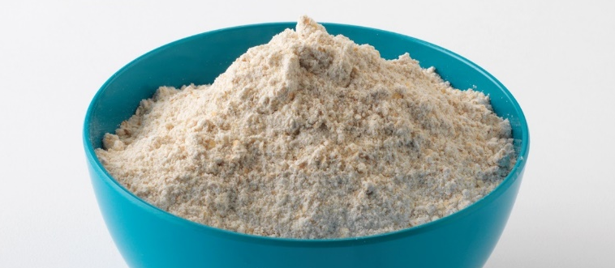
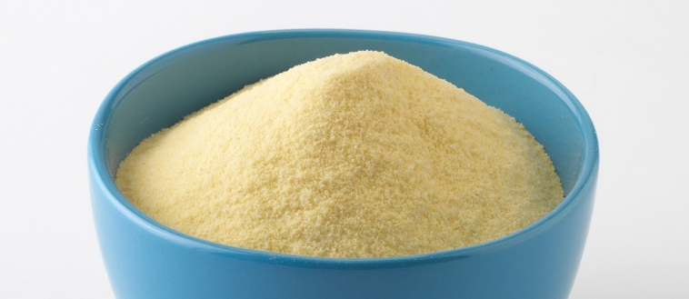
TYPES OF WHEAT FLOUR
Durum flour
Pastry flour
Semolina flour
Hard wheat flour
Breads
Gluten content 13.5%–14%
Cookies, pie pastry, sweet yeast doughs, biscuits, muffins
Feels like cake flour
Creamy color of bread flour
Gluten content 9%–10%
Type of durum flour
Coarsely ground
Fine texture
Pastas and Italian pastries
Gluten content 13.5% or more
Notes:
Durum flour: This is a hard wheat flour used to make breads; its gluten content is a little higher than that of typical bread flour. Gluten content is about 13.5%–14%.
Pastry flour: This flour is not as strong as bread flour and not as delicate as cake flour. Use pastry flour for baking cookies, pie pastry, and some sweet
yeast doughs, biscuits, and muffins. It feels like cake flour, but has the creamy color of bread flour. Gluten content is 9%–10%.
Semolina flour: This is a type of durum flour, but it is more coarsely ground than the flour used to make most breads. It has a fine texture with a high
gluten content and is primarily used to make pastas and certain Italian pastries. Gluten content is 13.5% or more.

Slide 6
BAKER’S INGREDIENTS
Fats/shortenings:
Moist
Add flavor
Stays fresh longer
Thoroughly mixed—impact overall texture
Rubbed, cut, or rolled—flaky texture
Creamed—smooth, soft, cake-like
Notes:
Fats/Shortenings make baked goods moist, add flavor, and keep baked items fresh longer. Any fat, such as oil or butter, acts as a shortening in baking.
The more thoroughly mixed, the more the fat will affect the item’s overall texture. Fats that are rubbed, cut, or rolled into doughs tend to separate the
dough into layers, creating a flaky texture. When the fat is thoroughly creamed together with the other ingredients, the resulting texture of the baked
item will be smooth, soft, and more cake-like.

Slide 7
BAKER’S INGREDIENTS
Sweeteners:
Refined sugars, sugar syrups, molasses, brown sugar, corn syrup, honey, malt syrup
Add flavor and color
Blend shortening with other ingredients
Product soft and tender
Caramelization—heat causes sugar to brown
Artificial sweeteners and sugar substitutes do not caramelize
Notes:
Sweeteners include refined sugars, sugar syrups, molasses, brown sugar, corn syrup, honey, and malt syrup (usually used in yeast breads). Sweeteners add
flavor and color to baked goods. They also help the shortening blend with other ingredients and make the product soft and tender. When a product containing refined sugars is baked, the heat causes the sugar to turn a light brown color. This process is called caramelization and occurs whenever sugar is used as an ingredient in baked items. Artificial sweeteners and sugar substitutes used in baking do not create caramelization, so they will produce baked goods that are lighter in color.

Slide 8
BAKER’S INGREDIENTS
Leaveners:
Dough or batter rises
Measure carefully
Chemical, organic, and physical
Notes:
Leaveners are necessary in baking because they allow the dough or batter to rise. It is important to measure all leavening agents very carefully.
Even small changes can produce major defects in baked products. Leaveners fall into three categories: chemical, organic, and physical.

Slide 9
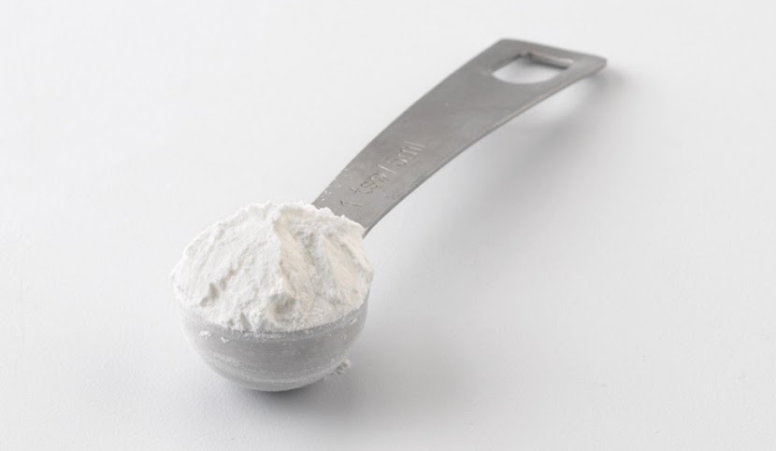
TYPES OF LEAVENERS
Baking powder:
Chemical leavener
Produces carbon dioxide gas
Batter rises
Baking soda and acid with inactive ingredient
Heat and liquid—leavening occurs
Notes:
Chemical leaveners react with other ingredients to produce carbon dioxide gas, which helps batter to rise as it is heated. Baking powder is a very versatile chemical leavener. It is a mixture of baking soda and an acid with an inactive material, like starch. Because there is acid in the baking powder, the pastry chef does not need to add any acid to the batter for leavening to take place. Leavening occurs when liquid and heat are added.

Slide 10
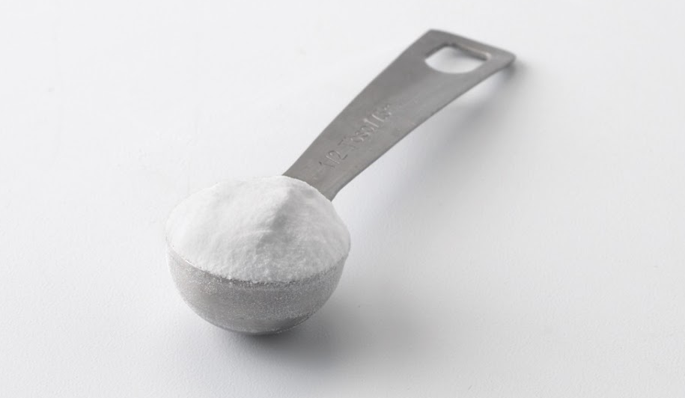
TYPES OF LEAVENERS
Baking soda:
Chemical leavener
Sodium bicarbonate
Produces carbon dioxide gas—liquid and acid
Batter rises—heat not necessary
Bake immediately
Notes:
Baking soda (sodium bicarbonate) is a chemical leavener that releases carbon dioxide gas when mixed with a liquid and an acid. For example, baking soda will leaven a batter when mixed with an acid such as lemon juice, yogurt, or buttermilk. Other, less reliable reactants are honey, molasses, cocoa, and chocolate. Because heat is not necessary for the leavening process to occur, bake the item right away to prevent the gases from escaping and leavening the item too soon.

Slide 11
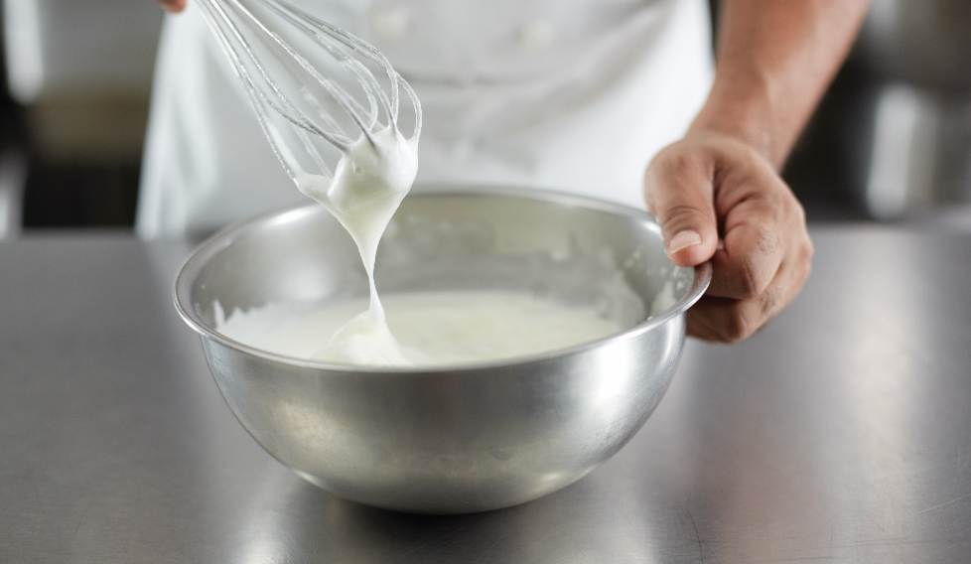
TYPES OF LEAVENERS
Physical leavener:
Introduce air into batter
Air expands during baking
Creaming method
  Fat and sugar
  Cakes and cookies
Foaming method
  Eggs with or without sugar
Whole egg foams—sponge cakes
Egg-white foams—angle food cake, meringue, soufflé
Steam—cream puffs and pie crusts
Notes:
Introducing air into the batter is another way to leaven a baked item. The air expands during baking and leavens the product. Pastry chefs use two methods to introduce air into batter: creaming and foaming. In the creaming method, beat the fat and sugar together. Use the creaming method most often in cake and cookie making. In the foaming method, beat eggs, with or without sugar. Use whole-egg foams in sponge cakes, and egg-white foams in angel food cakes, meringues, and soufflés. Steam plays a role in all baked goods. When water is converted to steam, the volume increases. Steam is used as a leavener in
cream puffs and pie crusts.

Slide 12
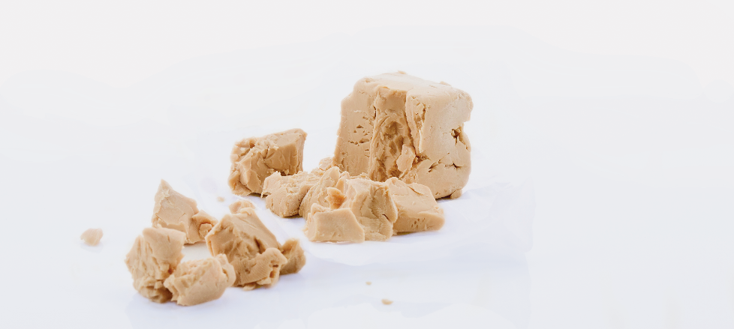
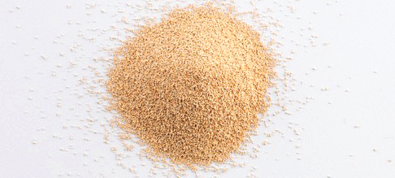
TYPES OF LEAVENERS
Yeast:
Organic leavener
Microscopic fungus
Fresh or dry
Ferment—yeast and carbohydrates
Release carbon dioxide gas—dough rises
Notes:
An organic leavener, yeast is a microscopic fungus used often in baking. It comes in two forms: fresh or dry. When yeast is mixed with carbohydrates (such as sugar and flour) and liquid it ferments, or produces carbon dioxide gas and alcohol. Yeast works in much the same way that the chemical leaveners do, by releasing carbon dioxide gas, causing the bread dough to rise.

Slide 13
BAKER’S INGREDIENTS
Thickeners:
Gelatin, flour, arrowroot, cornstarch, eggs
Determine consistency of finished product
Notes:
Thickeners include gelatin, flour, arrowroot (a powdered starch made from a tropical root), cornstarch, and eggs. Thickeners, combined with the stirring
process, determine the consistency of the finished product. For example, custard cooked over direct heat and stirred constantly will result in a sauce. The same custard recipe can be cooked (without stirring) by placing it in a bain-marie and then gently cooking it by surrounding the pan with simmering water. Then, it will set into a firm custard that can be sliced.

Slide 14
BAKER’S INGREDIENTS
Flavorings:
Cocoa, spices, salt, nuts, extracts
Taste and color
Spices—cinnamon, nutmeg, mace, gloves, ginger, caraway, cardamom, allspice, anise, poppy seed
Salt
  Enhances flavor
  Improves texture
  Controls yeast fermentation
Extracts
  Flavorful oils
  Vanilla bean, lemon, almond
  Measure accurately
Notes:
Flavorings, such as cocoa, spices, salt, nuts, and extracts, affect a baked item’s taste and color. Cocoa is the basis of all chocolate desserts and
is absolutely vital to any dessert menu. Spices used most often in baking are cinnamon, nutmeg, mace, cloves, ginger, caraway, cardamom,
allspice, anise, and poppy seed.
Salt plays an important role in baking. In addition to enhancing flavor, it improves the texture of breads and controls how yeast ferments in
bread doughs. Extracts are flavorful oils (some are alcohol based) taken from such food items as vanilla bean, lemon, and almond. A few drops
of extract will greatly enhance the flavor of baked goods. Flavorings need to be measured accurately so that the flavor of the spice or extract
will not overwhelm the flavor of the finished baked product.

Slide 15
BAKER’S INGREDIENTS
Liquids:
Water, milk, cream, molasses, honey, vegetable oils, butter
Provides moisture
Gluten develops properly
Water—common and basic
Milk—flavor, nutritional value, texture
Notes:
Liquids are one of the most important elements used in baking. The liquid used in baking can be water, milk, cream, molasses, honey, vegetable oils, or butter. Liquid is used in baking to provide moisture to the product and to allow the gluten to properly develop. Water is the most basic and common form of liquid used in baking. Often, milk products such as whole milk, buttermilk, cream, or dried milk are used. Milk provides the baked product with flavor, nutritional value, and texture. Honey, molasses, eggs, oil, and butter also act as liquids in baking by contributing moisture to the baked item, as well as a unique taste and texture.

Slide 16
BAKER’S PERCENTAGES
Formulas—standardized recipes for bakery products
Proportions—form of percentages
Flour—proportion of 100%
Baker’s percentages—other ingredients calculated in relation to flour
(Weight of ingredient ÷ Weight of flour) × 100 Percent = Percent of ingredient
Notes:
Standardized recipes for bakery products are called formulas, and they are set up a bit differently than those for other food items. Proportions for each
ingredient are given in the form of percentages. A percentage indicates a part of a whole. For example, a pizza with four pieces is divided into quarters.
Each slice is 25 percent of the pizza. Two slices, half the pizza, is 50 percent, and three slices is 75 percent. The whole pizza is 100 percent.
In baking, flour always has a proportion of 100 percent, and the percentages of all other ingredients are calculated in relation to the flour. These are known
as baker’s percentages. In this way, pastry chefs can convert recipes to give larger or smaller yields. They simply change ingredient amounts while keeping
proportions and percentages the same. The formula for baker’s percentages is expressed like this:
(Weight of ingredient ÷ Weight of flour) × 100 Percent = Percent of ingredient

Slide 17
FORMULA FOR SOFT YEAST DINNER ROLLS USING BAKER’S PERCENTAGES
Ingredient | Baker’s Percentages
Active dry yeast, 2 ounces | 4.5%
Water (temperature controlled), 1 pound 8 ounces | 54.5%
Bread flour, 2 pounds 12 ounces | 100%
Salt, 1 ounce | 2.3%
Granulated sugar, 4 ounces | 9%
Nonfat dry milk powder, 2 ounces | 4.5%
Shortening, 2 ounces | 4.5%
Unsalted butter, softened, 2 ounces | 4.5%
Eggs, 3.2 ounces (2 eggs) | 7.3%
Egg wash, as needed
Total dough weight: 5 pounds 4 ounces
Notes:
The table shows a formula for soft rolls using baker’s percentages. Although the example does not include directions, usually the formula
also shows the various directions given in a bakeshop recipe, such as mixing, yeast fermentation time, scaling, and baking temperature.

Slide 18
CONVERTING BAKING YIELDS
Calculate weight of ingredient
Change ingredient percentage to decimal
Multiply by weight of flour
Sift dry ingredients before mixing
Notes:
Not every baking recipe will produce enough product for every situation. In baking, it is necessary to convert recipes to yield different amounts.
Understanding baker’s percentages makes it easy to calculate the weight of any ingredient or to convert a formula to a new yield. A yield is how
much of something is produced.
To calculate the weight of a particular ingredient, change the ingredient percentage to decimal form. Then, multiply the weight of the flour by this
decimal to get the weight of the ingredient. For example, if a formula calls for 20 percent sugar and the pastry chef is using 10 pounds of flour, how
much sugar does the chef need by weight?
20 percent = 0.20
10 pounds flour × 0.20 = 2 pounds sugar
Use the weight of the flour and remaining ingredient percentages to calculate the weights of the other ingredients. Check recipes carefully to see
whether ingredients are to be scaled (or measured) before or after sifting. Sifting is very important in baking. Dry ingredients must be sifted before
they are mixed into the dough or batter.
See Essential Skills: Sifting: Why It Matters, on page 405.

Slide 19
COOKIES
Sweet baked food
Flour and sugar
Small, flat, and round
Creaming—how far cookie spreads during baking
Consistency and shape
  Bake evenly
  Similar look
Decorative and appetizing
Convection oven—gentler environment
Notes:
A cookie is a sweet baked food made from flour and sugar that is usually small, flat, and round. Many pastry chefs mix the fat and sugar together to
achieve a creamy texture. This “creaming” of the dough determines how far a cookie will spread in the pan during baking. Many cookies require a lot
of shaping by hand during preparation. Consistency in shape and size will allow the cookies to bake evenly and look the same when they are
finished baking.
Cookies should be decorative and appetizing. Due to their high sugar content, cookies are best when they are baked in convection ovens. In a convection
oven, the air is pulled in by the fan, and then gently pushed out through the holes. This creates a gentler environment for baked goods that tend to burn
quickly because of their high sugar content.

Slide 20
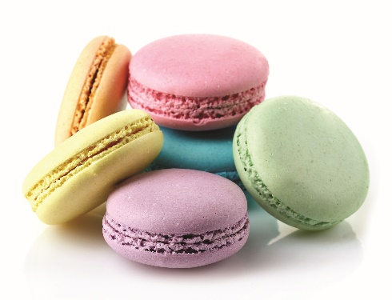
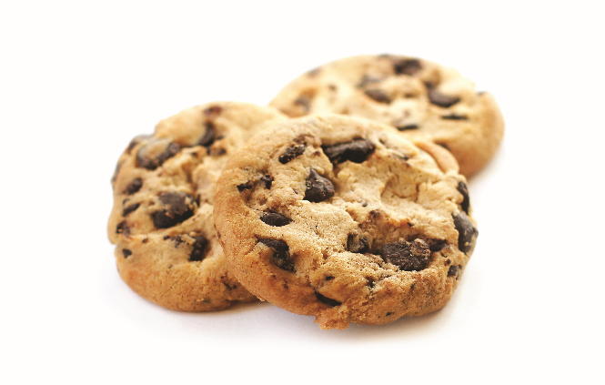
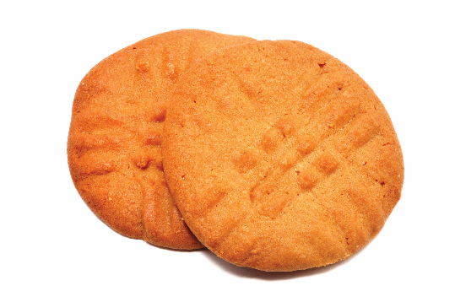
TYPES OF COOKIES
Bagged cookies
Dropped cookies
Molded cookies
Force soft dough through pastry bag
Ladyfingers, macarons, tea cookies
Soft dough
Dropped from spoon or scoop
Chocolate chip or oatmeal raisin
Mold stiff dough by hand
Peanut butter cookies
Notes:
Bagged cookies (also known as piped cookies): Make bagged cookies by forcing soft dough through a pastry bag.
Varieties include ladyfingers, macarons, and tea cookies.
Dropped cookies: Make dropped cookies, such as chocolate chip cookies and oatmeal cookies, from a soft dough and
drop them from a spoon or scoop onto the cookie sheet.
Molded cookies: Mold stiff dough by hand into any shape to make molded cookies. Peanut butter cookies are an example.

Slide 21
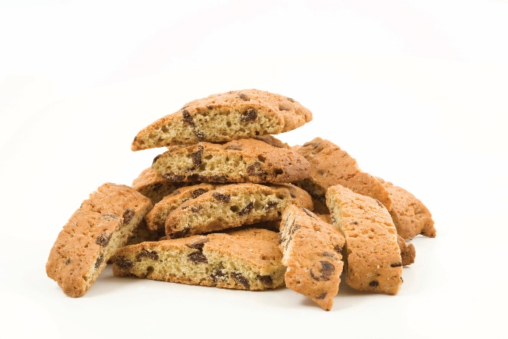
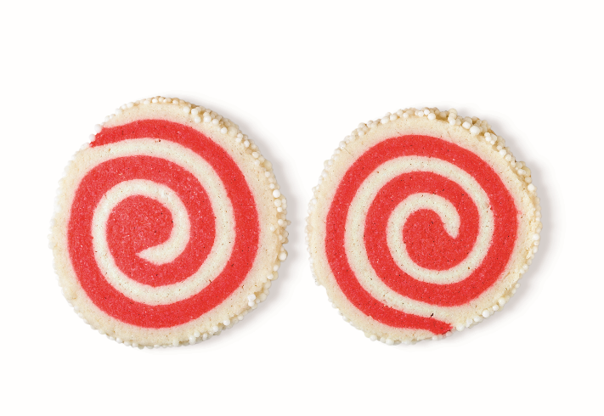
TYPES OF COOKIES
Bar cookies
Icebox cookies
Three or four bars of dough
Length of baking pan
Slice into small bars
Biscotti
Roll dough into log
Chill and slice before baking
Butterscotch icebox and chocolate icebox
Notes:
Bar cookies: Make bar cookies by baking three or four bars of dough the length of the baking pan,
and then slicing them into small bars. One variety is biscotti.
Icebox cookies: Make icebox cookies by rolling dough into a log, chilling it, and then slicing it just before
baking. Butterscotch icebox cookies and chocolate icebox cookies are examples.

Slide 22
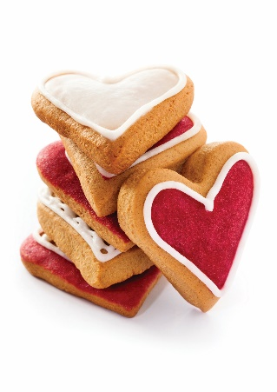
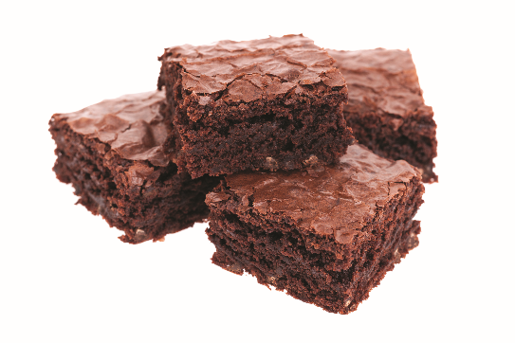
TYPES OF COOKIES
Rolled cookies
Sheet cookies
Cut from stiff dough
Rolled out on baking bench
Decorated sugar cookies and shortbread
Pour batter into baking pan
Slice individual squares or rectangles
Brownies, butterscotch brownies, or blondies
Notes:
Rolled cookies: Rolled cookies are made more often at home than in commercial kitchens because they
take a lot of work. Cut these cookies from a stiff dough that has been rolled out on a baking bench.
Varieties include decorated sugar cookies and shortbread.
Sheet cookies: Pour the batter into the entire baking pan and then slice it into individual squares or
rectangles after baking. Brownies are usually made this way. Other types of sheet cookies include
butterscotch brownies or blondies.

Slide 23
QUICK BREADS
Any baked good not leavened by yeast or eggs
Chemical leaveners
Biscuits, muffins, scones, banana bread, soda bread, pancakes and waffles
Three methods for mixing quick breads
  Creaming method
  Muffin method
  Biscuit method
Notes:
Quick breads generally refer to any baked good not leavened by yeast or eggs. Typical leaveners used in quick breads are chemical leaveners, such as
baking powder or baking soda. The quick chemical reaction of these leaveners allows the bread to be baked immediately.
Quick breads are staples in the American diet. Some examples of quick breads include biscuits, muffins, scones, banana bread, soda bread, and even
pancakes and waffles. In the morning, you are likely to see a bigger selection of quick breads in the form of scones and muffins. Later in the day and
into the evening, you are likely to see a wider variety of breads or cakes instead.
There are primarily three methods for mixing quick breads.

Slide 24
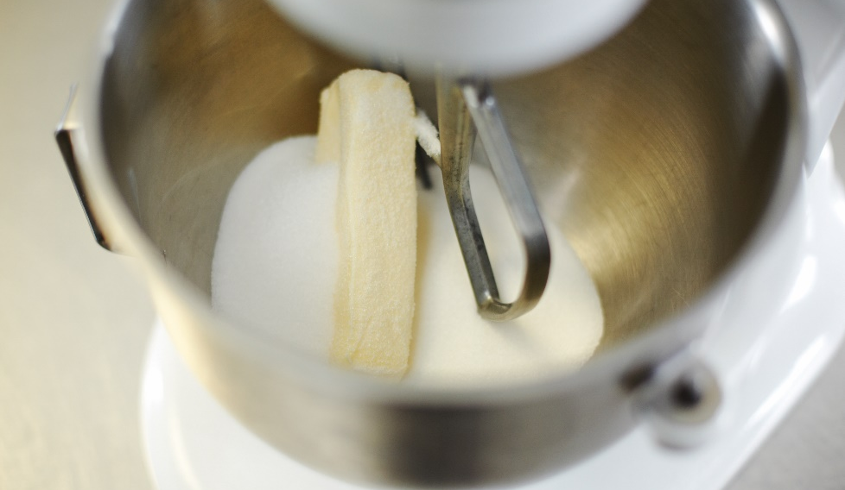
THE THREE METHODS OF PREPARING QUICK BREADS
Creaming method:
Fat creamed with sugar
Electric mixer with paddle attachment
Mix until creamy
Add dry ingredients gradually
Chocolate chip or raisin spice muffins
Notes:
The creaming method uses solid fat, which is creamed with sugar for three to four minutes before adding the liquids and dry ingredients.
It is important to add ingredients gradually to avoid curdling.
Creaming method (fat is creamed with sugar):
• This mixing method is best done with the aid of an electric mixer and a paddle attachment.
• The fat is a solid fat and is always mixed with sugar until creamy.
Chocolate chip or raisin spice muffins are examples of quick breads made using the creaming method.

Slide 25
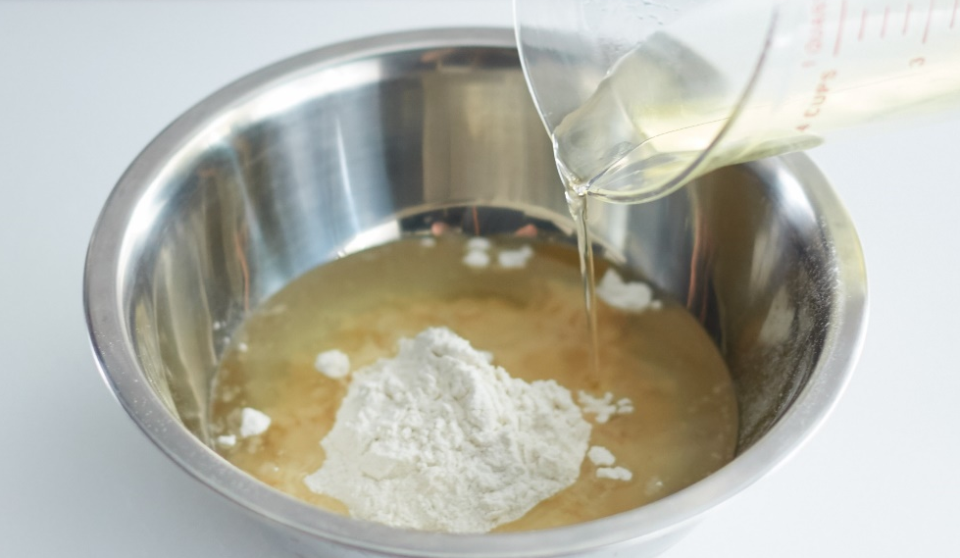
THE THREE METHODS OF PREPARING QUICK BREADS
Muffin method:
Liquid/melted fat and dry ingredients
Mix by hand or use paddle attachment
Cornbread and blueberry muffins; pancakes
Notes:
The muffin method uses liquid or melted fat, which is mixed with the liquids and added to the dry ingredients.
Muffin method (liquid/melted fat is used):
• This mixing method may be done by hand or done with a paddle attachment for larger-volume recipes.
• The fat is always a liquid/melted fat.
Cornbread and blueberry muffins are examples of quick breads made using the muffin method. Pancakes are also mixed this way.

Slide 26
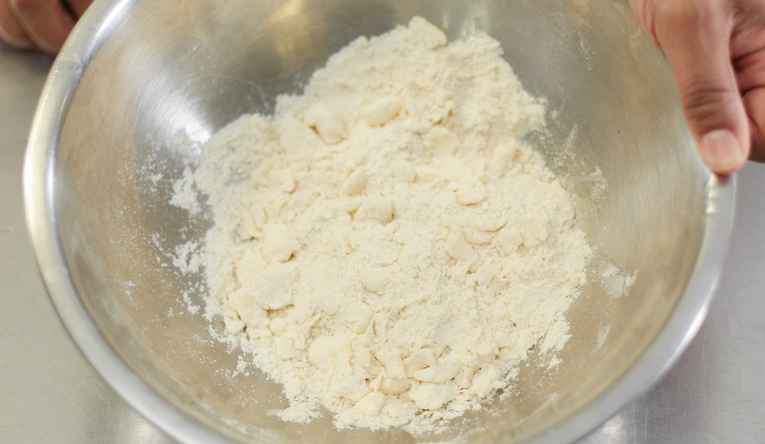
THE THREE METHODS OF PREPARING QUICK BREADS
Biscuit method:
Solid fat “cut” into flour by hand
Pea-size pieces
Use very cold ingredients
Buttermilk biscuits, cornbread biscuits
Notes:
The biscuit method uses solid fat, which is “cut” into the flour to resemble pea-sized pieces, before the liquids are added.
Biscuit method (solid fat is “cut” into flour by hand):
• This mixing method is best done by hand.
• The fat is always a solid fat and is mixed into flour into pea-sized pieces. It is often recommended that all ingredients are very cold for this method.
Buttermilk biscuits, cornbread biscuits, and scones are examples of quick breads made using the biscuit method.

Slide 27
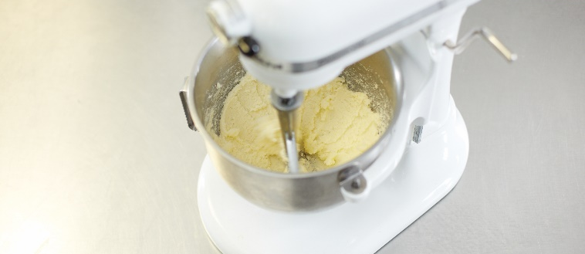
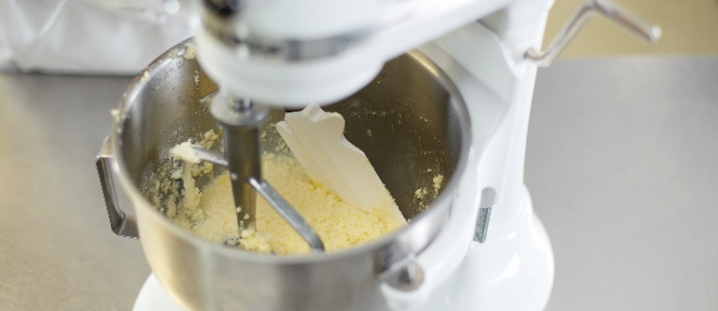
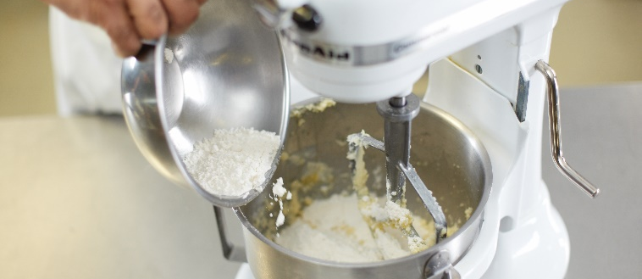
CREAMING METHOD FOR QUICK BREADS
Cream fat and sugar
  Three to four minutes
Add eggs with liquids
Add combined liquids
  Blend thoroughly
  Scrape sides
Add sifted dry ingredients
  Mix until just incorporated
Notes:
Cream the fat and sugar together for three to four minutes.
Combine eggs with liquids.
Add combined liquids to creamed fat and blend thoroughly; scrape sides.
Add sifted dry ingredients to fat and liquid mixture; mix just until incorporated.

Slide 28
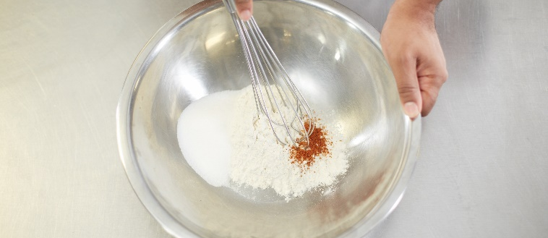
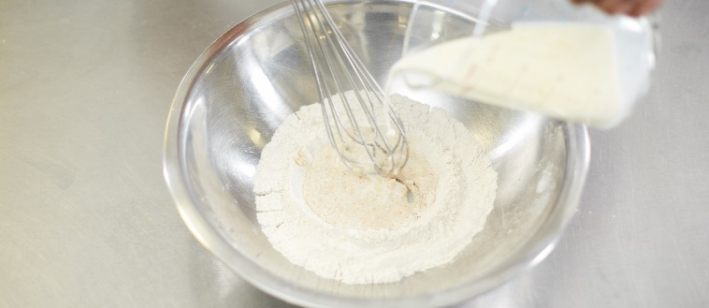
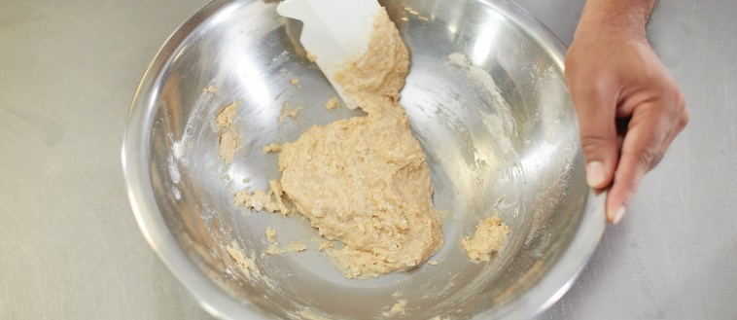
MUFFIN METHOD FOR QUICK BREADS
Mix dry ingredients—30 seconds
Combine all liquids
Add liquids to dry ingredients
  Mix until just incorporated
Notes:
Mix dry ingredients for 30 seconds.
Combine all liquids, including melted fat.
Add liquids to dry ingredients; mix just until incorporated.

Slide 29
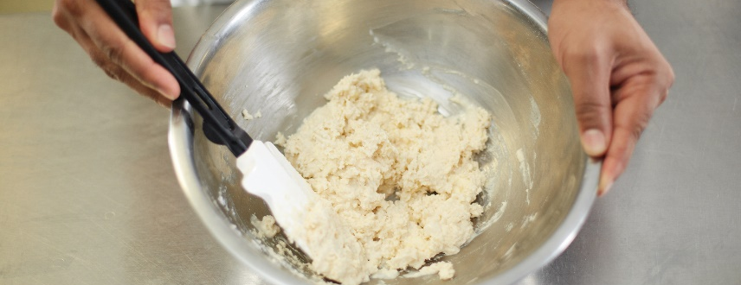
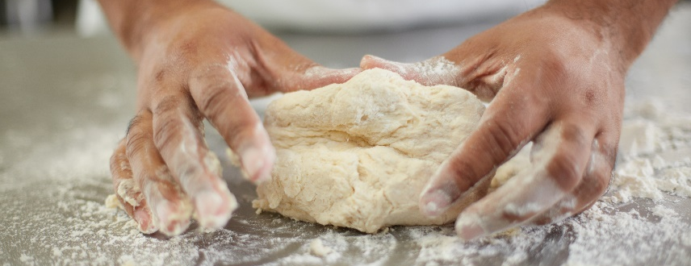
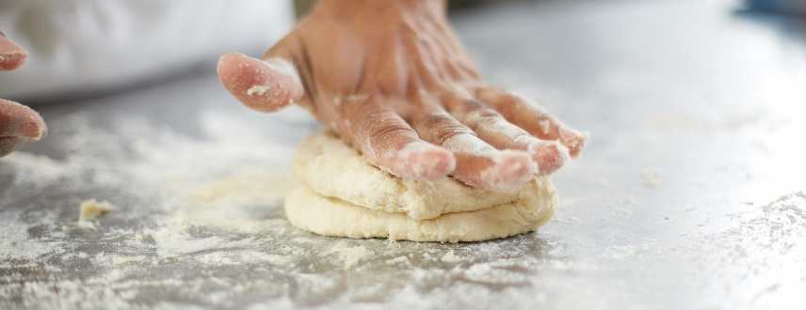
BISCUIT METHOD FOR QUICK BREADS
Sift dry ingredients
Cut solid fat into flour
  Pea-size pieces
Combine liquids and add to dry ingredients
  Mix until just incorporated
Shape kneaded dough into round ball
  Fold in half and rotate 90 degrees
Repeat kneading process three to four times
  Do not overmix
Notes:
Sift dry ingredients into a bowl.
Cut solid fat into the flour until it resembles coarse/mealy pea-sized pieces.
Combine liquids and add them to dry ingredients; mix just until incorporated.
Shape kneaded dough into a round ball; fold in half and rotate 90 degrees.
Repeat kneading process three to four times. Do not overmix.

