Slide 2
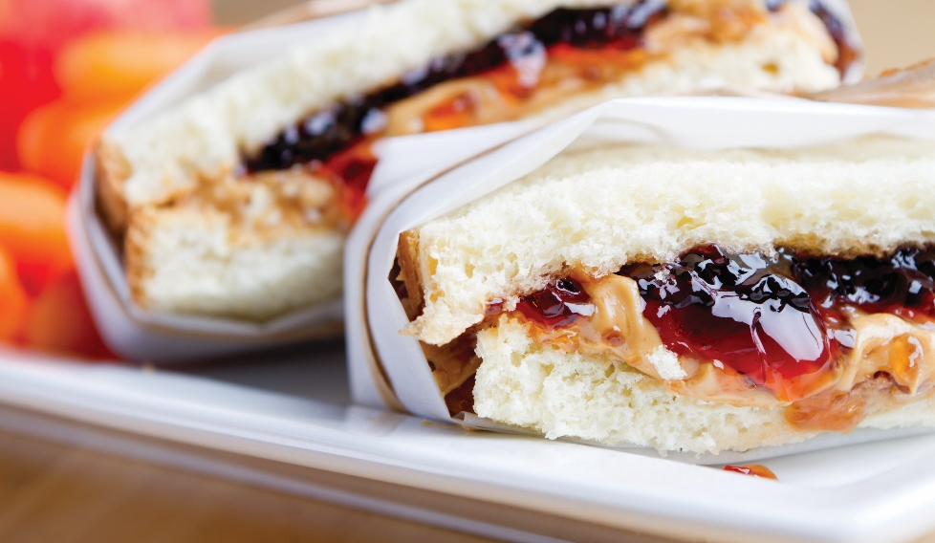
BASIC KINDS OF SANDWICHES
Combinations of flavors and textures:
Different breads
Condiments
Meat and vegetable
Two categories:
Hot or cold
Notes:
The most popular sandwiches in the United States are the turkey sandwich and the ham sandwich; but PB&J, grilled cheese, and the BLT are also favorites. And pizza is right up there with sandwiches. Americans eat the equivalent of 100 acres of pizza every day. That is three billion pizzas, or 46 slices for every person in the country per year. What does this mean? It means that pizza and sandwiches can both produce big business for the restaurant and foodservice industry.
When making a sandwich, you should consider the combinations of flavors and textures created by different breads, condiments, and meat and vegetable additions. For example, how does the texture of the bread blend with the texture of the filling? Do the flavors work together? Decide whether to serve the sandwich hot or cold, and consider the ratio of bread to the quantity and flavors of the other ingredients.
All sandwiches fall into one of two general categories—hot or cold. A simple hot sandwich is either heated whole or consists of hot fillings, such as hot roast beef or grilled vegetables, between two slices of bread or two halves of a roll. Additional items such as fresh tomato, lettuce, or onion may be added for flavor. In the United States, hamburgers and hot dogs are among the most popular hot sandwiches.
In the broadest sense of the word, sandwiches may be served in a variety of ways. Examples include open-faced on one slice of bread or even rolled up in a tortilla (such as a wrap sandwich).

Slide 3
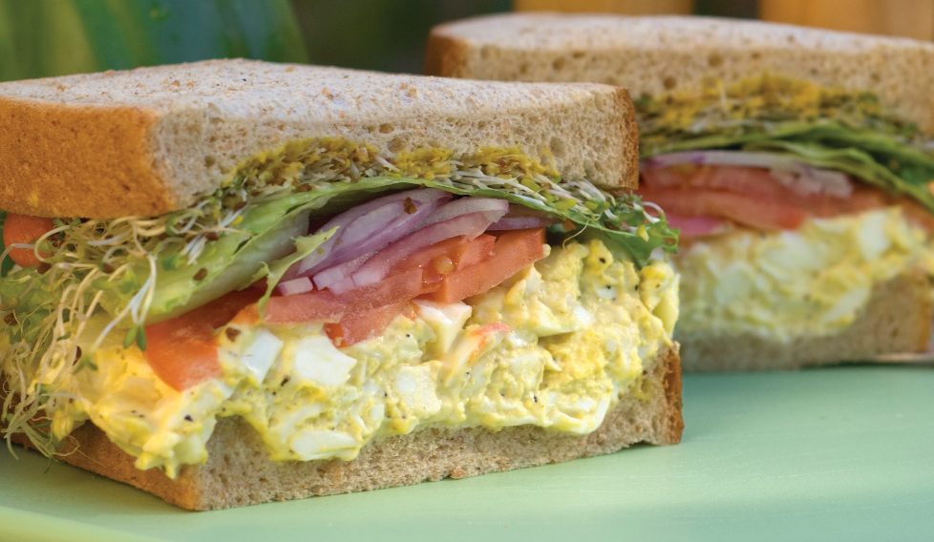
COLD SANDWICHES
Cold sandwich:
Two slices of bread or two halves of roll
Spread
Filling
  Meat and cheese
  Salad—egg or tuna salad
Notes:
A simple cold sandwich consists of two slices of bread or two halves of a roll, a spread, and a filling. As with hot sandwiches, the choices for fillings are many. The most common fillings are meat and cheese or a salad, such as egg salad or tuna salad.

Slide 4
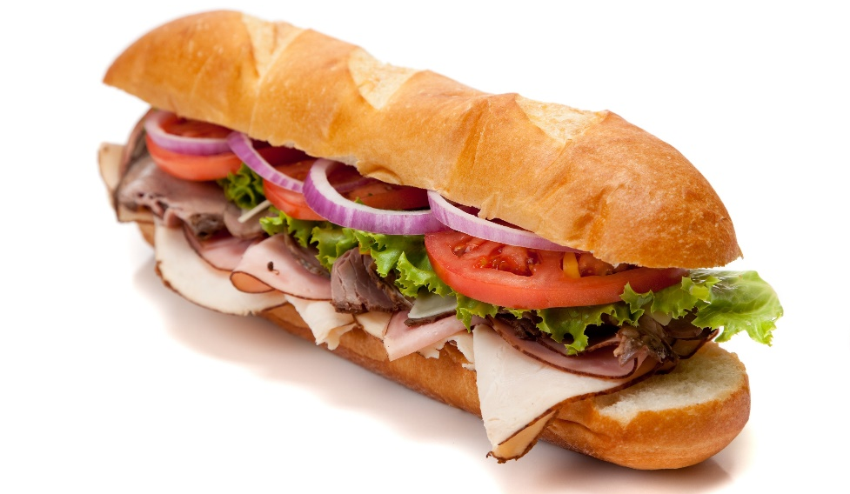
COLD SANDWICHES
Submarine sandwich:
Cold sandwich
Long, sliced roll
One or more types of
  Cheese
  Meat
  Lettuce
  Tomato
  Onion
  Other toppings
Subs, grinders, heroes, or hoagies
Hot filling—meatball sub
Notes:
A submarine sandwich usually refers to a cold sandwich served on a long, sliced roll with one or more types of cheese, meat, lettuce, tomato, onion, and various other toppings. These sandwiches may also be referred to as subs, grinders, heroes, or hoagies. In some instances, the filling may be hot, such as in a meatball sub.

Slide 5
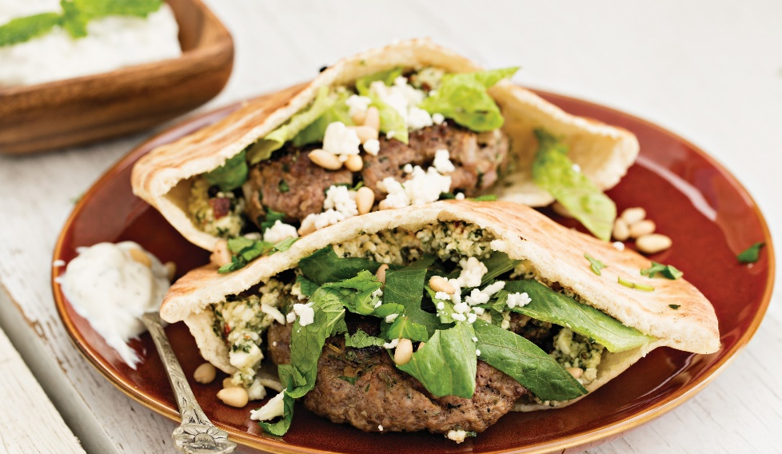
COLD SANDWICHES
Wrap sandwich:
Flat bread
  Tortillas
  Pita bread
  Cracker bread
  Rice-paper wrappers
Spread
Hot or cold filling
Rolled up
Pita—opens to form a pocket
Notes:
A wrap sandwich is made on any type of flat bread—for example, tortillas, pita bread, cracker bread, or rice-paper wrappers—and spread with a hot
or cold sandwich filling. It is then rolled up. A pita, or pita bread, is a flat bread that can be opened to form a pocket.

Slide 6
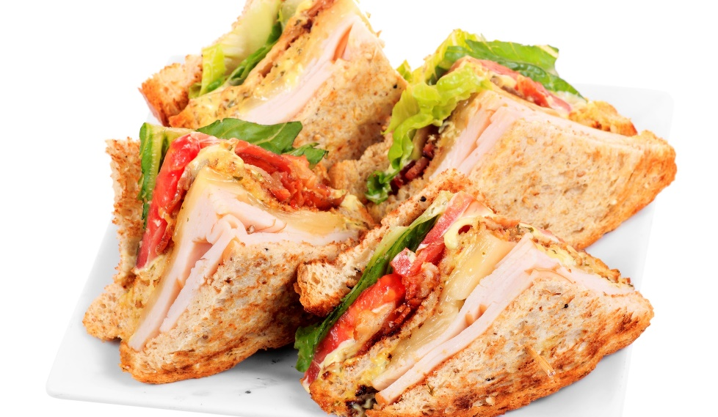
COLD SANDWICHES
Multidecker sandwich:
More than two slices of bread or roll
Several ingredients
Club sandwich
  Three slices of toasted bread
  Mayonnaise
  Sliced chicken and/or turkey, ham
  Bacon
  Cheese
  Lettuce
  Tomato
  Cut into four triangles
Notes:
A multidecker sandwich has more than two slices of bread (or roll), with several ingredients in the filling. The club sandwich is one example of a
multidecker sandwich. A traditional club sandwich is three slices of toasted bread spread with mayonnaise and filled with an assortment of sliced chicken and/or turkey, ham, bacon, cheese, lettuce, and tomato. Serve club sandwiches cut into four triangles.

Slide 7
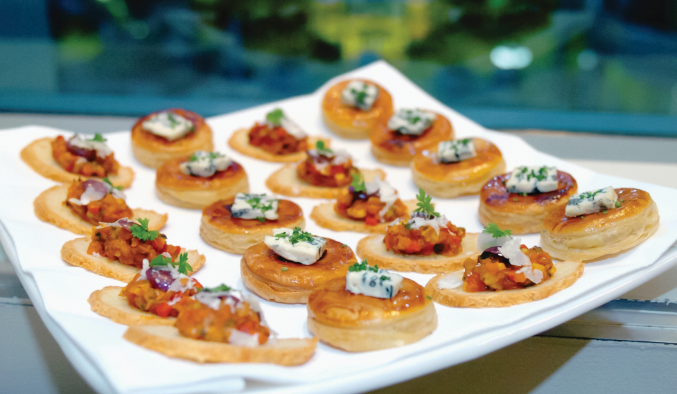
COLD SANDWICHES
Open-faced sandwich:
One slice of bread
Filling or topping
Canapé—type of hors d’oeuvre
Hors d’oeuvres
  Hot or cold bit-sized finger food
  Served before a meal
Notes:
An open-faced sandwich has only one slice of bread, without a second slice on top of the fillings. Open-faced cold sandwiches can be made with a single slice of bread, with the filling or topping attractively arranged and garnished. A version of the open-faced cold sandwich is the canapé (CAN-uh-pay), a type of hors d’oeuvre. Hors d’oeuvres (or-DERVS) are the cold or hot bite-sized finger food items that are served before a meal.

Slide 8
COLD SANDWICHES
Canapé:
Bread or toast cutouts
English muffins
Crackers
Melba toast
Tiny unsweetened pastry shells
Spread
  Flavored butter
  Cream cheese
  Meat or fish—zesty flavor
Base alternatives
  Fruit
  Vegetables
  Meat
Notes:
Make canapés from bread or toast cutouts, English muffins, crackers, Melba toasts, or tiny unsweetened pastry shells. Spreads can be as simple as flavored butter or softened cream cheese. Use meat or fish spreads to give a zestier flavor. Or use fruit, vegetables, and meat cut into bite-sized pieces as the base for canapés. An attractive garnish is the finishing touch to any canapé.

Slide 9
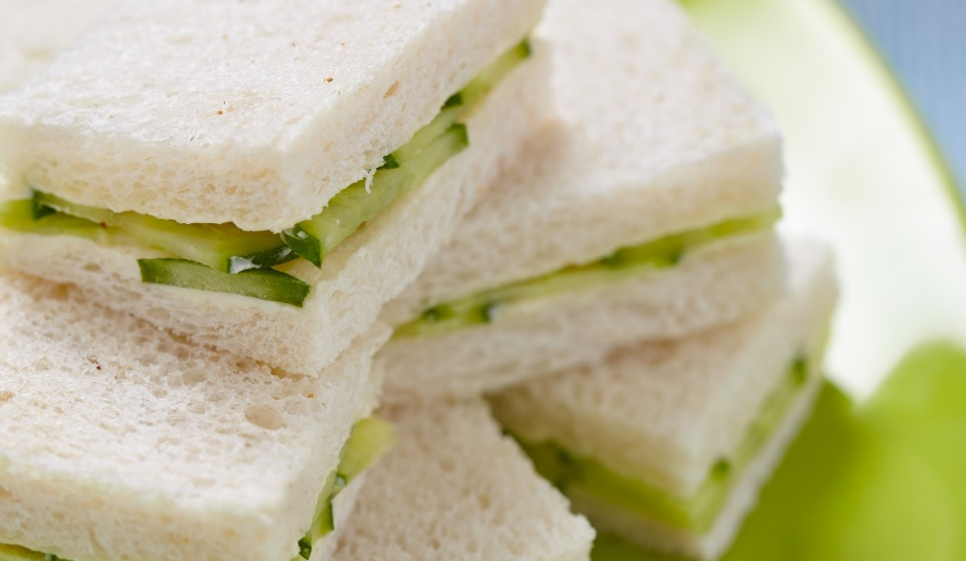
COLD SANDWICHES
Tea sandwiches:
Small, cold sandwiches
Served on bread or toast
No crust
Cut into shapes
Same filling as canapés
Can be open-faced
Notes:
Tea sandwiches are small, cold sandwiches usually served on bread or toast, trimmed of crusts, and cut into shapes. The filling and spread may be the same as those for canapés. Tea sandwiches may also be served open-faced.

Slide 10
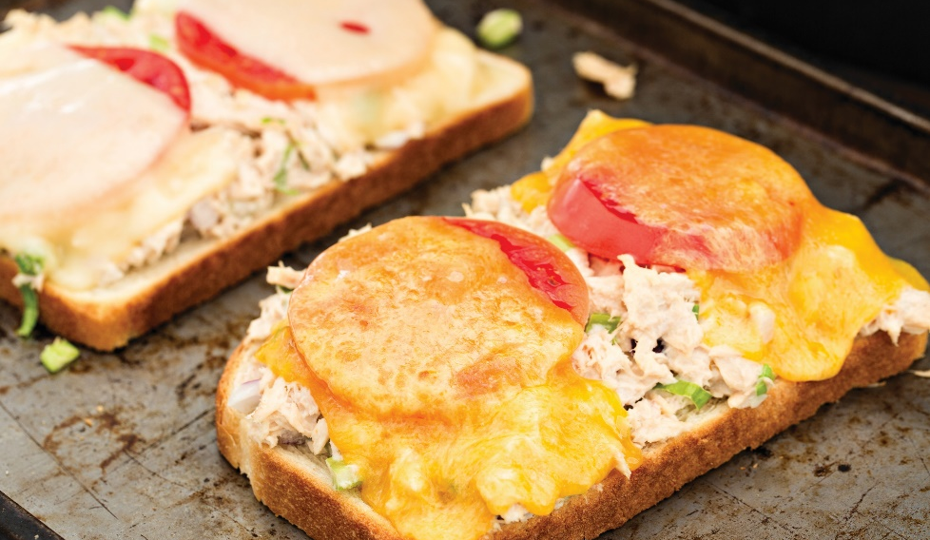
HOT SANDWICHES
Open-faced:
One slice of buttered of unbuttered bread
Half a roll
Top with hot meat or other fillings
Cover with hot toping
  Sauce
  Cheese
Broil quickly—melt cheese
Hors d’oeuvres—smaller versions
Notes:
To make an open-faced hot sandwich, first place one slice of buttered or unbuttered bread or half a roll on
a serving plate. Then top it with hot meat or other fillings and cover it with a hot topping, such as sauce or
cheese. Broil the sandwich quickly if the cheese needs melting. Smaller versions of some types of open-faced
hot sandwiches can be made for hors d’oeuvres.

Slide 11
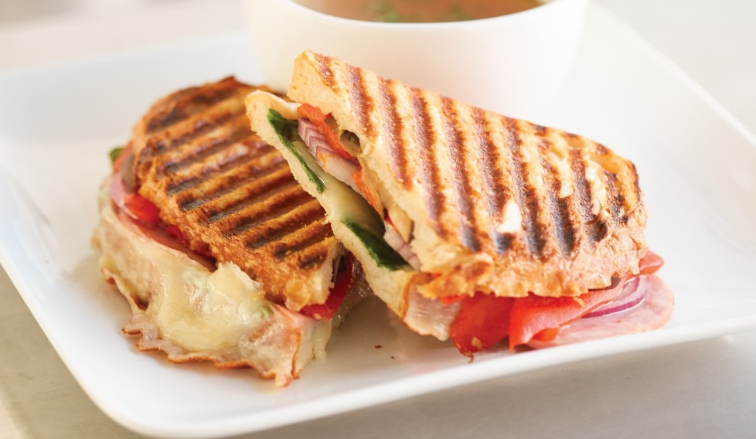
HOT SANDWICHES
Grilled (or toasted) sandwiches:
Filling between two slices of bread
Butter outside of bread
Brown on griddle or hot oven
Panini:
Compresses sandwich—panini press
Warms ingredients
Does not add additional fat
Notes:
Grilled (or toasted) sandwiches are another type of hot sandwich. These are made by placing a filling between two pieces of bread, buttering the outside of the bread, and browning it on the griddle or in a hot oven. Grilled cheese, grilled ham and cheese, and tuna melt (grilled tuna salad and cheese) are popular varieties.
Panini (PAH-nee-nee) sandwiches are made by grilling sandwiches on a panini press. This compresses the sandwich and warms the ingredients without adding additional fat to the outside of the sandwich.

Slide 12
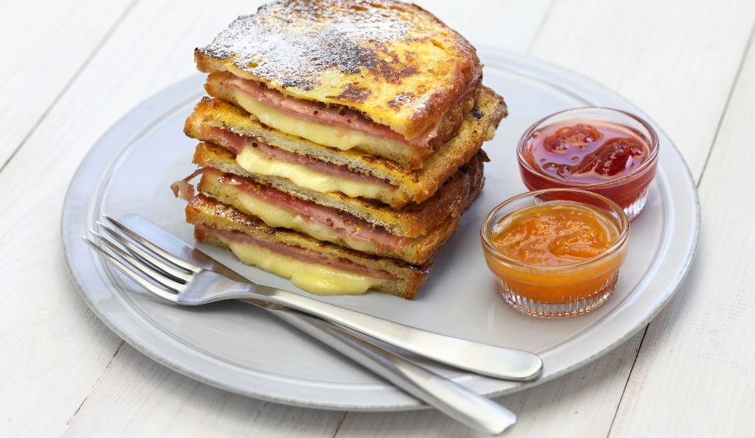
HOT SANDWICHES
Deep-fried sandwiches:
Dip sandwich in egg batter
Deep-fry sandwich
Flat griddle
  Reduce fat
  Less greasy
Monte Cristo
  Turkey or chicken breast
  Ham
  Swiss cheese
Notes:
Deep-fried sandwiches are made by dipping the filled sandwich in beaten egg batter (sometimes then coating it with bread crumbs) and deep-frying it.
Cook the sandwich on a flat griddle to reduce fat and make it less greasy. One example of a deep-fried sandwich is a Monte Cristo, which is filled with turkey or chicken breast, ham, and Swiss cheese.

Slide 13
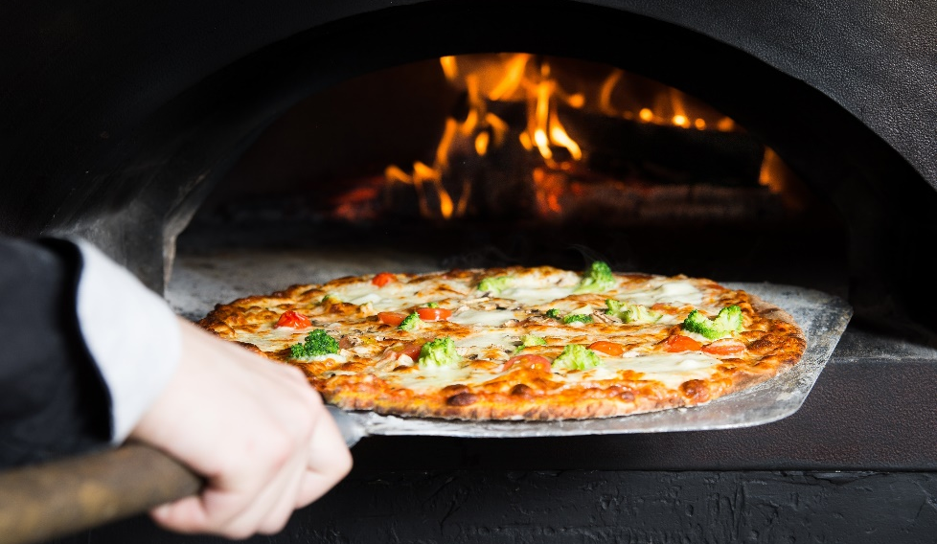
PIZZA
Hot, open-faced Italian pie
Yeast dough bottom
Baked
  Wood-fired
  Roasted
  Kiln-baked
Flavored or seasoned sauce
Toppings—cheese, meat, vegetables
Crust—thin, thick, pan
Themed pies
Notes:
It may not immediately come to mind when talking about sandwiches, but do not forget pizza! Pizza is a hot, open-faced Italian pie with a yeast dough
bottom. Pizza is baked with flavored or seasoned sauce and additional toppings, such as cheese, meat, and vegetables. Pizza comes in a wide variety
of crusts, such as thin, thick, and pan. There are a tremendous variety of toppings and sauces, as well as themed pies—chicken Alfredo, Hawaiian (with
pineapple and Canadian bacon), and taco pizza, to name a few. Pizzas can be wood-fired, roasted, or kiln-baked (baked in an extremely hot oven), and
pizza styles differ across the country.

Slide 14
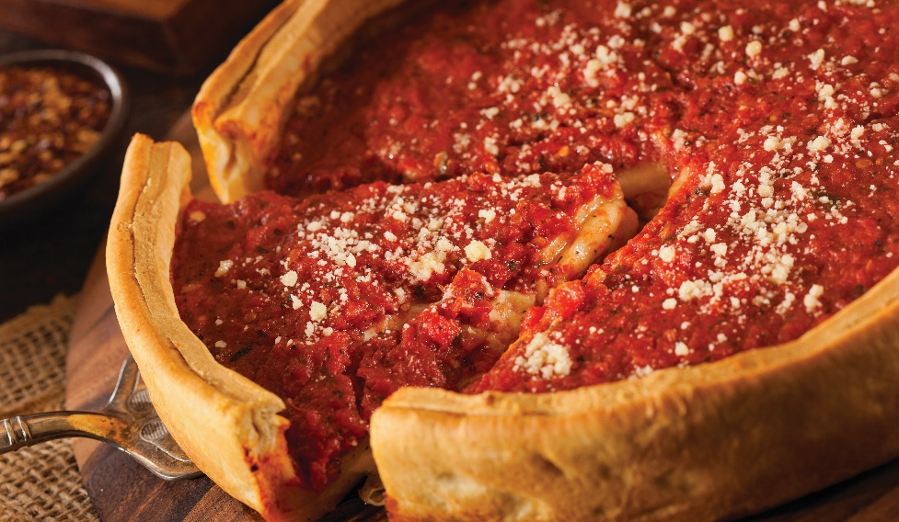
PIZZA
Chicago-style pizza:
Deep-dish dough
Inch or more of toppings and sauce
Another layer of sauce or dough
Notes:
Chicago-style pizza: characterized by a deep-dish dough with an inch or more of toppings and sauce. Sometimes covered with another layer of
dough and sauce to make a pie.

Slide 15
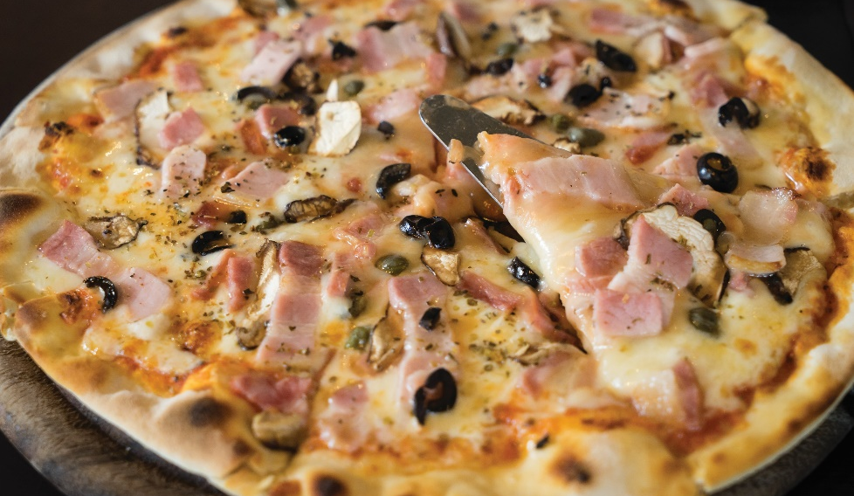
PIZZA
New York–style pizza:
Crisp, thin dough
Light tomato sauce
Limited toppings
Notes:
New York–style pizza: characterized by a crisp, thin dough with light tomato sauce and usually a limited number of toppings, given the thin
crust.

Slide 16
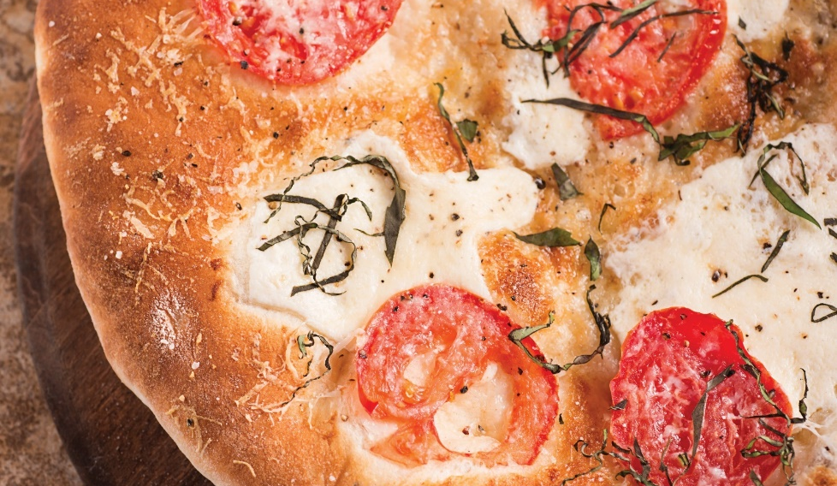
PIZZA
Neapolitan-style pizza:
Simple and fresh ingredients
  Basic dough—crispy
  Fresh tomatoes or tomato sauce
  Cheese
  Fresh basil
Notes:
Neapolitan-style pizza: described as pizza made from simple and fresh ingredients such as a basic dough cooked to crispness, fresh tomatoes or
tomato sauce, cheese, and fresh basil.

Slide 17
PRIMARY SANDWICH COMPONENTS: BREAD, SPREAD, AND FILLING
Prepared to order:
Ensures freshness
Prepared ahead of time:
Cover sandwiches
Plastic wrap
Refrigerate—2 to 3 days
Notes:
Preparing hot and cold sandwiches to order is an important skill for anyone who works in foodservice. Many operations prepare sandwiches to order to
ensure their freshness. Cover sandwiches prepared ahead of time with a sheet of plastic wrap and store them in a refrigerator for service within three hours, or wrap them individually and refrigerate them for two to three days.

Slide 18
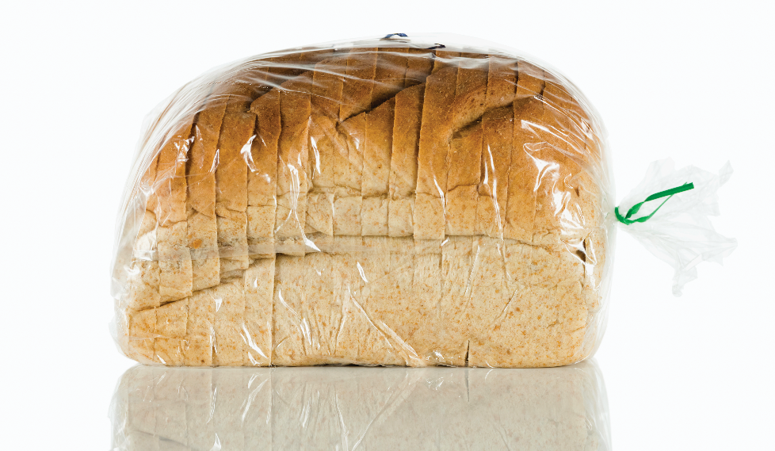
PRIMARY SANDWICH COMPONENTS: BREAD, SPREAD, AND FILLING
Bread:
Edible container for food inside
Provides bulk and nutrients
Pullman loaves
  White bread
  Most popular
Serve fresh
Notes:
The basic components of a sandwich are bread, spread, and filling. While bread serves as an edible container for the food inside, it also provides bulk
and nutrients. Pullman loaves, sandwich loaves of sliced white bread, are still the most frequently used sandwich bread (see Figure 16.9). But hard rolls, pita bread, French bread, tortillas, flatbreads, multigrain bread, and cinnamon-and-raisin bread are also very popular. Many restaurant and foodservice operations also offer a variety of whole wheat, marbled rye, and nonwheat or gluten-free breads. Regardless of the type, any bread or roll must be served fresh.

Slide 19
PRIMARY SANDWICH COMPONENTS: BREAD, SPREAD, AND FILLING
Spread:
Prevents bread from soaking up filling
Adds flavor
Adds moisture
Butter
  Soft enough to spread
  Whip in mixer
  Flavored butter
Mayonnaise
  More flavor
  Soggy bread
Notes:
There are many different types of spread that can be used when preparing a sandwich. A spread serves three main purposes—to prevent the bread
from soaking up the filling, to add flavor, and to add moisture. Butter and mayonnaise are the most common spreads. Butter must be soft enough to
spread easily without tearing the bread. Butter can be softened by whipping it in a mixer. Butter flavored with lemon, chive, mustard, honey, or other
ingredients is often used to add a unique flavor to a sandwich.
While mayonnaise is often used instead of butter because it has more flavor, it actually adds moisture to the bread and can make it soggy. Commercially prepared mayonnaise has been made with pasteurized eggs, and is therefore less hazardous than homemade mayonnaise. Raw, unpasteurized eggs should never be used to make mayonnaise in foodservice kitchens because of the increased risk of spoilage and food poisoning.

Slide 20
PRIMARY SANDWICH COMPONENTS: BREAD, SPREAD, AND FILLING
Filling:
Main attraction
Primary flavor
Protein or vegetable-based
  Sliced or grilled meat and cheeses
  Salad mixtures
  Sliced, ground, blended, or tossed
Notes:
The filling of the sandwich is the main attraction. The purpose of the filling is to provide the primary flavor to the sandwich. Generally, the filling is protein based, but it does not have to be. Vegetable-based sandwiches are popular today, such as Caesar salad wraps or Portobello mushroom sandwiches. Fillings can vary from sliced or grilled meat and cheeses to salad mixtures such as egg or tuna salad. The filling may be sliced, ground, blended, or tossed—any form that fits the type of sandwich being prepared. The flavors of a sandwich are limited only by the creativity of the
sandwich cook.

Slide 21
PRIMARY SANDWICH COMPONENTS: BREAD, SPREAD, AND FILLING
Sandwich accompaniments:
Condiments
  Ketchup
  Mustard
  Horseradish sauce
Fresh and pickled vegetables
  Lettuce, tomato, onion
  Sweet or dill pickles
French fries or chips
Potato salad and slaws
Notes:
Sandwiches are often served with accompaniments. These vary from additional condiments such as ketchup, mustard, or horseradish sauce, to fresh and pickled vegetables such as lettuce, onion, tomato, and sweet or dill pickles. French fries or chips are also a popular accompaniment, as are potato salads and slaws.

Slide 22
PRIMARY SANDWICH COMPONENTS
Beef:
Roast beef slices—hot or cold
Hamburger patties
Small steaks
Corned beef
Pastrami
Ground beef (sloppy joes)
Hot dogs

Slide 23
PRIMARY SANDWICH COMPONENTS
Mayonnaise-based salads:
Egg salad
Tuna salad
Chicken salad
Turkey salad
Crabmeat salad
Ham salad

Slide 24
PRIMARY SANDWICH COMPONENTS
Fish and shellfish:
Tuna
Sardines
Smoked salmon and lox
Shrimp
Anchovies
Fried fish

Slide 25
PRIMARY SANDWICH COMPONENTS
Pork products:
Roast pork
Ham
Bacon
Canadian bacon
Liverwurst
Poultry:
Turkey
Chicken

Slide 26
PRIMARY SANDWICH COMPONENTS
Cheeses:
Cheddar
Monterey jack
Mozzarella
Pepper jack
Provolone
American
Cream cheese

Slide 27
PRIMARY SANDWICH COMPONENTS
Pickled vegetables:
Dill and sweet pickles
Olives
Peppers
Artichoke hearts
Condiments:
Mustard
Horseradish sauce
Ketchup
Hot sauce
Relish
Barbecue sauce

Slide 28
PRIMARY SANDWICH COMPONENTS
Vegetables:
Lettuce
Tomatoes
Onions—raw or grilled
Sprouts (alfalfa, bean, etc.)
Spinach and other greens
Eggplant
Mushrooms (Portobello)

Slide 29
PRIMARY SANDWICH COMPONENTS
Other fillings:
Peanut butter and other nut butters
Jelly
Hard-cooked eggs
Fruits—fresh or dried
Hummus
Tabbouleh

Slide 30
PRIMARY SANDWICH COMPONENTS
Popular pizza toppings:
Meat, poultry, and seafood
  Pepperoni
  Sausage
  Bacon
  Chicken
  Anchovies
  Shrimp

Slide 31
PRIMARY SANDWICH COMPONENTS
Popular pizza toppings:
Cheese
  Mozzarella
  Parmesan
  Ricotta
  Gorgonzola
  Feta
Vegetables
  Mushrooms
  Olives
  Tomatoes
  Eggplant
  Peppers
  Onions
  Broccoli
  Spinach
  Arugula

Slide 32
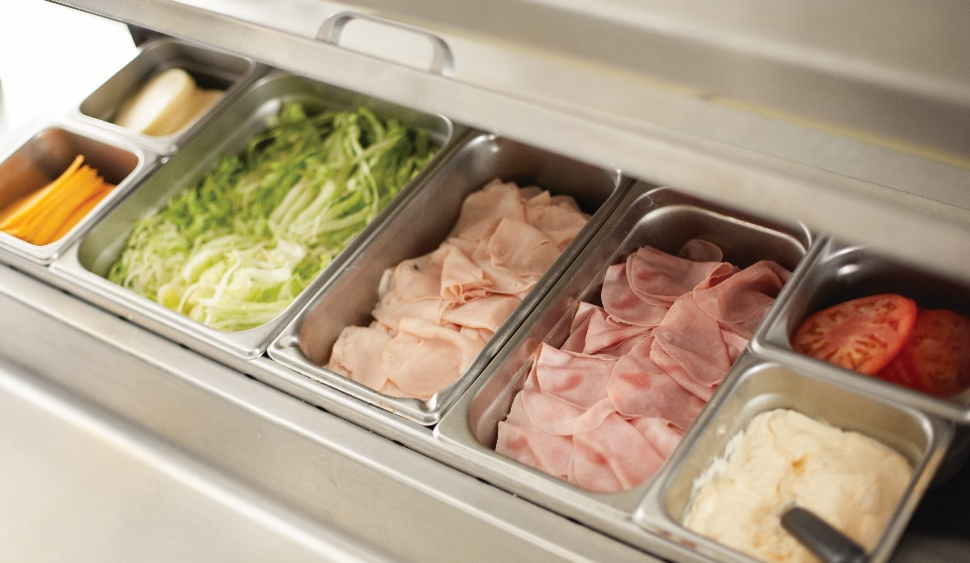
SANDWICH STATIONS
Reduce hand motions
Setup depends on menu
Available equipment and space
Two basic components
  Ingredients
  Equipment
Notes:
Sandwich preparation involves a great deal of handwork, precision, and speed. It is important to reduce hand motions, whether preparing sandwiches
in quantity or to order. The setup for a sandwich station depends on the operation’s menu and on available equipment and space. Like every other
station in a professional kitchen, the sandwich station needs two basic things—ingredients and equipment.

Slide 33
INGREDIENTS
Mise en place
  Separate and clean lettuce leaves
  Slice tomatoes
  Prepare garnishes
  Slice meats and cheeses
  Mix fillings
  Prepare spreads
Reduce hand movement
Portion sliced items
  Count
  Weight
Portion fillings
Notes:
Many sandwich ingredients must be prepared ahead of time. This is called mise en place—preparing everything you need for the dish and having it all in its place. Depending on the sandwich, this could mean separating and cleaning lettuce leaves, slicing tomatoes, preparing garnishes, slicing meats and cheeses, mixing fillings, or preparing spreads.
Arrange and store the ingredients to reduce hand movement. All the items should be within reach so you can work quickly and safely. At a busy sandwich station, every second counts. Portion sliced items by count and by weight. Portion fillings by weight as well. To keep recipes accurate,
each ingredient must be counted or weighed properly. As always, following the recipe is essential to maintaining the quality of the sandwich and meeting the expectations of the guest.

Slide 34
EQUIPMENT
Work table:
Spread out ingredients
Storage facilities:
Refrigeration equipment—cold ingredients
Steam table—hot ingredients
Dry storage
  Bread
  Dry goods
Storage materials:
Plastic wrap, deli paper, labels
Notes:
The type of equipment needed at a sandwich station depends on the size of the menu and the operation. An efficient sandwich station makes it easier to prepare sandwiches in large quantities. Most stations have the following:
• Work table: It must be big enough to spread out ingredients and do work.
• Storage facilities: This includes refrigeration equipment for cold ingredients, a steam table for hot ingredients, and dry storage for breads
and dry goods as well as paper products, plates, etc.
• Storage materials: This includes plastic wrap, deli paper, and labels.

Slide 35
EQUIPMENT
Hand tools:
Spreader, spatula, serrated knife, chef’s knife, cutting board, meat slicer
Portion-control equipment:
Portion scoop
Portion scale
Cooking equipment—hot sandwiches:
Griddles, grills, broilers, deep-fryers, microwave ovens
Notes:
• Hand tools: This includes a spreader, spatula, serrated knife, chef’s knife, cutting board, and meat slicer.
• Portion-control equipment: This includes scoops for fillings and a portion scale for measuring ingredients.
• Cooking equipment for hot sandwiches: This includes griddles, grills, broilers, deep-fryers, and microwave ovens.

Slide 36
PIZZA PREPARATION AND EQUIPMENT
Pizza preparation:
Separate prep area
Ingredients evenly distributed
Sauce and other ingredients
  Half inch to inch from edge
Notes:
Pizza should have its own preparation area, because the flour needed could easily fall into other ingredients. Ingredients on the pizza should be evenly
distributed across the top of it. The sauce and other ingredients should come to within a half inch to an inch of the edge of the pizza, depending on the size of the pie.

Slide 37

PIZZA PREPARATION AND EQUIPMENT
Equipment:
Ovens
  Conveyor ovens
  Deck ovens
  Wood-fired pizza kilns/ovens
Metal or wooden peels
Cutting equipment
  Rotary cutter (pizza wheel)
  Curved pizza knife
Rest pizza
Quick, clean cuts
Even slices—triangle or square
Notes:
The list of pizza equipment is similar to that of sandwich equipment, but varies based on cooking needs. Conveyer ovens, deck ovens, or wood-fired
pizza kilns/ovens can all be used. Metal or wooden peels (as shown in Figure 16.11) for moving the pizzas in and out of the ovens are needed, as well
as cutting equipment for finished pizzas. There are several methods and knives to choose from to cut pizza. Possibilities include a rotary cutter (pizza wheel) or a large curved pizza knife that cuts across the entire pizza at once. Let the pizza rest for a brief time before cutting or slicing, to allow the ingredients to set. Quick, clean cuts are best. Slices should be even in size, and can be triangular or square. The Essential Skills feature on page 339 discusses sandwich and pizza presentation.

Slide 38
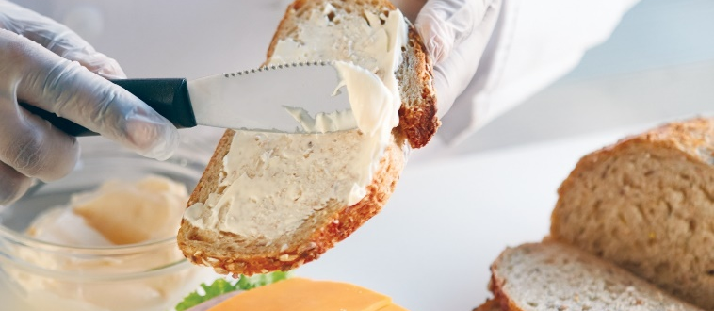
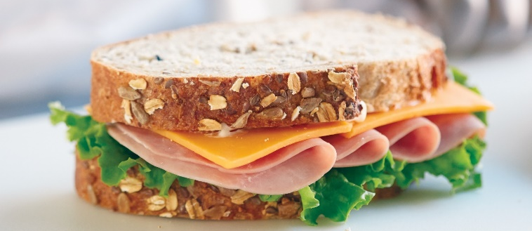
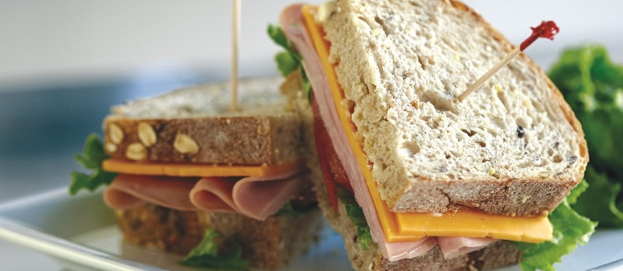
MAKING A SANDWICH
Pick type of bread (toast)
Choose spread
3. Assemble filling
4. Slice sandwich
Notes:
Pick a type of bread. If desired, toast the bread.
Choose a spread that will make the bread stick together. Margarine, mayonnaise, or avocado are some choices. Combine the spreads for a different taste.
Assemble the filling(s). Jam, peanut butter, ham, cheese, lettuce, tomato, vegetables, pickles, bacon bits, onion, turkey, beef, and chicken are just some of the options.
When you finish putting together the items, slice the sandwich for easier handling.

Slide 39
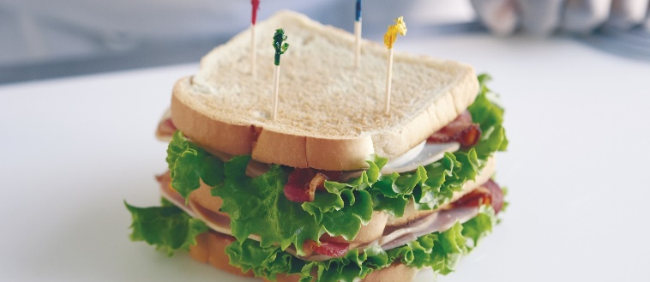
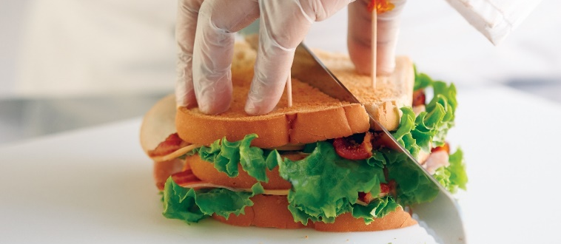
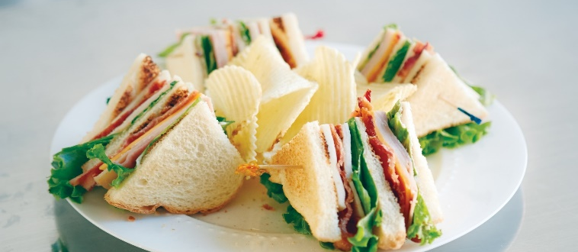
CUTTING A CLUB SANDWICH
Use four long, frilled toothpicks
2. Cut sandwich into quarters
Place sandwich with points
facing upward
Notes:
Use four long, frilled toothpicks and place one between the center and side for each of the four sides of the sandwich.
Cut the sandwich into quarters from corner to corner. Place the sandwich with the points facing upward.

Slide 40
GUIDELINES FOR MAKING CANAPÉS
Prep bases, spreads, and garnishes
Use quality ingredients
Assemble close to service
  Follow time and temperature guidelines
Keep spreads and garnishes simple and neat
Notes:
Pre-preparation is essential. All bases, spreads, and garnishes must be ready ahead of time.
Use quality ingredients. These do not necessarily have to be expensive, but they must be purchased, stored, and prepared with an eye to creating the best-tasting and most attractive-looking product possible.
Assemble canapés as close as possible to serving time. Bases quickly become soggy, and spreads and garnishes dry out easily. As trays are completed, they can be covered lightly with plastic and refrigerated for a short time. Always follow time and temperature rules for safe food handling.
Keep spreads and garnishes simple and neat. Elaborate garnishes can fall apart on the tray or in the guests’ hands.

Slide 41
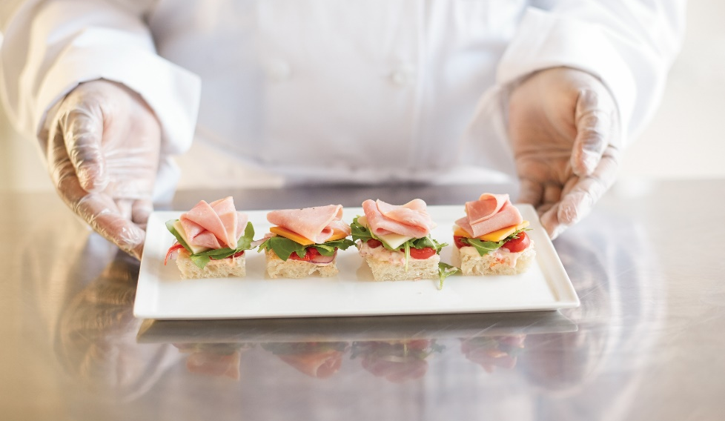
GUIDELINES FOR MAKING CANAPÉS
Flavor combinations
  Taste and appearance
Spicy or flavorful ingredients
  Offer variety—vegetarian and low-fat
Arrange carefully and attractively
Notes:
Use flavor combinations in spreads and garnishes that are appealing both in taste and in appearance. The ingredients must blend well together and look attractive.
Use spicy or flavorful ingredients. Offer a variety of canapés, including vegetarian and low-fat options to meet the needs of all guests.
Arrange the canapés carefully and attractively on trays.

Slide 42
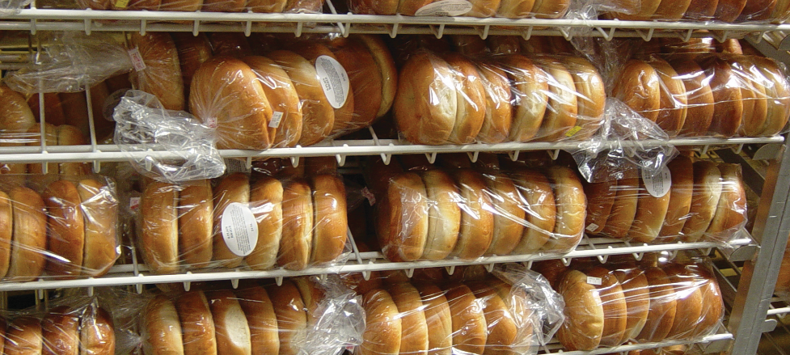
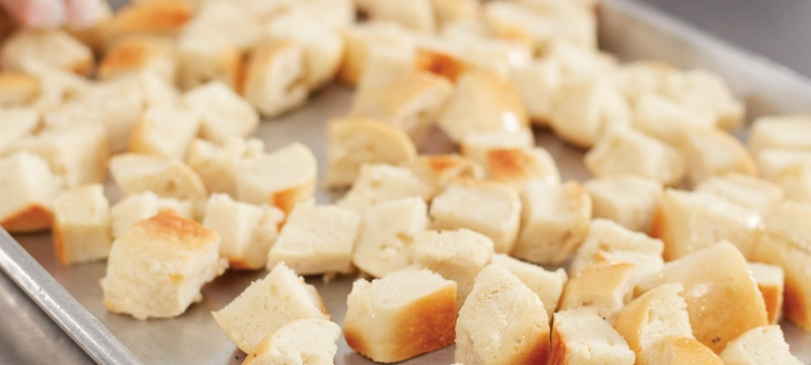
TIPS FOR KEEPING BREAD FRESH
Delivered daily
Moisture-proof wrapping
Store between 75°F and 85°F (24°C and 29°C)
French bread or hard-crusted bread
  Use the day baked or delivered
If kept > one day, store in freezer
  Thaw inside wrapping
6. Day-old bread—use for toasting
Notes:
Bread should be delivered daily, if possible.
Keep bread wrapped in moisture-proof wrapping until it is used.
Store bread between 75°F and 85°F (24°C and 29°C) rather than in a refrigerator.
Use French bread and other hard-crusted bread the day it is delivered or baked.
If bread must be kept more than one day, store it in the freezer. Thaw frozen bread inside its wrapping.
Day-old bread can be used for toasting without loss of quality.

Slide 43
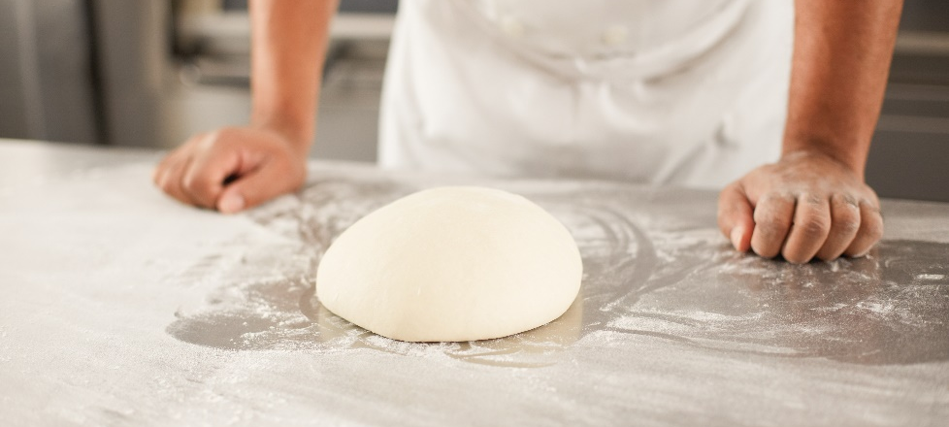
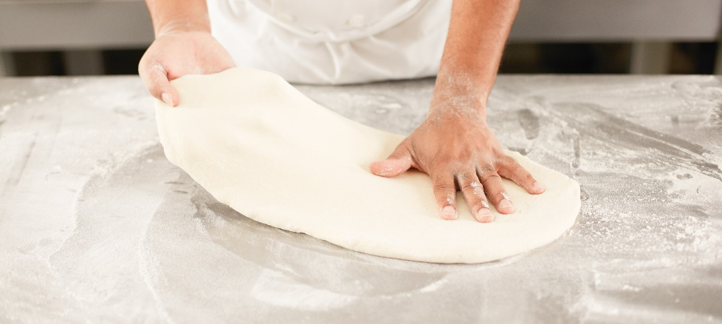
MAKING BASIC PIZZA
Remove dough from refrigerator
Set oven temperature
  High as possible
  Prepare surface with flour
Stretch dough
Dust pizza peel with flour or semolina
Notes:
Remove the pizza dough from the refrigerator.
While the dough is warming, set the oven temperature as high as it will go (500°F, or 260°C, is a minimum), and prepare a surface with flour so the dough will not stick.
Stretch and even out the dough on the floured surface using your fingers to press in the middle of the dough, and then push the dough outward. Leave a narrow edge on the dough.
Dust a pizza peel or baking sheet with a light, even dusting of flour or preferably semolina.

Slide 44
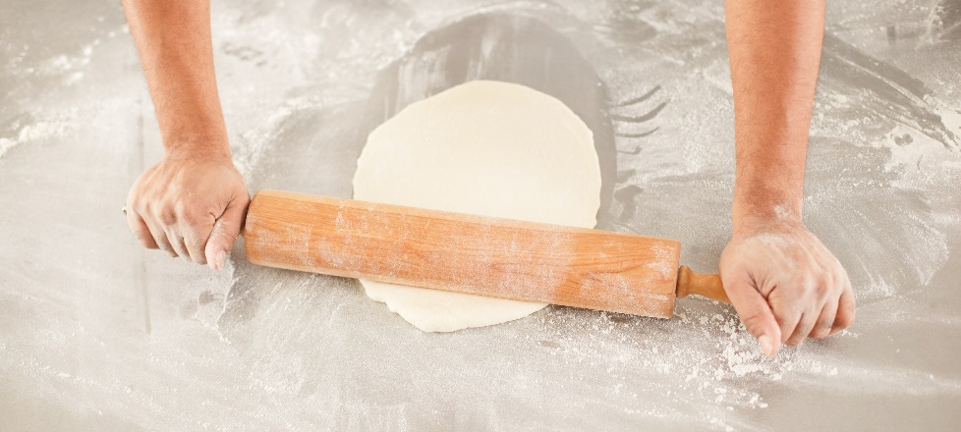
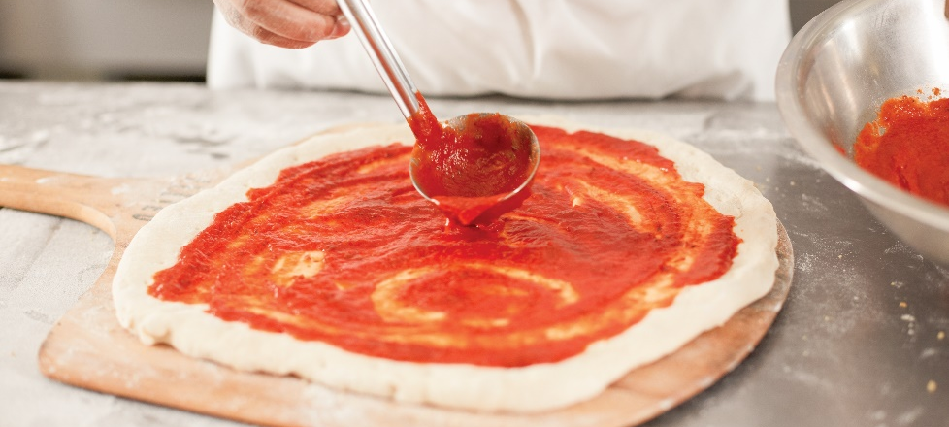
MAKING BASIC PIZZA
Drape dough over hand and rotate
  Can use rolling pin
Place dough on floured pizza peel
  Shake dough—no sticking
Spread sauce evenly
  Leave outermost edge dry
Notes:
Drape the dough over the back of your hand, and then rotate it slowly. The weight of the dough should gently stretch it to a circular shape and even thickness. (You can also use a rolling pin for this.)
Place the dough onto the floured pizza peel and shake gently to make sure the pizza does not stick.
Spread the sauce evenly over the dough, but leave the outermost edge dry.

Slide 45
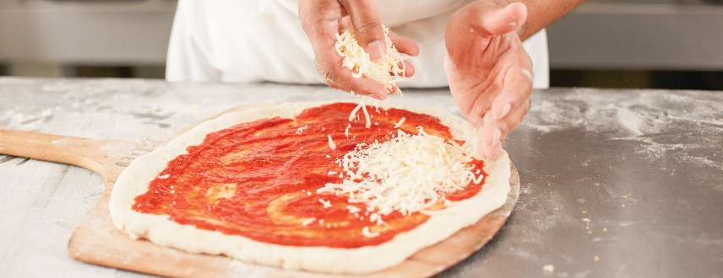
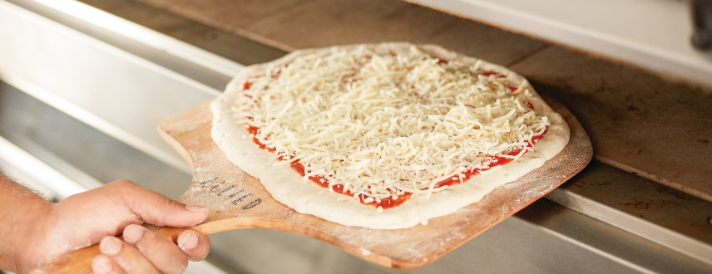
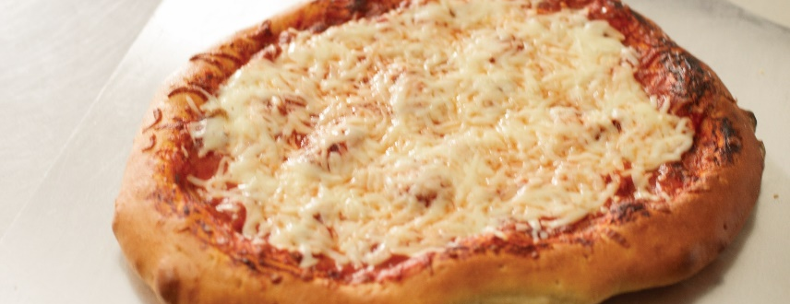
MAKING BASIC PIZZA
Sprinkle grated cheese evenly
Slip pizza into oven
Crust is brown and bubbles
Remove from oven with pizza peel
Season with fresh herbs
  Brush oil on crust
  Cut and serve immediately
Notes:
Sprinkle grated cheese evenly over the sauce.
Slip the pizza from the peel into the oven as quickly as possible.
Cook the pizza until the crust turns brown and bubbles.
Remove the pizza from the oven by using a pizza peel or baking sheet.
Season the pie with fresh herbs and brush the crust with oil. Cut and serve immediately.

