Slide 1
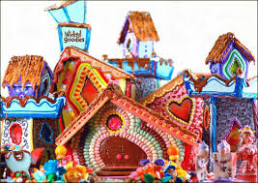
GINGERBREAD
CREATIONS
Putting the sweetness into the holiday season

Slide 2
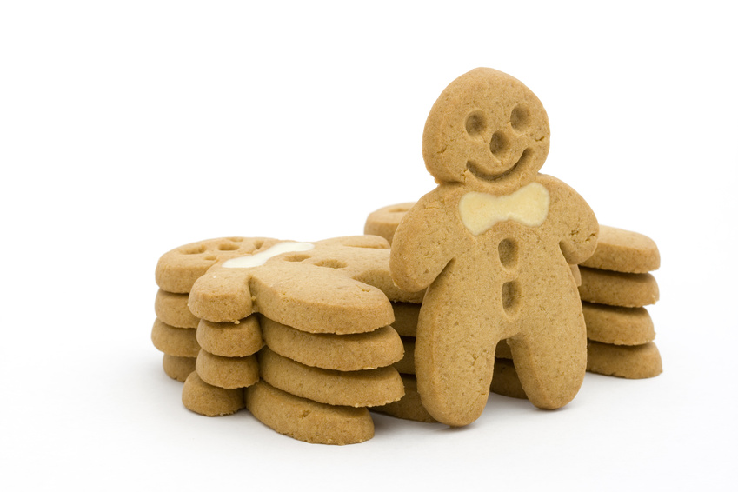
Occupational Skills in Gingerbread Design
Artist
Engineer
Pastry chef
Manager

Slide 3
Occupation #1
Get Creative and
Explore New Ideas!
Be the ARTIST
Use your creativity to plan the concept behind your design
Prepared gingerbread houses or gingerbread kits from the store are not allowed
Each group will receive one 24 x 17” platform
Determine what materials would be best suited for your design with the candy provided
All items on the board must be edible with the exception of toothpicks or other items to promote stability and/or lighting
Supplies on cart and other supplies in classroom (upon approval from instructor) are available but any other items may be purchased and brought in
Items purchased will not be reimbursed

Slide 4
Occupation #2
Be the ENGINEER
Sketch your model/concept
Draw and cut out all pieces to be used as templates
Label each piece (ex. house 1- left wall)
Be sure all pieces fit together BEFORE you make them out of gingerbread
Assemble carefully using the Royal Icing recipe provided
Be sure creation is structurally sound

Slide 5
Occupation #3
Be the PASTRY CHEF
Prepare the dough as needed
Each group can prepare 3 batches of dough and 3 batches of icing
Any additional batches must be either brought in or ingredients brought in
RESEARCH techniques that could be done in class with the materials provided or materials you bring in
All assembly/decorating must be done within the classroom

Slide 6
Occupation #4
Be the MANAGER
Use time wisely. This project requires a great amount of time management and patience
Choose the right person for the right task- utilize each other’s talents
Each day you must be cleaned up when the bell rings- no passes will be given for your next class
You may use your study halls to work on the creations as long as it has been approved by your instructor (dependent on the hour/class)

Slide 7
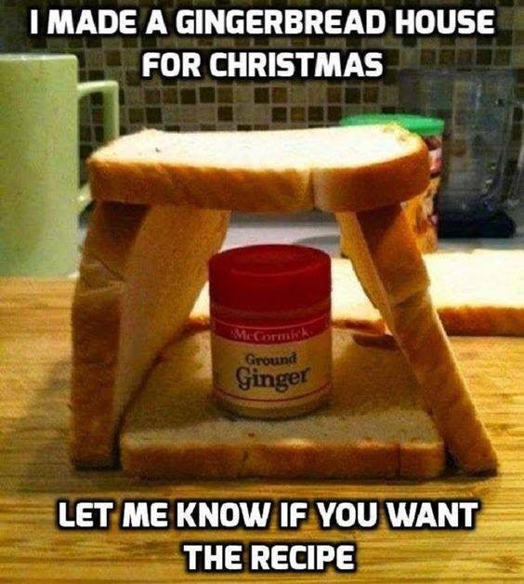
Rather than this...

Slide 8
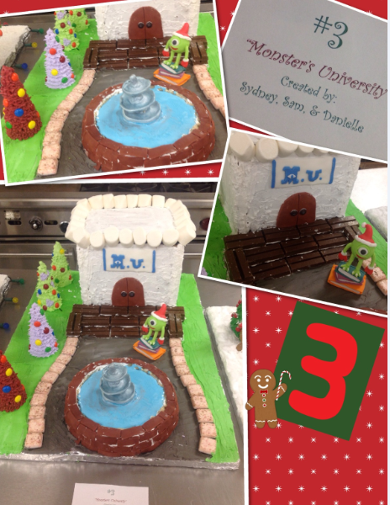
Dream big. Check out what students your age have done in the past at other schools!

Slide 9
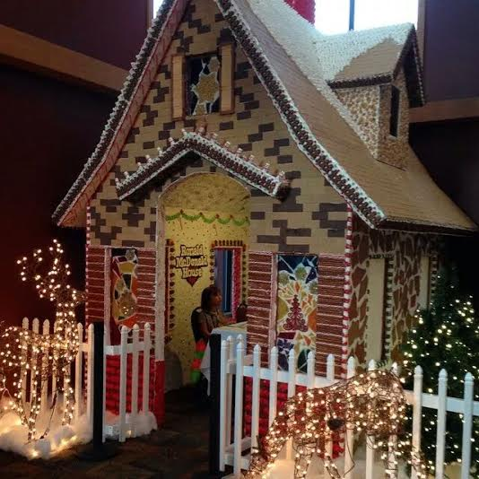
But not this big

Slide 10
Bring on the Holidays!

