Slide 1
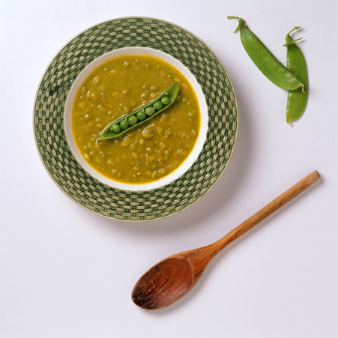
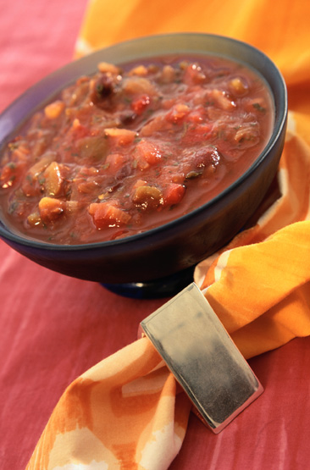
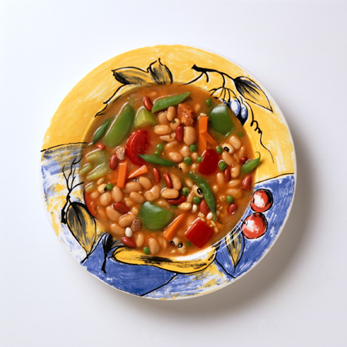
Culinary: Soup

Slide 2
Soup
Includes:
Thin sauce
Clarified, reduced, flavor enhanced, and well-garnished stock
Well-garnished, flavorful liquid, or semi-liquid served at any point in the meal
Notes:
References
The Art and Science of Culinary Preparation (1992) Chp 15
On Cooking 3rd Edition (1999) Chp 11
The New Professional Chef 6th Edition (1999) Chp 16
www.totalfoodnet.com

Slide 3
Soup Categories: Classifications
Most Commonly Prepared
Clear/Thin
Broth, stocks, consommé (clarified)
Thick
Purée, cream, velouté, vegetable
Specialty
National/Regional (e.g., chowder)
Notes:
Soup Classifications
Clear Thick Special
broths (bouillon) bisque/purée/coulis variety of national &
consommés classical vegetable regional types(Chowder)
paysanne or potage cold soups various creams fruit & nut soups
various veloutés

Slide 4
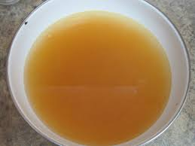
Broth
Thin soup
Stock/broth
Proper reduction
Seasoned
Quality: robust, rich flavor, and aromatic
Notes:
The terms bouillon and broth can be used interchangeably; however, in French cookery, the term bouillon applies mainly to the liquid part of a 'pot-au-feu', 'boiled beef dinner'. Broths are among the simplest soups to prepare. Normally, their flavor comes from long simmering of a variety of ingredients together in one pot. An assortment of separately cooked foods may be added at various times during cooking, depending on the cooking requirements of the individual items. All the ingredients should finish cooking at the same time. The plain, unclarified broth from boiling meat, fish, or vegetables is used instead of water or white stock for cooking certain dishes, and the preparation of soups and sauces.

Slide 5
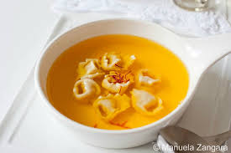
Consommé
Thin, clear soup
Stock
Proper reduction
Clarification
Seasoned
Garnish: brunoise, julienne of vegetable, meat
Quality: crystal clear, rich texture, and full flavor
Notes:
Consommé is a concentrated, thin, clear soup made from meat, poultry, or fish.
It is the clarification which makes it a true consommé.
The clarification process is simple.
Well flavored, fat free stock is brought slowly to a boil while a clarification mixture is whisked in. As the egg whites and the albumen from the ground meat in the clarification mixture cook, they expand and rise to the top of the stock. They form a gray froth of coagulated proteins which form a filter. This is called the raft. The consommé is left to simmer for approximately an hour. (The mixture is not allowed to boil once the raft has formed. The strong rolling action would break the raft a part.) This allows the impurities to percolate through the filter, leaving the liquid crystal clear and sparkling.
The prefered method for removing the consommé from the pot is to cook in a stock pot with a bottom spigot. The consommé is drained from the bottom without disturbing the raft. If this is not possible, carefully place a fine mesh chinois in the pot, disturbing the raft as little as possible and remove the clear consommé with a ladle from the chinois.
Consommé should have a clear tint. Meat consommé should be darker than that of chicken or fish.
Consommés are thickened naturally by their gelatin content. The gelatin content of consommé gives it a smooth texture when hot, and sets it, when chilled, to just the right shivering jelly. Ideally, the original stock should be made with enough bones to set the consommé. Gelatin, however, can be added during the last part of the clarification process to ensure that the consommé sets properly.
Consommé garnish is added just before serving so it does not cloud the soup. No ingredients should be larger than the size of a pea, and all cut garnishes must fit within the well of a bouillon spoon. Chopped herbs, small quenelles, pasta, and royales are appropriate garnishes.

Slide 6
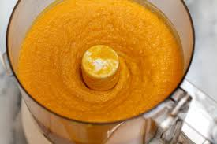
Purée
Thick soup
Starchy vegetables cooked in liquid
Ingredients puréed
Quality: smooth, creamy consistency, and rich flavor
Notes:
Purées of starchy vegetables or leguminous plants are made of vegetables rich in starch. These include white or red dried beans, kidney beans, lentils, split peas, and others. These vegetables contain enough starch naturally that they do not need added elements to bind.
Purées of fresh vegetables, less rich in starch, do need added binders. Often those added are cooked rice or a purée of some vegetable richer in starch content.
A good puréed soup requires thorough cooking to insures that the starchy ingredients, which give it body, are well blended in the purée.
The consistency of a puréed soups will vary with the ingredients used and the way in which they are processed.
A food mill produces a more coarsely textured purée than does a food processor.
The finest consistency is achieved by straining the puréed soup through a fine sieve prior to service.

Slide 7
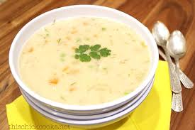
Cream
Thick soup
Meat, vegetables, poultry, fish, or shellfish
Base: milk, béchamel sauce, or stock
Needs a thickner
Ingredients are often puréed
Finished with cream (optional)
Quality: rich flavor, smooth, and creamy base
Notes:
The preparation of creams and veloutés are basically the same.
Preparing cream and velouté(ingredients may require some variation.)
Prepare a light velouté or bechamel sauce using a suitable roux. note: Binding of the sauce can be done with corn starch, waxy maize, or other starch.
Prepare the main flavoring ingredients: cut vegetables into thin slices or small dices; sweat them in butter; do not brown the vegetables; Green leafy vegetables should be blanched before being sweated in butter.
Add the bechamel or velouté to the flavoring ingredients and simmer until tender.
Purée the soup by passing through a food mill, food processor, or blender.
Add hot white consommé to the flavored velouté to gain the desired consistency, boiled cream to the flavored bechamel.
Adjust seasoning as needed.
At service time, finish with the appropriate liaison or heavy cream.
Add garnish and serve immediately.

Slide 8
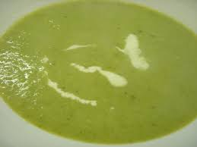
Velouté
Thick soup
Meat, vegetables, poultry, fish, or shellfish
Base: velouté sauce
Ingredients are often puréed
Finished with liaison of egg yolk and cream
Quality: rich flavor and smooth, creamy base
Notes:
The veloutés differ from the creams in that their thickening element is always a velouté sauce suitable for the nature of the ingredients of the soup being prepared. In addition, the final liaison in velouté soups is 5 to 6 egg yolks per cup of heavy cream for each quart of velouté soup. This differs from the cream soups where strictly heavy cream is used.
Velouté soups are always composed of 4 main items.
A purée of the main flavor/ingredient.
An ordinary poultry, game, vegetable, or fish velouté made slightly thinner than normel.
A liaison composed of egg yolk and cream.
A garnish in keeping with the nature of the soup.

Slide 9
Vegetable
Thick soup
Vegetables, meat, and poultry
Base: appropriate stock
Not puréed; chunky
Quality: evenly cooked, consistently sized pieces of vegetable and meat; thick broth; robust flavor
Notes:
Preparing vegetable soup.
Ingredients are cut into similar shapes, sizes.
Braise the vegetables well in butter.
Add liquid and simmer until solid ingredients are tender and the broth well flavored.

Slide 10
Chowder
Traditional U.S. soup; thick
Shellfish, fish, potato, or corn
Base: shellfish or fish stock, milk, béchamel, or velouté
Not puréed, chunky
Sometimes finished with cream
Quality: rich, thick, creamy base; evenly cooked ingredients; full-bodied flavor
Notes:
This is an American original first created by the Oyster men on Chesapeake Bay from onions. potatoes, butter, cream, and oysters.
Assign each student team one of the following soups to prepare
purée of Split Pea (Recipe #81)
Beef Consommé (Recipe #80)
Chicken Consommé Recipe # 79)
Cream of Asparagus Soup (Recipe #82)
Chicken Velouté Soup (Recipe #83)
Clear Vegetable Soup (Recipe #84)

