Slide 1
Menu Pricing: Part 2
Food Cost % Method
Contribution Markup Method
Straight Markup Method

Slide 2
Review:
PURCHASE UNIT:
Form in which the item is purchased
PURCHASE COST:
Amount you paid for the purchase unit
UNIT COST:
Purchase Cost divided by Purchase Unit
Round to nearest .001
AMOUNT NEEDED:
Amount in Specific Recipe
INGREDIENT COST:
Without dry spices
Unit Costs/Amounts must match
Round to nearest .001

Slide 3
Menu Pricing Techniques
Managers must determine what customers are willing to pay and examine:
Competitors prices
Cost to sales ratios
Contribution Margins:
The portion of dollars that a particular menu item contributes to overall profits.

Slide 4
Let’s Try It!
Unit cost label must match amount needed label
Ex. lb to oz must change to oz to oz; use equivalencies to match
Ingredients for 2 servings |  |  |  | Ingredient Cost
Item | Purchase Unit/ | Purchase = Cost | Unit Cost X (Round to nearest .001) | Amount= Needed | Ingredient Cost (Round to nearest .001)
Asparagus | .75 lb | $1.76 |  | 8 oz
Olive oil | 1 gallon | $15.67 |  | 2 fl oz
Garlic | 4 oz | $.75 |  | 2 cloves (1 oz)
Salt | N/A | N/A |  | TT
Pepper | N/A | N/A |  | ½ t
Parmesan cheese | 8 oz | $3.99 |  | 1 oz
$.147/oz
$1.173
$.122/fl oz
$.245
$.188/oz
$.188
N/A
Part of MU
N/A
Part of MU
$.499/oz
$.499

Slide 5
Calculating Portion Costs
Total Recipe Cost
1% markup for small amounts of dry herbs/spices (Q factor) (Multiply recipe cost by .01)
Total Recipe Cost
Portion Cost (Divide recipe cost w/mark-up by number of servings in recipe rounded to the cent)
$2.105
$0.021
$2.125
$1.06

Slide 6
Now you can use portion costs to determine...
MENU PRICE
Three Methods to Determine Menu Price:
Food Cost % Method
Contribution Markup Method
Straight Markup Method

Slide 7
Food Cost % Method
ITEM COST = Menu Price
Food Cost Percentage
FCP dependent on type of foodservice operation
ProStart- 33% mark-up
Example: Item cost = $1.00
$1.00/.33
Menu Price $3.03

Slide 8
Recipe Costs: Food Cost Percentage
Asparagus Total Recipe Cost
Portion Cost (for 2 servings)
Calculation for 33% FCP
Menu Price using 33% FCP
$2.104
$1.06
$1.06
.33
$3.21

Slide 9
Recipe Costs to Menu Pricing
Round the menu price to a more ideal menu price
Rather than $3.21
$3.50
$3.95
$4
Avoid menu pricing below the cost of the item or you’ll lose money

Slide 10
Contribution Margin Method
Knowing the portion costs for each item sold foodservice operators can determine the average contribution margin needed to cover overhead and yield a desired profit.
Calculate the average contribution per customer toward overhead costs and profit.
Add that number to the food cost.

Slide 11
Contribution Margin Method Example
Average contribution = $2.00
Menu Item Cost = $1.91
$3.91= menu price
Round up to a more ideal menu price
Ex. $3.95, $3.99, or $4

Slide 12
Recipe Costs: Contribution Margin
Asparagus Total Recipe Cost
Portion Cost (for 2 servings)
Average contribution (amount will be provided)
Menu Price w/ Contribution Margin Method
$2.104
$1.06
$2.25
$3.31

Slide 13
Straight Mark-Up Pricing Method
Managers multiply raw food costs by a predetermined fraction.
Example: A raw food cost of $1.91 uses a straight 2/3 mark-up.
1.91 x 2/3 = $1.27
1.91 + 1.27 = $3.18
Menu Price: $3.49

Slide 14
Recipe Costs: Straight Markup Method
Asparagus Total Recipe Cost
Portion Cost (for 2 servings)
Calculation for ⅔ Markup
Menu Price using ⅔ Straight Markup Method
$2.104
$1.06
$1.06 x ⅔ = A
$1.06 + A = B
$1.77

Slide 15
Pricing Main Entree with Multiple Recipes
Recipe #1 (Starch) Portion Cost | $0.78
Recipe #2 (Vegetable) Portion Cost | $1.23
Recipe #3 (Protein) Portion Cost | $3.01
Total of All Recipes | $5.02

Slide 16
Main Entree with Multiple Recipes
Total of All Recipes | $5.02
Food Cost % Method (33%)
Contribution Method ($4)
Straight Markup Method (⅔)
$15.21
$9.02
$8.37

Slide 17
How often should prices be adjusted?
Many operations price out all recipes and then check them every six months to see if they are still accurate
Others compare standard recipe costs to the national price index twice a year.

Slide 18
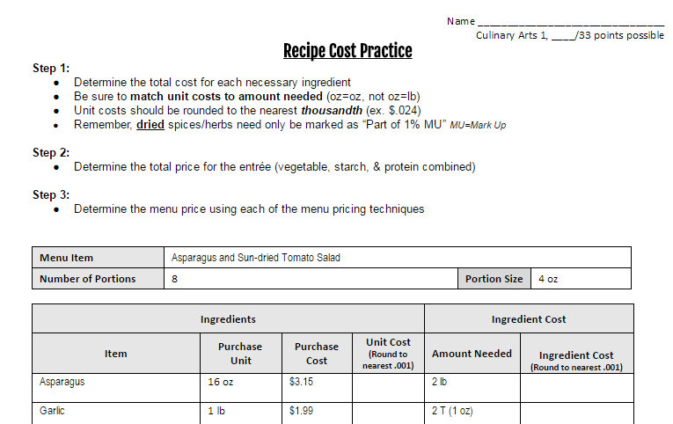
PRACTICE!!!
Menu Pricing Worksheet

