Slide 1
Kitchen Essentials 4.2
Standardization
Portion Control

Slide 2
The Need for Standardization
Reduces customer discontent
Ensures quantity and quality
Eliminates excessive cost

Slide 3
The Need for Standardization
Ensures all kitchen employees have needed production information readily available
Available on either recipe cards or maintained in computer files
Recipe will be prepared exactly the same each time
Must be available to employees preparing the food

Slide 4
Standardized Recipes
Recipes for institutional use, or standardized recipes, must follow a format that is clear to anyone who uses them.
A standardized recipe lists the ingredients first, in the order they are to be used, followed by assembly directions or the method for putting the ingredients together.

Slide 5
Standardized Recipes Include
Name of recipe
Ingredients
Yield
Portion size
Temperature, time, equipment
Step-by-step directions
Nutrition information

Slide 6
Portion Control includes . . .
Standardization:
Portion sizes
Recipes
Portion costs

Slide 7
Standard Portion Size
Definition:
The fixed quantity served to a customer for a fixed selling price.
Determined by quantifying menu item by weight volume, or count.

Slide 8
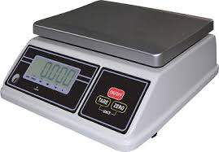
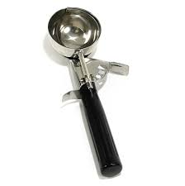
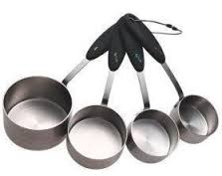
What tools can be used to standardize portions?
Scoops
Slotted spoons
Ladles
Portion Scales
Measuring cups

Slide 9
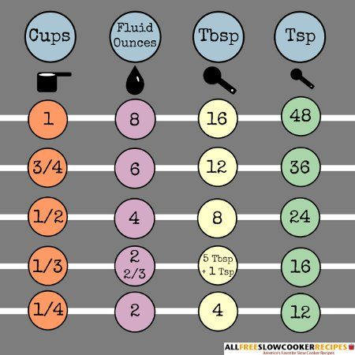
Review Kitchen Measurements
1 T =
3 t
1 C =
16 T
1 C =
8 fl oz
1 pt =
2 c

Slide 10
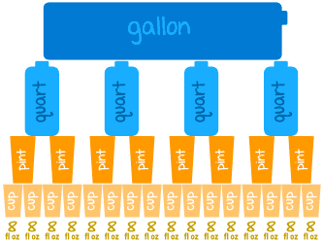
Review Kitchen Measurements
1 gal =
16 c
1 qt =
4 c
¼ c =
4 T
1 gal =
4 qt

Slide 11
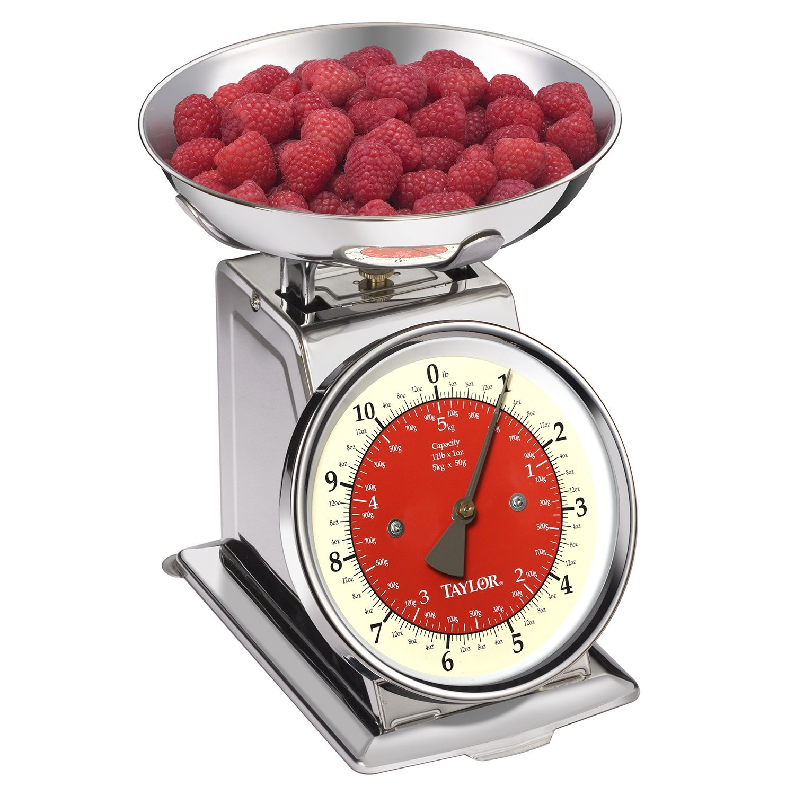
Review Kitchen Measurements
1 lb =
16 oz
½ fl oz=
1 T
Less than 1/8 tsp =
Dash or pinch
1/8 c =
2 T

Slide 12
Measuring
Measurement refers to how much of something is being used in a recipe.
Volume is the amount of space an ingredient takes up
Best used for liquids
Liquid measuring cups are see-through and have measurement markings on the side.
4.2

Slide 13
Measuring
Dry ingredients are measured by leveling them off evenly at the rim of the spoon or cup using a straightedge.
A typical set of measuring cups includes:
¼ cup, ⅓ cup, ½ c, 1 c
Measuring spoons generally come in a set of 4 or 6, sets including:
¼ t, ½ t, 1 t, 1 T (may have ½ T or ⅛ t)
4.2

Slide 14
Measuring
Weight is the measurement of an item’s resistance to gravity.
Weight is expressed in ounces and pounds.
A food scale is helpful for measuring ingredients by weight.
4.2

Slide 15
Measuring
Fat can be measured in several ways.
Stick method: Used for fat that comes in 1/4-pound sticks, such as butter or margarine. The wrapper is marked in tablespoons and in fractions of a cup. Simply cut off the amount needed.
Dry measuring cup method: Pack the fat down into the cup. Level off the top. When adding to the recipe, use a rubber scraper to empty as much of the fat as possible from the cup.
Water displacement method: This method involves combining fat with water in a liquid measuring cup.
4.2

Slide 16
Converting Recipes
Convert a recipe when the yield of the recipe (the amount it provides) is not the same as the amount of product needed.
The conversion of the recipe affects the cost of the recipe, but not necessarily the cost of the portion.
When properly converted and prepared, the quality of the product produced from the recipe should not vary from the original, no matter how many portions it yields.

Slide 17
Conversion Factor
DESIRED YIELD
ORIGINAL YIELD
Turn to page 262: As a group, complete #2 (Recipe Conversion)
Refer to page 248 “Essential Skills” chart for step-by-step instructions to convert recipes

Slide 18
Conversion Factor
DESIRED YIELD
ORIGINAL YIELD
Online Recipe Converter
Recipe | Conversion Factor | Final CF
Salad dressing | 450/12 | 37.5
BBQ sauce | 450/50 | 9
Buns | 450/120 | 3.75
Straw. Tart Filling | 450/24 | 18.75
Mar. Vegetables | 450/40 | 11.25

Slide 19
EP/AP Amounts
Most vegetables have to be trimmed and cut before being used in recipes.
Cooks must calculate the EDIBLE PORTION (EP) amount from the untrimmed AS PURCHASED (AP) amount
Products today can frequently be purchased in an “as edible portion.”
Purchased trimmed and cut.
4.2

Slide 20
EP/AP Amounts
TABLE 4.10: Percentage Yields of Produce (pg. 255-256)
To determine how much of an item is needed to yield an AP (as purchased ) amount:
edible portion amount = AP
yield percentage
Example: You need 10 lb asparagus for your recipe. How much should you purchase?
10
.55 =
18.2 lb asparagus need to be purchased
4.2

Slide 21
EP/AP Amounts
TABLE 4.10: Percentage Yields of Produce (pg. 255-256)
To determine how much you can make with a product you have on hand, reverse the above equation:
Edible Portion: As Purchased x % Yield
Example: You have10 lb asparagus on hand for your recipe. How much of this is edible?
10 lb x .55 =
5.5 lb asparagus can be prepared
4.2

Slide 22
EP/AP Amounts for Meat Products
To determine the AP quantity needed to result in a given EP (edible portion) quantity, it is also important to know the cooking loss for the item, especially for meat products.
4.2

Slide 23
Conversion Charts
A conversion chart is a list of food items showing the expected, or average, shrinkage from AP amount to EP amount.
A butcher test is used to measure the amount of shrinkage that occurs during the trimming of a meat product.
A cooking loss test is a way to measure the amount of product shrinkage during the cooking or roasting process.

Slide 24
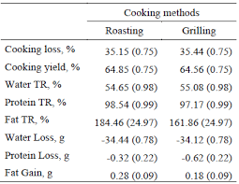
Example: Conversion Charts for Meat

Slide 25
Time to Practice
4.2 WORK PACKET
Standardized Recipes Crossword
Recipe Conversion
Determining Yields

