Slide 1
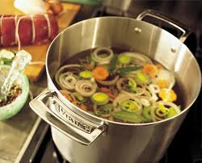
STOCKS & SOUPS

Slide 2
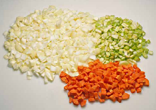
The Essential Parts of Stock
There are four essential parts to all stocks:
A major flavoring ingredient
A liquid, most often water
Mirepoix
Aromatics
6.1
Chapter 6 | Stocks, Sauces, and Soups

Slide 3
The Essential Parts of Stock
Mirepoix
French word that refers to the mixture of coarsely chopped onions, carrots, and celery that provide a flavor base for stock.
Aromatics
Examples: Bouquet garni and sachet d’épices
Herbs, spices, and flavorings that create a savory smell.
6.1
Chapter 6 | Stocks, Sauces, and Soups

Slide 4
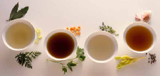
Types of Stocks
A stock is a flavorful liquid made by gently simmering bones and/or vegetables.
Stocks are often called the chef’s “building blocks.” They form the base for many soups and sauces.
There are many types of stock:
White stock, brown stock, fumet, court bouillon, glace, remouillage, bouillon, jus, and vegetable stock
6.1
Chapter 6 | Stocks, Sauces, and Soups

Slide 5
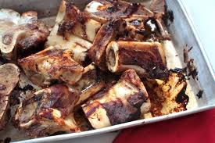
Types of Stocks
To use bones for stock:
Cut them to the right size and then prepare them by blanching, browning, or sweating.
6.1
Chapter 6 | Stocks, Sauces, and Soups

Slide 6
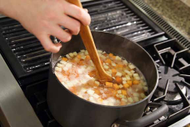
Preparing Stocks
Blanching the bones:
Rids them of some of the impurities that can cause cloudiness in a stock.
To brown bones:
Roast them in a hot (400°F) oven for about an hour, until they are golden brown.
Sweating
Causes bone and mirepoix to release flavor more quickly when liquid is added.
6.1
Chapter 6 | Stocks, Sauces, and Soups

Slide 7
Preparing Stocks
Flavor, color, body, and clarity determine the quality of stock.
A stock should be flavorful, but not so strong that it overpowers the other ingredients in the finished dish.
To make stock, the ratio of liquid to flavoring ingredients is standard.
Follow proper food safety practices when cooling stock to minimize the time the stock spends in the temperature danger zone.
6.1
Chapter 6 | Stocks, Sauces, and Soups

Slide 8
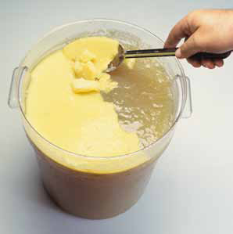
Degreasing Stock
Degreasing is the process of removing fat that has cooled and hardened from the surface of the stock.
Gives the stock a clearer and purer color.
Removes some of the fat content, making the stock more healthful.
Degrease stock by skimming, scraping, or lifting hard fat.
6.1
Chapter 6 | Stocks, Sauces, and Soups

Slide 9
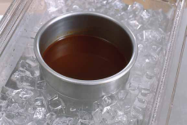
Section 6.1 Summary
Stocks contain four essential parts: a major flavoring ingredient, liquid, aromatics, and mirepoix.
There are many types of stock, including white stock, brown stock, fumet, court bouillon, glace, remouillage, bouillon, jus, and vegetable stock.
When using bones for stock, you must cut them to the right size and prepare them by blanching, browning, or sweating.
Degreasing is the process of removing fat that has cooled and hardened from the surface of the stock by lifting or scraping it away before the stock is reheated.
To cool stock, follow good food safety practices and limit the time the stock spends in the temperature danger zone (TDZ).
6.1
Chapter 6 | Stocks, Sauces, and Soups

Slide 10
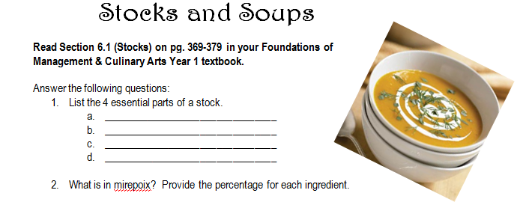
Assignment
Stocks and Soups Worksheet
More questions on the Canvas Assignment ☺

